Slide 1
ANTI-ADRENERGICS
BY
DR.G.AARTHIPRIYANKA
POST GRADUATE
DEPARTMENT OF PHARMACOLOGY

Slide 2
ADRENERGIC RECEPTOR ANTAGONIST
Drugs that inhibit the interaction of NE,epinephrine and other sympathomimetic drugs with alpha and beta receptors

Slide 3
TYPES OF ADRENERGIC ANTAGONISTS
ALPHA antagonist
BETA antagonist

Slide 4
ALPHA receptor antagonists
NON SELECTIVE - Phenoxybenzamine, Phentolamine
ALPHA -1 SELECTIVE - Prazosin,Terazosin,doxazosin,tamsulosin
ALPHA -2 SELECTIVE - Yohimbine

Slide 5
BETA receptor antagonists
FIRST generation – Non Selective – propranolol,Timolol
SECOND generation – Beta 1 selective – Atenolol,Metoprolol
THIRD generation – Non Selective – Carvedilol,Labetalol
- Beta Selective – Celiprolol,Nebivolol

Slide 6
ALPHA receptor antagonists
GENERAL PHARMACOLOGICAL PROPERTIES:
Vasodilatation – both arteries & veins, BP
HR – baroreceptor reflexes
Miosis
Increases intestinal motility
Trigone,sphincter & prostate tone is reduced: improve urine flow
Inhibit ejaculation : impotence

Slide 7
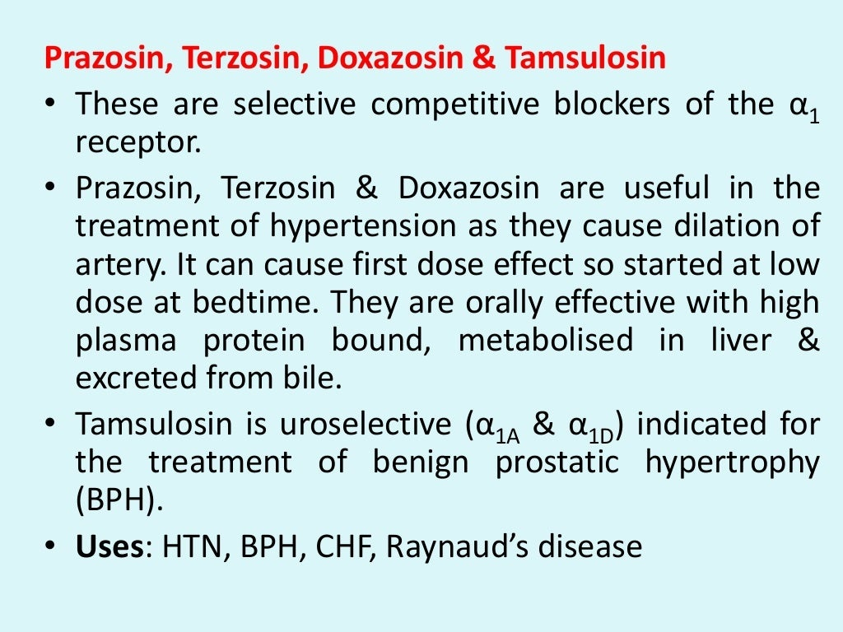

Slide 8
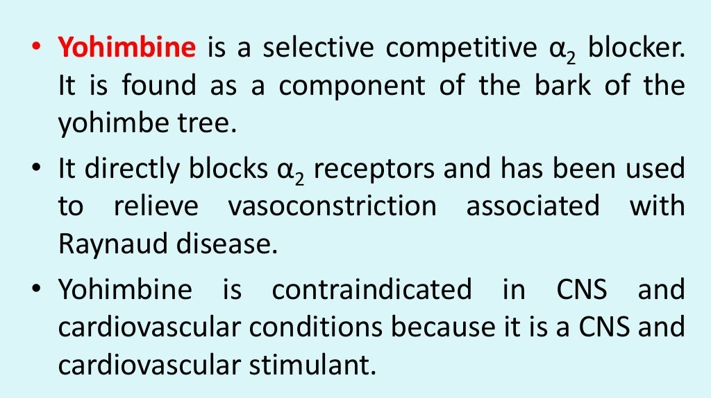

Slide 9
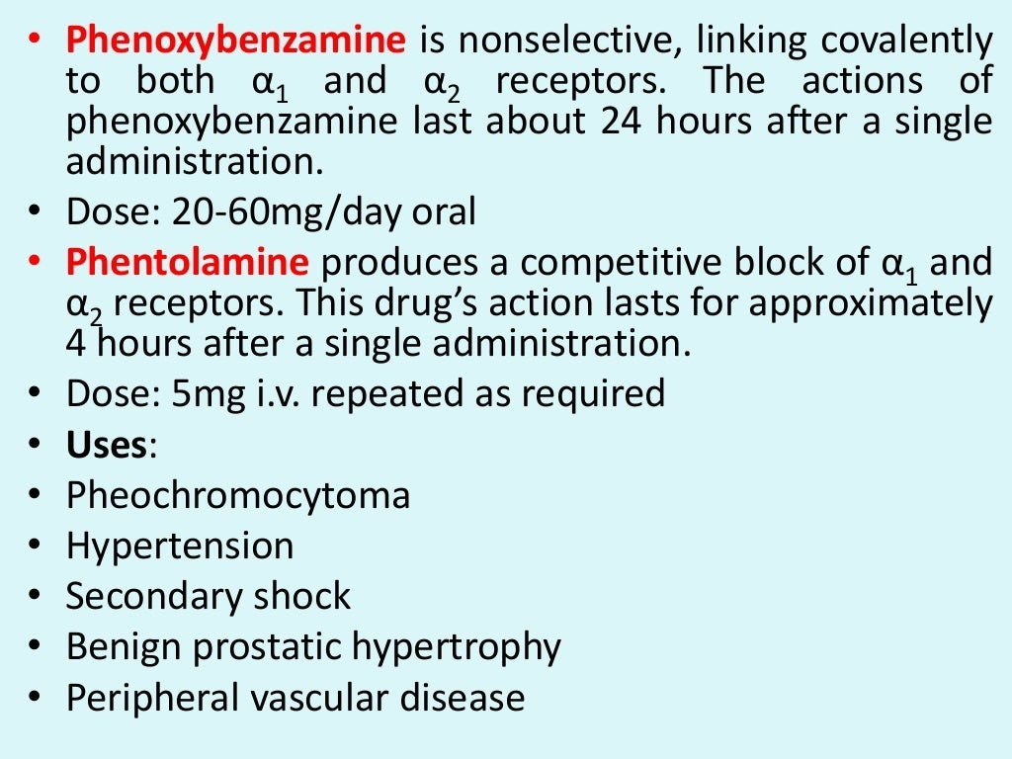

Slide 10
BETA RECEPTOR ANTAGONIST
DISTINGUISHED BY :
Relative affinity for beta1 and 2 receptors
Intrinsic sympathomimetic activity
Blockade of alpha receptors
Differences in lipid solubility(CNS penetration)
Capacity to induce vasodilatation
Pharmacokinetic parameters

Slide 11
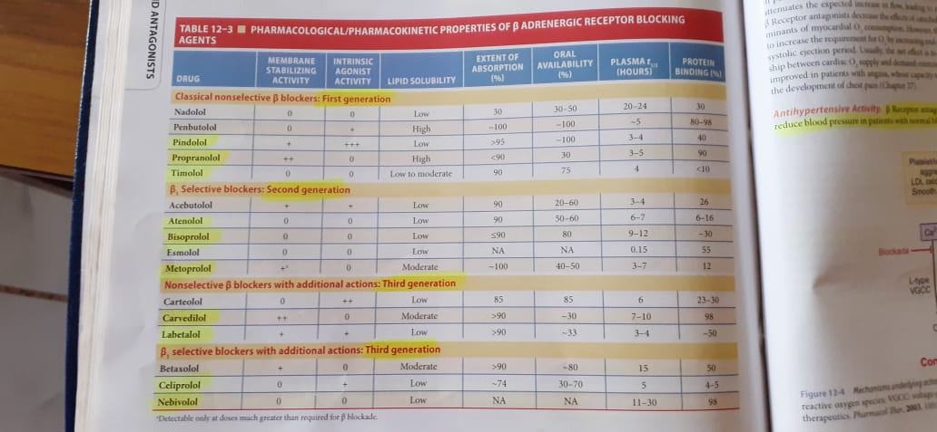

Slide 12
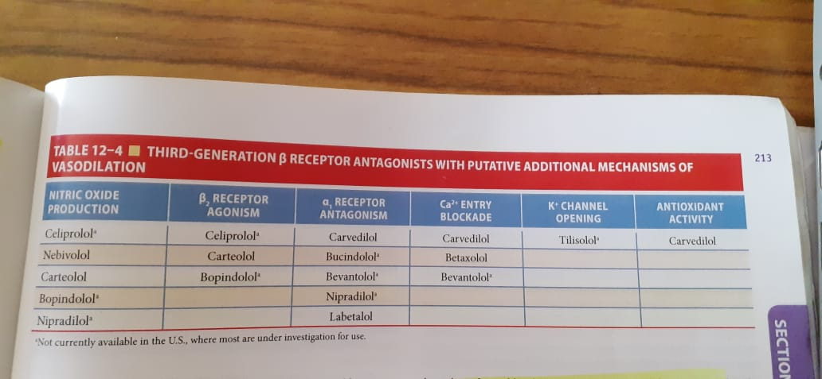

Slide 13
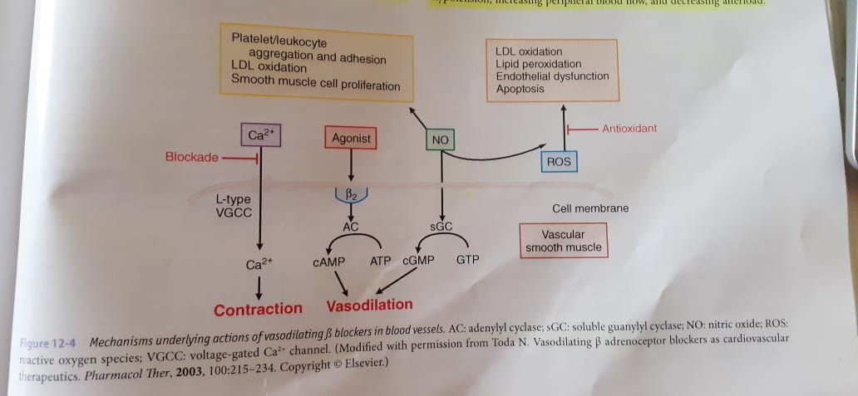

Slide 14
GENERAL PHARMACOLOGICAL PROPERTIES
Heart - HR,FOC
Anti-hypertensive property
Constriction of bronchi
Caution in patients with diabetes

Slide 15
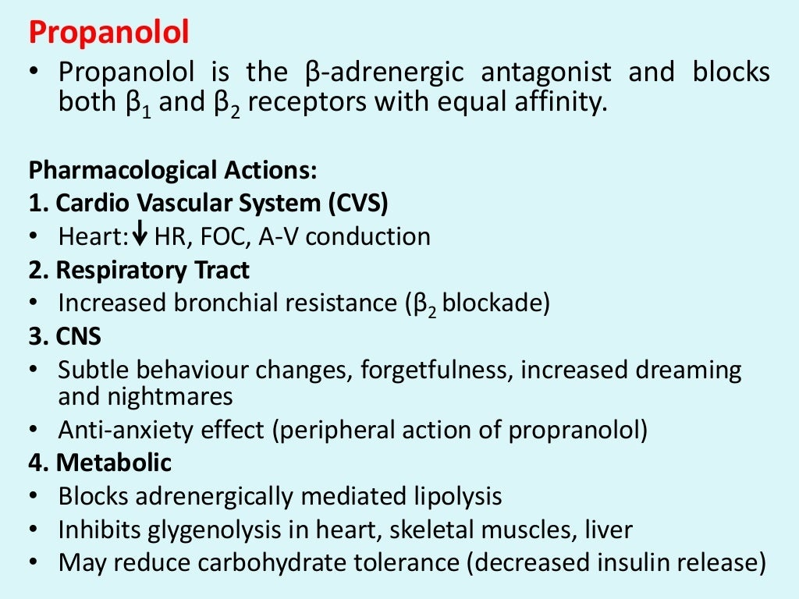

Slide 16
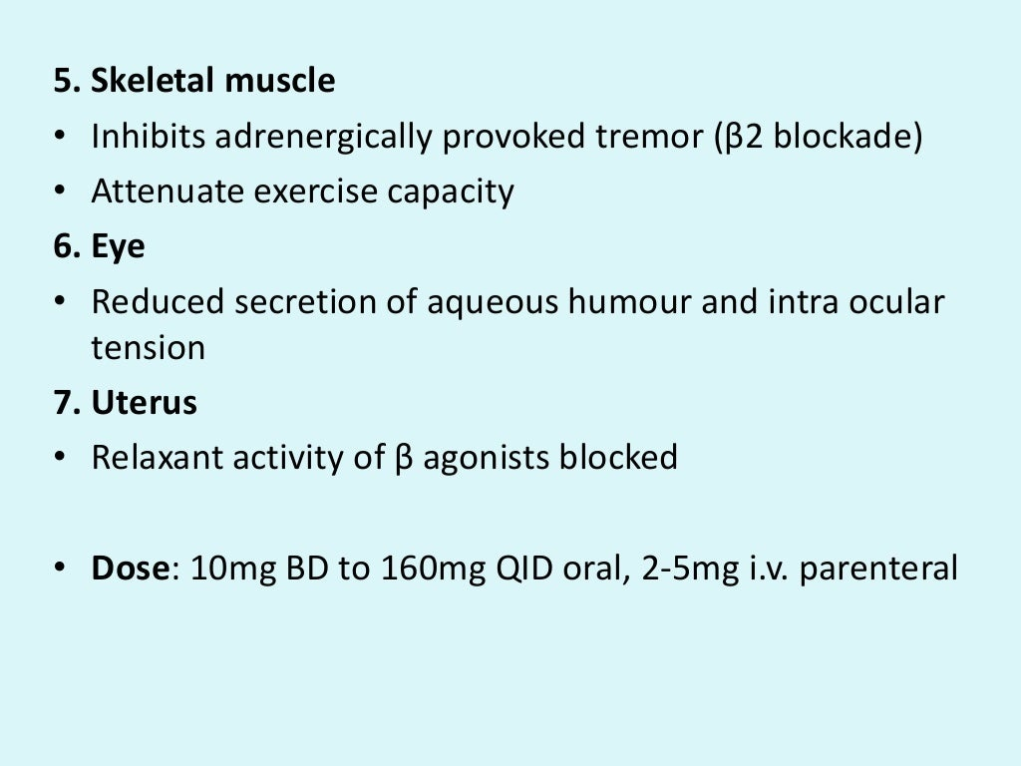

Slide 17
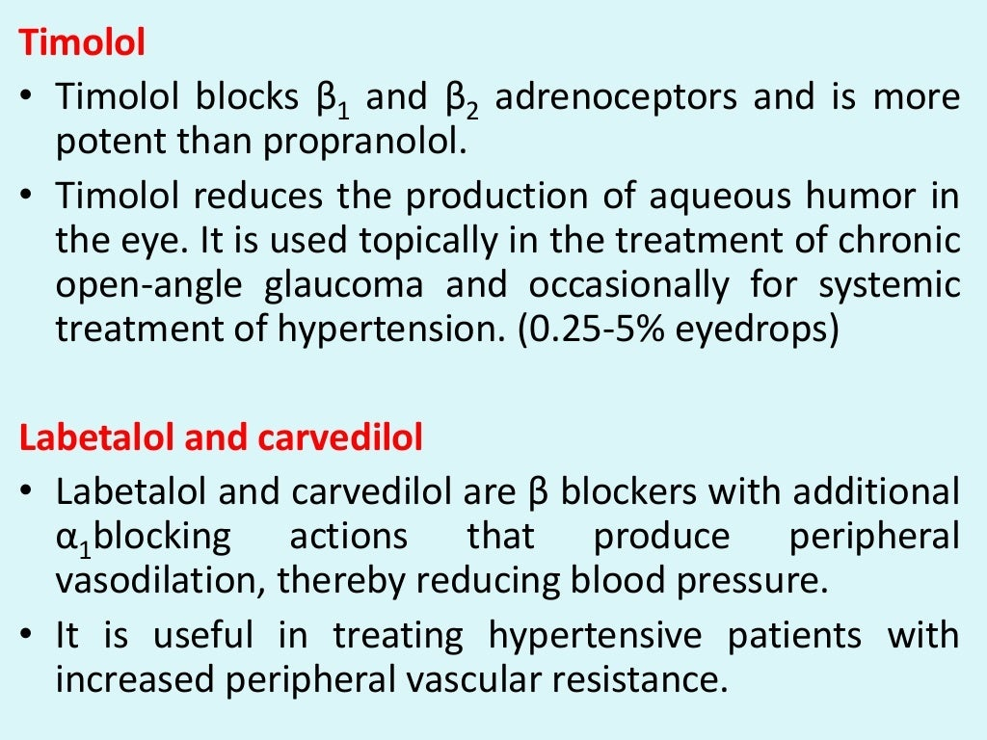

Slide 18
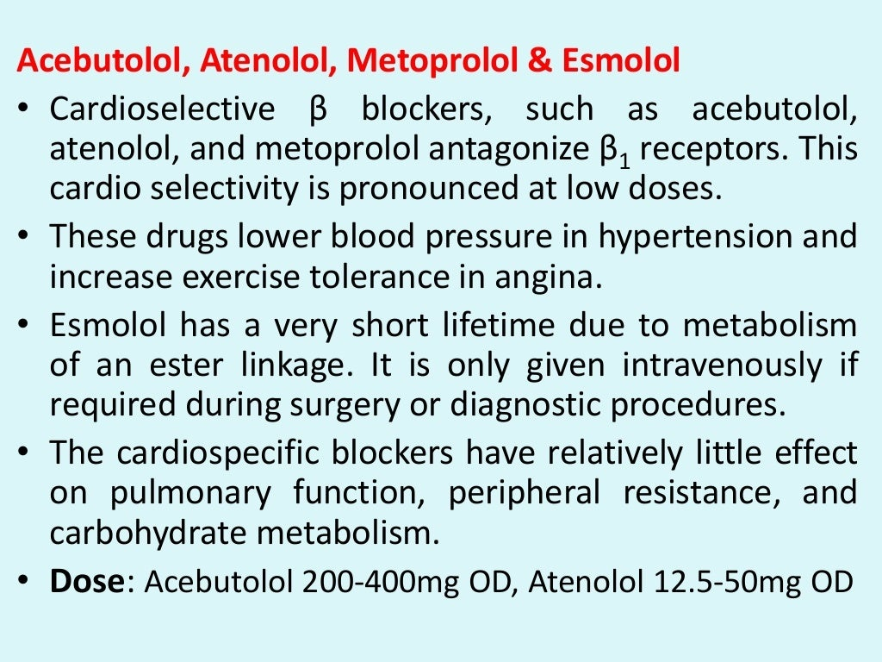

Slide 19
GESTATIONAL HYPERTENSION – DOC - labetalol

Slide 20
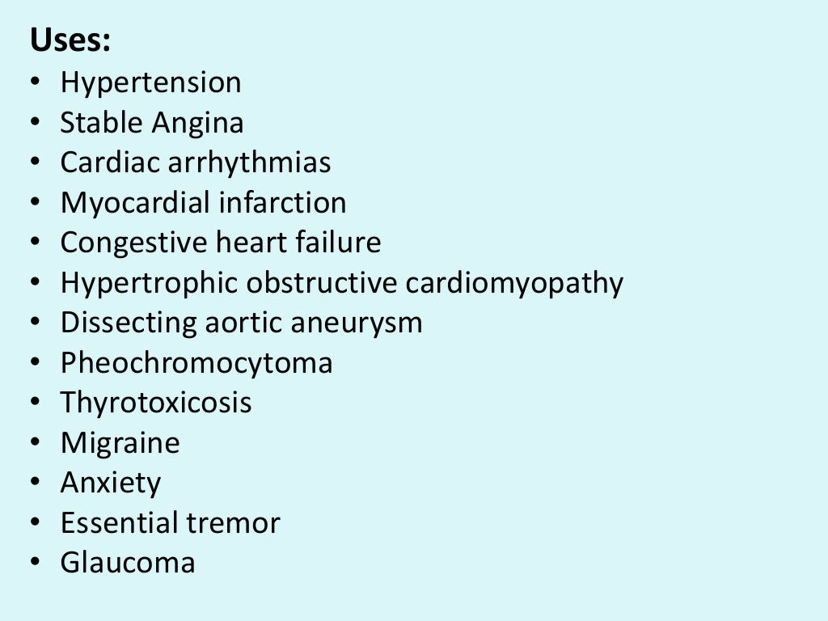

Slide 21
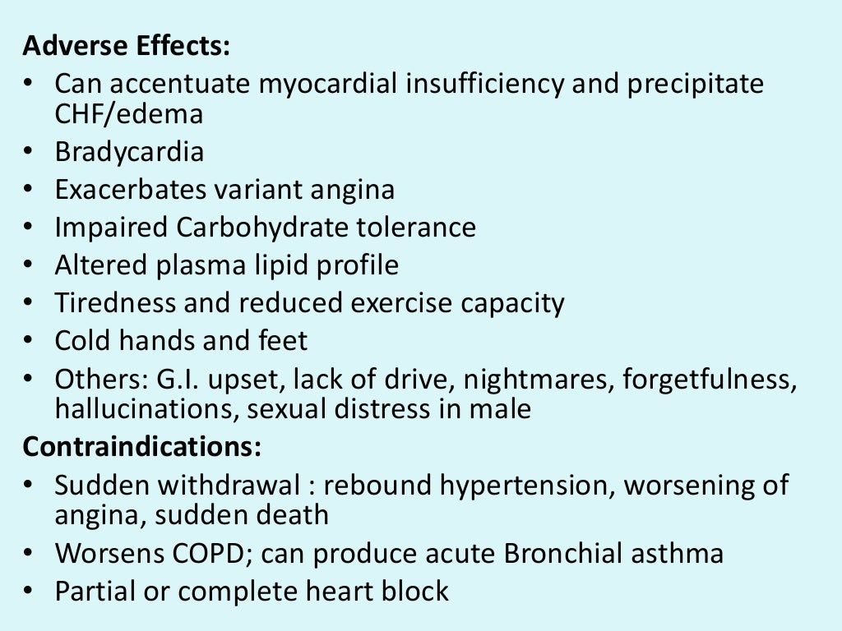

Slide 22
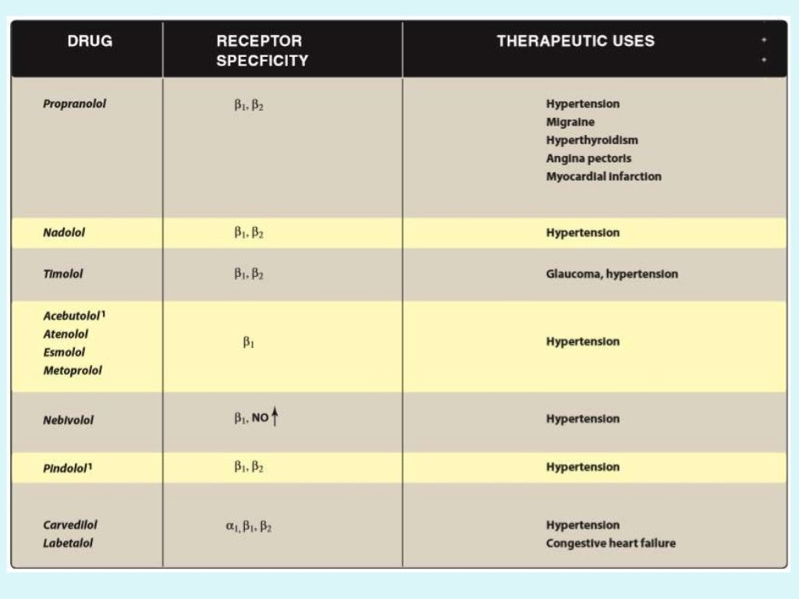

Slide 23
THANK YOU

