Slide 1
CRITICAL EVALUATION OF JOURNAL ARTICLE
BY
DR.G.AARTHIPRIYANKA
POST GRADUATE
DEPARTMENT OF PHARMACOLOGY

Slide 2
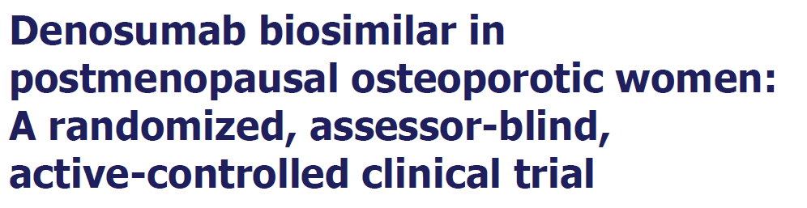
SUGGESTED TITLE:
Comparison of efficacy & safety of Denosumab reference with Denosumab biosimilar in post menopausal osteoporotic women: A randomized, assessor-blind, active-controlled, multi-centric clinical trial.

Slide 3
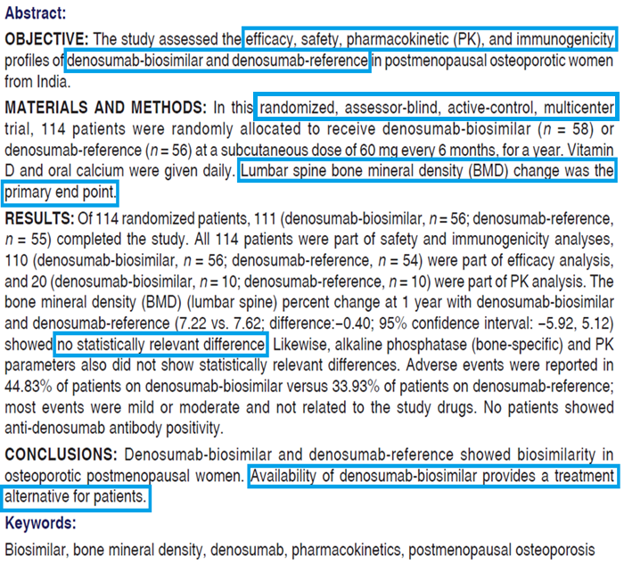
ABSTRACT
The author has mentioned the
Objective – may be mentioned as primary & secondary
Trial design
Methods
secondary end point has not been mentioned
Results
Conclusion

Slide 4
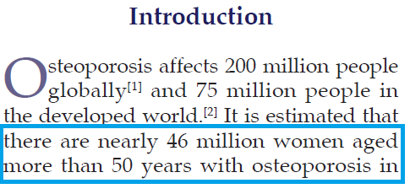

INTRODUCTION
Scientific background of the study:
Mentioned about why this disease

Slide 5
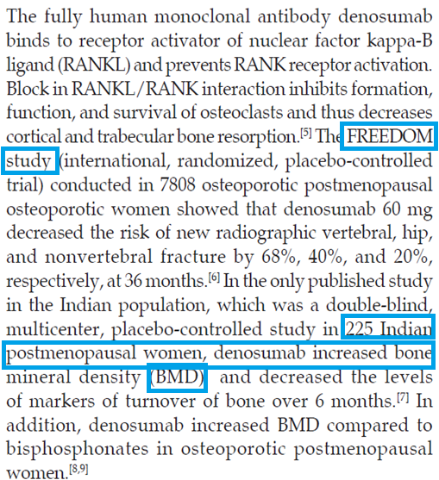
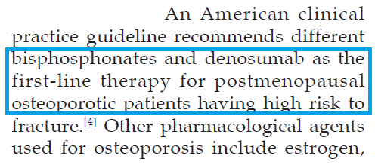
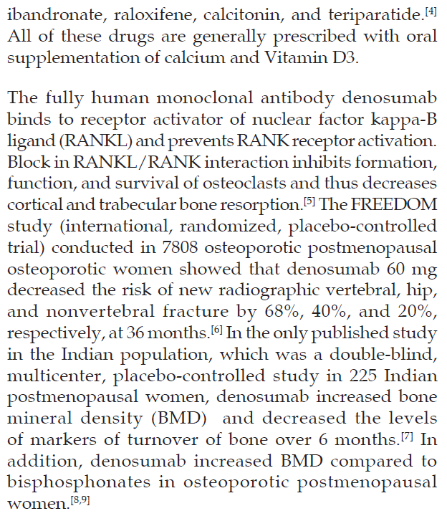
Why this drug chosen has been mentioned

Slide 6
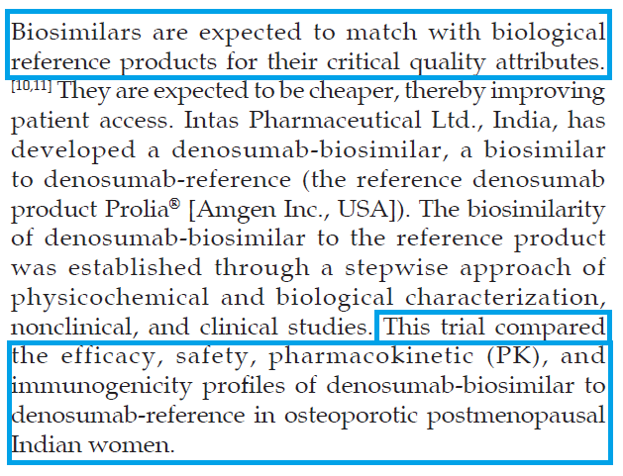
Explanation of rationale of choosing this study
Objectives are mentioned

Slide 7
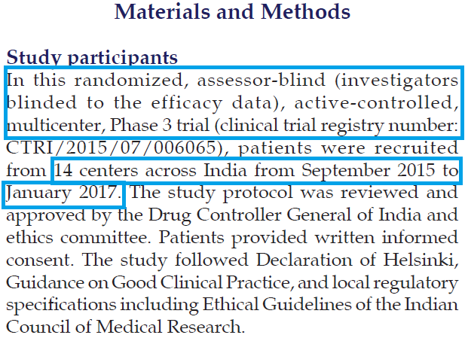
METHODS
Trial design has been specified
longer time duration may be needed for safety assessment
Location has been mentioned but details of the location – not available here though author has mentioned investigator team at the last.

Slide 8
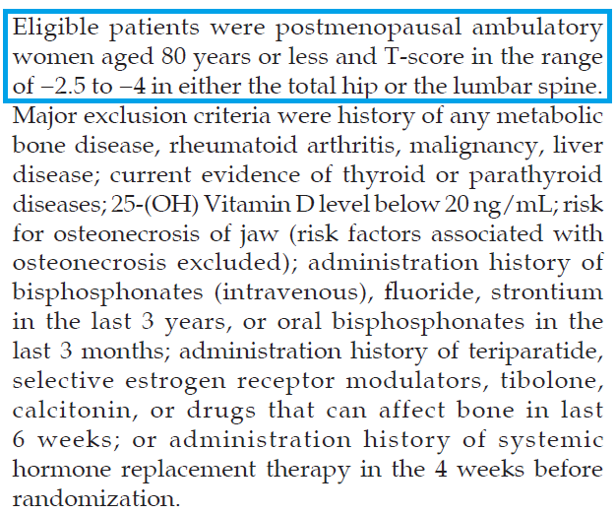
Eligibility criteria has been mentioned

Slide 9
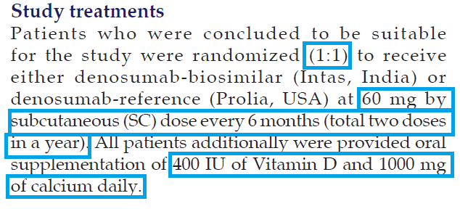
Allocation ratio has been mentioned
Intervention to each group has been mentioned
method used for random allocation sequence has not been mentioned
Who generated random allocation sequence
Who assigned participants to interventions
Allocation concealment

Slide 10
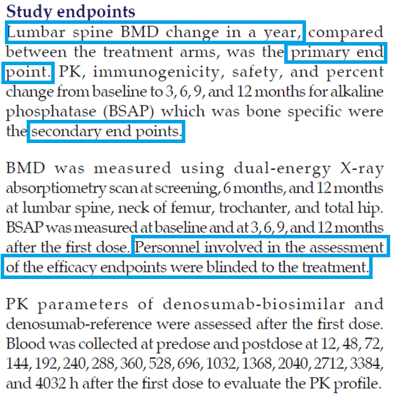
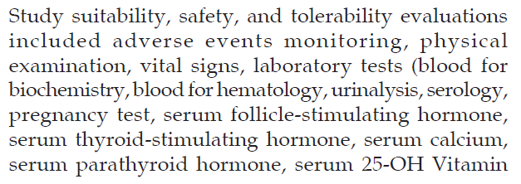
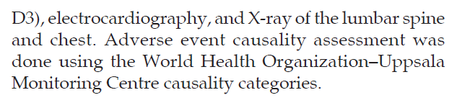
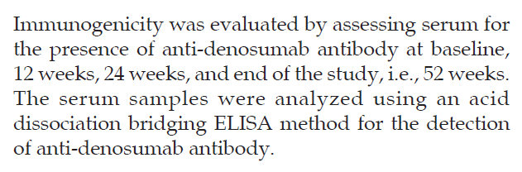
OUTCOMES - how & when has been mentioned

Slide 11
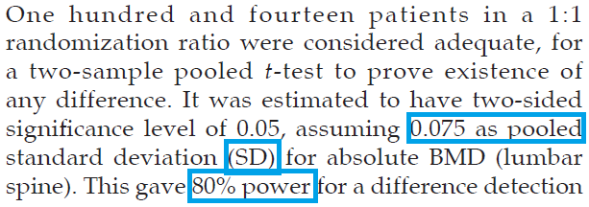

SAMPLE SIZE
Explained how sample size is determined
As it is phase 3 trial, sample size can be larger than this.

Slide 12
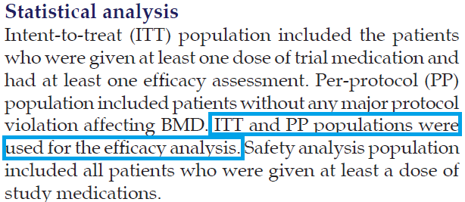
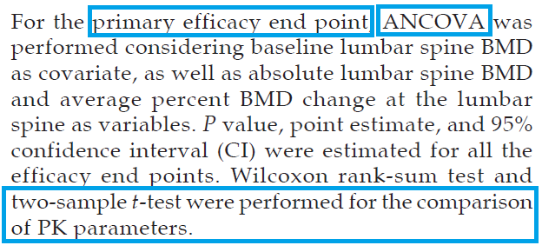
STATISTICAL METHODS
Methods for primary & secondary outcomes has been mentioned

Slide 13
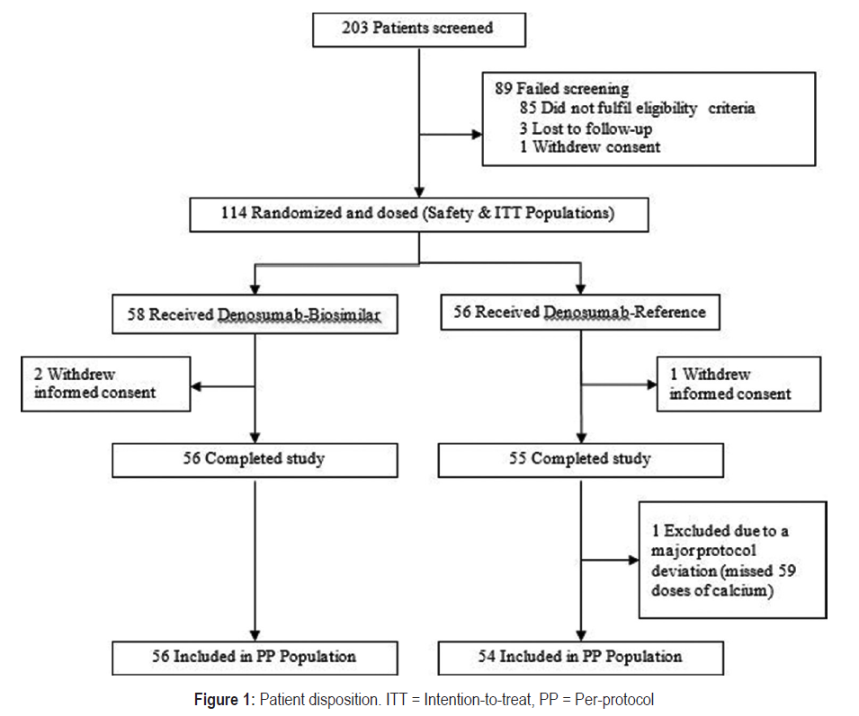
PARTICIPANT FLOW DIAGRAM

Slide 14
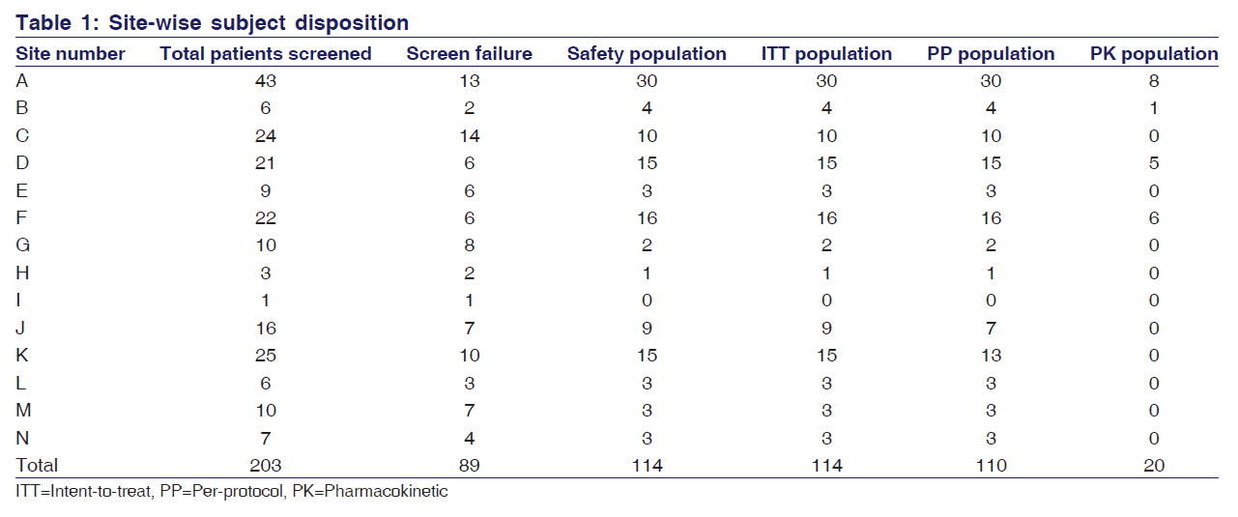
RESULTS
Site wise disposition has been given but specification of sites as A,B has not been mentioned

Slide 15
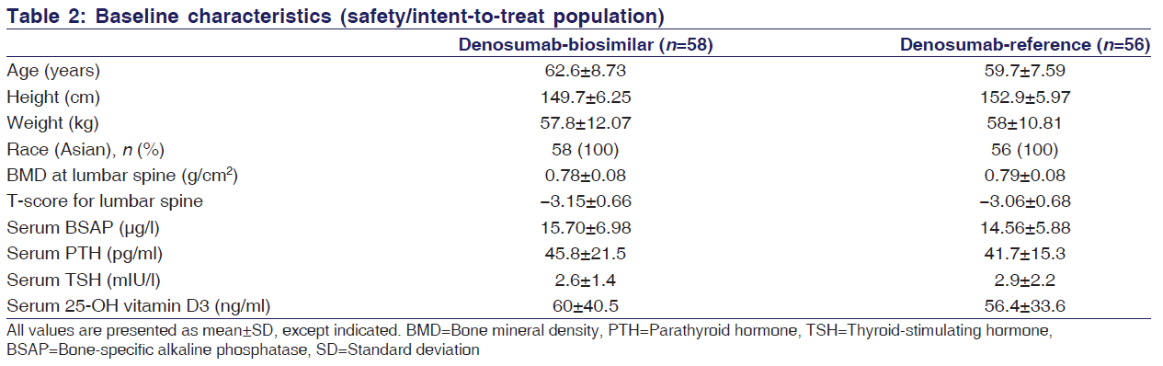
RESULTS
Baseline demographic data & clinical characteristics of each group has been mentioned

Slide 16
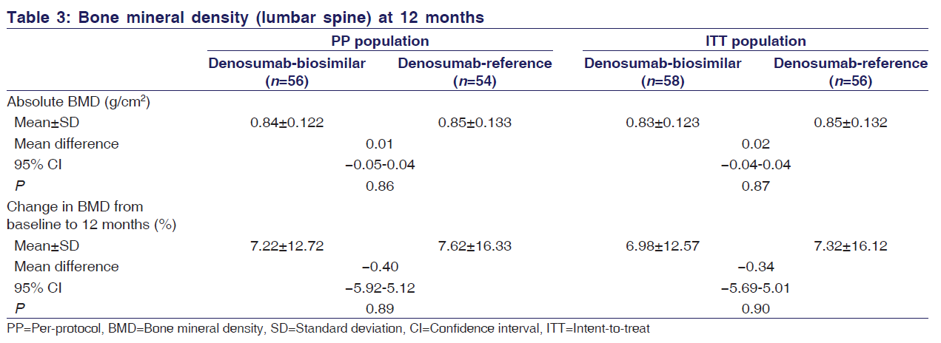
RESULTS
Efficacy end point difference has been mentioned

Slide 17
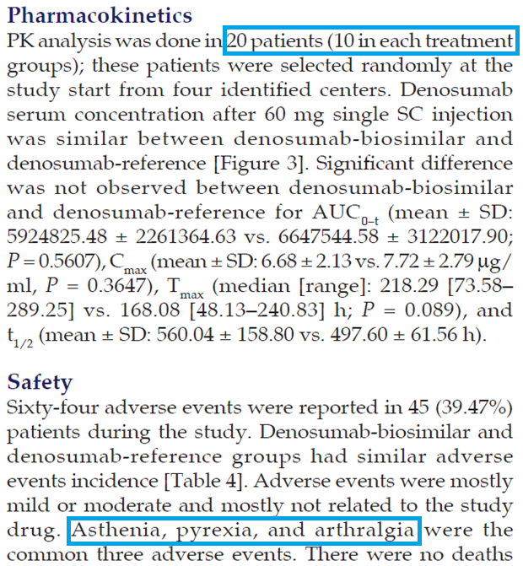
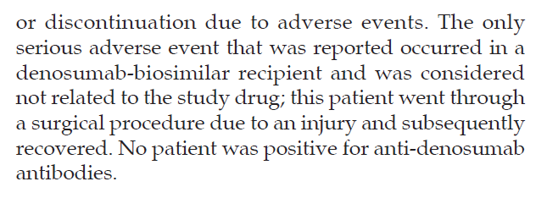
RESULTS
Pharmacokinetic analysis result has been mentioned but it has been done in limited number of patients
Harms – mentioned

Slide 18
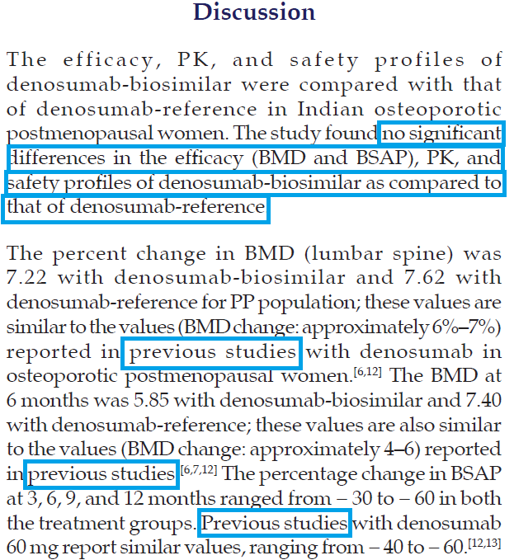
DISCUSSION
Interpretation of study results has been done
Generalizability – external validity has been mentioned

Slide 19
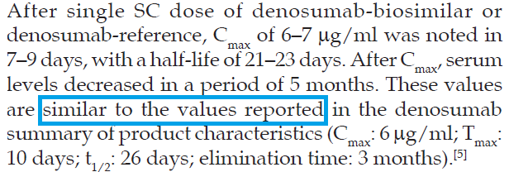

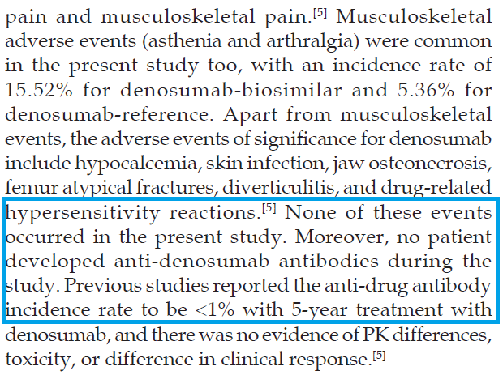
DISCUSSION

Slide 20
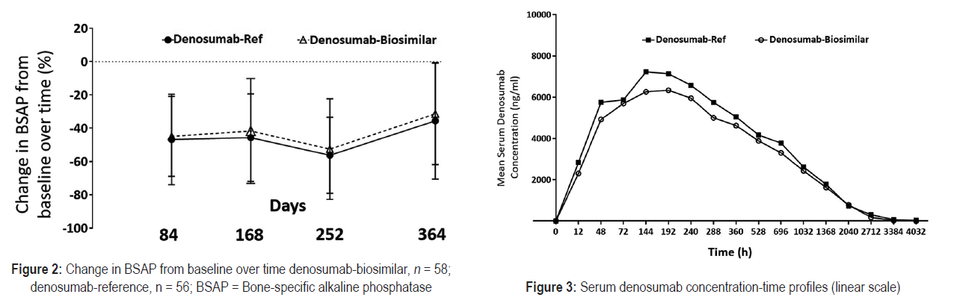

Slide 21
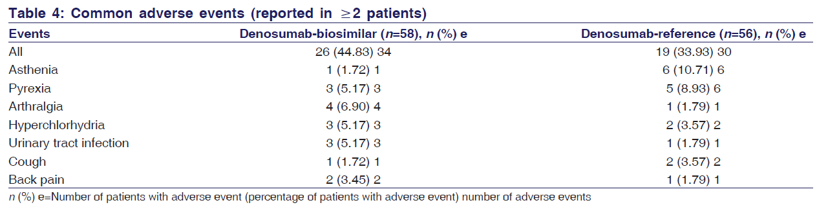
ADVERSE EVENT

Slide 22
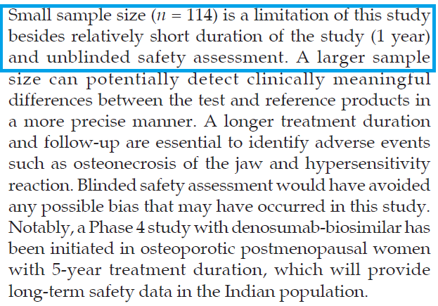
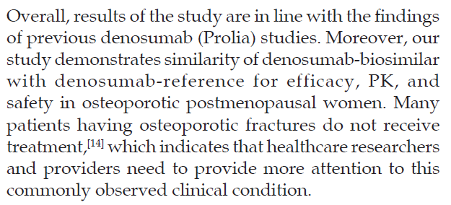
DISCUSSION
Study limitations has been mentioned

Slide 23
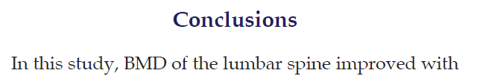
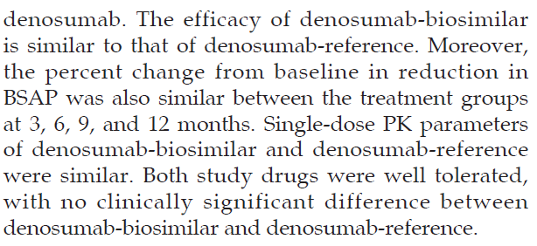
CONCLUSION
Author has concluded his study results in accordance with his objectives

Slide 24
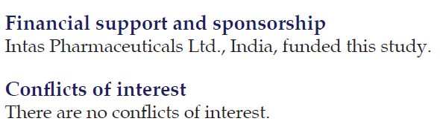
OTHER INFORMATION
Funding has been mentioned
Vancouver referencing has been followed
Trial registration number - mentioned

Slide 25
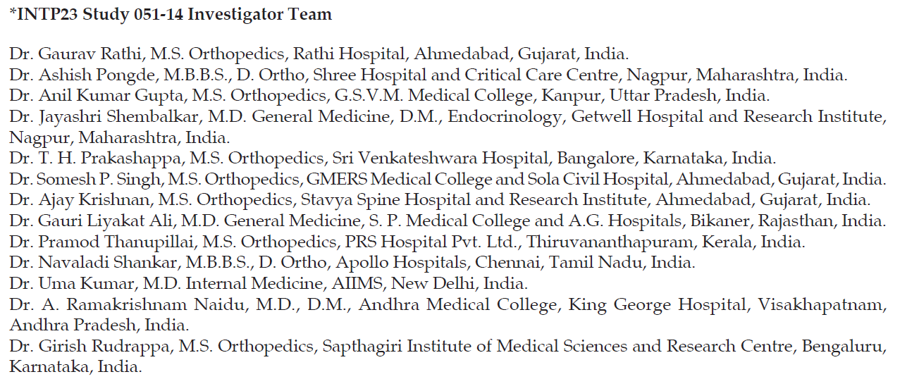
Author also mentioned about his TEAM

Slide 26
THANK YOU

