Slide 1
MUSEUM
HISTORY OF MEDICINE
BY
DR.AARTHIPRIYANKA
POST GRADUATE
DEPARTMENT OF PHARMACOLOGY

Slide 2
JENNER – SMALL POX
British physician
1796,First ever vaccine-small pox
VACCINIA- live pox virus
Term vaccine derived from “VARIOLAE VACCINAE”(small pox of the cow)
James Phipps
Sarah nelmes
FATHER OF IMMUNOLOGY
Relationship between cow pox & small pox
1980- small pox eradication by WHO

Slide 3
GALEN
Greek physician,surgeon,philosopher
Experimental methods in medical investigation
Dissection of Barbery apes,pigs
Physiology of circulatory system-arteries carry blood,liver as source of venous blood
Identification of disease- small pox,plague
HIPPOCRATES-Blood,yellow bile,black bile,phlegm-moods
Sanguine,choleric,melancholics,phlegmatic
Extroverted&social,energy-passion-charisma,creative-kind-considerate,dependability-kindness-affection.
Performed cataract
Neuro anatomy-difference between sensory& motor,muscle tone,agonist and antagonist
GALENICIALS – Various methods of extracting the crude drugs

Slide 4
JOSEPH GOLDBERGER
American physician
Epidemiologist in united states public health services
Pellegra and poor diet
delusion,dermatitis,diarrhoea,death
Casal’s necklace,glove and stocking lesions
Corn-staple food
CONRAD ELVEHJEM- niacin-14 to 16mg/day

Slide 5
HARVEY
English physician
Circulation of blood
Existence of ductus arteriosus
Conflict of Galen
Doesn’t find capillaries
Pulmonary circulation already found

Slide 6
PARACELSUS
Swiss physician
FATHER OF TOXICOLOGY
Pioneered the use of chemicals and minerals in medicine
Tria prima -Three humors- sulphur,mercury,salt
Soul,spirit,body
Magnetisim
First to give elemental zinc

Slide 7
LAENNEC
French physician,musician
Invented stethoscope
Stethos-chest,skopos-examination –GREEK WORD
Described lung sounds
Immediate auscultation with ear-difficult with fat woman
Peritonitis,cirrhosis,melanoma
TB- himself died at 45

Slide 8
THOMAS SYDENHAM
FATHER OF CLINICAL MEDICINE / ENGLISH HIPPOCRATES
Sydenham’s chorea
Small pox,hysteria,gout
Named the disease “pertussis”-violent cough of any type
Advocated the use of peruvian bark-malaria

Slide 9
ALEXANDER FLEMING
Scottish physician
Discovery of penicillin when antiseptics are useless in deep wounds
Noble prize in medicine
Enzyme-lysozyme- first antimicrobial protein innate immune system
Fungal mould-p.rubrum
First clinical trial-sinusitis-H.influenza-unsusceptible
CECIL GEORGE PAINE- conjunctivitis
Antibiotic resistance

Slide 10
J.MARION SIMS
American physician
FATHER OF MORDERN GYNAECOLOGY
SIM’S speculum,sigmoid catheter,position
Operating without anaesthesia on enslaved black women
First women hospital in history
Also interested in Neonatal tetanus

Slide 11
VIRCHOW
German physician
FATHER OF MODERN PATHOLOGY
FOUNDER OF SOCIAL MEDICINE
Cell theory-All cells come from cells
Leukemia,chondroma,ochronosis,embolism,thrombosis
Virchow’s node,Virchow-robin spaces,Virchow method of autopsy,Virchow’s triad

Slide 12
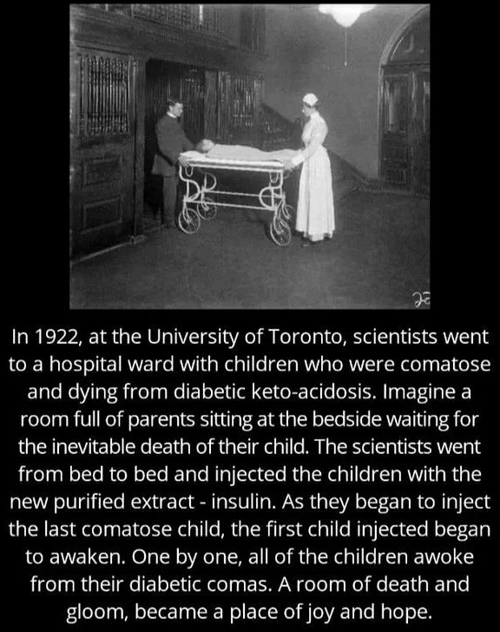
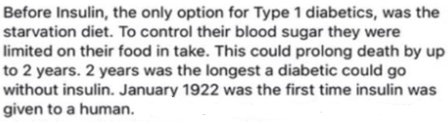
BANTING & BEST
Discovered INSULIN
Canadian scientist
Nobel prize

Slide 13
IGNAZ SEMMELWEIS
Saviour of mother’s
Puerperal fever
Proposed the practice of washing hands with chlorinated lime solutions
Two clinics & his friend’s death
Asylum,died of gangrene of hand at 47

Slide 14
MORGAGNI
Italian anatomist
FATHER OF MODERN ANATOMICAL PATHOLOGY
Foramina of margagni,morgagnian cataract,sinus of Morgagni,Morgagni’s hernia
Disease is not vaguely dispersed throughout the body,but originate locally in specific organs and tissues.

Slide 15
VESALIUS
FOUNDER OF MODERN HUMAN ANATOMY
Medicine has three aspects: Drugs,Diet & the use of hands
Detailed illustrations of anatomy
Death by shipwreck at age of 49

Slide 16
HUNTER
Scottish surgeon
Teacher of jenner
Improve understanding of human teeth,bone growth and remodelling,inflammation,gunshot wounds,venereal diseases,digestion,functioning of lacteals,child development,seperateness of maternal and foetal blood supplies
Role of lymphatic system
First recorded ‘ARTIFICIAL INSEMINATION’

Slide 17
LAVOISIER
CHEMIST
Identified hydrogen,oxygen
Diamond is a crystalline form of carbon
Gasometers
Radical theory

Slide 18
LOUIS PASTEUR
French chemist
Pasteurization
Microbial fermentation
Vaccination for rabies,chlorea,anthrax.
Rejected theory of spontaneous generation
One of the founder of GERM THEORY OF DISEASE

Slide 19
WILHELM RONTGEN
Physicist
1895,electromagnetic radiation in a wavelength called X-RAYS
Element 111-roentgenium
Unit of measurement-roentgen
FATHER OF DIAGNOSTIC RADIOLOGY
NOBEL PRIZE
First x-ray-his wife’s hand,then friend’s hand

Slide 20
ANTONIE VAN LEEUWWENHOEK
FATHER OF MICROBIOLOGY
Discovered bacteria( little animals)- large selenomonads from the human mouth
Vacuole of the cell
Spermatozoa
Banded pattern of muscular fibres
Many lenses
Multicellular organisms

Slide 21
AMBROISE PARE
FATHER OF SURGERY
Mordern forensic pathology- effects of death on internal organs,legal aspects of medicine
Invented several surgical instruments
Haemostasis
Phantom pain-brain not in limb
prostheses

Slide 22
JAMES LIND
Scottish doctor
Vitamin C cures scurvy
Pioneer of naval hygiene
Clinical trial-group 1-quart of cider daily
group 2-25 drops of elixir of vitriol
group 3-6 spoonful of vinegar
group 4-half a pint of sea water
group 5-2 oranges,1 lemon
group 6-spicy paste+drink of barley water

Slide 23
PAUL EHRLICH
German physician
NOBEL PRIZE IN MEDICINE
First effective medicinal treatment for syphilis
Naming the concept of CHEMOTHERAPY
IMMUNOLOGY-even autoimmunity
Antiserum
HEMATOLOGY

Slide 24
GERHARD DOMAGK -discovery of Sulfonamidochrysoidine (KI-730), the first commercially available antibiotic and marketed under the brand name Prontosil, for which he received the 1939 Nobel Prize in Physiology or Medicine
THOMAS HUNT MORGAN - Nobel Prize in Physiology or Medicine in 1933 for discoveries elucidating the role that the chromosome plays in heredity.
OTTOLOEWI - role of acetylcholine as an endogenous neurotransmitter. For his discovery he was awarded the Nobel Prize in Physiology or Medicine in 1936

Slide 25
SIR ALEXANDER FLEMING - world's first broadly effective antibiotic substance, which he named penicillin, Nobel Prize in Physiology or Medicine in 1945
FREDRICK BANTING -discovery of insulin, Nobel Prize
CHARLES BEST
GERTRUDE BELLE ELION - Nobel Prize in Physiology or Medicine with George H. Hitchings and Sir James Black for their use of innovative methods of rational drug design for the development of new drugs
PAUL EHRLICH - Nobel Prize in Physiology or Medicine for his contributions to immunology

Slide 26
ALFRED NOBEL - Nobel's most famous invention was dynamite, a safer and easier means of harnessing the explosive power of nitroglycerin; bequeathed his fortune to establish the Nobel Prize
ROBERT KOCH - For his research on tuberculosis, he received the Nobel Prize in Physiology or Medicine in 1905
GILMAN - Gilman shared the Nobel Prize in Physiology or Medicine with Dr. Martin Rodbell of the National Institute of Environmental Health Sciences for their discovery of G proteins.

Slide 27
WILLIAM HARVEY -circulation of blood
COLIN DOLLERY - clinical pharmacology(cardiovascular)
CHARLES DARWIN -origin of species
LOUIS PASTEUR -father of bacteriology
SIGMUND FREUD -psychoanalysis

