Slide 1
PHARMACODYNAMICS
BY
DR.AARTHIPRIYANKA
POST GRADUATE
DEPARTMENT OF PHARMACOLOGY

Slide 2
Introduction
Pharmacodynamics is the study of drug effects.
It starts with describing what the drugs do, and goes on to explain how they do it.

Slide 3
Principles of Drug Action
The basic types of drug action can be broadly classed as:
Stimulation
Depression
Irritation
Replacement
Cytotoxic action

Slide 4
Stimulation
Selective enhancement of the level of activity of specialized cells.
Adrenaline stimulates heart.
Pilocarpine stimulates salivary glands.

Slide 5
Depression
Selective diminution of activity of specialized eelIs.
Barbiturates depress CNS
Quinidine depresses heart
Omeprazole depresses gastric acid secretion.

Slide 6
Irritation
A nonselective, often noxious effect and is particularly applied to less specialized cells (epithelium, connective tissue).
Strong irritation results in inflammation, corrosion, necrosis and morphological damage.

Slide 7
Replacement
Use of natural metabolites, hormones or their congeners in deficiency states.
Levodopa in parkinsonism
Insulin in diabetes mellitus
Iron in anaemia.

Slide 8
Cytotoxic action
Selective cytotoxic action on invading parasites or cancer cells, attenuating them without significantly affecting the host cells.
Utilized for cure/palliation of infections and neoplasms.
e.g. penicillin, chloroquine, zidovudine, cyclophosphamide, etc.

Slide 9
Mechanism of drug action
Only a handful of drugs act by virtue of their simple physical or chemical property; examples are:
Bulk laxatives (ispaghula)-physical mass
Paraamino benzoic acid-absorption of UV rays
Activated charcoal-adsorptive property
Mannitol, mag. sulfate-osmotic activity
¹³¹ I and other radioisotopes-radioactivity
Antacids-neutralization of gastric HCI
Pot. permanganate-oxidizing property
Chelating agents (EDTA, dimercaprol)-chelation of heavy metals.

Slide 10
Ell
Majority of drugs produce their effects by interacting with a discrete target biomolecule, which usually is a protein. Such mechanism confers selectivity of action to the drug.
Functional proteins that are targets of drug action can be grouped into four major categories, viz.
Enzymes,
Ion channels,
Transporters and
Receptors.

Slide 11
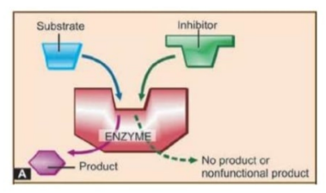
Enzymes
Almost all biological reactions are carried out under catalytic influence of enzymes;
Drugs can either increase or decrease the rate of enzymatically mediated reactions.
Substrate
I
lnhi ltor
\
\
Product
....• • No produci or
nonruncuonal p roduct

Slide 12
Enzyme inhibition
-- - - - - - - - - - - - - - - - - - -
Selective inhibition of a particular enzyme is a
common mode of drug action.
Such inhibition is either competitive or noncompetitive.
Enzyme
Endogenous substrate
Competitive Inhibitor
Ch oline sterase
Monoamine-oxidase A (MAO-A)
Dopa decarboxylase
Xanthine oxidase
Angiotensin converting enzyme (ACE)
5a-Reductase
Aromatase
Bacterial folate synthase
Acetylcholine Catecholamines Levodopa Hypoxanthine Angiotensin-1 Testosterone
Testosterone, Androstenedione Para-amino benzoic acid (PABA)
Physostigmine, Neostigmine Moclobemide
Carbidopa, Benserazide Allopurinol
Captoprll
Finasteride
Letrozole, Anastrozole Sulfadiazine

Slide 13
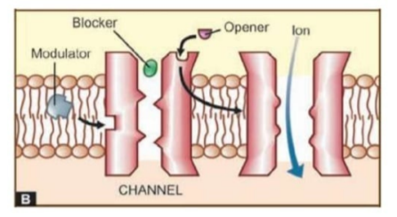
_
Ion Channels
..
Ligand gated channels (e.g. nicotinic receptor)
G-proteins and are termed G-protein regulated channels (e.g.cardiac 1 adrenergic receptor activated Ca2+ channel).
Blocker
Opener Ion
CHANNEL

Slide 14
Ion Channels
11111
□ Drugs can also act on voltage operated and stretch sensitive channels by directly binding to the channel and affecting ion movement through it, e.g. local anaesthetics which obstruct voltage sensitive Na+ channels.

Slide 15
Ion Channels
Certain drugs modulate opening and closing of the channels, e.g.:
Nifedipine blocks L-type of voltage sensitive Ca2+ channel.
Ethosuximide inhibits T-type of Ca2+ channels in thalamic neurones.

Slide 16
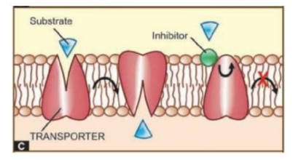

Transporters
-- - - - - - - - - - - - - - - - - - -
□ Several substrates are translocated across
mem- branes by binding to specific transporters (carriers) which either faciIitate
diffusion in the direction of the concentration gradient or pump the metabolite/ion against the concentration gradient using metabolic
energy.

Slide 17
Transporters
-- --- - - - - - - - - - - - - - - - -
□ Many drugs produce their action by directly
interacting with the solute carrier (SLC) class of transporter proteins to inhibit the ongoing physiological transport of the metabolite/ion.

Slide 18
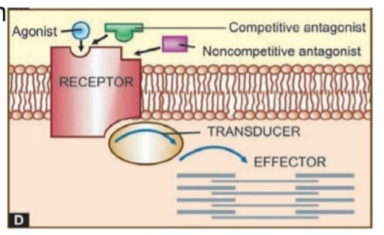



Receptors
-- - - - - - - - - - - - - - - - - - -
□ Macromolecule or binding site located on the
surface or inside the effector cell that serves to recognize the signal molecule/drug and initiate the response to it, but itself has no other
func tion-- - - - - - - - - - - --
....rF,::(-;JF - .=-.
Agonist
- Competitive antagonist
•
Noncompetitive antagonist
. EFFECTOR

Slide 19
Agonist: An agent which activates a receptor to produce an effect similar to that of the physiological signal molecule.
Inverse agonist: An agent which activates a receptor to produce an effect in the opposite direction to that of the agonist.
Antagonist: An agent which prevents the action of an agonist on a receptor or the subsequent response, but does not have any effect of its own.
Partial agonist: An agent which activates a receptor to produce submaximal effect but antagonizes the action of a full agonist.

Slide 20
□ Agonists have both affinity and maximal intrinsic activity (IA
= 1 ), e.g. adrenaline, histamine, morphine.
Competitive antagonists have affinity but no intrinsic activity (IA = 0), e.g. propranolol, atropine, chlorpheniramine,
naloxone.
Partial agonists have affinity and submaximal intrinsic activity (IA between O and 1), e.g. dichloroisoproterenol (on adrenergic receptor), pentazocine (on µ opioid receptor).
Inverse agonists have affinity but intrinsic activity with a minus sign (IA between O and -1 ),e.g. DMCM (on benzodiazepine receptor),chlorpheniramine (on H1 histamine receptor)

Slide 21
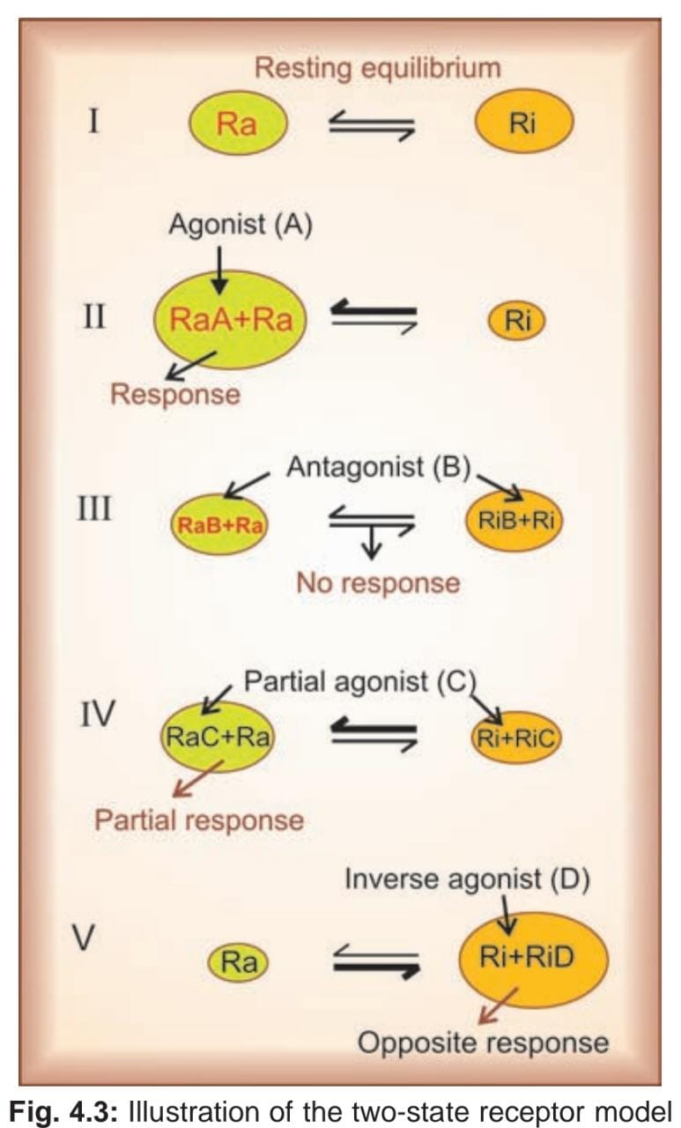

Slide 22
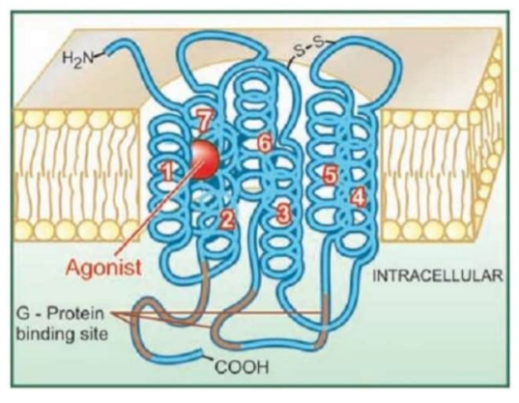
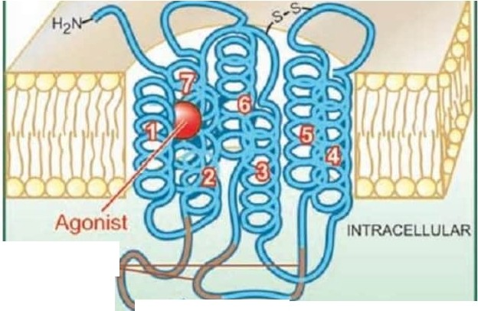
G protein coupled receptor
G-Protein
binding SJte
=
COOH

Slide 23
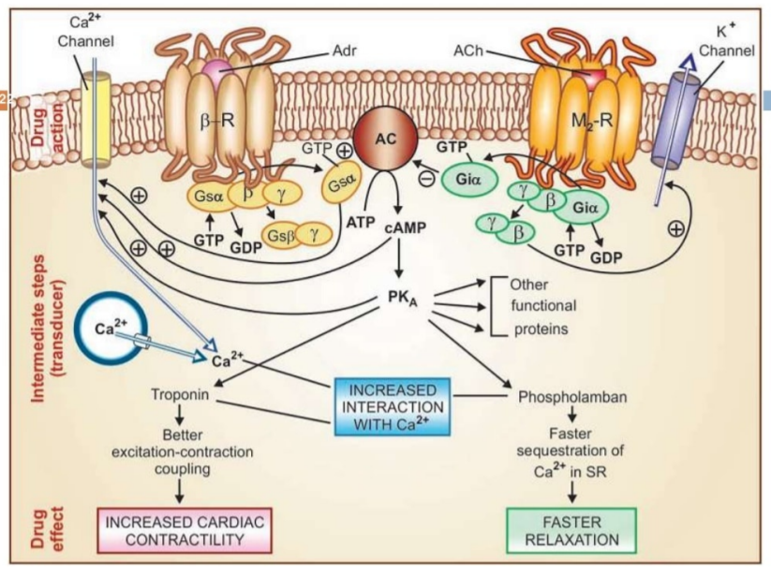

Slide 24
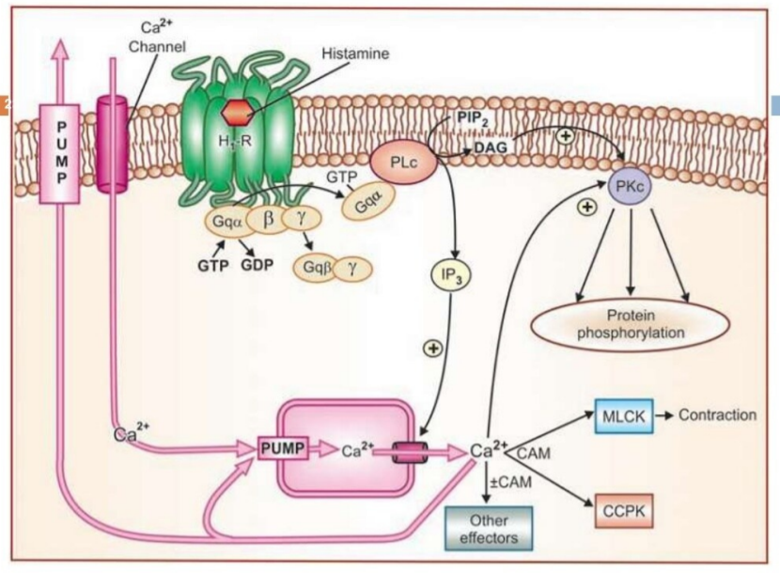

Slide 25
Gs : Adenylyl cyclase activation, Ca2+ channel openi•ng
Gi : Adenylyl cyclase inhibition, K+ channel openi•ng
Go : Ca2+ channel inhibition
Gq : Phospholipase C activation

Slide 26
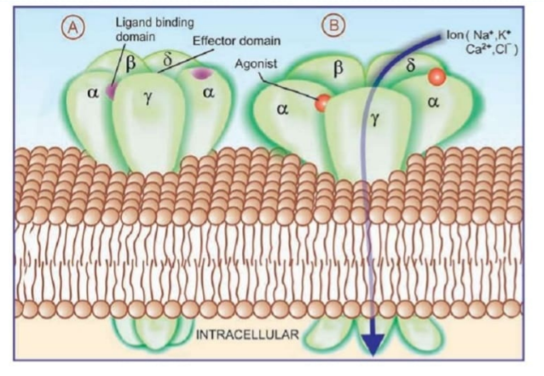

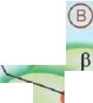
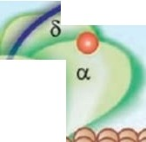







Ion channel receptor
Ligand binding
domain
Effector domain
Agonisl
a.
Ion ( Na•.K•
ca2·.c r>
a
y
a
'Y
I N T RACELLULAR

Slide 27
Ion channel receptor
-- - - - - - - - - - - - - - - - - - -
□ These cell surface receptors, also called ligand gated ion channels, enclose ion selective channels (for Na+, K+, Ca2+ or c1-) within their molecules.
Agonist binding opens the channel and causes depolarization/hyperpolarization/ changes in cytosolic ionic composition, depending on the ion that flows through.
The nicotinic cholinergic, GABAA, glycine (inhibitory AA), excitatory AA-glutamate (kainate, NMDA and AMPA) and 5HT3 receptors fall in this category.

Slide 28
Transmembrane enzyme-linked
111111 ^{recen}t!-^{tor}-^{s} - - - - - - - - - - - - -
Utilized primarily by peptide hormones.
Made up of a large extracellular ligand binding domain connected through a single transmembrane helical peptide chain to an intracellular subunit having enzymatic property.
Examples are-insulin, epidermal growth factor (EGF), nerve growth factor (NGF) and many other growth factor receptors.

Slide 29
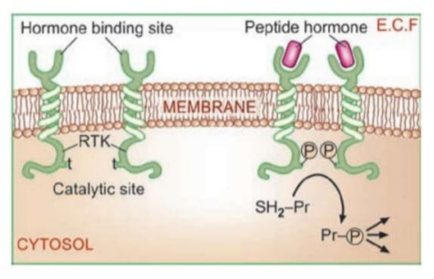
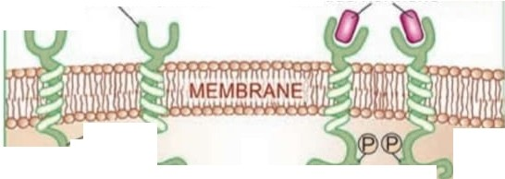

Transmembrane enzyme-linked
recep_to_r_s _
-- - - - - - - - - - - - - - - - - - -
Hormone binding site
Peptide hormone E.C.F
(
RTK
t
C atalytic site
CYTOSOL
Model of receptor tyrosine kinase, an enzyme­ linked receptor

Slide 30
Transmembrane JAK-STAT binding
.. recegtors
□Agonist induced dimerization alters the intracellular domain conformation to increase its affinity for a cytosolic tyrosine protein kinase JAK (Janus Kinase).
On binding, JAK gets activated and phosphorylates tyrosine residues of the receRtor, which now bind another free moving protein STAT (signal transducer and activator of transcription).
This is also phosphorylated by JAK. Pairs of phosphorylated STAT dimerize and translocate to the nucleus to regulate gene transcription resulting in a biological response.

Slide 31
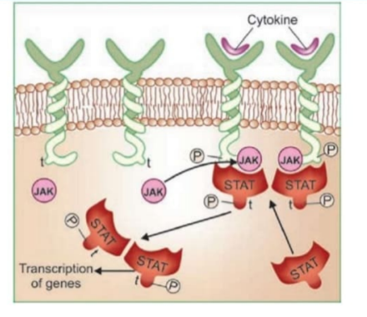
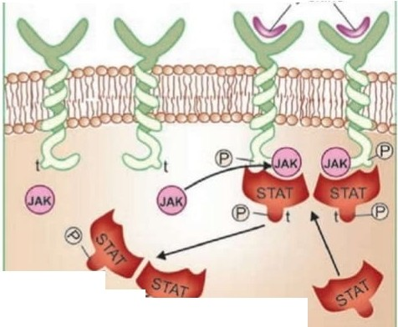
Transmembrane JAK-STAT binding
.. receptors
_
Cytoklne
-,,
T ranscnpbo.n,. ge nes _ I
_
Many cytokines, growth hormone, prolactin, interferons, etc. act through this type of receptor

Slide 32
Receptors regulating gene expression (Transcription factors, Nuclear
These are intracellular (cytoplasmic or nuclear) soluble proteins which respond to lipid soluble chemical messengers that penetrate the cell.
The liganded receptor diamer moves to the nucleus and binds other co-activator/co-repressor proteins which have a modulatory influence on its capacity to alter gene function.
All steroidal hormones (glucocorticoids, mineralocorticoids, androgens, estrogens, progeste­ rone), thyroxine, vit D and vit A function in this manner.

Slide 33
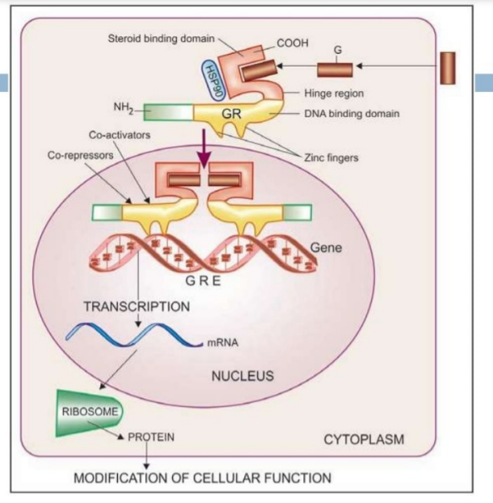

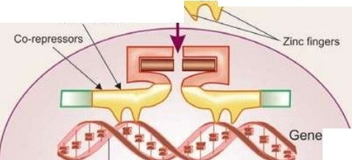
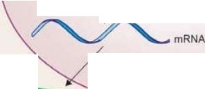

j I 1- - - - --10
G
Steroidbinding domain
COOH
:::y
\
H i ng e region
DNA binding domain
GR _ .,7 -
Co-actvi ators
TRANSC·R₋IPTION GRE
NUCLEUS
RIBOSOME
PROTEIN
CYTOPLASM
MODIFICATIONOF CELLULAR FUNCTION

Slide 34
Drug potency and efficacy
Drug potency which refers to the amount of drug needed to produce a certain response.
Drug efficacy and refers to the maximal response that can be elicited by the drug.

Slide 35
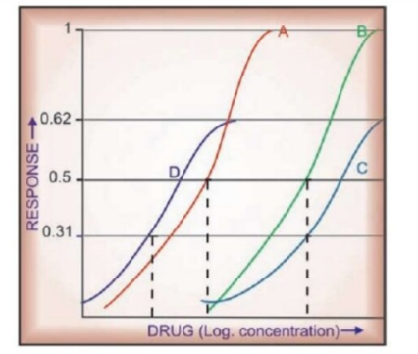
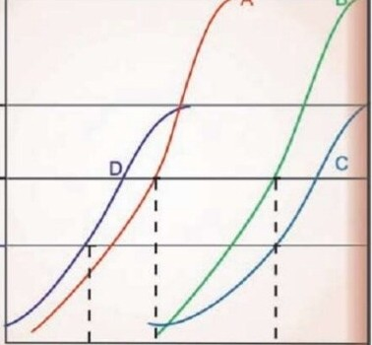
Drug potency and efficacy
1 -.--- | - | - - - - .,_- - -fn-
t 0.62 e^{w}n o^{z} 0 .5 _{e}Q._{n} w o:0 .31 | I I I I DRUG (Log concentration)_.
Drug B is less potent but equally efficacious as drug A. Drug C is less potent and less efficacious than drug A.
Drug D is more potent than drugs A, B, & C, but less efficacious than drugs A & B, and equally efficacious as drug C.

Slide 36
Therapeutic index
1nedian lethal dose
Therapeutic index =
1nedian effective dose
LDso
o r - -
ED₅₀
where: Median effective dose (ED50) is the dose which produces the specified effect in 50% individuals and
median lethal dose (LD50) is the dose which kills 50%
of the recipients.

Slide 37
_
Combined effect of Drugs
..
Synergism
When the action of one drug is facilitated or increased by the other, they are said to be synergistic.

Slide 38
Additive Synergism
-
- - - - - - - - - - - - - - - -
The effect of the two drugs is in the same direction and simply adds up:
Effect of drugs A+ B = effect of drug A+ effect of
drug B.
Additive drug combinations
Aspirin + paracetamol
as analgesic/ antipyretlc
as general anaesthetic
as antihypertensive as hypoglycaemic as bronchodifa tor
Nitrous oxide + hafothane
Amlodipine + atenolof
Glibenclam
i de +
m e tformin
Ephedrine + theophyfline
□ Side effects of the components of an additive pair may be different-do not add up. Thus, the combination is better tolerated than higher dose of one component.

Slide 39
Supraadditive Synergism
- - - - - - - - - - - - - - - -
The effect of combination is greater than the
individual effects of the components:
effect of drug A+ B > effect of drug A+ effect of drug B
This is always the case when one component given alone produces no effect, but enhances the effect of the other (potentiation).

Slide 40
IEII
Supraadditive drug combinations
Drug pair
Acetylcholine + physostigmine
Basis of potentiation
Inhibition of break down
Inhibition of peripheral metabolism
Inhibition of neuronal uptake
Sequential blockade
Levodopa + carbidopa/ benserazlde
Adrenaline + cocaine/ desipramine
Sulfamethoxazole + trimethoprim
Antihypertensives (enalapril+ hydrochlorothiazide)
Tyramine + MAO inhibitors
Tackling two contributory factors
Increasing releaseable CA store

Slide 41
Antagonism
IEII
When one drug decreases or abolishes the action of another, they are said to be antagonistic:
effect of drugs A+ B< effect of drug A+effect of drug B

Slide 42
Physical antagonism
..
□ Based on the physical property of the drugs,
e.g. charcoal adsorbs alkaloids and can prevent their absorption-used in alkaloidal po1ison1• ngs.

Slide 43
Chemical antagonism
..
The two drugs react chemically and form an inactive product, e.g
KMn04 oxidizes alkaloids-used for gastric lavage in poisoning.
Chelating agents (BAL, Cal. disod. edetate) complex toxic metals (As, Pb).

Slide 44
Physiological/functional
.. antagonis....m......"""""'---- - - - - - -
The two drugs act on different receptors or by different mechanisms, but have opposite overt effects on the same physiological function, i.e. have pharmacological effects in opposite direction.
Histamine and adrenaline on bronchial muscles and BP.
Glucagon and insulin on blood sugar level.

Slide 45
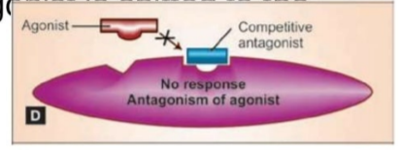

Receptor antagonism
..
Competitive antagonism (equilibrium type)
The antagonist is chemically similar to the agonist, competes with it and binds to the same site to the exclusion of the agonist molecules.
Because the antagonist has affinity but no intrinsic activity , no response is produced and
the log DRC of the ag
r1,ght.
·-=-.L =- -'-=.t.&.- -¹J. -
.LI--
Agon1st
j ; / Co1T1p_elitive
I an tago n ist
"'ll

Slide 46
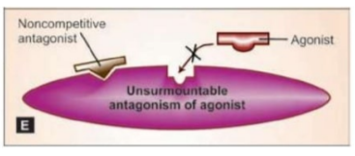
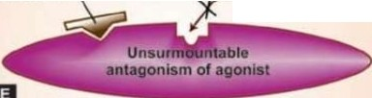
Noncompetitive antagonism
-- --- - - - - - - - - - - - - - - - -
□ The antagonist is chemically unrelated to the
agonist, binds to a different allosteric site altering the receptor in such a way that it is unable to combine with the agonist , or is unable to transduce the response.
Noncompetitive antagonist
c::,::;:J
Agon,st

Slide 47
Competitive (equilibrium type)
..
Noncompetitive
Antagonist binds with the same receptor as the agonist
Antagonist resembles chemically with the agonist
Parallel rightward shift of agonist DRC
The same maximal response can be
attained by increasing dose of agonist (surmountable antagonism)
Intensity of response depends on the concen­ tration of both agonist and antagonist
Examples: ACh-Atropine Morphni e- Naloxone
Binds to another site of receptor Does not resemble
Flattening of agonist DRC Maximal response is suppressed
(unsurmountable antagonism)
Maximal response depends only on the concentration of antagonist Diazepam-Bicuculline

Slide 48
lllfll

