Slide 1
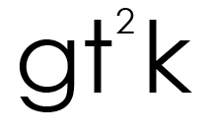
Georgia Tech Gesture Toolkit:
Supporting Experiment in Gesture Recognition
Kent Lyons
Helene Brashear
Tracy Westeyn
Jung Soo Kim
Thad Starner
Contextual Computing Group
College of Computing
Georgia Institute of Technology
Atlanta, GA USA

Slide 2
Motivation
Gesture is becoming more common for interfaces
Building gesture recognition systems is very difficult

Slide 3
gt²k is…
A user interface toolkit designed to enable the development of gesture-based applications.
Written in Java for cross-platform use and easy integration into graphical user interface development tools.

Slide 4
When to use gt²k
Applications using symbolic/iconic gesture
  Sign language
  handwriting
Applicable to research in many fields
  Human-Computer Interaction
  Assistive Technologies
  Robotics
  Brain Research
  etc.

Slide 5
Outline
Example applications
  WritingPad
  Accelerometer
  Camera
gt²k architecture
  Overview
    Sensor
    Library
    Machine Learning
  Recognition Process
    Data collection
    Training
    Recognition
In-depth sample example
  How to make your own application

Slide 6
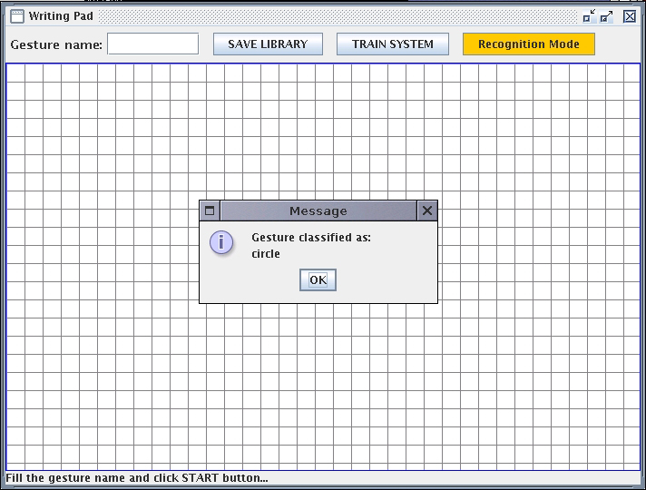
Application : WritingPad
Sensor : mouse sensor
Allows a user to draw a gesture with a mouse

Slide 7
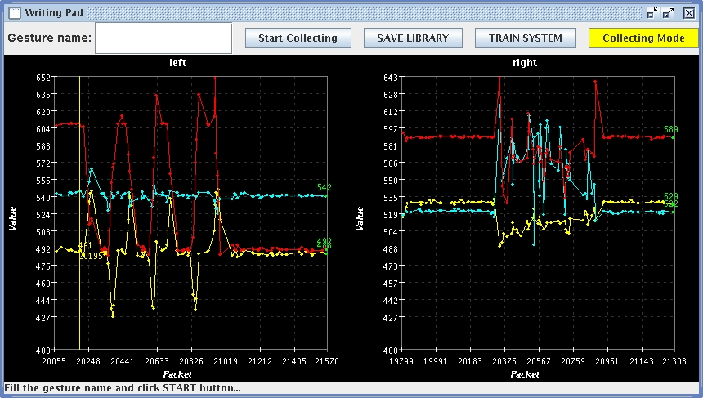
Application : Accelerometer
Sensor : Accelerometer
Collects information about users’ physical movement

Slide 8
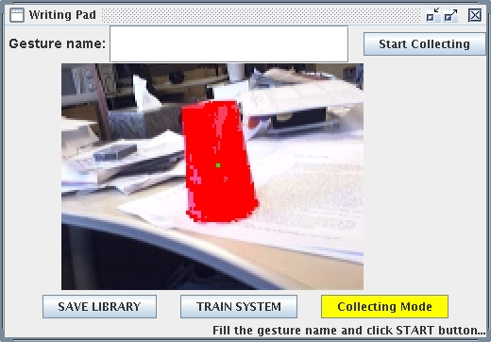
Application : Vision Tracker
Sensor : Image Sensor
Tracks the movement of objects

Slide 9
Architecture overview
Application
Result
Machine Learning
Request
Wrapper
CU-HTK
Library
Data
Segment
Library
Utils/Tools
Sensor
Sample
Sample
: gt2k api
: user/3rd party app.

Slide 10
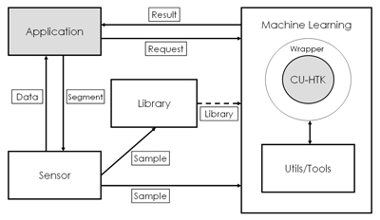
Sensor
Interfaces with the hardware and collect data.
Provides parsing or post-processing of the data.
Designed around an event-based architecture.
Allows for both synchronous or asynchronous reading of sensors.

Slide 11
Library
Responsible for storing and organizing data.
Composed of a collection of samples.
  <?xml version="1.0" encoding="UTF-8"?>
  <library name="WritingPadLib">
  <samples>
  <sample id="1">
  <tag end="144" label="star" start="0"/>
  <fvectors>
  <v>0.0 0.0</v>
  <v>-0.32175055 3.1622777</v>
  :
  <v>-1.815775 4.1231055</v>
  </fvectors>
  </sample>
  </samples>
  </library>

Slide 12
Machine Learning
Provides the toolkit’s abstraction for the machine learning algorithms.
Used for modeling data samples (training) and recognizing gesture samples.
Utilizes Cambridge University’s Hidden Markov Model Toolkit (CU-HTK).

Slide 13
Gesture Recognition Process
Data Collection
Segment&label
data
Store data as
feature vector
Training
Train model
with collected
data
Recognition
Recognize new
raw data using
trained model

Slide 14
Data Collection
Application
Result
Machine Learning
Request
Wrapper
CU-HTK
②
①
Library
Data
Segment
Library
②
Utils/Tools
Sensor
Sample
Sample

Slide 15
Training
④
Application
Result
Machine Learning
①
Request
Wrapper
CU-HTK
Library
Data
Segment
②
Library
③
Utils/Tools
Sensor
Sample
Sample

Slide 16
Recognition
④
Application
Result
Machine Learning
Request
Wrapper
CU-HTK
②
①
Library
Data
Segment
Library
③
②
Utils/Tools
Sensor
Sample
Sample

Slide 17
How to make your own application?
Considerations:
  What kind of sensor will you use?
    Is it already in the gt²k package or should I build new sensor?
  How are you going to segment data?
    Mouse Sensor segments data by clicking (start) and releasing (stop) mouse button
  How big is my feature vector?
    Vector size of mouse sensor : 2 (X and Y)
    Vector size of accelerometer : 3 (X, Y and Z)
    What if I have two accelerometer sensors?

Slide 18
How to make your own application?
Create a new set of options :
  GT2kOptions myOpts = GT2kOptions();
  myOpts.setVectorSize(2);
Create or load a library object :
  try { library=Library.load(“MyLibrary.xml");
  } catch (Exception e) {
  library=new Library(“MyLibrary");
  }
Initializes the machine learning component :
  HTK htk = new HTK(myOpts);
Create a new sensor:
  MouseDragVectorSensor mySensor = new MouseDragVectorSensor();

Slide 19
How to make your own application?
For data collection
  Connect the sensor to the library so it can save the samples
    mySensor.addSensorSampleListener(library);
For recognition
  Connect the sensor to the HTK object
    mySensor.addSensorSampleListener(htk);
  Connect HTK object to application to get a result
    htk.addResultListener(myApplication);

Slide 20
How to make your own application?
WritingPad application structure
WritingPad
Initializes the program
-creates the main frame
Instantiates the needed gt2k objects
(MouseSensor, Library
, Options and HTK)
-connects a sensor, library, HTK,
Result objects
WritingPadPanel
creates all of the components
of UI
-defines all button’s actions
CoordinateArea
Displays the on-screen grid for user
feedback
-listens to the MouseSensor and
plots points

Slide 21
How to make your own sensor?
Considerations:
  Make sensor Runnable?
    Mouse sensor implements mouse listeners
    Accelerometer sensor implements Runnable
      Start or stop from application
  Drivers and Java library for your sensor
    May not work under Windows but Linux

Slide 22
How to make your own sensor?
Things to do/write
  Communication with physical sensor
  Parses output (float type)
  Connects to the gt²k sensor infrastructure

Slide 23
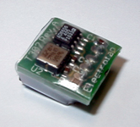
How to make your own sensor?
Structure
Sensor
Send out data or sample to the listeners
add/remove data listener
- add/remove sample listener
extends
YourSensor
- Provide Post-processing (parsing output)
· Whenever data gets generated,
sends data.
· Whenever one gesture gets created,
sends a sample.
YourSensorController
Drivers or communication tools with
your physical sensor

Slide 24
Questions?
For more information
visit:
http://ccg.cc.gt.atl.ga.us/bliki/prj:gt2k:gt2kmanual
email:
Kent Lyons : kent@cc.gatech.edu
Helene Brashear : brashear@cc.gatech.edu
Tracy Westeyn : turtle@cc.gatech.edu
Jung Soo Kim : jszzang@cc.gatech.edu

