Slide 1
A Tutorial on Object Detection Using OpenCV

Slide 2
Introduction
The goal of object detection is to find an object of a pre-defined class in a static image or video frame.

Slide 3


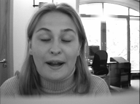


Methods
Simple objects
Extracting certain image features, such as edges, color regions, textures, contours, etc.
Complex objects
Learning-based method:
Viola and Jones, “Rapid object detection using a boosted cascade of simple features”, CVPR 2001

Slide 4
Statistical model-based training
Take multiple “positive” samples, i.e., objects of interest, and “negative” samples, i.e., images that do not contain objects.
Different features are extracted from samples and distinctive features are “compressed” into the statistical model parameters.
It is easy to make an adjustment by adding new positive or negative samples.

Slide 5
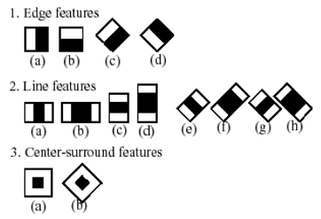
Haar-like Features

Slide 6
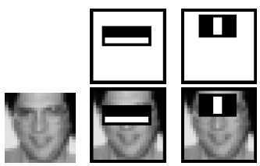
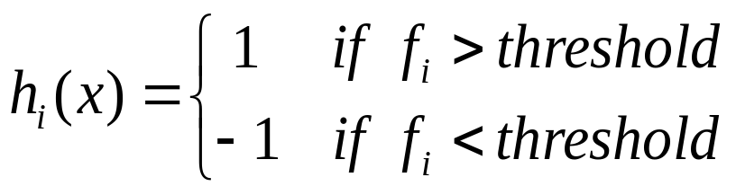
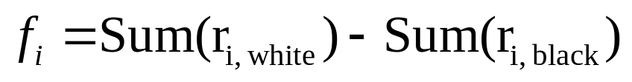
Example
Feature’s value is calculated as the difference between the sum of the pixels within white and black rectangle regions.

Slide 7
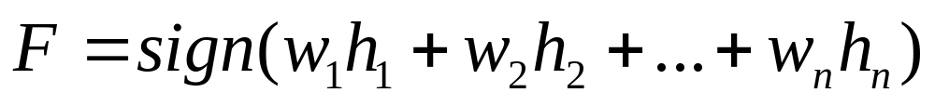

Adaboost Learning
The more distinctive the feature, the larger the weight.

Slide 8
Detector in Intel OpenCV
Collect a database of positive samples and a database of negative samples.
Mark object by objectmarker.exe
Build a vec file out of positive samples using createsamples.exe
Run haartraining.exe to build the classifier.
Run performance.exe to evaluate the classifier.
Run haarconv.exe to convert classifier to .xml file

Slide 9
Links
Original paper: http://research.microsoft.com/~viola/Pubs/Detect/violaJones_CVPR2001.pdf
How-to build a cascade of boosted classifiers based on Haar-like features: http://lab.cntl.kyutech.ac.jp/~kobalab/nishida/opencv/OpenCV_ObjectDetection_HowTo.pdf
Objectmarker.exe and haarconv.exe, *.dll:
http://www.iem.pw.edu.pl/~domanskj/haarkit.rar

