Slide 1
Electro-cardiogram (ECG) – Detection of R-peaks
Surya Penmetsa

Slide 2
Content
How ECG is recorded?
Why the ECG occurs?
Detecting R-peaks and measuring the heart rate of a person using MATLAB.

Slide 3
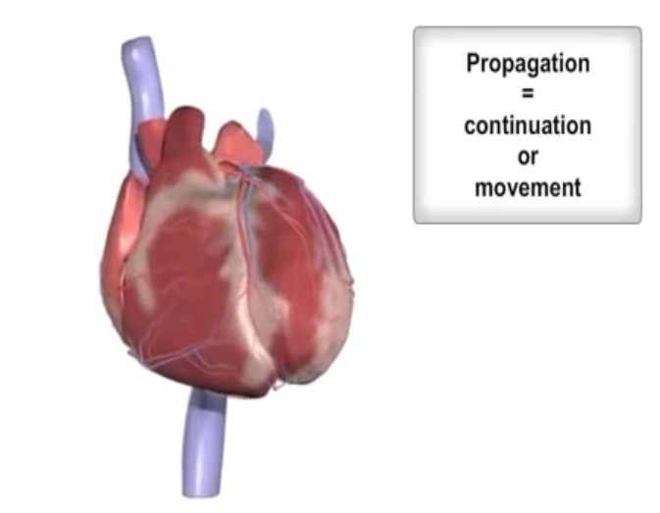
ECG Introduction
The heart muscles contract and expand to generate signals that is recorded as ECG.
ECG is the measured electrical activity of the heart.

Slide 4
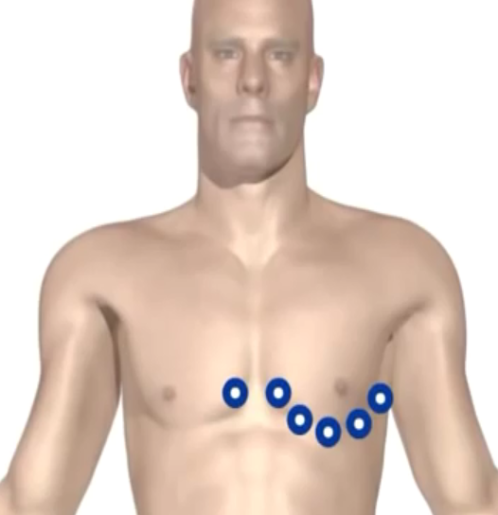
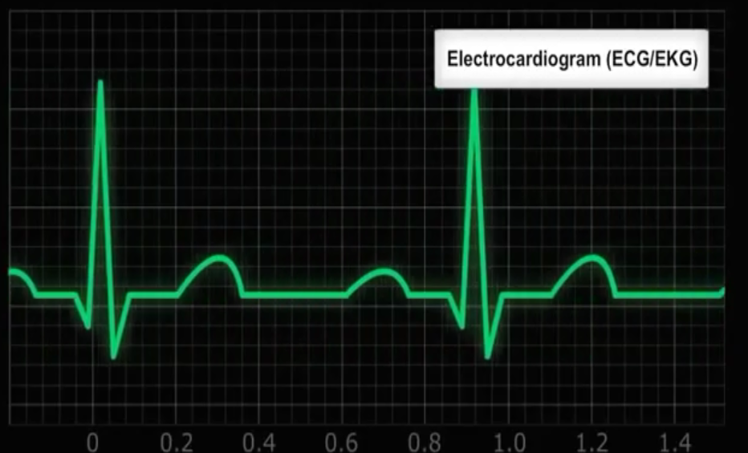
ECG Introduction
This electrical activity and be measured by placing electrodes at specific points on the skin.

Slide 5
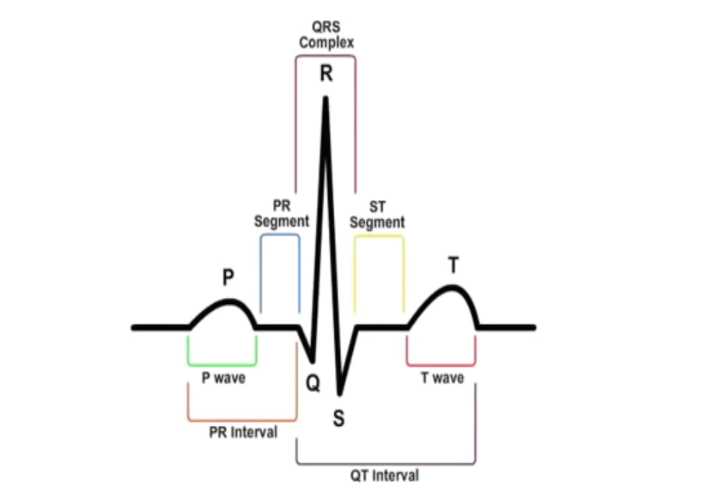
ECG Introduction
An Ideal ECG looks like this and it keeps repeating itself.
We will try to detect the R-peaks in this presentation.

Slide 6
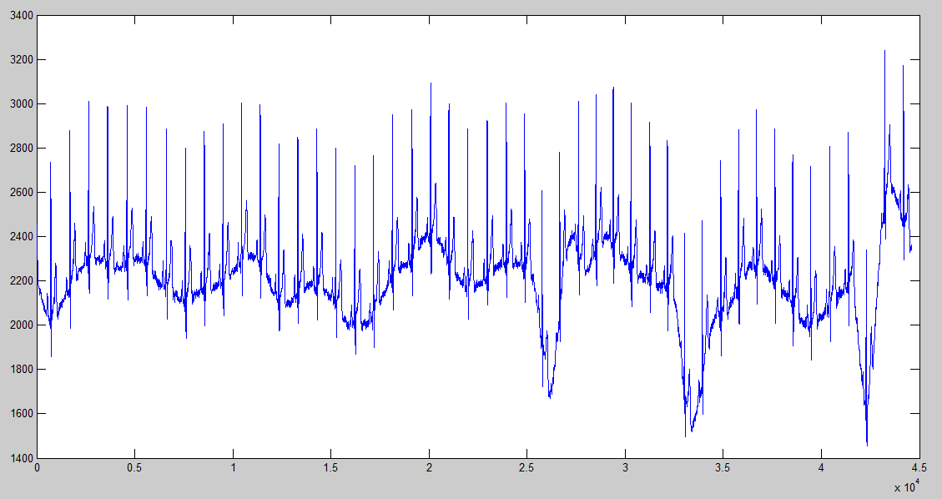
R-peaks detection in MATLAB
The ECG signal we are going to work with looks like this.

Slide 7
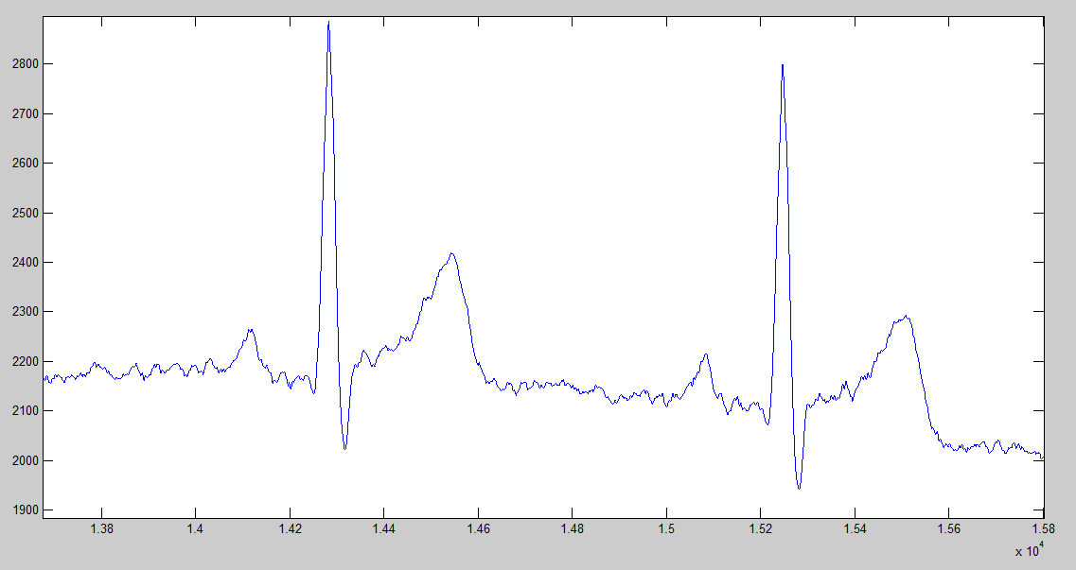
R-peaks detection in MATLAB
A closer look at the signal

Slide 8
Steps for Detection
Remove low frequency components
Change to frequency domain using fft
Remove low frequency components
Back to time domain using ifft
Find local maxima using windowed filter
Remove small values, store significant ones
Adjust filter size and repeat 2,3

Slide 9
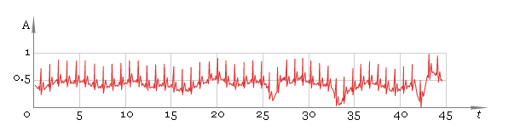
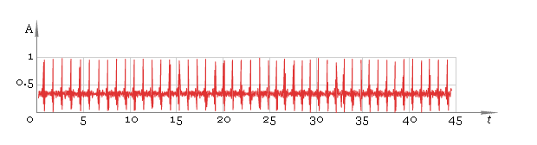
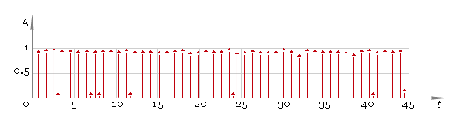
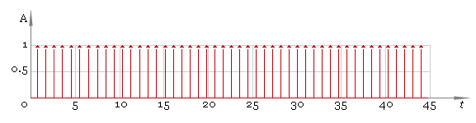
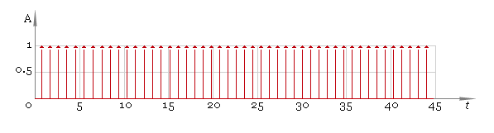
Input
After removing low frequency components.
Using a windowing filter
Thresholding
Using the adjusted filter

Slide 10
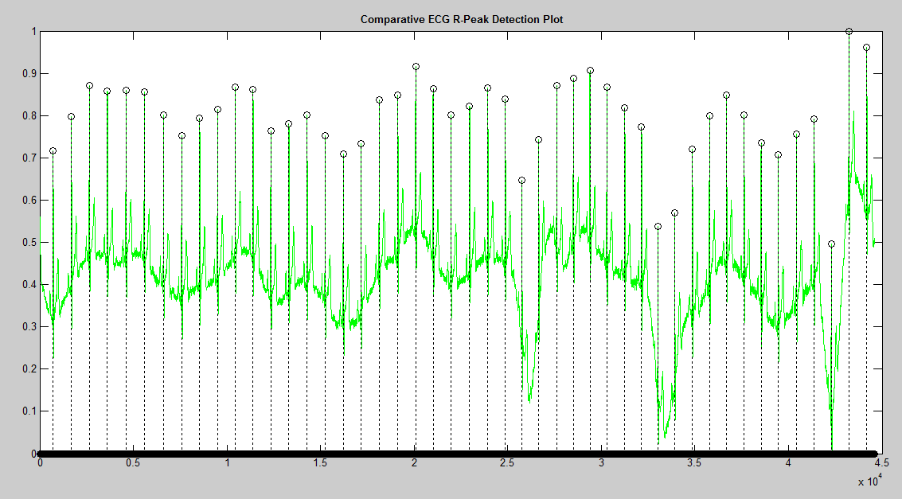
Final result of Algorithm

Slide 11
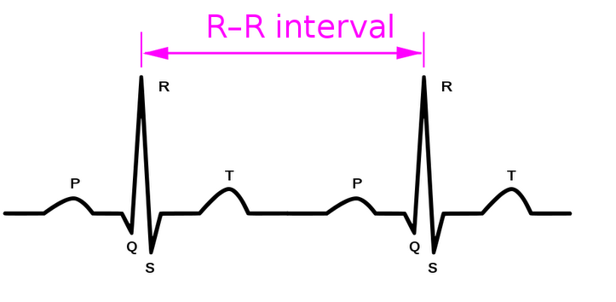
Calculating heart beat
This is my contribution to the code.
Heart Beat Rate in (beats/second) can be calculated by the formula-
Rate= 60*sampling rate/(R-R interval)

Slide 12
References
Most of the content in this presentation has been picked up from
Medo Yasar YouTube Video -https://www.youtube.com/watch?v=KWrzdJY4G9Q
Sergey Chernenko’s code - http://www.librow.com/cases/case-2
I do not own any of these pictures and take no credit for the code in this presentation- except for the heart beat calculation part.

Slide 13
Thanks!

