Slide 1
Introduction to FlexRay
Communication in distributed systems within automotive context
Developed by the FlexRay consortium (BMW, DaimlerChrysler, Motorola, Philips) founded in 1999
Aim:
flexible, fault-tolerant communication Protocol

Slide 2
Key Features of FlexRay
Open Bus System
Support of redundant transmission channels
Data rate of 10 Mbit/sec per channel
Static and dynamic data transmission (scalable)
– Deterministic data transmission
– Arbitration free transmission
Fault tolerant and time triggered services implemented

Slide 3
General
FlexRay is a Time Division Multiple Access (TDMA) protocol
Every node in a flexray gets a fixed duration of time on the bus to communicate.
A FlexRay cluster is set of nodes (ECU’s) which communicate to each other over a fixed baud rate.

Slide 4
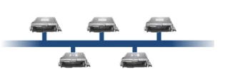
FlexRay Network topology
Dual channel bus configuration

Slide 5
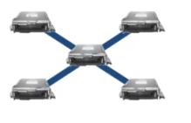
Star Configuration

Slide 6
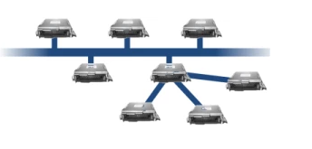
Hybrid Topology

Slide 7
Communication Cycle
It is an instance on the bus which repeats after a fixed duration.
Cycle duration defines the baud rate of the bus i.e. the rate at which the nodes forming a cluster will communicate with each other.
E.g. The cycle time of the bus is defined to be 5 ms

Slide 8
Sub division of Communication Cycle
Static Segment
Dynamic Segment
Symbol Window
NIT (Network Idle Time).

Slide 9
Static Segment
It is a portion in the communication cycle wherein the access to the bus is solely determined by time i.e. the time duration of this segment is fixed and the nodes are allotted fixed time to communicate on the bus.
It is a mandatory segment in the communication cycle.
A Static Segment consists of Static Slots,

Slide 10
Static Slots
It is fixed duration slot which is allotted to a node for communicating on the bus.
This duration remains with the node irrespective of whether the data is available for transmission or not.
A fixed number of static slots are available per static segment.

Slide 11
Dynamic Segment
The data is transmitted based on the mini-slotting scheme (Flexible Time Division Multiple Access)
The Dynamic Segment is used for a wider variety of event-based data that does not require determinism.
The time duration allotted to a node is based on the data to be transmitted i.e. if a node has data to be transmitted that is larger than the smallest time slot in the dynamic segment (mini slot) then the time duration is increased.

Slide 12
Mini slots:
It is the smallest instance in the dynamic segment allotted to a node for communicating on the bus.
The data to be transmitted by the bus is larger than the duration of the mini slot then node can continue its transmission in the next mini slot.

Slide 13
Symbol Window:
Symbol window used for network maintenance.
For example wake-up symbol for waking up the FlexRay cluster
It is an optional field in the communication cycle.

Slide 14
Network Idle Time (NIT):
It is a period during which the node applies the clock correction and helps nodes to re-synchronize to the bus.
It is a mandatory field in the communication cycle.
The duration of NIT is defined in terms of macro ticks which is a multiple of micro ticks.

Slide 15
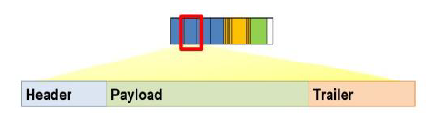
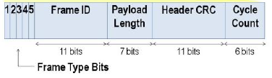
The Header is 5 bytes (40 bits) long and includes the following fields:
Status Bits - 5 bits
Frame ID - 11 bits
Payload Length - 7 bits
Header CRC - 11 bits
Cycle Count - 6 bits

Slide 16
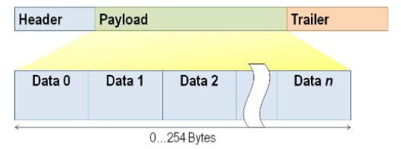
Payload
The payload contains the actual data transferred by the frame.
The length of the FlexRay payload or data frame is up to 127 words (254 bytes)

Slide 17
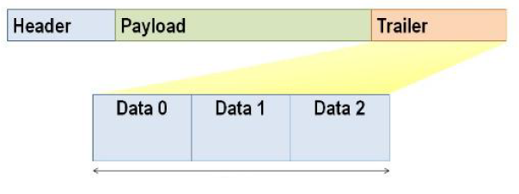
Trailer
The trailer contains three 8-bit CRCs to detect errors.

Slide 18
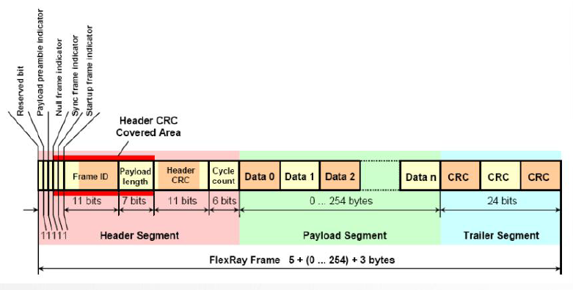
Frame Format
Static Segment

Slide 19
