Slide 1
LIN (Local Interconnect Network)
A slower & low cost alternative to CAN
Developed by Consortium Group in 2002
Developed as a sub-network of CAN to reduce the Bus Load
Mono-master, up to 15 slaves
All messages are initiated by the master
The master node can also act as a slave by replying to its own messages.
1 wire bus
up to 19.2 kbit/s @ 40 meter bus length

Slide 2
Bitrates from 1 to 20 Kbits/s : 2.4, 9.6 and 19.2 Kbits are usually used in automotive applications
Sleep / wake-up capability
Applications
Automotive, White Goods, Medical – for sensors and actuators

Slide 3
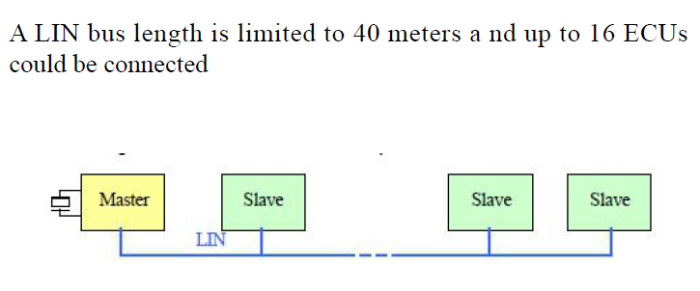
LIN Network physical Structure

Slide 4
LIN bus message frame
The standard LIN consist of two parts,
Header
Synchronization break
Synchronization byte,
Identifier byte
Response
Data bytes,
Checksum

Slide 5
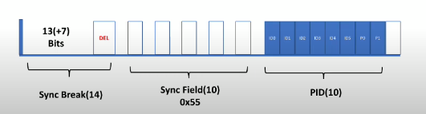
LIN Message Header

Slide 6
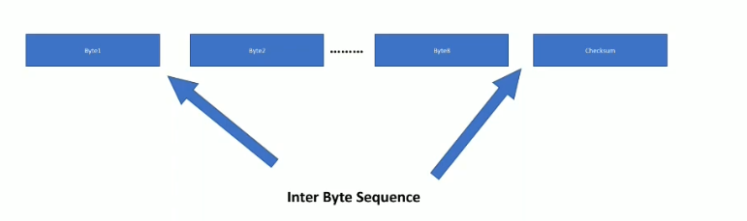
LIN Response

Slide 7
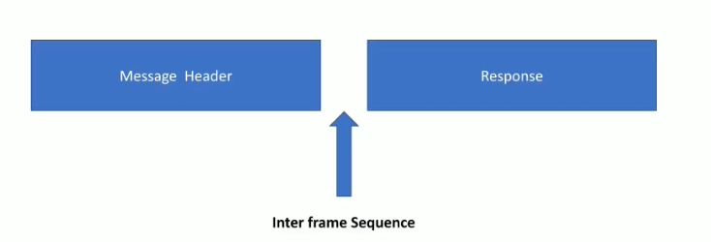
Interframe Sequence

Slide 8
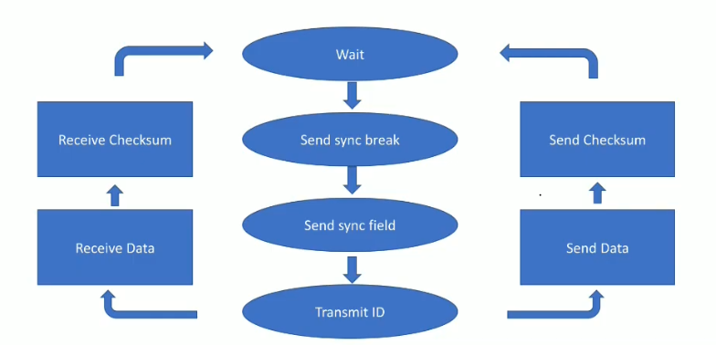
LIN master flow

Slide 9
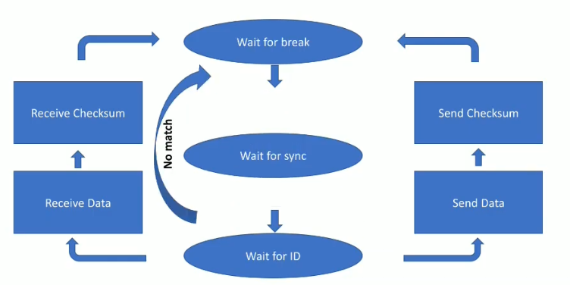
LIN slave flow

Slide 10
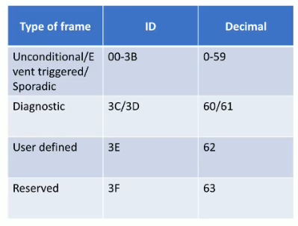
LIN Message Types

Slide 11
Unconditional Frame
This is the default form of communication where the master simply sends a header, requesting information from a specific slave. The relevant slave reacts accordingly.
Event Triggered frame
Its like broadcast, master send header to multiple slaves, if a slave had a data then it response data to network,
If more than one slave had data, then all slaves send data which results collision, master detects collision and again sends header through unconditional frame.

Slide 12
Sporadic frame
If slave had an updated data then, master sends sporadic frame.
Sporadic frame is created by master by sending header and response data itself.

Slide 13
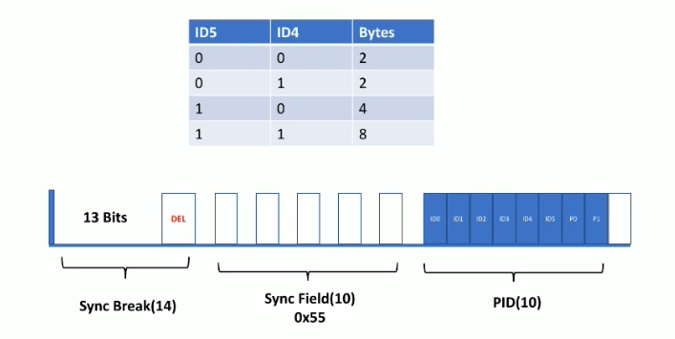
LIN data rates

Slide 14
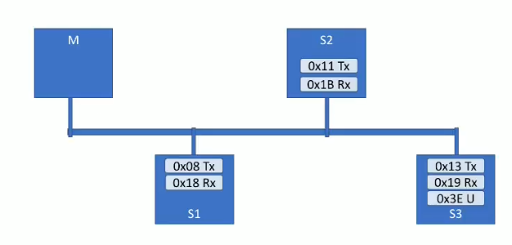
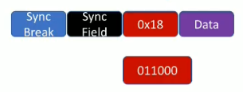
LIN Example

Slide 15
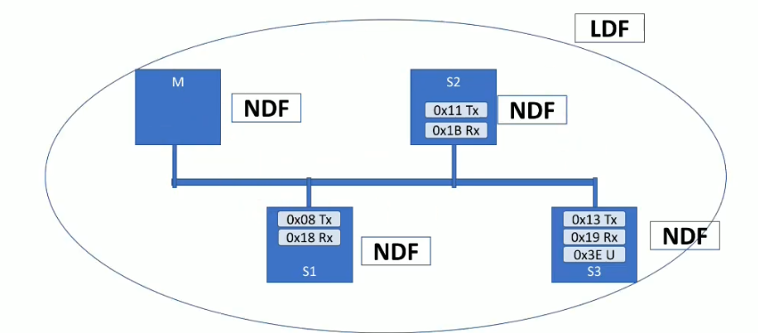
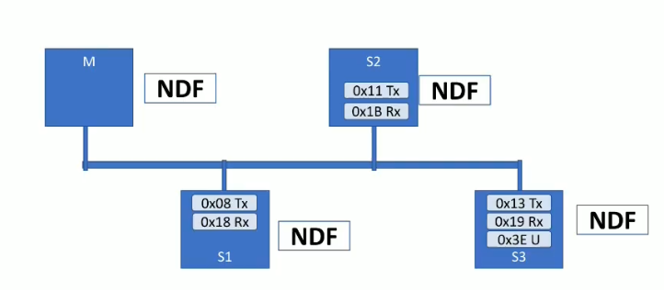
LIN Cluster

Slide 16
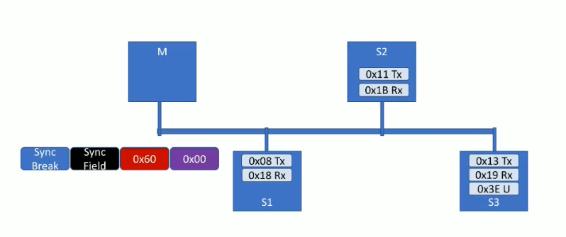
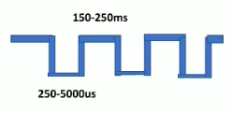
LIN Bus sleep and wake up
4s
3 times

