Slide 1



SMART INDIA HACKATHON 2026
• Problem Statement ID: SIH26261
• Problem Statement Title: AI-Powered Application Validation, Document Authentication and Regulatory Compliance Verification
• Theme: Smart Automation
• PS Category: Software
• Team ID:
• Team Name: NAVDRISHTI

Slide 2




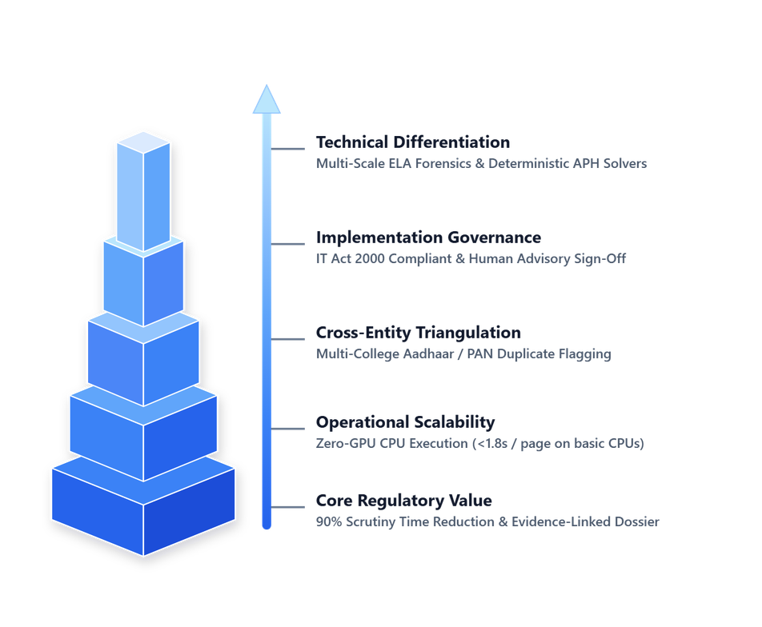
NAVDRISHTI
ARGUS: Authentication & Recognition Guardian for Unified Screening
An air-gap-ready compliance and forensic screening engine designed to accelerate institutional approval scrutiny, targeting under 15 minutes per dossier with deterministic rule-based verification.
1. The 4-Pillar Forensic Engine:
  Pixel-Level Forensic Scrutiny: Multi-scale ELA (50/70/90) and noise analysis detect doctored dates, whiteout masking, and cloned municipal seals on Fire NOCs & Land Deeds before OCR extraction.
  Deterministic APH Norms Solver: Applies explicit mathematical constraints to FSR, cadre ratios, and carpet-area requirements, producing reproducible calculations and traceable rule-level results.
  Inter-Document Triangulation: Graph-based cross-document entity matching detecting duplicate professors across colleges via Aadhaar/PAN hashing and safety capacity mismatches.
  Cryptographic Trust Bridge: Decodes official QR seals and validates PAdES/PKCS#7 Digital Signatures offline (with planned DigiLocker & State e-District API sync in connected environments).
2. Core Regulatory Impact:
  Cuts Scrutiny Time by 90%: Projected to accelerate the standard 14-day committee scrutiny cycle to under 15 minutes per college.
  Prevents Approval Slippage: Catches subtle digital manipulation, expired safety certificates, and unrecorded intake expansions.
  Evidence-Linked Audit Trail: Produces a structured deficiency matrix with rule-level statutory citations for objective review by Standing Hearing Committees (SHC).
3. Key Technical Innovations:
  Decoupled Architecture: Isolates AI extraction from deterministic math rules for traceable decisions with rule-level audit logs.
  Forensics First: Analyzes pixel compression artifacts & EXIF before OCR extraction.
  Human-in-the-Loop: Strictly an advisory assistant; final regulatory sign-off remains with AICTE.
2

Slide 3
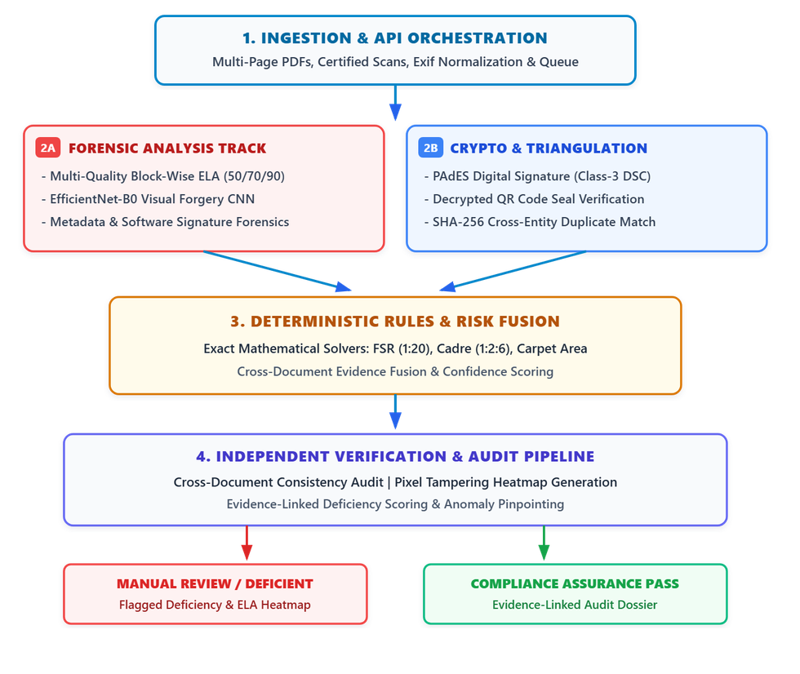





TECHNICAL APPROACH
NAVDRISHTI
Architectural Layers & Technologies to be Used:
  Core Forensics & Vision Layer: PyTorch (EfficientNet-B0 visual forgery CNN), OpenCV (Multi-scale ELA & morphological filtering), PyHanko (PAdES Digital Signature verification), PyZbar (QR seals).
  Ingestion & Extraction: PyMuPDF (300-DPI page rendering and multi-page processing), EasyOCR (Full-page tables & layout), TrOCR (Reserved strictly for cropped anomalous signatures & dates).
  Serving & Scrutiny Cockpit: FastAPI (Async microservice architecture), Redis (Queue worker), PostgreSQL (Tamper-evident audit logs), React.js (Scrutiny Officer Cockpit with pixel heatmap overlays).
  Air-Gapped & On-Premises Ready: Engineered for secure self-hosted deployment on AICTE servers; zero sensitive institutional data (faculty Aadhaar, financial deeds) is transmitted to third-party commercial APIs.
3

Slide 4
FEASIBILITY AND VIABILITY
NAVDRISHTI
1. Analysis of Feasibility:
  Technical Feasibility: Built on standard, battle-tested computer-vision algorithms (ELA, CNN, constraint solvers) requiring no specialized supercomputing hardware.
  Operational Feasibility: Seamlessly integrates with existing web portals as an asynchronous REST API microservice without altering institutional submission workflows.
  Legal & Standards Alignment: Implements cryptographic verification workflows informed by applicable electronic-signature requirements and relevant PDF signature standards (PAdES / ISO 32000-1).
  Hardware Footprint: Operates on standard 4-core cloud/on-prem CPU • < 1.5 GB RAM footprint • Zero GPU dependency.
3. Engineering Mitigation Strategies:
  Mitigation 1 (Robust Preprocessing): Uses Adaptive Median Absolute Deviation (MAD) normalization and multi-probe ELA (qualities 50, 70, 90) to help reduce false positives on authentic scanned documents.
  Mitigation 2 (Strict Advisory Mode): Outputs flags (VERIFIED, ANOMALY, MANUAL-REVIEW-REQUIRED). Final regulatory action strictly requires human scrutiny officer sign-off.
  Mitigation 3 (Asynchronous Queue Architecture): Redis job queuing, stateless horizontal FastAPI workers, and parallelized multi-page chunking (<1.8s/page on 4-core CPU).
Viability & Scale Dimension | Engineering Mitigation Strategy
Infrastructure & Cost Viability | Zero GPU Dependency: Operates on standard 4-core CPU (<1.5 GB RAM); projected ~85% compute cost reduction compared to dedicated cloud GPU clusters (commodity CPU baseline).
Data Sovereignty & Cert-In Compliance | Air-Gapped On-Premises Deployment: Self-hosted inside NIC/AICTE data centers; sensitive PII (PAN/biometrics) never leaves government servers.
Throughput & Peak-Season Elasticity | Projected Target Throughput: ~800 dossiers/day per 4-core node (assumes avg. 200-page dossier; stateless Redis + FastAPI async worker scaling).
2. Potential Challenges & Risks:
  Risk 1 (Document Diversity & Scan Quality): Low-DPI scans, mobile camera distortions, or wrinkled physical paper uploads causing false alarms.
  Risk 2 (Adverse Regulatory Misjudgement): Risk of an AI algorithm incorrectly rejecting an institution's application.
  Risk 3 (High Submission Volume): Peak-load bottleneck when thousands of institutions submit EoA applications in April–May.
4

Slide 5
IMPACT AND BENEFITS
NAVDRISHTI
90% Time Reduction
Projected workflow acceleration: Targets reducing institutional dossier scrutiny from a 14-day manual cycle to under 15 minutes per college.
Cross-Institutional Faculty Duplicate Detection
Automated Aadhaar / PAN Duplicate Flagging Rate across institutions via cross-entity graph matching.
Evidence-Linked Audit Trail
Deficiency citations tied directly to statutory APH clauses, supporting objective, defensible review during institutional hearings.
Illustrative Synthetic Dossier — APH Compliance Evaluation
Inspection Parameter | Mandatory APH Norm | Extracted / Computed | Status Flag | Evidence & Statutory Rule
Faculty-to-Student Ratio (FSR) | Max 1 : 20 (B.Tech Engg) | 1 : 18.2 (52 Faculty, 946 Students) | ● COMPLIANT | APH 2024–27 Clause 7.1
Cadre Ratio (Prof : Assoc : Asst) | 1 : 2 : 6 mandatory ratio | 0 : 2 : 7 (Zero Professors Found) | ● DEFICIENT | APH Norms Table 2.1 (Deficiency)
Fire Safety NOC Expiry | Valid on date of scrutiny | Expired: 12-Dec-2025 | ● ANOMALY | Page 4 (Municipal Fire NOC Seal)
Approved Intake vs Fire NOC Cap | Fire NOC Cap ≥ Total Intake | NOC Cap: 450 | Total Intake: 600 | ● SAFETY RISK | Inter-Doc Triangulation (Building Plan)
Faculty Identity Integrity | Unique Aadhaar / PAN / Biometrics | Duplicate in Inst. #1042 | ● DUPLICATE IDENTITY | Salted HMAC-SHA256 & Face Embedding Match (Advisory Flag)
▲ Figure: Scrutiny Officer Deficiency Matrix — Actionable cockpit output produced for Standing Hearing Committees (SHC)
5

Slide 6
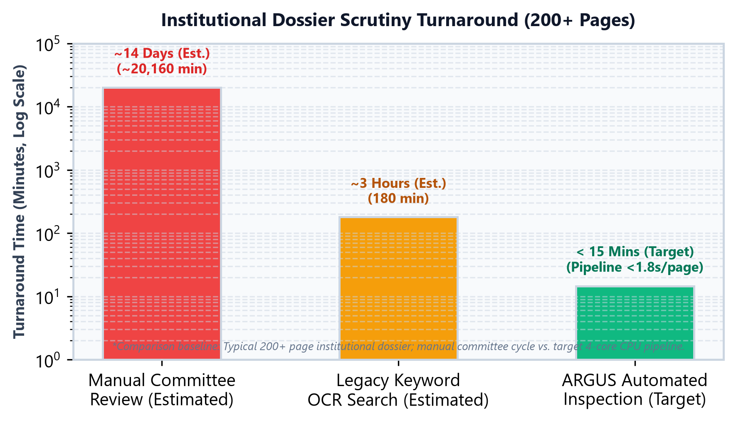
RESEARCH AND REFERENCES
NAVDRISHTI
Live Proof of Concept (Working Prototype)
  GitHub Repository: ARGUS-GitHub[https://github.com/Aravkataria/ARGUS ]
  Validated Core Features: Multi-scale ELA + EfficientNet-B0 visual forensics; 300-DPI multi-page OCR table parsing; deterministic Python math solvers for FSR, Cadre & Fire NOC; evidence-linked deficiency reports.
  • Prototype Execution Specs: Lightweight CPU runtime (<1.8s/page on 4-core CPU); 100% air-gapped on-premises architecture; designed to compress 14-day committee review to < 15 mins.
1. Regulatory Frameworks & Standards (Statutory Baselines):
• AICTE Approval Process Handbook (APH 2024–27): Statutory norms for FSR (1:20), Cadre Ratios (1:2:6), Instructional/Administrative area, and Land/Building norms. [aicteindia.org/bureaus/approval/aph-2024-27]
• Information Technology Act, 2000 (Section 3 & 3A): Statutory criteria for legal validity of electronic records, asymmetric cryptosystems, and Digital Signature Certificates (DSC). [indiacode.nic.in/handle/123456789/1999]
• ISO 32000-1 / PAdES Standard (ETSI TS 102 778): International standards for PDF Advanced Electronic Signatures, timestamping, and long-term document integrity validation. [iso.org/standard/51502.html]
2. Academic & Forensic Research References:
• Error Level Analysis (ELA) in Digital Forensics: Krawetz, N. (2007), "A Picture's Worth... Digital Image Analysis & JPEG Compression Artifacts", Black Hat Briefings. [hackerfactor.com/papers/krawetz-ela.pdf]
• Convolutional Neural Networks for Image Forgery: Tan, M., & Le, Q. V. (2019), "EfficientNet: Rethinking Model Scaling for CNNs", ICML (arXiv:1905.11946). [arxiv.org/abs/1905.11946]
• Benchmark Datasets in Document Forensics: CASIA Image Tampering Dataset v2.0 (CASIA-TIDE) & RVL-CDIP Document Classification Dataset. [forensics.idealtest.org/casiav2]
• Digital Public Infrastructure (DPI) & Verification APIs: National Academic Depository (NAD) & NIC DigiLocker Developer API Integration Specifications. [partners.digitallocker.gov.in]
6

