Slide 1
Introduction to Artificial Intelligence Project 3 – Learning
Jianmin Li & Minlie Huang
Spring 2017
Notes:
Good afternoon, everyone! My name is Zhang Shifeng, a Ph.D student at Tsinghua University, China.
Today I want to give a talk on a new supervised hashing algorithm which can be scalable

Slide 2
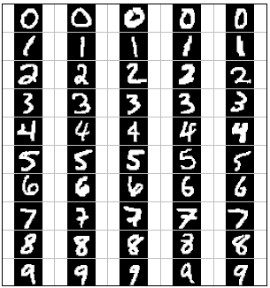
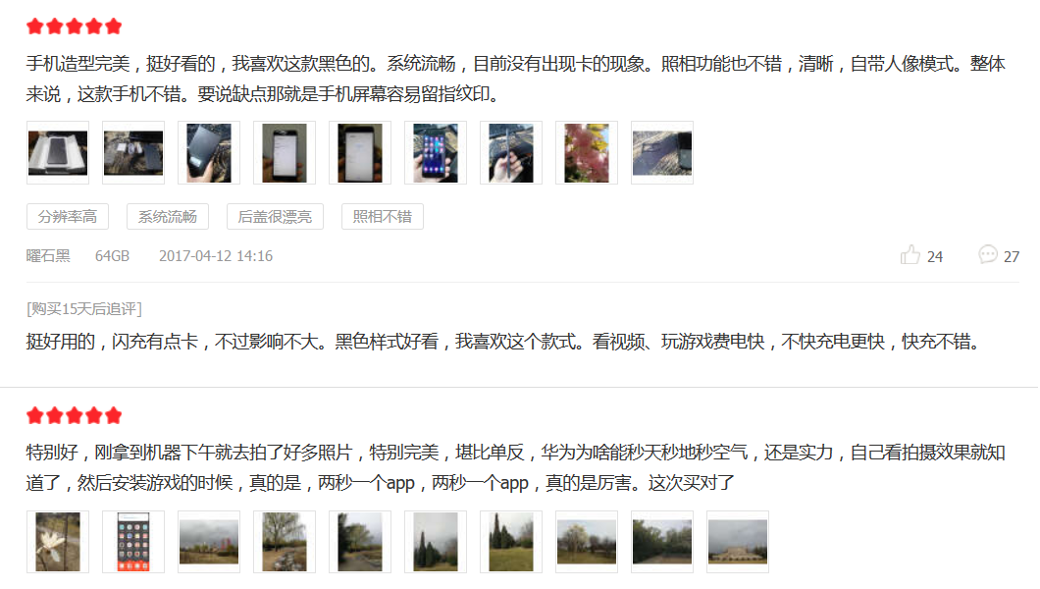
Classification

Slide 3
Pre-requirements
At least 400MB disk space and 800MB memory
Python package that you should be familiar with
numpy
Python packages that should be installed:
numpy
scipy
skimage
Anaconda is recommended
Python packages that MUST NOT BE USED
sklearn

Slide 4
Basic Tasks
KNN(4 points)
Implement KNNClassifier.classify method in classifiers.py
python dataClassifier.py –c knn –n 5
Perceptron(5 points)
Implement PerceptronClassifier.train in classifiers.py
python dataClassifier.py –c perceptron
SVM(6 points)
Implement SVMClassifier.train, SVMClassifier.classify, SVMClassifier.trainSVM in classifiers.py
python dataClassifier.py –c svm –k rbf –C 10
The optimization algorithm is provided. You just need to fill in the objective function

Slide 5
Basic Tasks
PCA (5 points)
Implement PCAFeatureExtractorDigit.fit/extract/reconstruct methods in featureExtractor.py (4 points)
python dataClassifier –f pca –m 32
Visualizing PCA (1 points)
python dataClassifier –f pca –m 32 –v
Answer the question answers.py in the method q5, returning either 'a' or 'b'

Slide 6
Bonus
Sentiment Analysis(5 points)
Implement FeatureExtractorText and ClassifierText class in sentimentAnalysis.py
python dataClassifier –d text

Slide 7
Submission
A 2-3 pages report (either Chinese or English)
Zip the files as the following structure
student_id.zip (e.g. 20090112xx.zip)
student_id.pdf
classifiers.py
featureExtractor.py
answer.py
sentimentAnalysis.py (optional)

Slide 8
Due
2017/5/21 23:59:59
Correctness of algorithms (80%)
Report (20%)

