Slide 1


Predicting COVID-19 ICU Admissions
A Machine Learning Approach

Slide 2
Task to be Performed
Task #1
Predict admission to the ICU of confirmed COVID-19 cases.
Based on the data available, is it feasible to predict which patients will need intensive care unit support?
The aim is to provide tertiary and quarternary hospitals with the most accurate answer, so ICU resources can be arranged or patient transfer can be scheduled.
Task #2
Predict NOT admission to the ICU of confirmed COVID-19 cases.
Based on the subsample of widely available data, is it feasible to predict which patients will not need intensive care unit support?
The aim is to provide local and temporary hospitals a good enough answer, so frontline physicians can safely discharge and remotely follow up with these patients.

Slide 3
The Dataset
The dataset used in the development of this machine learning model is as follows:
COVID-19 - Clinical Data to assess diagnosis
Sírio-Libanês data for AI and Analytics by Data Intelligence Team
Obtained from https://www.kaggle.com/datasets/S%C3%ADrio-Libanes/covid19 on 9/15/2024

Slide 4
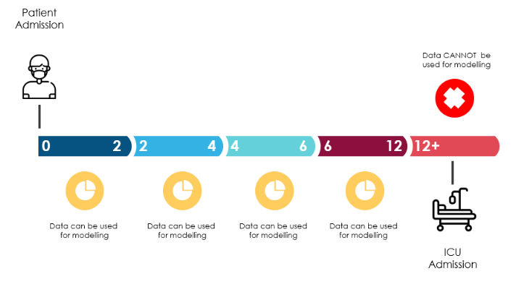
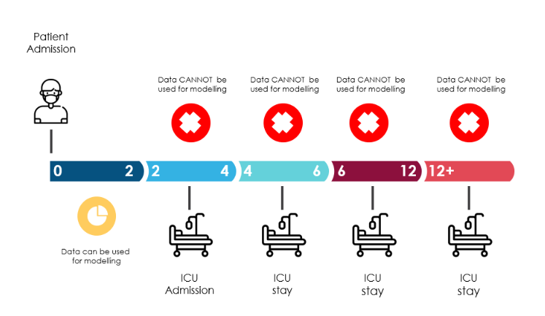
Dataset Notes
I DID NOT to use the data when the target variable is present, as it is unknown the order of the event (maybe the target event happened before the results were obtained).

Slide 5
The caution provided by the dataset note was addressed via determination by patient, weather they were ever placed in ICU (1 for yes, 0 for no) and then elimination of all dataset rows where the ICU indicator was positive originally and using the “ICU_EVER” feature as the target variable in our analysis.

Slide 6
Exploratory Data Analysis (“EDA”)
Upon importing the ingesting the data set, I began exploration of the layout, characteristics and types of data available.

Slide 7
EDA Continued:
The original dataset was 1925 rows x 231 columns consisting of records of 5 separate post hospital admission windows for 384 distinct patients.
The dataset contained 2 categorical columns, 6 integer columns and 225 float columns.
None of the categorical features had any missing data.
None of the integer features had any missing data.
All of the float features had at least some missing data.

Slide 8
EDA Continued:
Categorical Features: Although there were no records with missing data, we did encode the categorical features to integer values in order to facilitate analysis.
Float Features: Since 100% of the float features had at least a single missing data point, we used front and/or back filling as appropriate to populate the data as directed in the specifications.

Slide 9
EDA Continued:
Once the data was prepared, we then determined the correlation of the features with each other and selected the top 20 to use in our analysis.

Slide 10
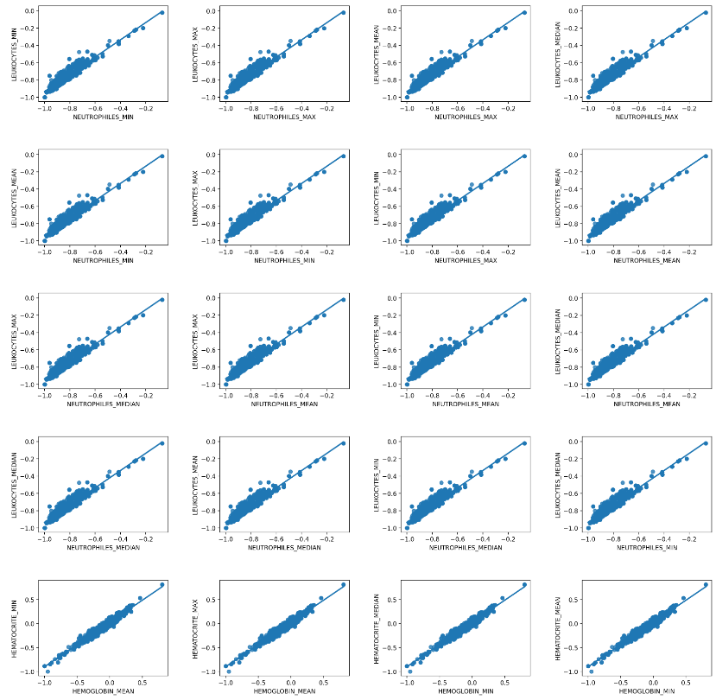

Slide 11
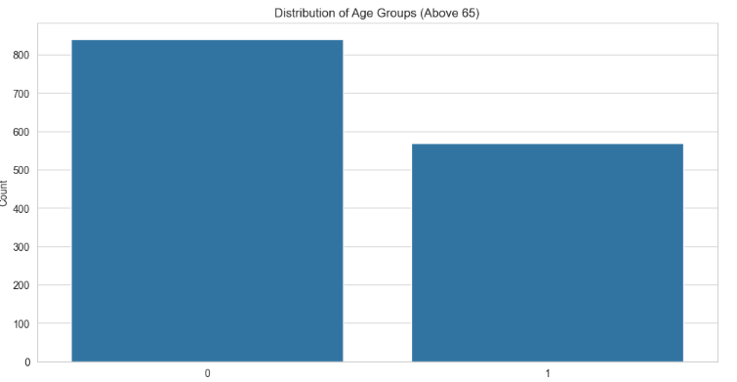
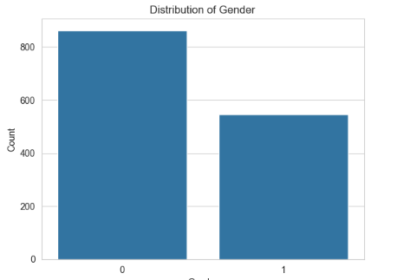
EDA Continued:
Our prepared and cleaned data consisted of 1,410 records with 212 features. The majority of our records were for male patients under the age of 65.

Slide 12
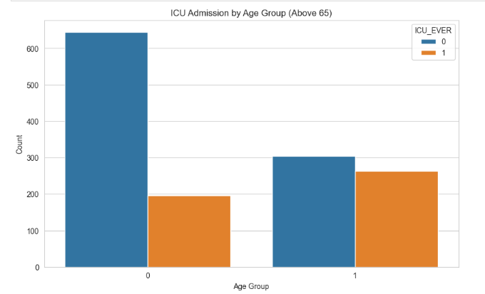
EDA Continued:
The majority of ICU admissions were for patients over the age of 65 where as the majority of hospital admissions in general were for patients under the age of 65

Slide 13
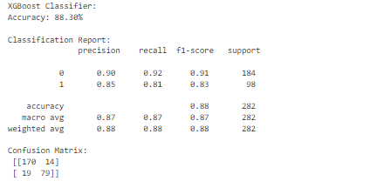
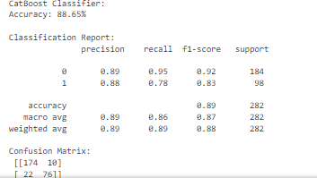
Model Selection and Testing
Using the 20 most correlated features, we ran an XgBoost and a CatBoost model using the 20 features to train each model to predict the ICU_EVER target value results were as follows:

Slide 14
Conclusion
Based on our testing results we believe use of either of these models would be acceptable. There did not appear to be any issues of overfitting or underfitting and the accuracy of each model was well over 88% at a 20% testing size and a random state of 42.
As shown of the previous slide each model does slightly better at predicting who will not need ICU resources vs. who will based on the 20 features correlated; however, the difference is minimal and the chosen model should be a very effective tool for admission decisions as well as resource allocation determinations.

