Slide 1
Loan App
21SW047

Slide 2
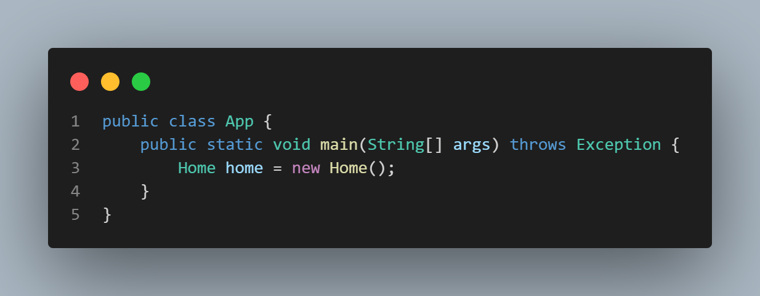
Class App

Slide 3
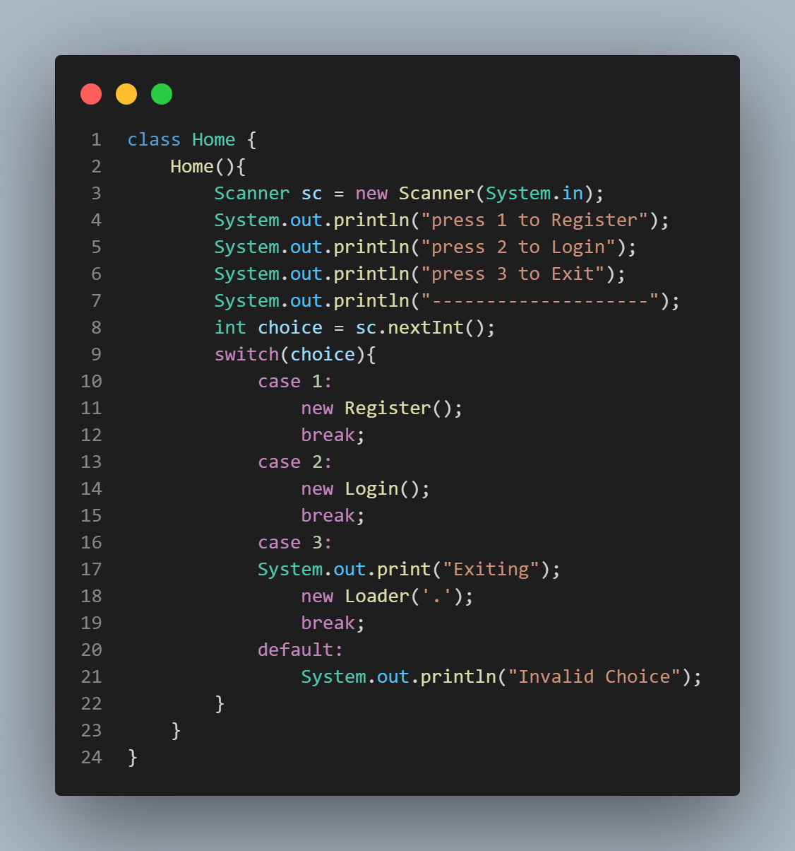
Home class

Slide 4
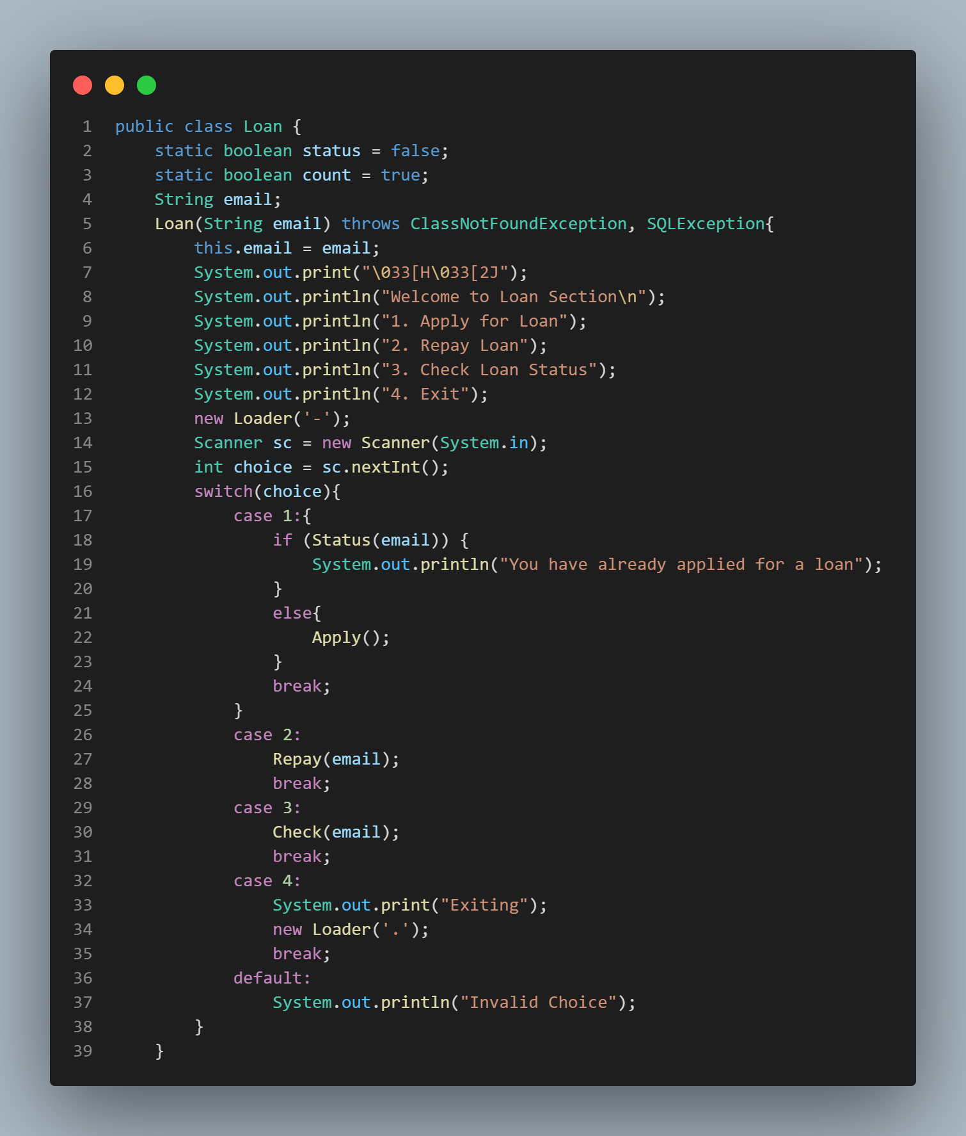

Slide 6
Two Content Layout with SmartArt
Task 1
Task 2
Task 3
Task 4
Task 5
First bullet point here
Second bullet point here
Third bullet point here

