Slide 1
DECISION TREES &
PEGASOS SVMs
FROM SCRATCH
Price regression and premium-tier classification on bina.az listings
MLE-AI-201 Machine Learning • Cohort II

Slide 2
01 Problem & Dataset
Task A: predict the listing sale price (AZN).
Task B: classify listings as Standard or Premium.
Source: bina.az sale listings; apartments, houses, plots and other properties.
Goal: implement core algorithms in NumPy and benchmark against scikit-learn.
Dataset cleaning and target construction use training-only statistics to reduce leakage.
MLE-AI-201 | ML Final Project
2

Slide 3
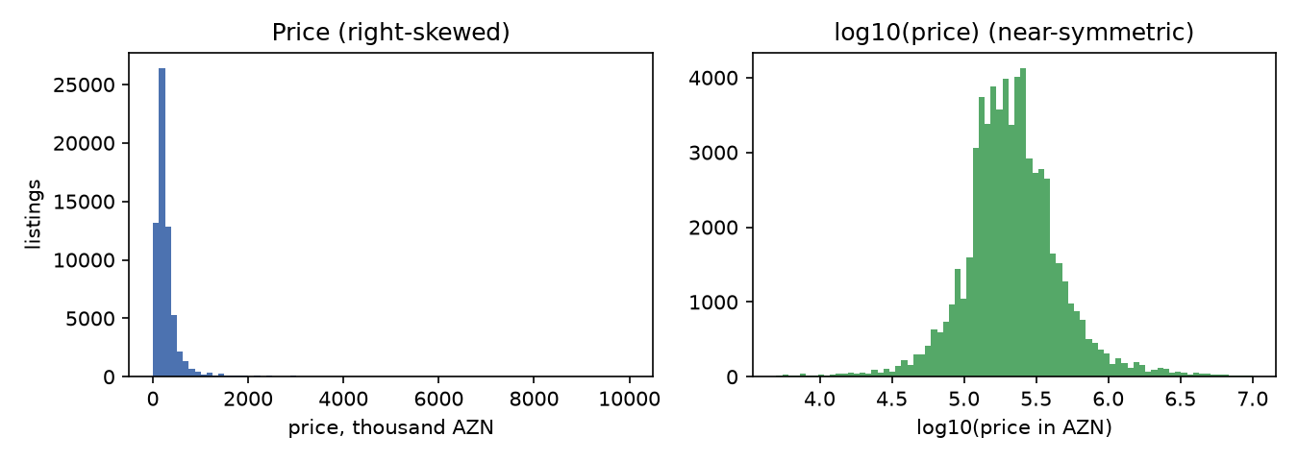
02 Cleaning, Features & Leakage Control
Deduplicate repeated listings and near-identical records.
Parse numeric fields, area units, floor information and coordinates.
Remove target-derived fields (unit_price, total_price) and identifiers.
Fit imputation, encoding and scaling using training data only.
Split: 70% train / 15% validation / 15% test; seed = 42.
MLE-AI-201 | ML Final Project
3

Slide 4
03 Decision Tree — From Scratch
Regression: minimize mean squared error (MSE) at each split.
Classification: select splits using Gini or entropy impurity.
Search thresholds over sorted feature values.
Control complexity: max_depth, min_samples_split, min_samples_leaf.
Leaves return mean price or class probabilities.
A tree captures nonlinear, threshold-like effects in location and property size.
MLE-AI-201 | ML Final Project
4

Slide 5
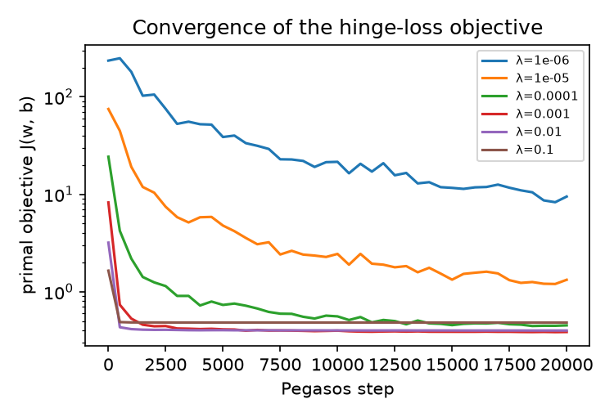
04 Pegasos SVM — From Scratch
Objective: λ/2 · ||w||² + (1/n) Σ max(0, 1 − yᵢ(wᵀxᵢ + b))
Mini-batch subgradient updates with regularization.
Standardized input features; linear hinge-loss classifier.
Hyperparameter search over λ, epochs and learning-rate schedule.
Random Fourier Features (RFF) approximate a nonlinear RBF kernel.
MLE-AI-201 | ML Final Project
5

Slide 6
05 Experimental Setup
Train / validation / test separation; tune on validation only.
Regression metrics: RMSE, MAE and R².
Classification metrics: Accuracy, Precision, Recall, F1, ROC-AUC and PR-AUC.
Benchmarks: scikit-learn DecisionTree, SGDClassifier and SVC RBF.
Uncertainty: bootstrap test-set estimates and 5-fold cross-validation.
Primary comparison: from-scratch NumPy implementations vs matched library baselines.
MLE-AI-201 | ML Final Project
6

Slide 7
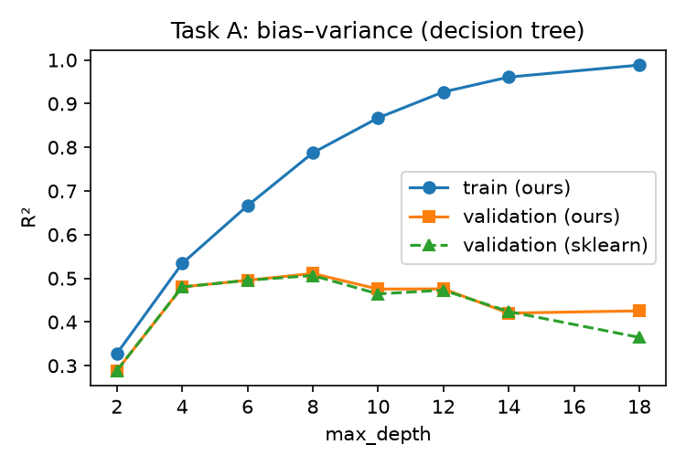
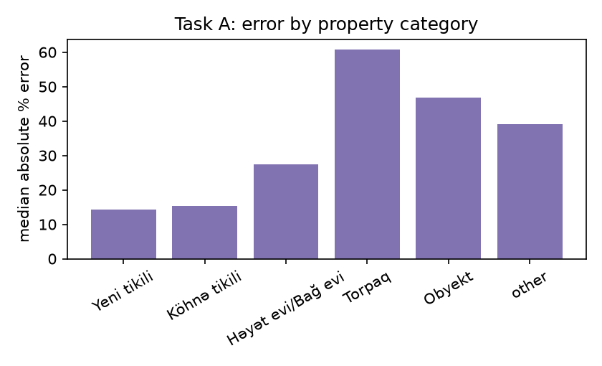
06 Task A — Price Regression
Model | RMSE (AZN) | MAE (AZN) | R²
Our Decision Tree | 342,525 | 102,958 | 0.5330
sklearn Tree | 342,515 | 102,938 | 0.5331
Our Log-price Tree | 365,036 | 98,963 | 0.4696
Our tree closely matches sklearn; log-price improves MAE but worsens RMSE.
MLE-AI-201 | ML Final Project
7

Slide 8
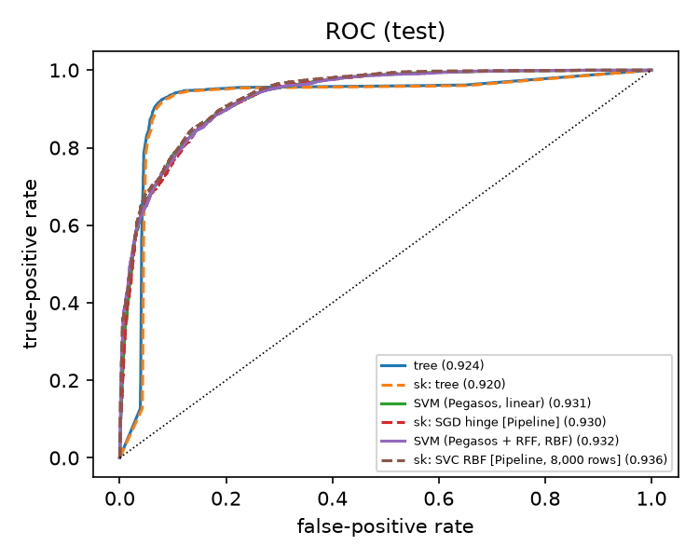
07 Task B — Premium vs Standard
Model | F1 | ROC-AUC
Our Decision Tree | 0.9219 | 0.9244
sklearn Tree | 0.9191 | 0.9200
Our Linear Pegasos | 0.8499 | 0.9310
sklearn SGD Hinge | 0.8501 | 0.9300
Our Pegasos + RFF | 0.8485 | 0.9320
sklearn SVC RBF | 0.8547 | 0.9364
Tree wins on F1; SVM-based models score higher on ROC-AUC.
MLE-AI-201 | ML Final Project
8

Slide 9
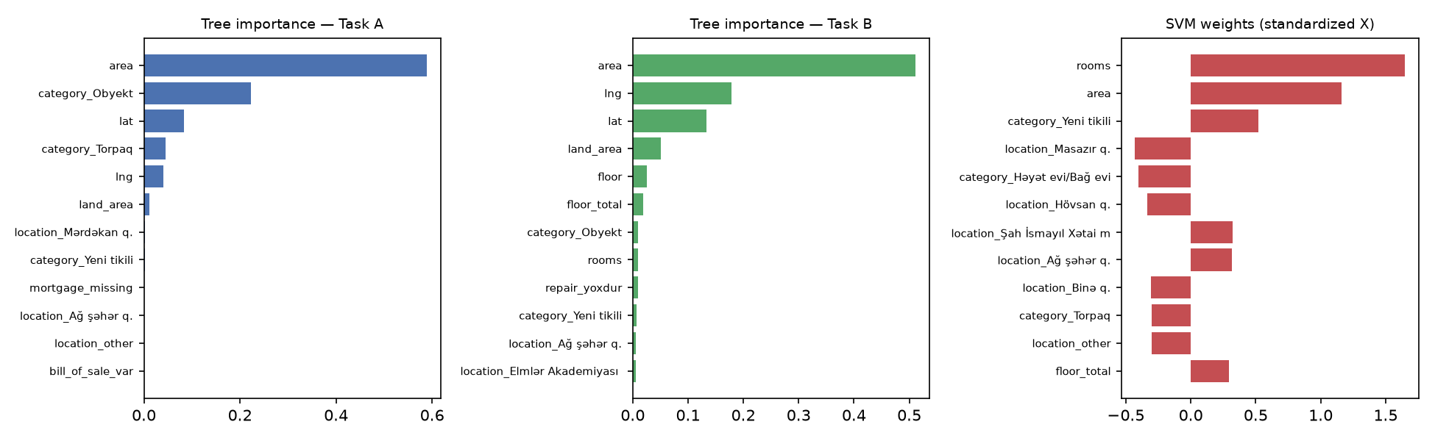
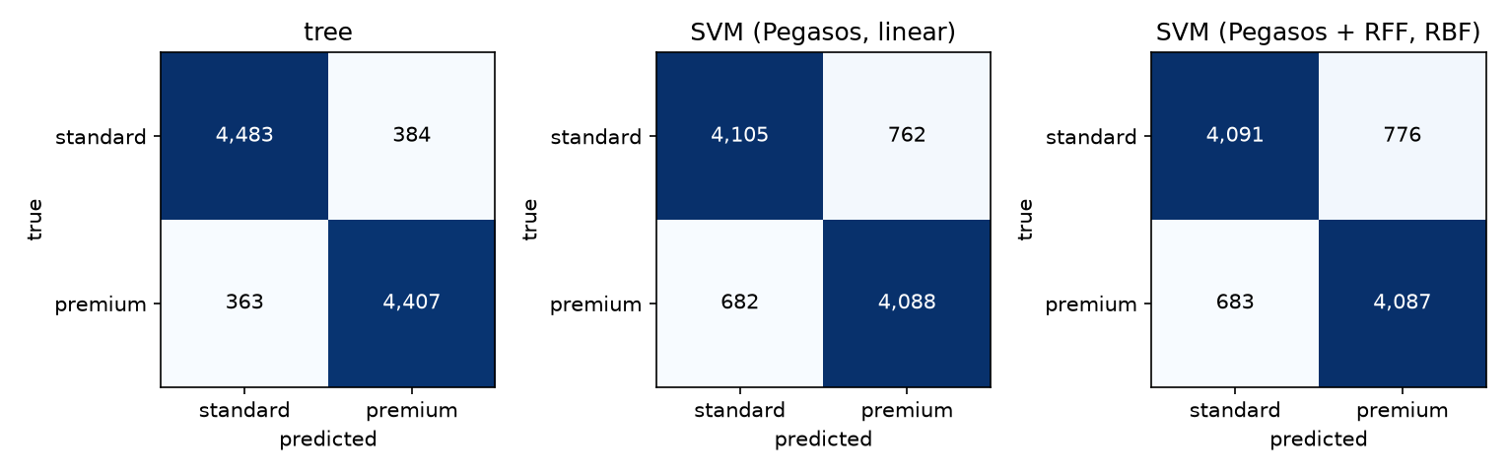
08 Model Behavior & Error Analysis
Size, location and property category are important predictive features.
Price extremes and less-represented property categories remain difficult.
Near-threshold premium/standard listings are harder to classify.
MLE-AI-201 | ML Final Project
9

Slide 10
09 Limitations & Next Steps
Listing prices are asking prices, not verified transaction values.
Rare locations and property types can be underrepresented.
Large price outliers inflate RMSE; tree predictions are not perfect.
RBF SVC baseline uses a smaller training subset.
Next: category-specific models, richer location features and ensembles.
Team contributions: [Member 1] • [Member 2] • [Member 3] • [Member 4]
MLE-AI-201 | ML Final Project
10

Slide 11
10 Conclusions & Discussion
From-scratch Decision Tree closely reproduces sklearn regression performance.
Classification: our tree achieves F1 = 0.9219 on held-out data.
Linear Pegasos reaches F1 = 0.8499 and ROC-AUC = 0.9310.
RFF adds a small ROC-AUC improvement, not an F1 improvement.
Model choice depends on the evaluation metric and deployment objective.
THANK YOU • QUESTIONS?
MLE-AI-201 | ML Final Project
11

