Slide 1
Property Price Prediction & Price-Tier Classification
From-scratch Decision Trees and Pegasos SVM | MLE-AI-201
Azerbaijan real-estate listings
100,773 cleaned records · 7 categories
Team members: Joshgun Malikov, Huseynali Mehdiyev, Araz Velishov, Elsef Bagirov
01

Slide 2
Problem & Dataset
Two supervised learning tasks for each property category
REGRESSION
Predict listing price (AZN)
CLASSIFICATION
Premium vs. standard using the category training-price median
57,895 new-build · 18,099 older apartments · 15,571 houses
4,919 land · 4,046 commercial · 154 offices · 89 garages
02

Slide 3
Preprocessing & Leakage Controls
100,775 raw rows → 100,773 after removing two extreme-price listings
• Separate models and evaluation for each category
• Encode categorical fields; impute missing numerical values
• Standardize numerical inputs for SVM
• Exclude identifiers and price-derived predictors
• Group known listing item IDs across train / validation / test
Approx. 70% train · 15% validation · 15% held-out test
03

Slide 4
NumPy Decision Tree
Recursive, feature-threshold-based partitioning
Regression: minimize squared error; predict leaf mean
Classification: minimize Gini impurity; predict leaf class
Max depth: 20 | Min split: 20 | Min leaf: 2 | Seed: 42
Implemented from scratch and compared with scikit-learn baselines.
04

Slide 5
NumPy Pegasos SVM
Linear margin classifier optimized by stochastic subgradient steps
Objective: λ/2 ||w||² + mean(max(0, 1 − y(w·x + b)))
Pegasos: λ = 0.001, 300,000 iterations
LinearSVC baseline: C = 0.1, squared hinge, max_iter = 50,000
No kernelized SVM was implemented.
05

Slide 6
Experimental Design
Validation selects configurations; held-out test is evaluated once
Regression metrics: MAE, RMSE, median absolute error, R²
Classification metrics: accuracy, precision, recall, F1, ROC-AUC
Final Decision Tree evaluation refits on train + validation.
Scores are from one split, not cross-validation averages.
06

Slide 7
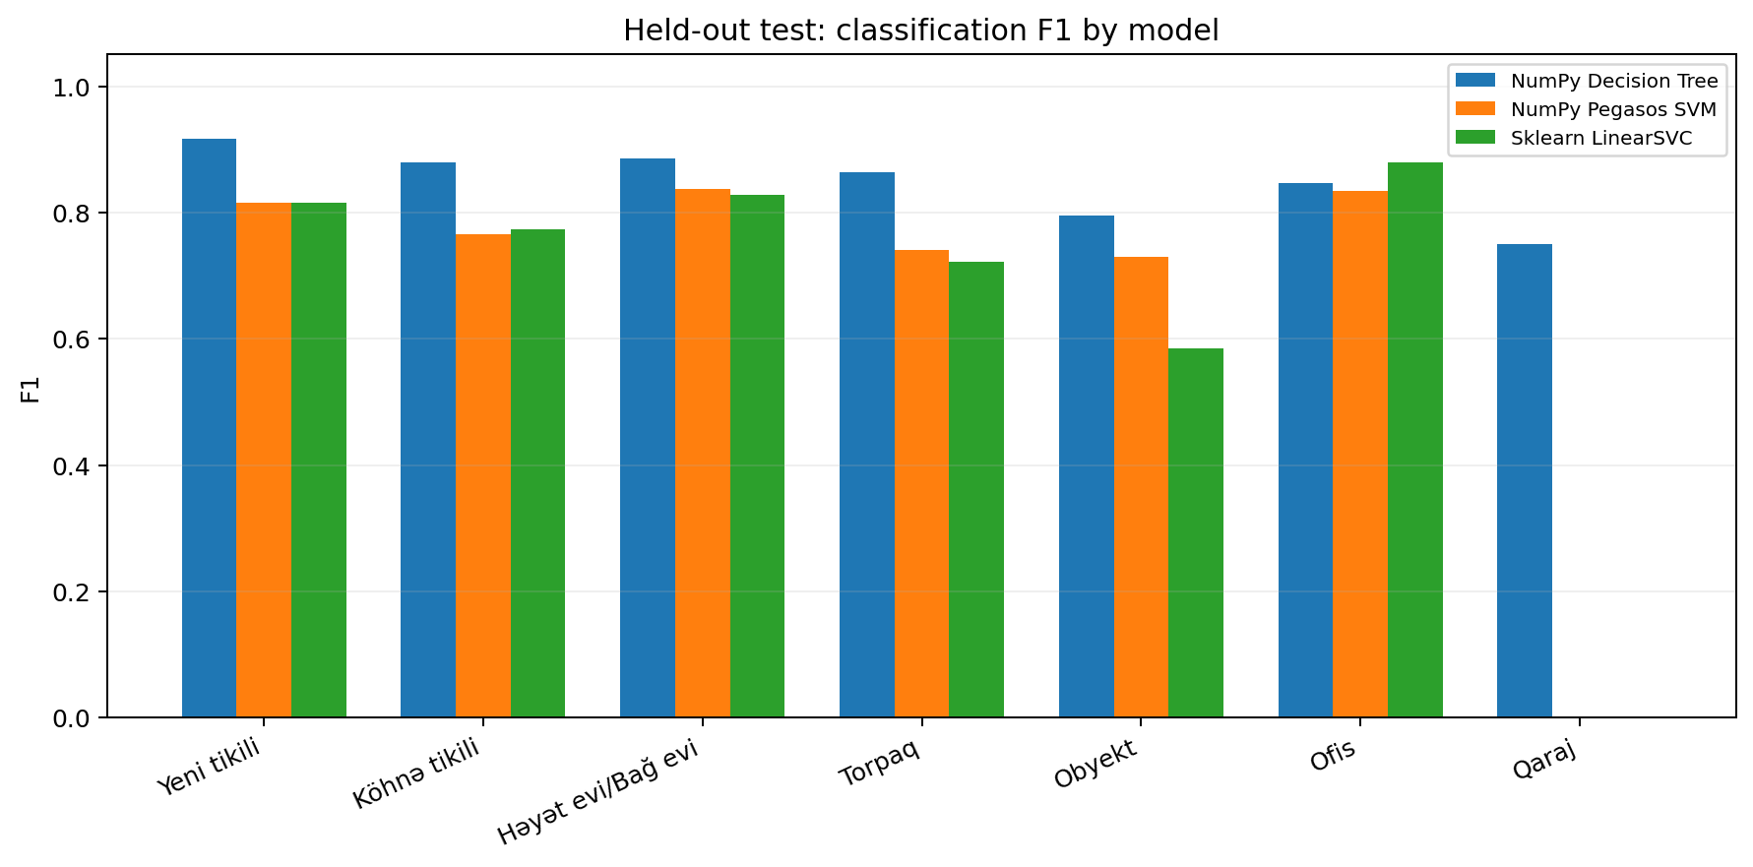
Validation: Classification Comparison
F1 scores across Decision Tree, Pegasos and LinearSVC
07

Slide 8
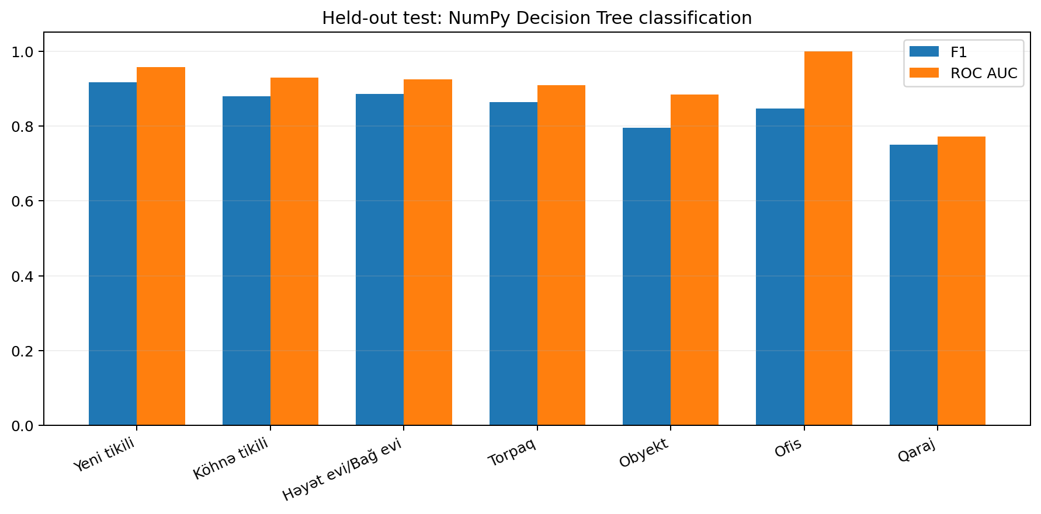
Held-Out Test: Decision Tree
Strongest classification F1: new-build apartments (0.916)
New-build: MAE 38,428 AZN
R² 0.712 · F1 0.916
Older apartments: MAE 22,217 AZN
R² 0.710 · F1 0.879
08

Slide 9
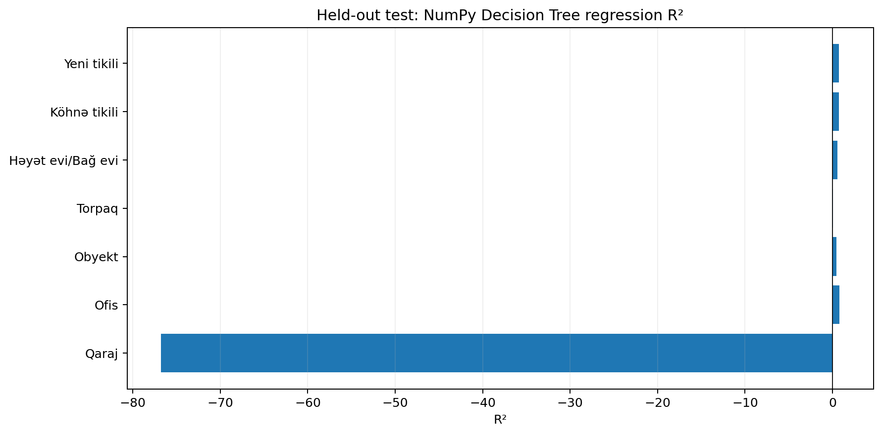
Regression Failures & Limitations
Performance differs sharply across property categories
Garage R² = −76.78
Land R² = 0.078
Small test groups: office 28, garage 12
Relisted properties may evade URL-based grouping.
09

Slide 10
Conclusions & Next Steps
Category-specific evaluation is essential
• From-scratch NumPy models and sklearn comparisons completed
• Apartment categories show stronger generalization
• Land, commercial and small-sample groups remain challenging
• Future: richer features, robust grouping and uncertainty analysis
10

