Slide 1
FOR DOMINIC
Gamma & the Greeks
How dealer hedging moves price, and how to trade the Greeks.
Retail cash account · SPY snapshot 16 Oct 2026
IN THIS BRIEFING
01
02
03
04
The hedge
The flip
Walls and risk
The Greeks
Educational briefing. Not a recommendation to trade.

Slide 2
01 DEALER HEDGING
Dealers hedge with the underlying
They trade shares against options they have sold. That flow is a push on price.
01
02
03
04
SOLD
DELTA MOVES
HEDGE
PRICE IMPACT
Customers buy the option.
The dealer is short it.
Spot changes.
Delta changes with it.
They buy or sell shares
to get flat again.
Those shares hit the tape
and move the price.
GAMMA DECIDES WHICH WAY THAT HEDGE FACES
LONG GAMMA
SHORT GAMMA
Above the flip
Below the flip
Buy dips, sell rips.
Price ranges and pins.
Sell drops, buy rips.
Moves accelerate and trend.
GAMMA & THE GREEKS
Educational briefing
02 / 16

Slide 3
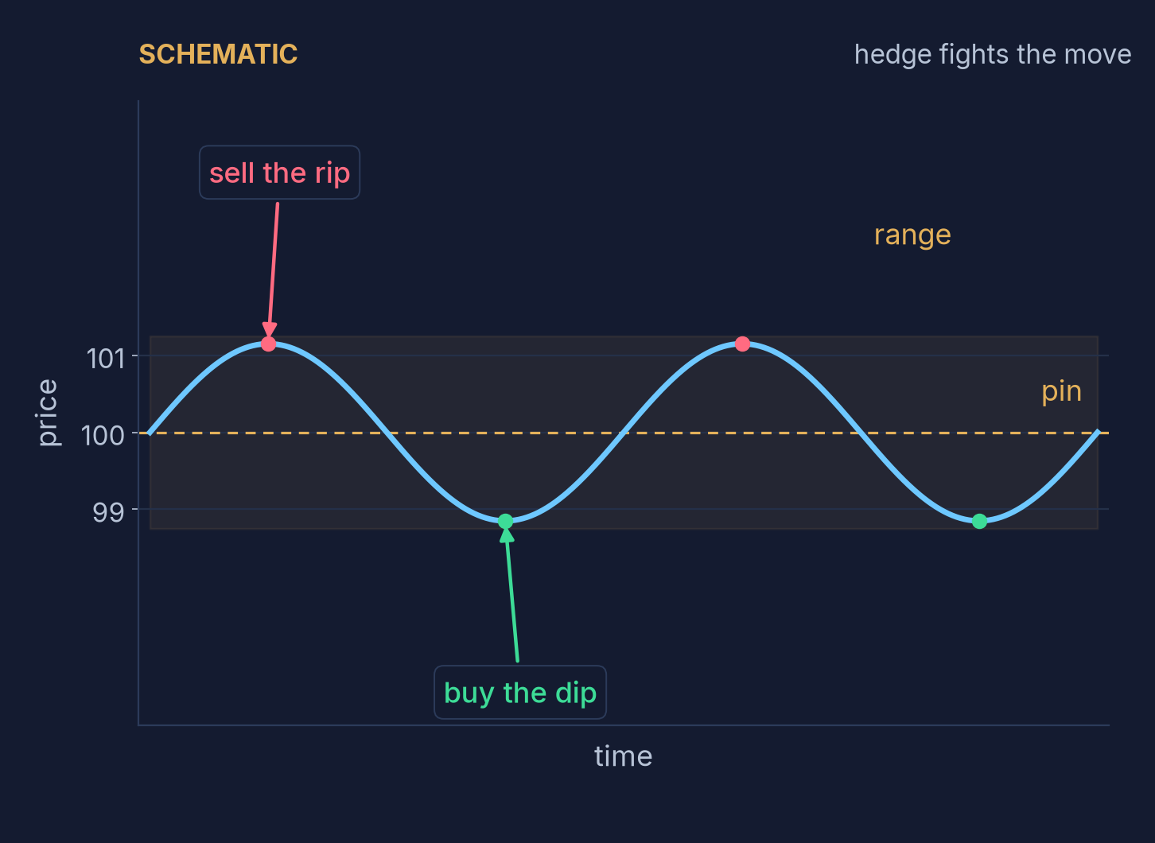
02 POSITIVE GAMMA
Buy dips, sell rips
Above the flip. Dealers are long gamma, so the hedge fades the move.
ABOVE THE FLIP
Price ranges and pins
Dealers are net long options.
They buy dips and sell rips.
The hedge fights the move.
START
UP $1
DOWN $1
500
100
100
short shares
sell the rip
buy the dip
Example · long 10 calls · long puts fade too
GAMMA & THE GREEKS
Educational briefing
03 / 16

Slide 4
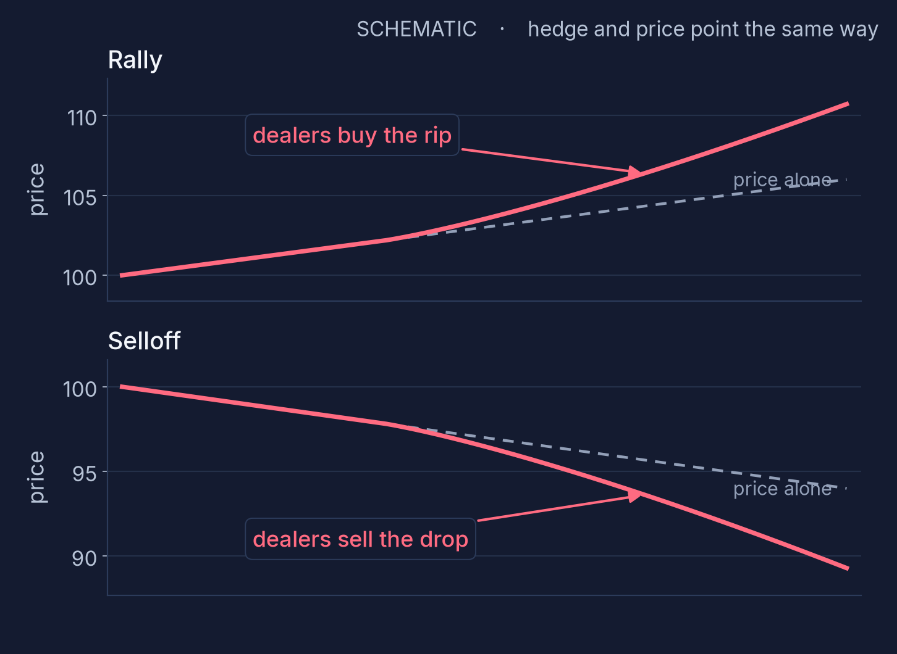
03 NEGATIVE GAMMA
Sell drops, buy rips
Below the flip. Dealers are short gamma, so the hedge chases the move.
BELOW THE FLIP
Moves accelerate
Dealers are net short options.
They sell drops and buy rips.
The hedge feeds the move.
START
UP $1
DOWN $1
500
100
100
long shares
buy the rip
sell the drop
Example · short 10 calls · short puts chase too
GAMMA & THE GREEKS
Educational briefing
04 / 16

Slide 5
04 THREE LEVELS
Flip, call wall, put wall
Three strikes that change the speed of the tape.
THE BOUNDARY
ABOVE SPOT
BELOW SPOT
Gamma flip
Call wall
Put wall
Dealer gamma changes sign here.
Above it, they fade the move.
Below it, they chase the move.
The large call-gamma strike above spot.
It can resist, or act as a magnet.
Price often slows as it gets there.
The large put-gamma strike below spot.
It is support while it holds.
Dealers are leaning against a drop.
A loss of the flip is a regime change.
A break above it can squeeze higher.
A break below it speeds up selling.
Walls slow price. They are not floors or ceilings. A break changes the speed.
GAMMA & THE GREEKS
Educational briefing
05 / 16

Slide 6
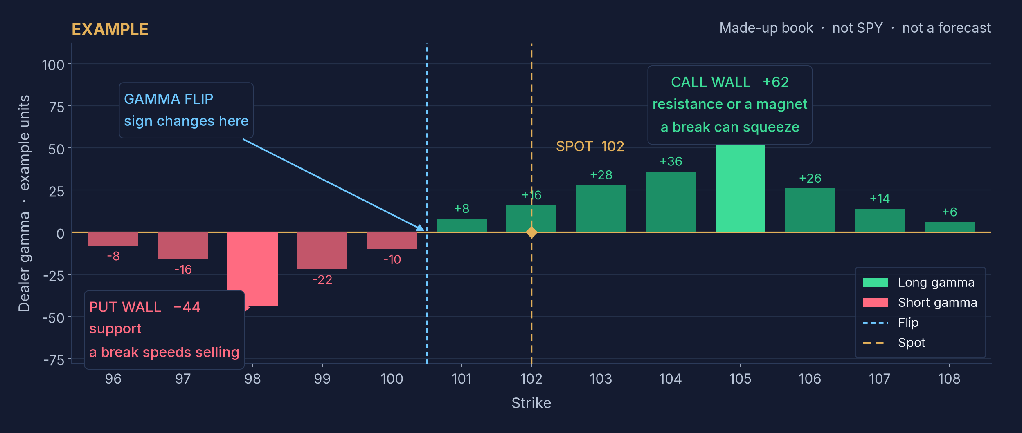
05 EXAMPLE BOOK
Gamma by strike
Illustrative numbers only, so the labels are easy to see. The SPY snapshot is next.
GAMMA & THE GREEKS
Educational briefing
06 / 16

Slide 7
06 SPY SNAPSHOT
SPY at the 16 Oct 2026 close
Real levels. Spot about 763.25, above the flip, inside a one-point pocket.
REGIME
POSITIVE GAMMA
Above the flip by $2.06.
Dealers fade. A range
is the base case.
CALL WALL 764
THE POCKET
SPOT ≈ 763.25
763 under spot, 764 over it.
Fade into the walls.
Take profit at the walls.
PUT WALL 763
GAMMA FLIP 761.19
IF IT BREAKS
NEGATIVE GAMMA
Above 764 can squeeze.
Below 763, selling speeds up.
4h close under 761.19
changes the regime.
True price scale
GAMMA & THE GREEKS
Educational briefing
07 / 16

Slide 8
07 RISK
Trade the regime you are in
Same levels. Opposite trades. The flip picks the playbook.
ABOVE THE FLIP
BELOW THE FLIP
Fade
Go with it
Fade into the walls.
Take profit at the walls.
The base case is a range.
Trade with the move.
Size down. Use wider stops.
Do not fade.
STOPS
REGIME CHANGE
4-HOUR CLOSE
Put them beyond the wall, not on it. A tag of the wall is normal. A stop sitting on it gets run.
Losing the flip ends the fade. Switch playbooks. Do not keep fading a trend.
Confirm on a 4h candle close. A wick through the level is not a break.
GAMMA & THE GREEKS
Educational briefing
08 / 16

Slide 9
08 TIMEFRAMES
Which clock you are on
The same levels do a different job on each clock.
INTRADAY
EXPIRATION WEEK
THE WEEK AFTER
OVER A MONTH
Levels matter most
Price tends to pin
Ranges expand
Regime sets size
The flip and the walls
guide the session.
Large strikes act
as magnets.
The pin releases once
expiration passes.
Above or below the flip
decides how big.
GAMMA & THE GREEKS
Educational briefing
09 / 16

Slide 10
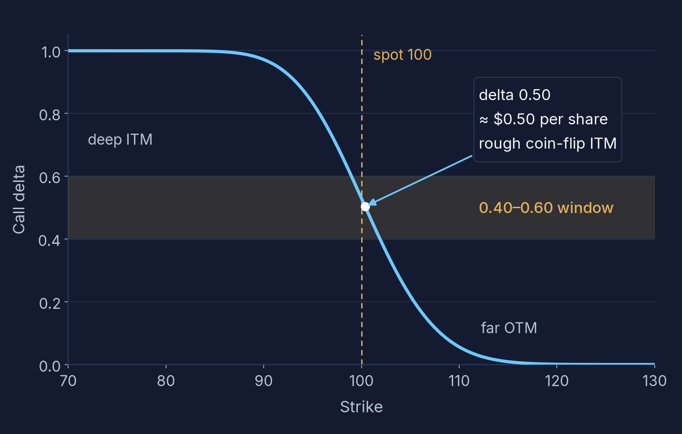
09 DELTA
The move, and the odds
Per $1 of the underlying, and a rough read on finishing in the money.
PER $1
0.40 delta ≈ $0.40 a share.
About $40 a contract,
before gamma updates.
ROUGH ODDS
Traders read |delta| as the
chance of finishing ITM.
Close to the model. Not equal.
THE WINDOW
The band is 0.40–0.60.
That is the zone for a single
when the move should be fast.
Black–Scholes call · spot 100 · IV 20% · 30 days · illustrative
GAMMA & THE GREEKS
Educational briefing
10 / 16

Slide 11
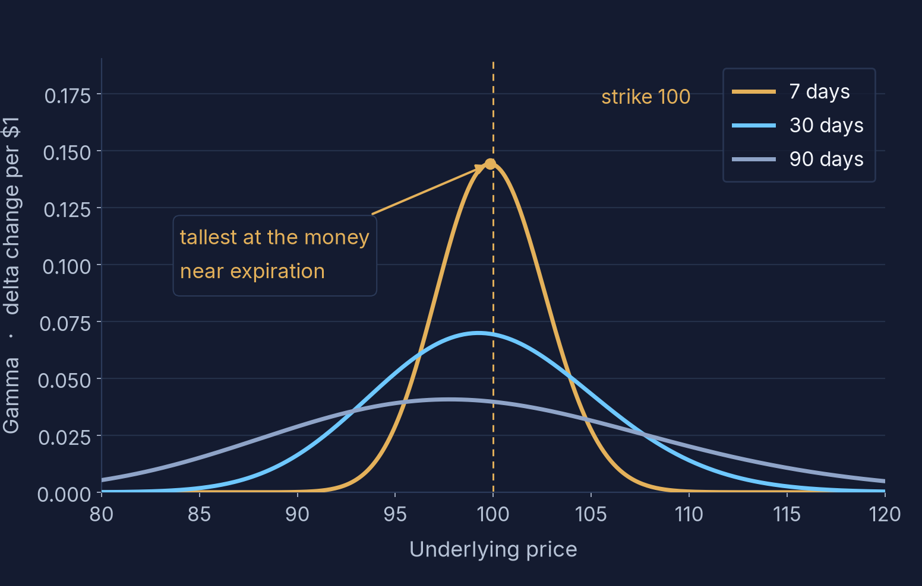
10 GAMMA
How fast delta changes
Highest at the money, and tallest when expiration is close.
PER $1
Gamma of 0.05 means delta
changes by about 0.05
if the underlying moves $1.
THREE CURVES
Same strike, three expirations.
7 days spikes.
90 days is a low hill.
YOU PAY FOR IT
Long gamma wants movement.
A quiet tape hands it back
as theta.
Black–Scholes · strike 100 · IV 20% · 7, 30, and 90 days · illustrative
GAMMA & THE GREEKS
Educational briefing
11 / 16

Slide 12
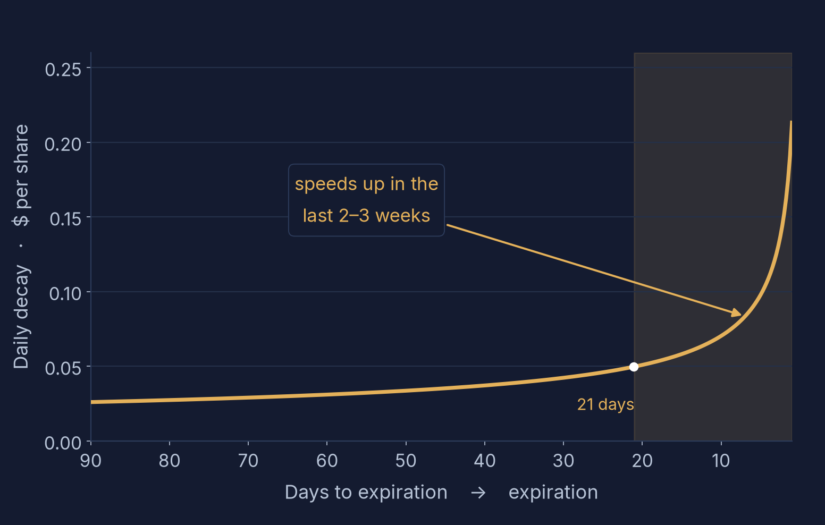
11 THETA
What a day costs
Daily decay of a long option. It speeds up in the last 2–3 weeks.
PER SHARE
The curve is the daily cost
of holding, per share.
Multiply by 100 for one lot.
THE BEND
Shading is the last 21 days.
That is where decay
gets expensive.
QUIET TAPE
Short-dated longs bleed
when price does nothing.
That is the theta bill.
ATM call · spot = strike = 100 · IV 20% · calendar-day decay · illustrative
GAMMA & THE GREEKS
Educational briefing
12 / 16

Slide 13
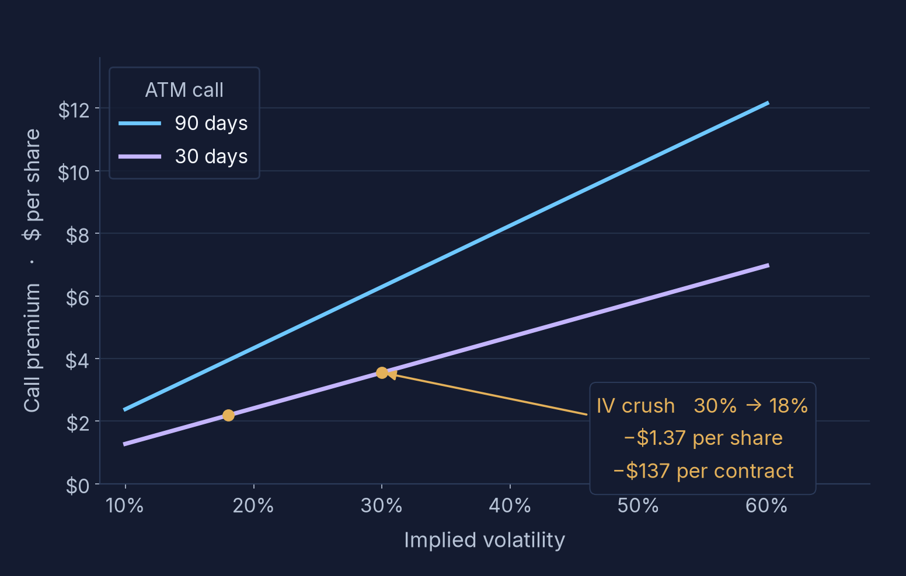
12 VEGA
What IV can take back
The slope is vega. A drop in IV is a crush — even if direction was right.
THE SLOPE
Steeper means more vega.
90-day premium moves more
than 30-day premium.
THE ARROW
30% IV to 18% on the
30-day call. Premium falls
with no move in spot.
BEFORE YOU BUY
Rich IV favors a spread.
Cheap IV can justify a single.
Check IV first.
ATM calls · spot = strike = 100 · crush marked 30% → 18% · illustrative
GAMMA & THE GREEKS
Educational briefing
13 / 16

Slide 14
13 PRACTICAL RULES
How to buy it
Cash account. The contract has to match the speed of the move and the IV.
01
Single long options
0.40–0.60 delta, for a fast move or cheap IV.
02
Debit spreads
For a slow move or rich IV. You sell the expensive wing.
03
Quiet stretches
Do not hold short-dated options when nothing is happening.
04
Check IV
Know what you are paying. Crush can give the gain back.
05
Cash account only
No margin. The most you lose is the debit you paid.
GAMMA & THE GREEKS
Educational briefing
14 / 16

Slide 15
14 CAVEATS
Context, not a trigger
Use the map. Do not let the map take the trade.
01
Estimates
Gamma numbers are a model. They shift through the day as price, time, and IV change.
02
Next to the tape
Read them with moving averages and price action. They map positioning, not a signal.
03
Never alone
If the level and the tape disagree, trust the tape. Do not trade gamma by itself.
The example book is not SPY. These levels are one close, and they move.
GAMMA & THE GREEKS
Educational briefing
15 / 16

Slide 16
15 SUMMARY
The whole map
One page. Price on the left, the contract on the right.
THE TAPE
THE CONTRACT
01
Dealers hedge sold options by trading shares.
01
Delta: the move per $1, and rough ITM odds.
02
Above the flip: buy dips, sell rips, pin.
02
Gamma peaks at the money, near expiration.
03
Below the flip: sell drops, buy rips, trend.
03
Theta speeds up in the last 2–3 weeks.
04
Call wall resists or pins. A break can squeeze.
04
Vega is IV risk. Crush can take premium back.
05
Put wall is support. A break speeds selling.
05
0.40–0.60 singles if fast or cheap IV.
06
Fade above. Go with it below. Stops past the walls.
06
Spreads if slow or rich. Check IV. Cash only.
Intraday, levels matter. Expiration week, price pins. The week after, ranges expand. Over a month, the regime sets size.
Gamma is an estimate and it moves all day. Use it with moving averages and price action — never alone.
GAMMA & THE GREEKS
Educational briefing
16 / 16

