Slide 1
Positive Gamma
Dealer Gamma
Sell rallies. Buy dips.
Gamma
Sell
Buy
Swing Trading
Price ranges and pins.
How the hedge pushes price.
Long premium, short premium, and defined-risk spreads.
The walls, the flip, and the limits of the model.
The Flip: Behavior Changes Here
Negative Gamma
Buy rallies. Sell dips.
Open Interest
Call Wall
Put Wall
The Flip
Long Gamma
Short Gamma
Spreads
Buy
Sell
October 2026
Price trends and accelerates.
Gamma Swing
01

Slide 2
Start Here
Read It as a Map
What You Get
What This Is Not
What Stays True
The dealer hedge, the flip,
and the walls.
How long gamma and short
gamma differ.
Where the model stops.
Dealers hedge with the stock.
Gamma is how fast delta changes.
A wick and a close
are different prints.
No win rate.
No backtest.
No invented track record.
Example numbers are marked.
1
2
3
4
5
Regime
Walls
Flip
Structure
The Model
Numbers that are not the October 16, 2026 SPY book are marked EXAMPLE.
Charts are Black-Scholes. The inputs are printed on the slide.
Gamma Swing
02

Slide 3
The Read
What a Gamma Read Uses
Book
Open interest by strike. That is the swing map.
Dealer Gamma
Their hedge
in the stock.
Positive: they fade.
Negative: they chase.
Spot
Where price sits against that book.
Flip
Where net gamma changes sign.
Walls
The heavy call strike above. The heavy put strike below.
Your Gamma
Long options: long gamma.
Short options: short gamma.
The two books can match,
or they can oppose.
Check
A second public source, when you have one.
Chart
Price, so a close can be told from a wick.
Gamma Swing
03

Slide 4
The Point
Gamma Shows Where the Hedge Pushes
1
2
3
4
Customers trade
options
Dealers take
the other side
Dealers hedge
with the stock
Gamma says how
hard that pushes
Dealers hedge. Gamma shows where that hedging pushes price.
The push is pressure from the hedge. It is not a promise.
A wick through a level and a close beyond it are different prints.
Your long or short gamma is a separate fact from the dealer book.
Gamma Swing
04

Slide 5
Dealers
Three Lines on Dealers
01
"Dealers hold large options positions from institutional and retail trading"
Their book is the other side of that flow. You read the net book, not one order.
02
"Dealers use the underlying stock to hedge their options positions"
They buy or sell shares against the option. That hedge is in the stock you chart.
03
"Delta tells them how many shares they need to stay neutral"
Delta is the share count. When delta changes, the count is wrong, so they trade again.
Gamma Swing
05

Slide 6
Delta
Delta Is Their Share Count
One contract stands for 100 shares.
Exposure is delta times those 100 shares.
You Are Not the Dealer
Call Delta 0.20
About 20 Shares
The dealer hedge is in the stock.
Your position is the option.
One contract is exposure to 100 shares, times delta.
That exposure is not the same as holding the shares.
Call Delta 0.50
About 50 Shares
Call Delta 0.80
About 80 Shares
A long put with delta -0.50 acts like short 50 shares. You still only own the put.
You did not borrow stock. The sign is direction. The number is size. Later you will ignore the sign on purpose.
Gamma Swing
06

Slide 7
Gamma
Gamma Is How Fast Delta Changes
Dealers re-hedge when delta changes. Gamma sets how much, and how often.
High Gamma
Low Gamma
A small move changes delta a lot.
The share hedge is rebuilt in size.
Dealers are back in the stock often.
This is the strike, near expiry.
The same move barely changes delta.
The hedge is a small update.
They can sit.
This is far from the strike, or far from expiry.
Calls and puts have the same gamma. The sign of the book is a separate question.
The next slide is the shape, from the model. The one after that is the share count.
Gamma Swing
07

Slide 8
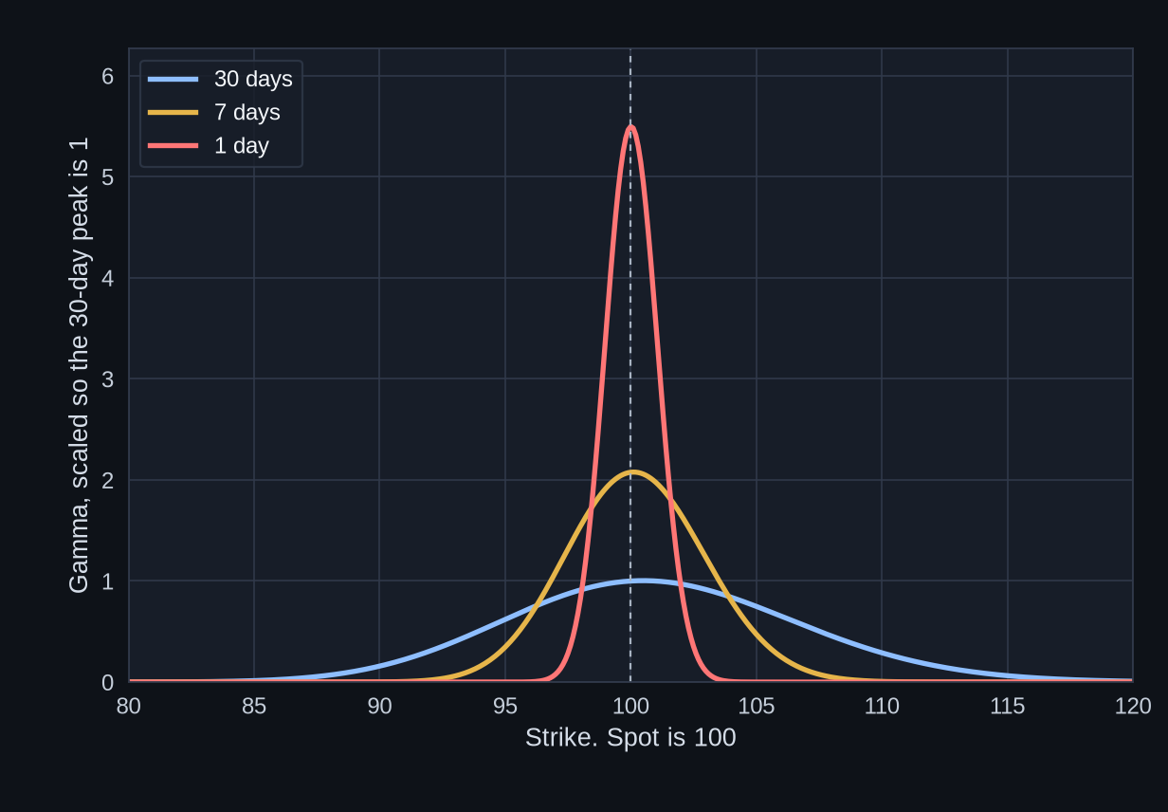
Black-Scholes
Gamma Peaks at the Strike, Near Expiry
The peak is at the money. Here, strike 100.
1-day gamma at the peak is about 5.5 times the 30-day peak.
7-day gamma at the peak is about 2.1 times the 30-day peak.
Far from the strike the line is flat. Little re-hedging.
Scaled so the 30-day peak is 1.
EXAMPLE. Black-Scholes, European, no dividend. Spot 100, IV 20%, rate 4%. Not a forecast.
Gamma Swing
08

Slide 9
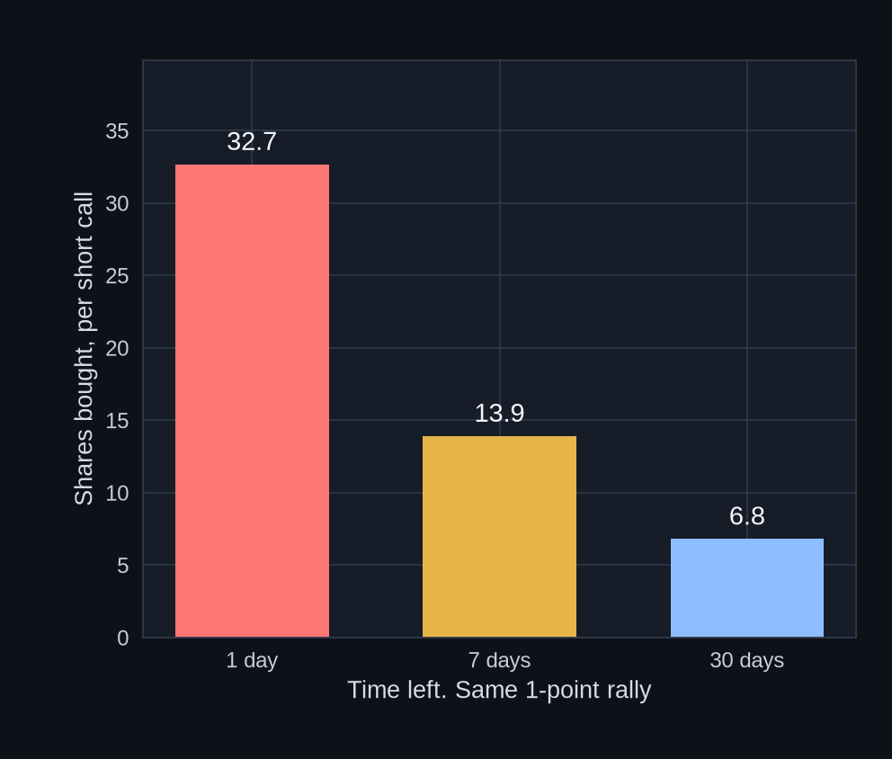
Re-Hedge
One Point of Price, Three Hedges
What the Bars Are
EXAMPLE. The dealer is short one ATM call. Strike 100.
Spot goes from 100 to 101.
The bars are the shares they must buy to get back to neutral.
32.7, 13.9, and 6.8 shares.
Flip the book. If the dealer is long that call, the same sizes are shares they sell. Same gamma. Opposite trade.
EXAMPLE. Black-Scholes, European, no dividend. IV 20%, rate 4%. Share counts match the bars. Not a forecast.
Gamma Swing
09

Slide 10
Regimes
Two Ways the Hedge Can Push
Positive Gamma
Negative Gamma
Above the flip.
Dealers sell rallies and buy dips.
Below the flip.
Dealers chase the move.
Sell
Buy
Buy
Sell
Price ranges, and it can pin.
Pin means price sticks near a heavy strike.
Price can trend, and it can accelerate.
Fades get run over.
This deck reads dealer gamma. Above the flip is positive. Below the flip is negative.
Gamma Swing
10

Slide 11
Positive Gamma
They Sell the Rally and Buy the Dip
ILLUSTRATIVE
Two Different Books
Call Wall
Rally into the call wall.
Dealers sell stock.
Price tends to range, and it can pin near a heavy strike.
A long option is long gamma. A credit spread, condor, or butterfly is short gamma.
Those structures are later slides. They are not the dealer hedge.
Price stays
in the range.
Dip into the put wall.
Dealers buy stock.
Put Wall
Gamma Swing
11

Slide 12
Negative Gamma
They Chase, So the Move Can Run
ILLUSTRATIVE
If the Move Runs
Rally. Dealers buy.
The rally gets fuel.
Call Wall
The hedge can add fuel, so a move can extend.
Long gamma gains delta as the move runs. Short gamma loses as it runs.
A naked short has that short gamma, and the loss is not capped.
A break can
run.
Put Wall
Drop. Dealers sell.
The drop gets fuel.
Gamma Swing
12

Slide 13
Example
Same Calls, Opposite Hedge
EXAMPLE. 10 contracts. Deltas are chosen so the share count is obvious. This is one call book, not every book.
Positive Book
Dealer Is Long the Calls
Negative Book
Dealer Is Short the Calls
Start. Delta +0.50.
Hedge: short 500 shares.
Later. Delta +0.60.
Hedge: short 600 shares.
They sell 100 shares
into the rally.
Start. Delta -0.50.
Hedge: long 500 shares.
Later. Delta -0.60.
Hedge: long 600 shares.
They buy 100 shares
into the rally.
Gamma Swing
13

Slide 14
The Flip
The Flip Is a Change in Behavior
Price
Not a Level to Lean On
The flip marks a change in behavior.
Support and resistance are the walls.
Above the flip
Positive gamma. Fade.
Flip: Net Gamma Changes Sign
It Can Sit on a Wall
The flip can fall between two strikes.
If it sits on a wall, that edge is the regime line and the level, together.
Below the flip
Negative gamma. Chase.
Gamma Swing
14

Slide 15
The Flip
On the Flip, the Hedge Goes Quiet
There is near-zero hedging on the flip itself.
Price often consolidates there, until it picks a side.
A tight chop on the line is not a signal. It is the wait.
On the Line
Accepts Above
Accepts Below
A close holds above the flip. Expect fade behavior. Read it as positive.
A close holds below the flip. Expect chase behavior. Read it as negative.
Little stock to buy or sell for the gamma hedge. Price often sits.
Gamma Swing
15

Slide 16
The Flip
A Wick Is Not a New Side
ILLUSTRATIVE
ILLUSTRATIVE
Flip
Wick through.
Close back on
the old side.
Flip
The close is through
the flip. It still
has to hold.
Still the Old Regime.
Possible New Side.
A wick through the line is not a held close. A close through still has to hold on a later bar.
If later candles hold on the new side, the regime may have changed. Read the book again.
Gamma Swing
16

Slide 17
Levels
The Walls Are Support and Resistance
ILLUSTRATIVE
How to Use Them
115 Call Wall Resistance
Call wall: the heavy call strike above. Often resistance.
Put wall: the heavy put strike below. Often support.
They are open-interest levels.
The flip is drawn here so it is not read as a third wall.
The dealer regime says how the hedge behaves at the level.
108 Flip Behavior, Not a Wall
100 Spot
90 Put Wall Support
Gamma Swing
17

Slide 18
Levels
The Hedge at a Wall Depends on the Regime
Positive Gamma at a Wall
Negative Gamma at a Wall
Once price goes through, the hedge can chase.
A wick through the wall is not a held close.
A close that stays outside is a move the hedge may fuel.
The wall does not stop being a strike just because price tagged it.
The hedge leans back into the range.
A tag of the wall and a close back inside are the same side of the flip.
A close that holds outside can be a different regime.
The wall is still just the heavy strike.
Gamma Swing
18

Slide 19
Levels
Walls Move. Big Expiries Reset Them
The Wall Is This Book
OPEX
Open interest is what
builds the wall.
When that expiry passes,
those contracts are gone.
The monthly expiry is
the big reset.
SPY also expires through
the week. After a large
one, rebuild the map
before you trust the
old levels.
Earlier
Call Wall
Open Interest Shifts
Later
New Call Wall
Read them again.
Yesterday's line can be dead.
Gamma Swing
19

Slide 20
Textbook Only
Charm and Vanna, in One Pass
Charm
Vanna
The change in delta as time
passes, with price and IV
held still.
Also called delta decay.
A hedge can drift on a flat
day because the clock moved.
The change in delta when IV
changes, with price held still.
It is also the change in vega
when price changes.
A hedge can shift on a
volatility move, even if the
stock has not.
Textbook definitions. This deck does not trade charm or vanna.
You trade gamma, the walls, and the close. These two only explain a hedge that moves on a quiet tape.
Gamma Swing
20

Slide 21
Unusual Whales
Four Rules on the Gamma Page
01
02
Heatmap Colors Are Net Gamma.
By-Strike Draws Two Lines.
Not put gamma. Not call gamma by itself. The combined number.
The call wall, and spot. It does not draw the put wall. It does not draw the flip.
03
04
You Find the Put Wall.
You Find the Flip.
It is the longest purple bar below spot.
It is where the heatmap color changes. Not a printed line.
Open interest is the swing. Directionalized Volume is the day. The next drawings are schematics.
They are marked ILLUSTRATIVE. They are not screenshots, and the heatmap colors are stand-ins.
Gamma Swing
21

Slide 22
Heatmap
The Color Is Net Gamma
ILLUSTRATIVE
Stand-in colors. Not the Unusual Whales palette.
0DTE
+2d
+7d
+14d
Month
+2mo
Read It This Way
800
+
+
+
+
+
+
790
+
+
+
+
+
+
780
+
+
+
+
+
+
Plus cells: positive net gamma.
Minus cells: negative net gamma.
The sign is the lesson. The shade is not live data.
On the real page, match the color to the legend. Do not memorize a hue.
770
+
+
+
+
+
+
Flip = Where the Color Changes
760
-
-
-
-
-
-
750
-
-
-
-
-
-
740
-
-
-
-
-
-
730
-
-
-
-
-
-
Gamma Swing
22

Slide 23
By Strike
This Chart Does Not Draw Every Level
ILLUSTRATIVE
Drawn for You
790
Spot, and the call wall. Those two lines are on the chart.
785
780
You Mark the Put Wall
775
Call Wall
Longest purple bar below spot. Here that is 760. It is not drawn as a line.
770
765
Ignore the Trap
Spot
The long bar at 780 is above spot. Longest bar on the wrong side is not the put wall.
760
755
Flip Is Not Here
750
Do not look for it on this chart. The color change is on the heatmap.
745
Gamma Swing
23

Slide 24
Two Clocks
Open Interest Is the Swing. Volume Is the Day
Open Interest
Directionalized Volume
Contracts that are still open.
This is the book already on.
It builds the walls and
the flip.
Use it for swing levels
and for the regime.
What traded in the session,
with a direction on the flow.
This is the intraday view.
It does not set the swing
wall, and it does not set
the monthly regime.
A midday push on Directionalized Volume does not move the open-interest wall.
Gamma Swing
24

Slide 25
Check
Check the Three Levels in Public
Write These Down
If the Second Source Disagrees
The same story, not the same pixel.
Same expiry?
Open interest, not today's volume?
Dealer gamma, or the customer sign? Customer gamma flips the colors.
If they still disagree, the level is not confirmed. The sign convention is a common cause.
1
Put Wall
Support. From open interest.
2
Call Wall
Resistance. From open interest.
3
Flip
Where net gamma changes sign.
Gamma Swing
25

Slide 26
Time
The Month and the Day Are Two Books
Today's Open Interest
The Longer Book
The nearby book.
Spot above the flip:
dealer gamma is positive.
They tend to fade.
Spot below the flip:
dealer gamma is negative.
They can chase.
Further expiries carry their own walls.
A positive longer book is a pinning backdrop.
A negative longer book is a backdrop where breaks can run.
It does not replace today's strikes.
If today and the longer book disagree, they are two facts.
Do not average them into a new price.
Today's open interest is the nearby hedge. The longer book is the backdrop.
Gamma Swing
26

Slide 27
Time
Where Each Clock Sits
1
0DTE
Separate Books
The one-day gamma spike. Not the swing open interest.
Each expiry is its own book.
The 0DTE column on a heatmap is today's gamma, not the monthly wall.
A price chart shows whether a close held beyond a level. The level still comes from open interest.
2
Weekly Book
The near walls and the near flip.
3
Monthly Book
The larger strikes, and the longer regime.
4
The Chart
Where a close is visible against those levels.
Gamma Swing
27

Slide 28
Price and Gamma
Trade the Range and the Walls Together
ILLUSTRATIVE
ILLUSTRATIVE
They Line Up
They Do Not
Call Wall
= Box Top
Walls Outside
4h Box Is
Only the Middle
Put Wall
= Box Bottom
It works best when they line up. Then the gamma levels and the chart levels are the same prices.
When they are not, you have two stories. Do not average them into a new price.
Gamma Swing
28

Slide 29
Price and Gamma
If the Maps Disagree, Wait
Box Inside the Walls
The edges of the box are price action only. Do not call them walls. The walls are still outside.
Through a Wall, No Close
Price has poked a wall and the 4h has not closed out. Wait for that close. A wick is not a side.
Wall Inside the Box
The wall is the level. The rest of the box is range. Do not split the difference and invent a third price.
Gamma Swing
29

Slide 30
October 16, 2026
The SPY Book from That Close
Put Wall
Call Wall
Flip
Spot
760
775
about 774.5
about 763.2
Support. Bottom of the box.
Resistance. Top of the box.
Behavior change. On the ceiling.
Under the flip. Inside the walls.
Regime: negative gamma. Spot is under the flip. Most of 760 to 775 is under it too.
These are the open-interest levels from the October 16, 2026 SPY close, as used for this example.
775 minus 760 is 15 points. On spot about 763, that box is about 2% wide.
Gamma Swing
30

Slide 31
October 16, 2026
The 4h Range Was the Walls
Top of the Box, Opened Up
775
Flip
775 Call Wall
774.5
Half a point apart. Linear scale.
4h Range
760 to 775
What the Picture Says
The box and the walls
are the same prices.
The flip is glued to
the call wall.
Almost the whole box
is negative gamma.
763.2 Spot
760 Put Wall
Gamma Swing
31

Slide 32
October 16, 2026
What That Book Was Saying
Close Through 760
Poke, Then Back In
Holds Above 775
Still under the flip.
Negative gamma stands.
The downside hedge
can add fuel.
The close is inside
the box.
The outside print
did not hold.
Spot crossed the flip
and the call wall.
The regime may
have changed.
Inside 760 to 775, spot was under the flip, so most of the box was negative gamma.
The flip was about 774.5, half a point under the call wall. A hold above 775 is a cross of both.
That is a new read of the book. The old sign does not carry across the flip by itself.
Gamma Swing
32

Slide 33
Structures
Buying and Selling in Positive Gamma
Long Premium
Credit Spreads
A credit spread sells premium, and the loss is capped.
A call credit spread sits above a call wall.
A put credit spread sits below a put wall.
Max loss is the width minus the credit.
The short strike is where that loss starts.
The position is short gamma.
A long call or a long put is long gamma.
Delta moves with the price.
Theta is the cost, every day.
A debit spread is the same idea with less gamma, less vega, and a capped gain.
Max loss on both is the debit.
Gamma Swing
33

Slide 34
Structures
Condors and Butterflies Around the Walls
Iron Condor
Butterfly
What They Share
A short put spread below the put wall, and a short call spread above the call wall.
Profit if price finishes between the short strikes.
The loss is defined. It is larger than the credit.
Both are short gamma next to a long option.
A quiet range is the gain.
A move through a wing is the loss.
The wings are the defined-risk lines.
Long one wing, short two at the body, long the other wing.
Profit if price finishes near the body.
The body is often a heavy strike, where a pin is possible.
Gamma Swing
34

Slide 35
Structures
Buying and Selling in Negative Gamma
Long Options and Debit Spreads
Short Premium
Negative dealer gamma means the hedge can chase a move.
A long option is long gamma, so its delta grows with the run.
A debit spread does the same with less gamma and a capped gain.
Theta is still paid.
A credit spread, condor, or butterfly is short gamma.
The chase is the loss, up to the defined wing.
A naked short has the same short gamma and no wing.
The credit is the most that position can make.
Dealer gamma describes their hedge. These structures are ways to be long or short gamma yourself. They can match the dealer book, or oppose it.
Gamma Swing
35

Slide 36
Your Book
Long Gamma and Short Gamma
Long Gamma
Short Gamma
Long calls and long puts.
As price moves, delta increases in that direction.
A further move can add to the gain.
Theta is the cost.
A debit spread is long gamma in a smaller size. The short leg cuts the gamma and caps the gain.
Short calls, short puts, credit spreads, condors, and butterflies.
As price moves, delta increases against the position.
A quiet underlying is when theta is collected.
A large move is when the loss shows up.
Defined-risk shorts stop at the long strike. Naked shorts do not.
This is your position. Dealer gamma is their hedge. You can be long gamma while dealers are short, or the other way around.
Gamma Swing
36

Slide 37
Breaks
A Poke Is Not a Break
ILLUSTRATIVE
ILLUSTRATIVE
Comes Back
Holds
Range
Range
Pushes out.
Closes back in.
Next bar stays in.
Closes out.
The next close
stays out.
The Close Came Back In.
A Later Close Held Outside.
A wick, or one close outside, is not the same as a close that stays outside. If price closes back inside, the outside close did not hold.
Gamma Swing
37

Slide 38
Breaks
When a Close Holds, the Book Can Change
1
2
3
4
Close Outside
It Holds
The Book Can Change
Read It Again
A candle finishes outside the old range.
A later candle is still closed outside. It did not come back in.
Spot may have crossed the flip. The walls may be the same, or not.
New open interest. New flip. New spot. The old map was the old book.
A close back inside means the outside close did not hold.
If the close also crosses the flip, the dealer hedge may have changed sign. That is a new read of the book, not a label carried over from the old one.
The walls are still the open-interest strikes. They move when the book moves.
Gamma Swing
38

Slide 39
Squeeze
A Gamma Squeeze Is the Hedge Feeding Itself
Calls, and a Rising Price
Puts, and a Falling Price
Dealers who are short calls are short gamma.
Price rises. Call delta rises. They buy stock to get back to neutral.
That buying can push price higher, which raises delta again.
The loop is strongest near the strike, and near expiry, where gamma peaks.
It is a feedback story. It is not a schedule, and it does not have to finish.
The other direction is the same gamma.
Dealers who are short puts, and a falling price, sell stock to hedge.
That selling can push price lower.
The upside version is the one called a squeeze.
Both are negative-gamma hedging.
Neither one is a measured share count. The chart of gamma shows where the sensitivity is highest.
Gamma Swing
39

Slide 40
Volatility
VIX Is the Price of Index Volatility
What VIX Is
High IV and Low IV
VIX is the market's price for 30-day S&P 500 volatility.
It is implied volatility. It is not a print of what the index will do.
A higher VIX means richer option premiums.
The same delta then hedges with more sensitivity to volatility.
A lower VIX means cheaper premiums.
The gamma shape still peaks at the strike. VIX scales the premium.
When implied volatility is high, a long option costs more, and a credit collected is larger.
When implied volatility is low, the long option is cheaper, and the credit is smaller.
IV can rise or fall with price held still. That sensitivity is vega.
A fast drop in IV is crush. The crush chart is that drop, including a case where the stock rose and the call still fell.
Gamma Swing
40

Slide 41
Markets
A Single Stock and an Index Are Different Books
A Single Stock
An Index
Open interest can sit in size at a few strikes.
The wall is sharper. The stock can gap through it.
A trading halt is possible.
The dealer hedge is in that one name.
News and earnings land on the name itself.
The gamma peak near expiry is the same shape. The book behind it is thinner.
The book is deeper. The hedge is spread across many names.
Walls are usually wider, and less abrupt, than a single-name wall.
SPX, SPY, and the futures are related. They are not the same open interest.
A name can move while the index does not, and the reverse.
The October 16 example in this deck is SPY.
Gamma Swing
41

Slide 42
The Model
What GEX Does Not Know
A Model, Not a Tape
The Sign Is Assumed
GEX estimates a dealer hedge from open interest. It is not the shares already bought or sold.
The model assigns options to dealers or to customers. Swap that assumption and the colors flip.
OI Is Not the Session
It Leaves Things Out
It does not show the hedge already on, futures versus stock, or inventory you cannot see. A level is pressure, not a promise.
Open interest is the open book. Volume can be opening or closing. The swing map and the day are different.
Gamma Swing
42

Slide 43
Structures
A Naked Short Has No Cap
Short Call
Short Put
The loss has no cap. The stock can rise without a limit.
Assignment turns the short call into short stock, or into the cash to buy the shares.
The credit is the most the position can make.
Margin is required. The broker can close the position.
The loss grows as the stock falls.
Near zero, the loss is about the strike times 100, minus the credit.
Assignment turns the short put into long stock.
Same facts: the loss is not capped on the way down, margin is required, and the broker can close it.
A long option at a further strike caps that short. The cap is a spread. Without the long leg, the short is naked. American options can be assigned before expiry.
Gamma Swing
43

Slide 44
Structures
The Side Is the View. The Structure Is the Risk
Upside
Downside
A long call, or a call debit spread, is long gamma to the upside.
A call credit spread, or a short call, is short gamma to the upside.
The first pays a debit. The second collects a credit.
Only the spread, or a covered short, has a defined loss.
A long put, or a put debit spread, is long gamma to the downside.
A put credit spread, or a short put, is short gamma to the downside.
Same split: debit or credit.
A naked short put is not capped until the stock is near zero.
Gamma Swing
44

Slide 45
Structures
Five Ways the Same View Is Held
Long Option
Long gamma. Debit. Loss capped at the debit. Gain is open.
Debit Spread
Long gamma, smaller. Debit. Loss capped. Gain capped at the short strike.
Credit Spread
Short gamma. Credit. Gain capped at the credit. Loss capped at the width.
Condor or Butterfly
Short gamma around the walls or a strike. Gain if price sits. Loss defined at the wings.
Naked Short
Short gamma. Credit. Gain capped. Loss is not capped. Margin is required.
Gamma Swing
45

Slide 46
Structures
What a Single Long Option Is
Long gamma
Delta increases as price moves in favor of the option.
The debit
The most the long option can lose is the premium paid.
Theta and vega
Time decay is paid every day. A drop in IV can cut the price even if the stock rises.
One contract is 100 shares of exposure, times delta. The shares are the exposure figure. They are not a stock position.
Gamma Swing
46

Slide 47
Structures
What a Vertical Spread Is
Same expiry. One long strike.
One short strike, further out.
The Short Leg
It is covered by the long leg of the same expiry.
American options can be assigned early on that short leg.
The long leg is what makes the loss defined.
Without it, the short is naked.
Long the nearer
strike.
Short the further
strike.
Debit spread: the long strike costs more. Max loss is the debit. Past the short strike the gain stops.
Credit spread: the short strike brings in more. Max gain is the credit. Max loss is the width minus the credit.
Call spread for the upside. Put spread for the downside.
Gamma Swing
47

Slide 48
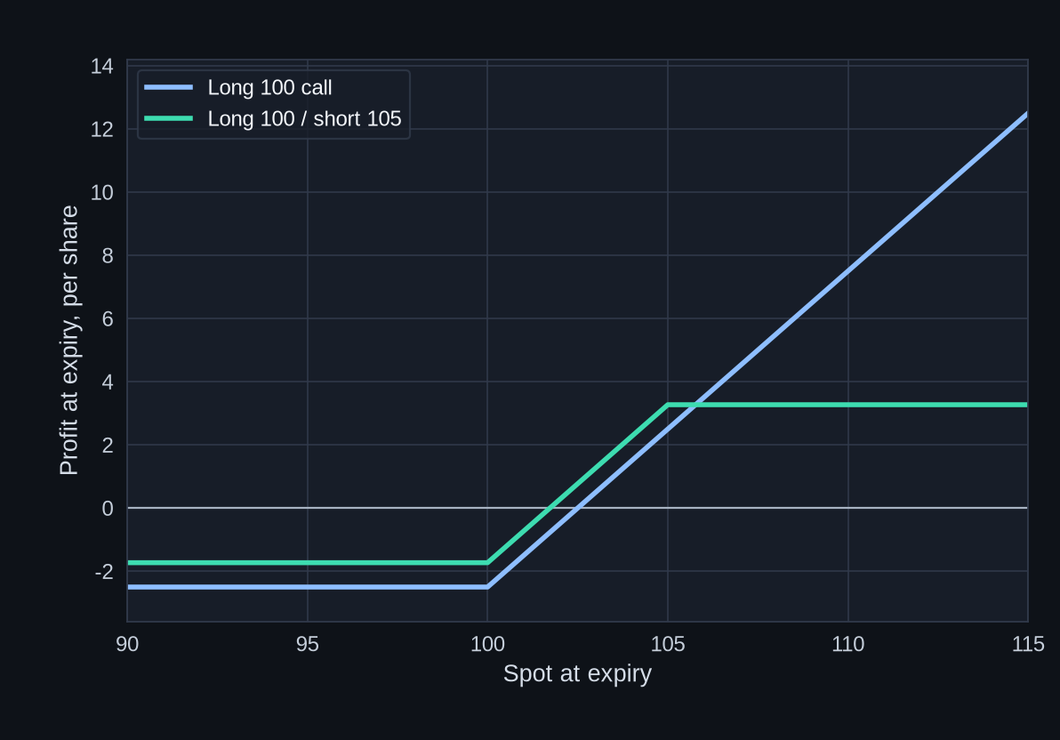
Example
Payoff at Expiry, Single Versus Spread
The Example Debits
21 days. IV 25%.
Spot 100. Rate 4%.
No dividend.
Long 100 call: 2.51
100/105 spread: 1.74
Spread max gain:
3.26 per share.
About 326 dollars
a contract.
EXAMPLE. Black-Scholes prices, then the expiry payoff of those debits. Per share. A contract is times 100. Not a forecast.
Gamma Swing
48

Slide 49
Example
What Rich IV Does to the Price
EXAMPLE. Same 21-day 100/105 call spread. Spot 100. Rate 4%. No dividend. Only IV changes.
IV 18%
IV 40%
ATM Call
1.84
3.94
Spread Debit
1.52
1.95
Spread Max Gain
3.48
3.05
The single call more than doubles. The spread debit rises less. Rich IV raises the single more than it raises the spread.
Gamma Swing
49

Slide 50
October 16, 2026
How a Structure Sat on That Map
A picture of the October 16 book. Not an order. IV for that session is not in the example.
Through 760, Still Negative
Through 775, Across the Flip
Spot stays under the flip.
A long put, or a put debit spread, is long gamma to the downside.
A put credit spread is short gamma under the put wall.
A naked short put has no cap if the drop continues.
That close crosses the call wall and the flip, about 774.5.
The dealer sign may have changed. Read the book again.
A long call is long gamma above there.
A call credit spread is short gamma at the wall.
A naked short call has no cap if the rise continues.
Gamma Swing
50

Slide 51
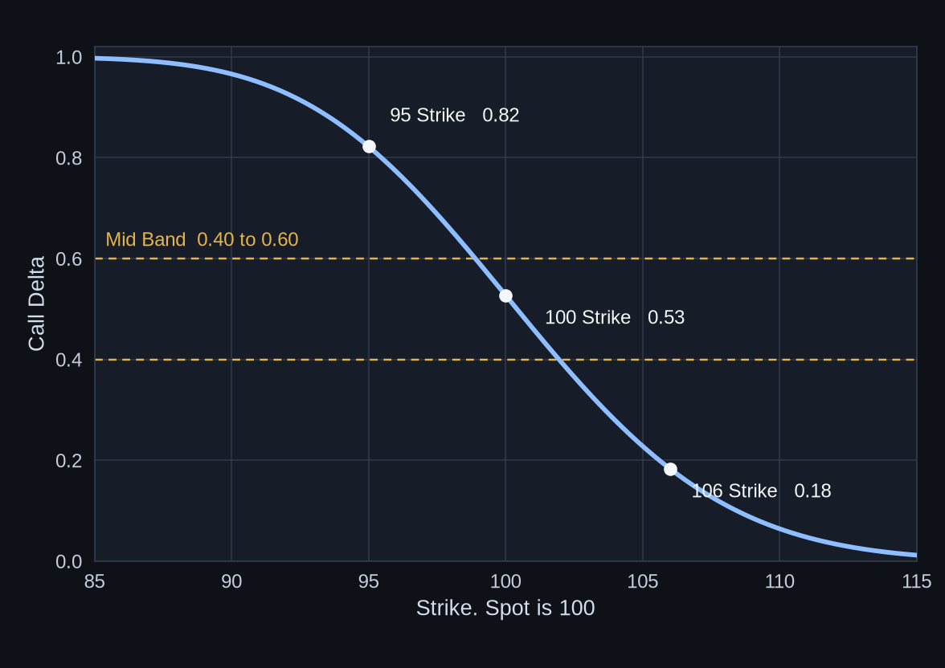
Delta
High Delta, Mid Delta, Low Delta
High 0.82 Strike 95
Costs more. Moves like the stock.
About 5.81 a share. About 82 shares of exposure.
Mid 0.53 Strike 100
0.40 to 0.60. Reacts fast.
About 2.51 a share. About 53 shares of exposure.
Low 0.18 Strike 106
Cheap. Needs a big move. Often expires worthless.
About 0.58 a share. About 18 shares of exposure.
EXAMPLE. 21 days, IV 25%, spot 100, rate 4%, no dividend. Exposure is delta times 100 shares, on a small move. That figure is not a share position.
Gamma Swing
51

Slide 52
Delta
Delta, Ignoring the Sign
Delta (ignoring the sign) is roughly the chance the option finishes in the money.
Call Delta +0.45
Put Delta -0.45
Ignore the plus.
Read it as about a 45 percent chance.
Ignore the minus.
Same read. About 45 percent.
Rough guide. Closer on short-dated options.
In the model, the chance of finishing in the money is a nearby number, not this one.
Use it to plan. Do not treat it as exact.
Gamma Swing
52

Slide 53
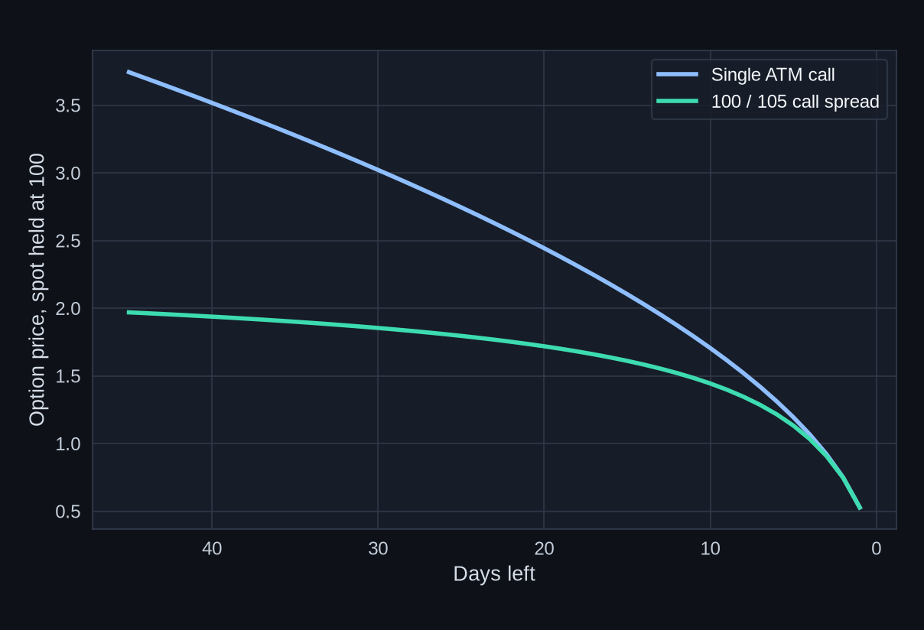
Theta
Theta Is Decay
What the Curves Say
Spot held at 100.
IV 25%. EXAMPLE.
Single call, 45 days
to 1 day: 3.74
to 0.53.
100/105 spread:
1.97 to
0.53.
The single gives up
more dollars. The curve
steepens into expiry.
With a day left, the 105
call is nearly worthless,
so the two meet.
A long option pays theta every day it is open. A short option collects that theta.
Gamma Swing
53

Slide 54
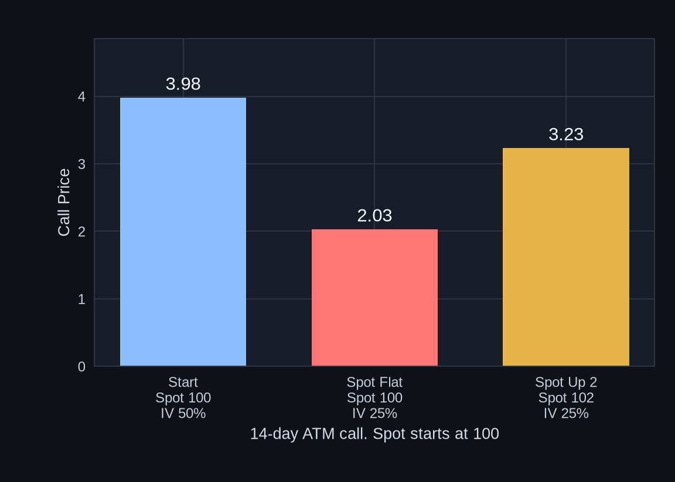
IV
IV Crush Is a Fast Drop in IV
The Three Bars
14-day ATM call.
EXAMPLE.
Start, IV 50%:
3.98
Spot stays 100,
IV falls to 25%:
2.03
Spot rises to 102,
IV falls to 25%:
3.23
The stock rose.
The call still fell.
Often after an event. The option can lose value even if the stock stays flat, or rises. Black-Scholes, rate 4%, no dividend.
Gamma Swing
54

Slide 55
Events
Earnings, and the 0DTE Book
Earnings
0DTE
IV is often bid up into the report, then it drops.
That drop is crush. The option can lose value even if the stock moves the right way.
The actual IV is on the chain. It is not assumed.
A long option carries that vega. A spread carries less of it.
This is the one-day spike on the gamma chart.
Theta is gone by the close.
The 0DTE column is that day's gamma.
It is not the weekly or monthly open interest, and it is not the swing wall.
Gamma Swing
55

Slide 56
Risk
Where the Loss Stops
Long Option
The premium paid. The contract can go to zero. It cannot go below zero.
Debit Spread
The debit. The gain stops at the distance between the strikes, minus that debit.
Credit Spread
The width of the strikes, minus the credit. The gain stops at the credit.
Naked Short
No defined stop in the option itself. A short call is open-ended. A short put runs toward the strike.
Gamma Swing
56

Slide 57
Risk
Margin and Early Assignment
Margin
Early Assignment
A long option is paid in full. The debit is the cash outlay.
A short option requires margin, because the loss may exceed the credit.
A defined-risk spread margins the width, not an open-ended move.
The broker can close a position that no longer fits the margin.
American options can be assigned before expiry.
The short leg of a spread is the one that can be assigned.
The long leg is the cover. It does not stop the assignment notice. It caps the stock position that assignment creates.
A naked short has no long leg behind it.
Gamma Swing
57

Slide 58
Flow
Flow, Dark Pool, and the Dollars
Options Flow
Dark Pool
A Print
Large stock prints near a wall are size in the stock, at that price.
Size is not the open-interest wall.
Large prints at a wall are more size than prints in the middle of the range.
Size is not the gamma map.
A print does not replace the regime, the wall, or a close.
It is a number of contracts, or of shares.
Dollar Premium. Price x Contracts x 100.
EXAMPLE. 2.00 x 500 x 100 = 100,000 dollars. 12.00 x 80 x 100 = 96,000 dollars.
Similar money. Very different if you only count contracts.
Gamma Swing
58

Slide 59
October 16, 2026
That Book, in One Pass
Levels
Put wall 760. Call wall 775. Flip about 774.5. Spot about 763.2.
Regime
Negative. Spot was under the flip. Most of 760 to 775 was too.
Range
The 4h range was 760 to 775. It matched the walls.
760
A close through 760 stayed under the flip. The downside hedge could add fuel.
775
A hold above 775 crossed the call wall and the flip. That is a new read.
Structure
Long gamma rides a run. Short gamma, including a naked short, is exposed to it.
Model
IV for that day is not in the example. GEX is a model of this book, not a tape.
Gamma Swing
59

Slide 60
Checklist
Before the Structure
Regime
Levels
Spot versus the flip, on the expiry you mean.
Put wall and call wall, from open interest.
Dealer positive: the hedge tends to fade.
The same story on a second public source.
Dealer negative: the hedge can chase.
Customer gamma and dealer gamma are opposite signs.
The Model
Structure
GEX is an estimate from open interest.
Long gamma or short gamma, for your position.
It is not the shares already hedged.
Defined loss, or a naked short with no cap.
0DTE gamma is not the swing wall.
Debit, or credit. Theta is the other side of gamma.
A wick is not a held close.
Dollar premium is price times contracts times 100.
Gamma Swing
60

Slide 61
Mistakes
Easy Ways to Misread the Book
01
Treating the flip as support.
08
Treating GEX as shares already traded.
02
Reading the heatmap as put gamma.
09
Ignoring the customer-versus-dealer sign.
03
Looking for a put-wall line on the by-strike chart.
10
Calling a wick a held close.
04
Looking for a flip line on the by-strike chart.
11
Counting contracts and skipping the dollar premium.
05
Setting a swing level from Directionalized Volume.
12
Forgetting a naked short has no cap.
06
Using the 0DTE column as the swing wall.
13
Averaging two expiries into a new strike.
07
Confusing dealer gamma with your own gamma.
14
Reading a pin as a promise.
Gamma Swing
61

Slide 62
Glossary
The Words
Delta
Share count for the dealer hedge. For a long option, how it tracks the stock.
Gamma
How fast delta changes as the stock price moves.
Long Gamma
Your delta increases as price moves your way. Long options. You pay theta.
Short Gamma
Your delta moves against you as price runs. Short options. You collect theta.
Theta
Decay. What time takes from a long option, and what a short option collects.
Vega
How much the option price changes when IV changes.
IV
The volatility implied by the option's price. VIX is the index version.
GEX
A model of dealer hedge from open interest. Not a tape of shares.
Gamma Swing
62

Slide 63
Glossary
The Levels and the Structures
Call Wall
Credit Spread
Heavy call open interest above spot. Often resistance.
Short a nearer strike, long a further one. Max gain is the credit. Max loss is the width minus the credit.
Put Wall
Iron Condor
Heavy put open interest below spot. Often support. Longest purple bar under spot.
A short put spread and a short call spread. Profit if price finishes between the short strikes.
Flip
Butterfly
Where net gamma changes sign. A behavior change. Not support.
Long the wings, short two at the body. Profit if price finishes near the body.
Positive Gamma
Naked Short
Above the flip, for the dealer book. The hedge tends to fade. Price can range and pin.
A short option with no long leg covering it. The loss is not capped. Margin is required.
Negative Gamma
0DTE
Below the flip, for the dealer book. The hedge can chase. Price can extend.
Expires the same day. Extreme gamma. Extreme theta. Not the swing open interest.
Gamma Squeeze
IV Crush
Short-gamma hedging that buys into a rise, or sells into a drop, and can feed the move.
A fast drop in IV, often after an event. The option can lose value anyway.
Gamma Swing
63

Slide 64
Wrap-Up
The Whole Swing on One Page
Read It in This Order
Keep These Straight
1 Mark put wall, call wall, flip, and spot.
Flip: behavior change. Not support.
2 Name the expiry. 0DTE is not the swing book.
Walls: call strike above, put strike below.
Heatmap color: net gamma.
3 Check the three levels on a second source.
Put wall: longest purple bar below spot.
4 Dealer positive: the hedge tends to fade.
By-strike draws the call wall and spot only.
5 Dealer negative: the hedge can chase.
Open interest: the swing. Volume: the day.
6 Your gamma is long or short, separately.
VIX: the price of index volatility.
Squeeze: the hedge can feed the move.
7 A credit spread, condor, or butterfly is short gamma.
Single names gap. Index books are deeper.
8 A naked short has no cap, and it uses margin.
Dollar premium: price x contracts x 100.
9 GEX is a model. A wick is not a held close.
Customer gamma flips the dealer colors.
Dealers hedge. Gamma shows the push. Your gamma is a separate book.
Gamma Swing
64

