Slide 1










Suivez-nous… www.linkedin.com/school/adrarnumerique
www.adrar-numerique.com

Slide 2

Get
To
Know
Each
Other !

Slide 3
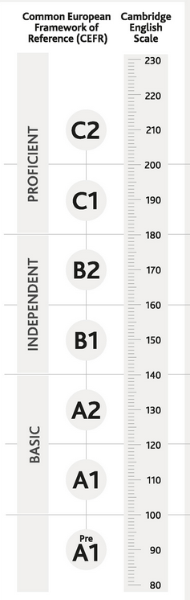

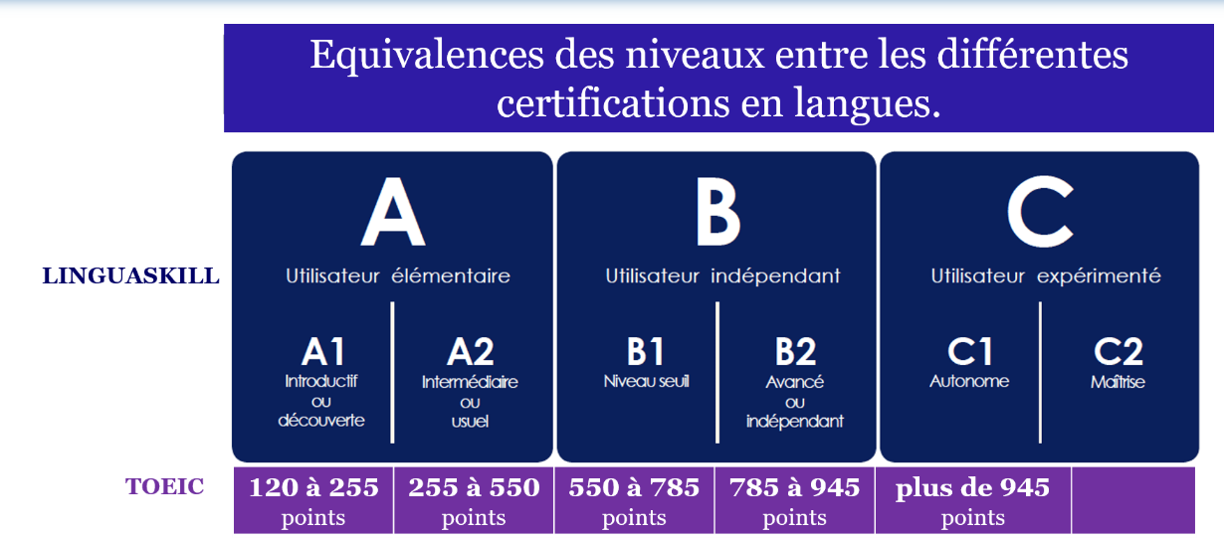


TOEIC SCORES CEFR (Common European Framework of Reference Languages) Your objective Fill up the stars ! & place you cv top of the list!

Slide 4
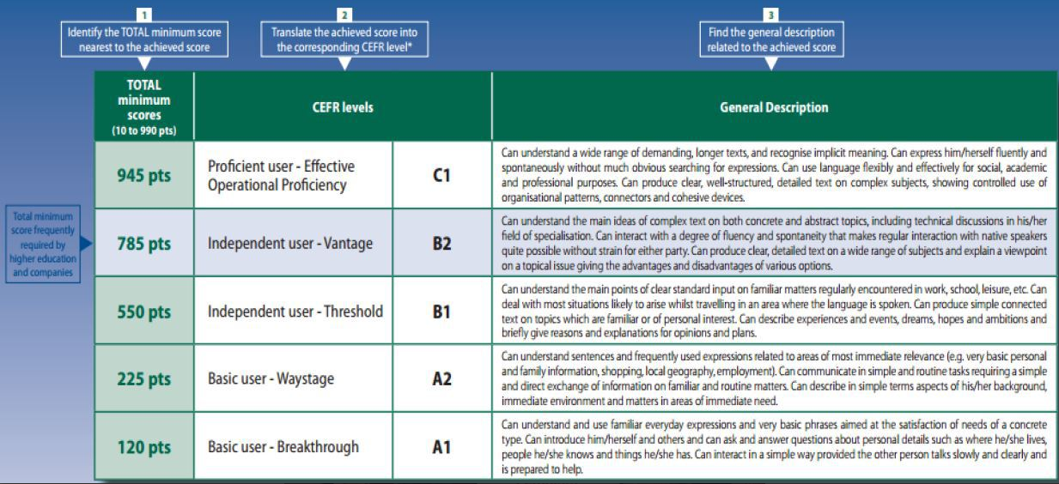
Get the best TOEIC score possible

Slide 5

Survey
https://www.mentimeter.com/app/presentation/aljipz12v2aiwqh622hcjewajrfwfg37/hsqpswrek47c/edit

Slide 6
Training Content
The art of introducing yourself
Write an abstract
Give a presentation of your company
Give a presentation of your project
Give a demo of your project
Tech watch
Programming Languages Vocabulary

Slide 7
Exams requirements
1 Written
Write an abstract (summary) of your project: 250 words minimum
2 Oral 3 to 5 mn
Using powerpoint,
Give a presentation of yourself (briefly)
AND / OR Give a presentation of your company / internship
AND / OR Give a presentation of your project
AND / OR Give a demo of your project

Slide 8
www.wordreference.com
www.deepl.com/translator
www.ego4u.com
https://www.e-anglais.com/
https://www.businessenglishsite.com/
www.breakingnewsenglish.com
https://www.anglaisfacile.com/beginners/
https://www.ispeakspokespoken.com/cours-anglais/#Cours-danglais-pour-avances
www.proprofs.com/quiz-school/topic/computer
https://global-exam.com/blog/fr/general-english-combien-de-temps-pour-apprendre-langlais/
Useful websites to browse

Slide 9
Useful websites to browse
Technique pour retenir le vocabulaire:
https://www.youtube.com/watch?v=Asmt1ws1ogw&list=PLpXDfP--B5esxM6zbiNUj_Tws-uGbEVPb&index=2
Email professionnel en anglais - partie 1
https://www.youtube.com/watch?v=xn1st-yv2kI&list=PLpXDfP--B5esxM6zbiNUj_Tws-uGbEVPb&index=14
Email professionnel en anglais - partie 2
https://www.youtube.com/watch?v=t5I_c5w9rUM&list=PLpXDfP--B5esxM6zbiNUj_Tws-uGbEVPb&index=15
Vocabulaire de l'informatique en anglais - partie 1
https://www.youtube.com/watch?v=-ReQcfZgm9w&list=PLpXDfP--B5esxM6zbiNUj_Tws-uGbEVPb&index=28
Vocabulaire de l'informatique en anglais - partie 2
https://www.youtube.com/watch?v=z3nrxcffbfI&list=PLpXDfP--B5esxM6zbiNUj_Tws-uGbEVPb&index=29
Vocabulaire niveau intermédiaire et avancé: mots et expressions
https://www.youtube.com/playlist?list=PLpXDfP--B5esxM6zbiNUj_Tws-uGbEVPb
Grammaire anglaise niveau intermédiaire et avancé
https://www.youtube.com/playlist?list=PLpXDfP--B5evNTAKT6qxxELb3QSP2Nz_d
Dictées
https://www.youtube.com/watch?v=AQ6yEINNZMs&list=PLpXDfP--B5esLa0TC2b5e00HFX9-8zyVc

Slide 10
Let’s go for the placement Test!
https://qruiz.net/Q/?jpoAh1

