Slide 1

ARIJ
Arbaaz Polra, Raul Sanchez, Isaiah Hernandez, Jonathan nguyen

Slide 2
Introduction
For this project, we’ll be using a desktop computer. The tool we have used is called QT. Qt Creator is a cross-platform C++, JavaScript and QML integrated development environment which is part of the SDK for the Qt GUI application development framework. C++ is the programming language used for this project. What we will be doing is creating a simple Blackboard GUI that includes a login feature and other course related functions. Two of our team members will be responsible for creating the GUI and its code. Other team members will be briefed on the code and how to run and properly use the application.

Slide 3
Roles
Arbaaz Polra - Project Manager
Raul Sanchez – Programmer
Isaiah Hernandez - Requirement Manager/ Programmer
Jonathan Nguyen – Software Architect

Slide 4
Schedule
Project milestone | Project artifact | Due Date
Project start |  | 03/01/2019
First Project Meeting | Staff Approach | 03/18/2019
Project halfway through | Parts of SRC/ Report | 11/10/2019
Project Presentation | PowerPoint/ GUI | 4/25/2019
Project Due | All artifacts | 04/28/2019

Slide 5
Team Organization
Democratic team
Strengths:
high quality code, consequence of positive attitude finding faults
Particularly good with hard problems
4 egoless programmers
Weaknesses:
Cannot be externally imposed

Slide 6
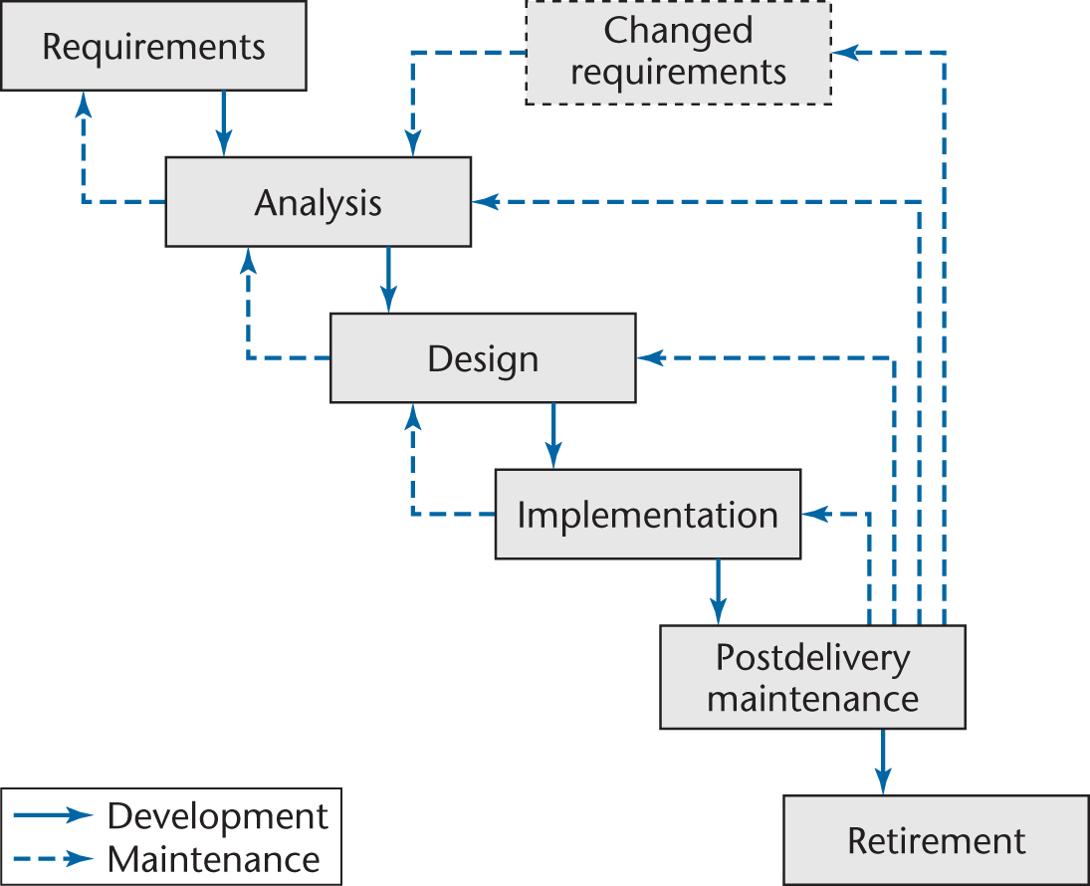
Waterfall Model
The life cycle model we used for this project is the Waterfall Model because its one of the better ways in documentation and the maintenance is a lot easier. This model does not show the order of events but it’s a linear life cycle model with feedback loops.

Slide 7
CRC CARDs
CRC Cards
CLASS StudentInfo
RESPONSIBILITY Displays student name and ID Display birthday and gender Display enrollment date, credits, current hours and withdrawal count Display GPA Display major and minor Student can view their account balance
COLLABORATION StudentCourse class Courses class
CLASS AdministratorView
RESPONSIBILITY Administrator can view students name and ID Administrator can view student’s enrollment date, credits, current hours and course drop count Administrator can view student’s GPA Administrator can view student’s field of study (major and/or minor)
COLLABORATION AdminstratorCourses AdministratorCourseGrades
CLASS AdministratorCourseGrades
RESPONSIBILITY Administrator can view student ID and course ID Administrator can modify the assignment and/or grade Administrator can modify assignment grade weight and due date Administrator can calculate cumulative grade for the course
COLLABORATION AdministratorCourses
CLASS StudentCourseGrades
RESPONSIBILITY Display student ID and course ID Display student grades for the courses Display the progress of the course (active/completed/withdrawn)
COLLABORATION StudentInfo class StudentCourses class
CLASS StudentCourses
RESPONSIBILITY Display the course name and degree category Display professor of course Display the building name and room number Display the days of the week to attend the class Display session time
COLLABORATION StudentInfo class StudentCourseGrades class
CLASS StudentCourseInfo
RESPONSIBILITY Display student ID and course ID Display assignments and numeric grade received for that assignment Display the grade weight and due date Display cumulative grade for the course
COLLABORATION StudentInfo class
CLASS AdministratorCourses
RESPONSIBILITY Administrator can modify course name and degree category Administrator can modify professor of the course Administrator can modify the building and course room number Administrator can modify days of week to attend the course Administrator can modify the session time
COLLABORATION AdministratorCourseGrades

Slide 8
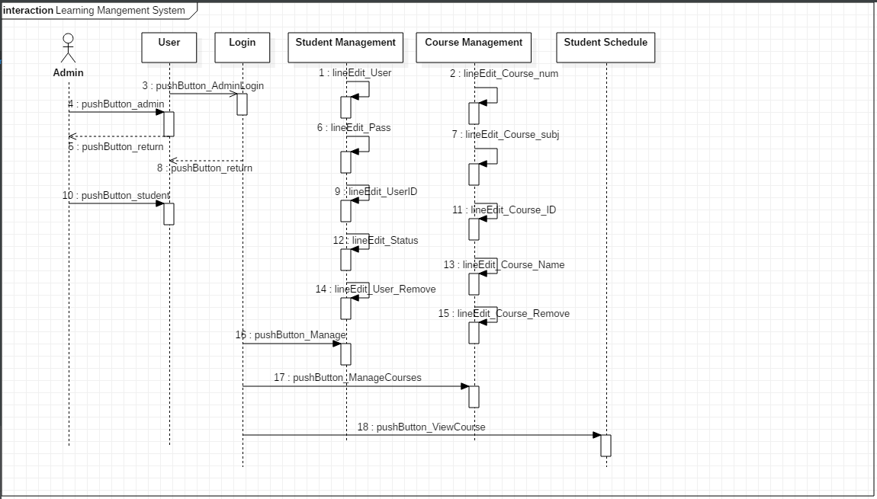
Sequence Diagram
The major components of the software design are the login feature. Depending on who (student or administrator) logs in, they will have certain roles. The student will only be able to look at his information; he/she can’t modify anything. If the administrator logs in, they can modify the student’s information, like their grades and the courses that the student is/wants to register for.
Actor: Admin, student
Lifeline: User, Student Management, Course Management, Student Schedule

Slide 9
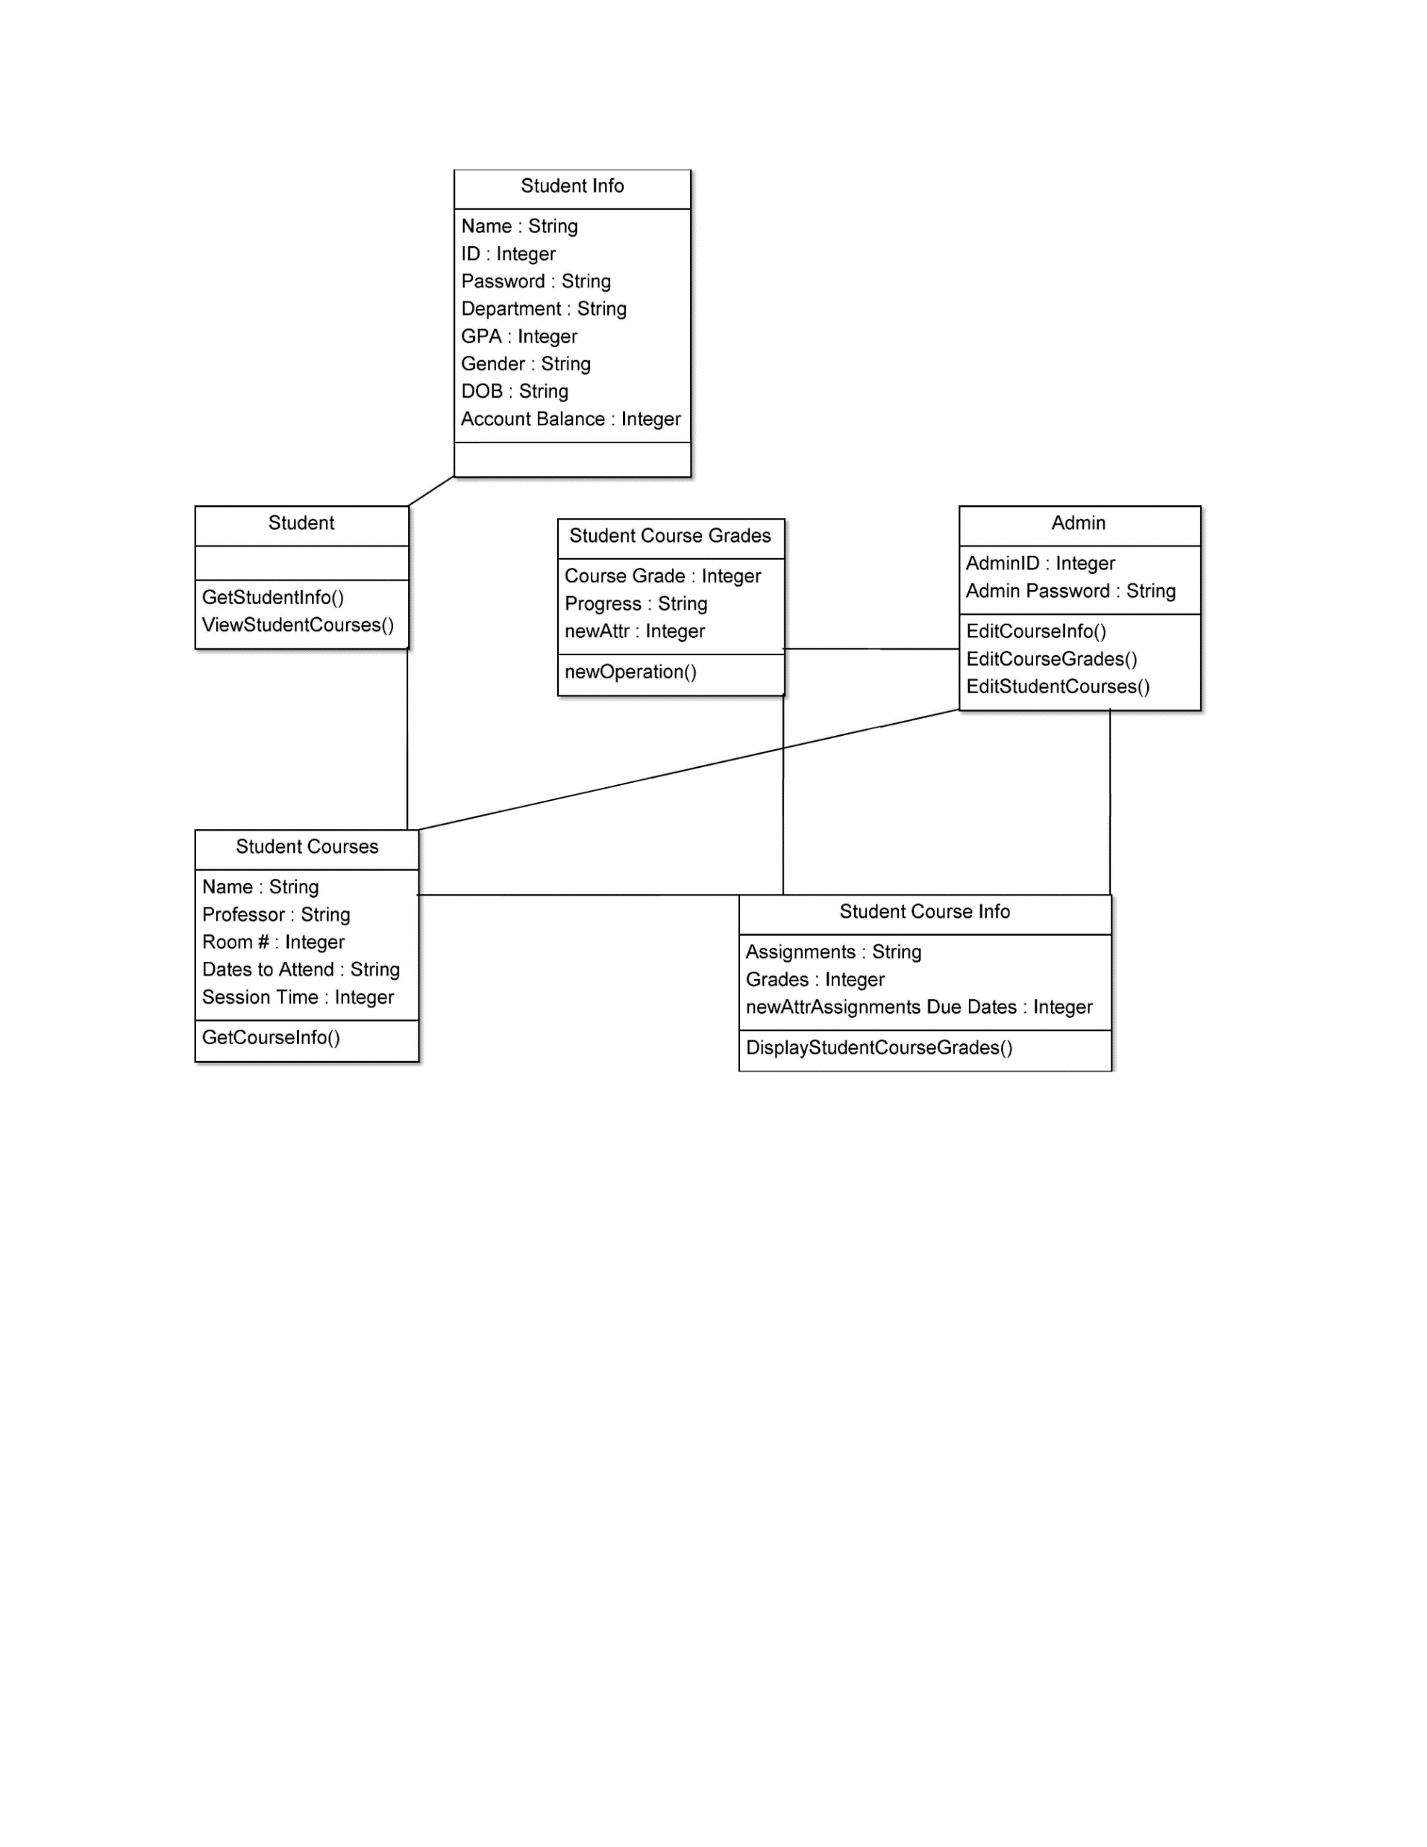
Class Diagram

