Slide 1
ADVANCED TECHNOLOGY PIONEERS 2026 · DCT ABU DHABI CHALLENGE
WHAT THE PACKAGE CONTAINS
Air2Stay
Web prototype
4 pages · 33 departure countries · one standalone HTML file
A what-if simulator that estimates how flight changes into Abu Dhabi change hotel check-ins and guest nights
Calculation audit workbook
11 sheets · 396 route baselines · 17,820 bridge rows
Technical guide & user manual
15 sections: method, demo script, glossary
DEFAULT DEMO: +3 WEEKLY INDIA FLIGHTS IN DECEMBER
+731
+2,706
Complete source code
12 files: Python, JavaScript, HTML/CSS, PowerShell
hotel check-ins / month
guest nights / month
vs. the historical baseline; estimates, not guarantees
DCT Abu Dhabi challenge statement: “How might we build a tool that predicts how flight changes affect hotel visits in Abu Dhabi?”
AI-tool declaration: prototype build used AI-assisted coding (OpenAI Codex) and the cover concept used OpenAI image generation, both under team direction; the team can explain every method, decision and result in its own words.
Notes:
Air2Stay lets a planner change a route, seat count or load factor and immediately see expected hotel check-ins and guest nights. Built for the DCT Abu Dhabi challenge in Advanced Technology Pioneers 2026. Sources: Technical Guide §1, Calculation Audit 'Worked example', Source Code document file map.

Slide 2
Team Air2Stay
Advanced Technology Pioneers 2026 – DCT Abu Dhabi sponsor track, flight-to-hotel demand simulator
TEAM MEMBER
TEAM MEMBER
TEAM MEMBER
TEAM MEMBER
Mohammed Affan Parkar
Yasmeen Alzarooni
Hazil Fateen
Arbab Hussain Zaidi (you)
A four-person team of BSc Computer Science students entering the DCT Abu Dhabi sponsor track, building a working, explainable flight-to-hotel demand simulator rather than a static report.

Slide 3
Flight data and hotel data mean different things by “country”
117,608
33
130
59
45
12
flight rows
departure countries
departure cities
airlines
hotel nationalities
hotel-only nationalities
FLIGHT FILE · AVIATION TEAM
WHY THE TWO CAN’T SIMPLY BE MATCHED
“Country” = where the aircraft departed. Holds flights, seats, filled seats, passengers, P2P, transfer, transit.
Traveller | Flight file says | Hotel file says
Australian passport holder flies from London | United Kingdom | Australia
UK passport holder flies from Delhi | India | United Kingdom
Indian resident returns home | India | No hotel check-in
Transfer passenger continuing to Europe | India | No Abu Dhabi check-in
HOTEL FILE · HOTEL TEAM
“Country” = the guest’s passport nationality. Holds daily New Arrivals, Guests and Same-Day Guests.
The 12 hotel-only nationalities (no same-named departure country): Australia, Brazil, Czechia, Denmark, Finland, Mexico, Morocco, Norway, Pakistan, Romania, South Africa, Sweden. The other 33 names match exactly.
Both files are correct: they answer different questions. Air2Stay builds an estimated bridge between them instead of pretending the fields are the same.
Notes:
Sources: Technical Guide §1 and §4 'Key findings', Table 15 examples; Audit workbook 'Source inventory' country coverage check (33 exact overlaps, 0 flight-only, 12 hotel-only). The problem: aviation and hotel teams plan from separate numbers, and many airport passengers never stay in an Abu Dhabi hotel.

Slide 4
Every number comes from six supplied files
Supplied file | Data rows | Coverage | What Air2Stay uses it for
flight_data.xlsx | 117,608 | Jan 2022 – Feb 2026 | Seats, PAX, P2P, transfer, transit, load factor, weekly frequency → 396 country-month route baselines
data international_train.xlsx | 58,622 | Jan 2022 – Jul 2025 | Daily New Arrivals, Guests, Same-Day Guests for 45 nationalities → check-ins, stays, bridge, validation
data international_test.xlsx | 9,202 | Aug 2025 – Feb 2026 | Future-style rows; Guests target intentionally missing
data domestic_train.xlsx | 1,308 | Jan 2022 – Jul 2025 | Separate domestic daily stay model
data domestic_test.xlsx | 212 | Aug 2025 – Feb 2026 | Domestic rows needing predicted Guests
Data_Dictionary.pdf | — | 8 pages | Field definitions only; supplies no forecast values
Check-ins
Guest nights
Average stay
Common grain
Hotel New Arrivals (column C)
Sum of daily Guests: one person over 3 nights counts 3 times
Total Guests ÷ total New Arrivals
2022 flights are monthly, later years daily, so everything is aggregated to month
The DCT challenge web page supplied the business problem and success criteria, not data. Flight columns used: A Date, B Departure Country, F Avg Weekly Frequency, M Load Factor, N Total P2P, O Total PAX, Q Total Seats, R Transfer, S Transit.
Route baselines per country × month: load factor = PAX ÷ seats; P2P share = P2P ÷ PAX; weeks = days ÷ 7; seats per flight = seats ÷ (weekly frequency × weeks); hotel conversion = New Arrivals ÷ P2P (training months, month-calibrated).
Notes:
Sources: Technical Guide Table 7 and Table 8 (source lineage); Audit workbook 'Source inventory' and 'Data lineage'. Hotel columns used: A Date, B Guests, C New Arrivals, D Same-Day Guests, E Nationality, F Residence. Excel data begin at row 2 (row 1 is the header). The standalone HTML contains derived aggregates only, not the row-level workbooks.

Slide 5
A five-step chain turns airline seats into hotel guest nights
1
2
3
4
5
Scheduled seats
Passengers
P2P visitors
Hotel check-ins
Guest nights
baseline + extra flights × seats × weeks
seats × load factor (88.1%)
passengers × P2P share (65.4%)
P2P × hotel conversion (42.5%)
check-ins × average stay (3.32)
298,700
263,155
172,103
73,144
242,838
INDIA, DECEMBER: BASELINE VS. SCENARIO
Added seats: 3 flights × 196 seats × (31 ÷ 7 = 4.4286 weeks) = 2,604
Baseline dials (from history): load factor 88.11%, P2P 65.37%, conversion 42.46%, stay 3.316 nights
Hotel conversion combines travel purpose and hotel choice, which the data don’t show separately. It is one labelled, editable dial.
Output | Baseline | Scenario | Change
Scheduled seats | 296,096 | 298,700 | +2,604
Passengers | 260,890 | 263,155 | +2,265
P2P visitors | 170,544 | 172,103 | +1,559
Hotel check-ins | 72,413 | 73,144 | +731
Guest nights | 240,131 | 242,838 | +2,706
READ THE HEADLINE CAREFULLY
The live demo uses rounded dials (88.1%, 65.4%, 42.5%, 3.32) vs. baseline 88.11%, 65.37%, 42.46%, 3.316. The workbook’s isolated flights-only test (full-precision dials) gives +637 check-ins and +2,112 guest nights. The rest of +731 / +2,706 comes from that rounding.
Notes:
Sources: Technical Guide §6–7 and Tables 12–13; Audit 'Worked example' (exact: +730.90 check-ins, +2,706.48 guest nights) and 'Test scenarios' (India +3, full-precision: +636.8 check-ins, +2,111.8 guest nights). The guide (§14) acknowledges this difference. Global starting ratios (competition deck notes, model_report.json): weighted load factor 82.4%, P2P share 50.9%, global hotel capture 42.5%. A calibrator is a measured conversion assumption between two steps; load factor, P2P share, hotel conversion and average stay are the main ones. The JavaScript engine: monthlySeats = max(0, baselineSeats + extraWeeklyFlights*seatsPerFlight*weeksInMonth); passengers = seats*LF; p2p = passengers*P2P; checkins = p2p*conversion; nights = checkins*stay.

Slide 6
The Country Bridge splits demand across 45 nationalities
It doesn’t change the total. It only divides the check-ins and guest nights that the chain already calculated.
HOW EACH WEIGHT IS BUILT (PER ORIGIN × MONTH)
Inputs: monthly P2P passengers per origin vs. New Arrivals per nationality, on a log(1 + value) scale
Combined: max(0, 0.70 × level correlation + 0.30 × change correlation)
Score: nationality share × (0.35 + 2 × combined²)
Direct-match prior: × 6 when names match (India→India), a preference, not a forced 100%
Season: score × seasonal factor^0.7, factor clipped to 0.35–2.5
Normalise: weight = score ÷ sum of scores, so all weights add to 100%
OTHER RULES
Planner override: edit weights; each is divided by the new total so all 45 still add to 100%. Reset removes it.
Per-nationality stay: 70% nationality-month + 30% nationality overall, clipped to 1–8 nights; rescaled so guest nights reconcile to the headline.
Not passenger tracking: an aggregate estimate, never for individual targeting.
Of +731 extra check-ins, ≈412.5 go to Indian nationals (56.4%). 17,820 rows = 33 origins × 12 months × 45 nationalities.
Notes:
Sources: Technical Guide §8–9; Audit 'Country bridge' (India December weights: India 0.5644, China 0.0547, UK 0.0544, Russian Federation 0.0472, USA 0.0260, Italy 0.0179, Germany 0.0174, France 0.0172, Saudi Arabia 0.0163, Kazakhstan 0.0149); build_model.py lines 308–332 confirm the 0.35–2.5 clip, the ×6 prior and the ^0.7 exponent. Level correlation: are both series high/low in the same months? Change correlation: do they move together month to month? Correlation does not prove causation.

Slide 7
Tested on 7 later months it never trained on
6.91%
7.24%
Transparent chain
Hybrid benchmark
107,148 ÷ 1,550,679
112,226 ÷ 1,550,679
11.28%
8.52%
Daily intl. stay model
Daily domestic stay model
4,138 rows, May–Jul 2025
separate domestic test
THE MACHINE-LEARNING LAYER
Ridge regression (regression with a stability penalty; features standardised, intercept not penalised)
Features: log P2P, log seats, load factor, P2P share, month sine/cosine, time trend
Decision: the hybrid scored worse, so the transparent chain is the engine. The hybrid is kept as evidence.
Split by time: trained on 36 months (Jan 2022–Dec 2024, 83.7%), rules locked, then scored on 7 months (Jan–Jul 2025, 16.3%).
WMAPE = sum of |actual − predicted| ÷ sum of actual. Lower is better.
Notes:
Sources: Technical Guide §10 and Tables 17–21; Audit 'Validation' sheet (monthly values and absolute errors); build_model.py (fit_ridge, alpha 4.0 for the flight-chain benchmark; ensemble = 0.55*ridge + 0.45*parametric). Black Actual line = international_train.xlsx column C New Arrivals summed over all days and nationalities. Daily stay split: 54,484 study rows (92.9%) vs 4,138 exam rows (7.1%). The daily stay models are per-nationality ridge models (alpha 12) using New Arrivals, Same-Day Guests, recent arrival lags, rolling averages and seasonal day patterns; they predict Guests from 1 May to 31 Jul 2025. A 6.91% WMAPE ≈ 7 check-ins of error per 100 actual across the validation period; it is not a software error.

Slide 8
Ranges, sensitivity and data support show what to trust
P10 / P50 / P90, INDIA DECEMBER TOTAL GUEST NIGHTS
P10
P50
P90
219,185
242,838
260,006
× 0.9026 · cautious lane
× 1 · central formula result
× 1.0707 · higher lane
Multipliers are the 10th and 90th percentiles of actual ÷ hybrid ratios over the 7 validation months. P50 does not mean “50% accurate”. With only 7 months these are rough planning lanes, not a calibrated probability or 95% interval.
DATA SUPPORT BADGE (EVIDENCE COVERAGE, NOT CONFIDENCE)
Badge | Rule for the selected country + month
High | 3 or more matching historical observations
Medium | 1 or 2 matching observations
Low | None: fallback (zero baseline seats, overall averages, seasonal nationality mix)
One input moves down and up while the others stay fixed. The biggest levers are stay length and hotel conversion, not seat count, so DCT should firm up those assumptions first. This is a decision guide, not a causal claim.
INTENDED IMPACT
Shows DCT planners the likely hotel demand effect of a route change in advance, turning capacity planning into a shared, numbers-based conversation.
Notes:
Sources: Technical Guide §11 and Tables 22, 23, 26; Audit 'Worked example' (P10 219,185.2; P50 242,837.6; P90 260,006.2) and 'Sensitivity' sheet (spans 73,143.8 / 57,138.3 / 37,131.1 / 27,563.9 / 1,411.3 / 648.1). build_model.py uses np.quantile(residual_ratio, 0.10 and 0.90). Suggested phrasing: 'about 243 thousand guest nights, rough range 219–260 thousand'.

Slide 9
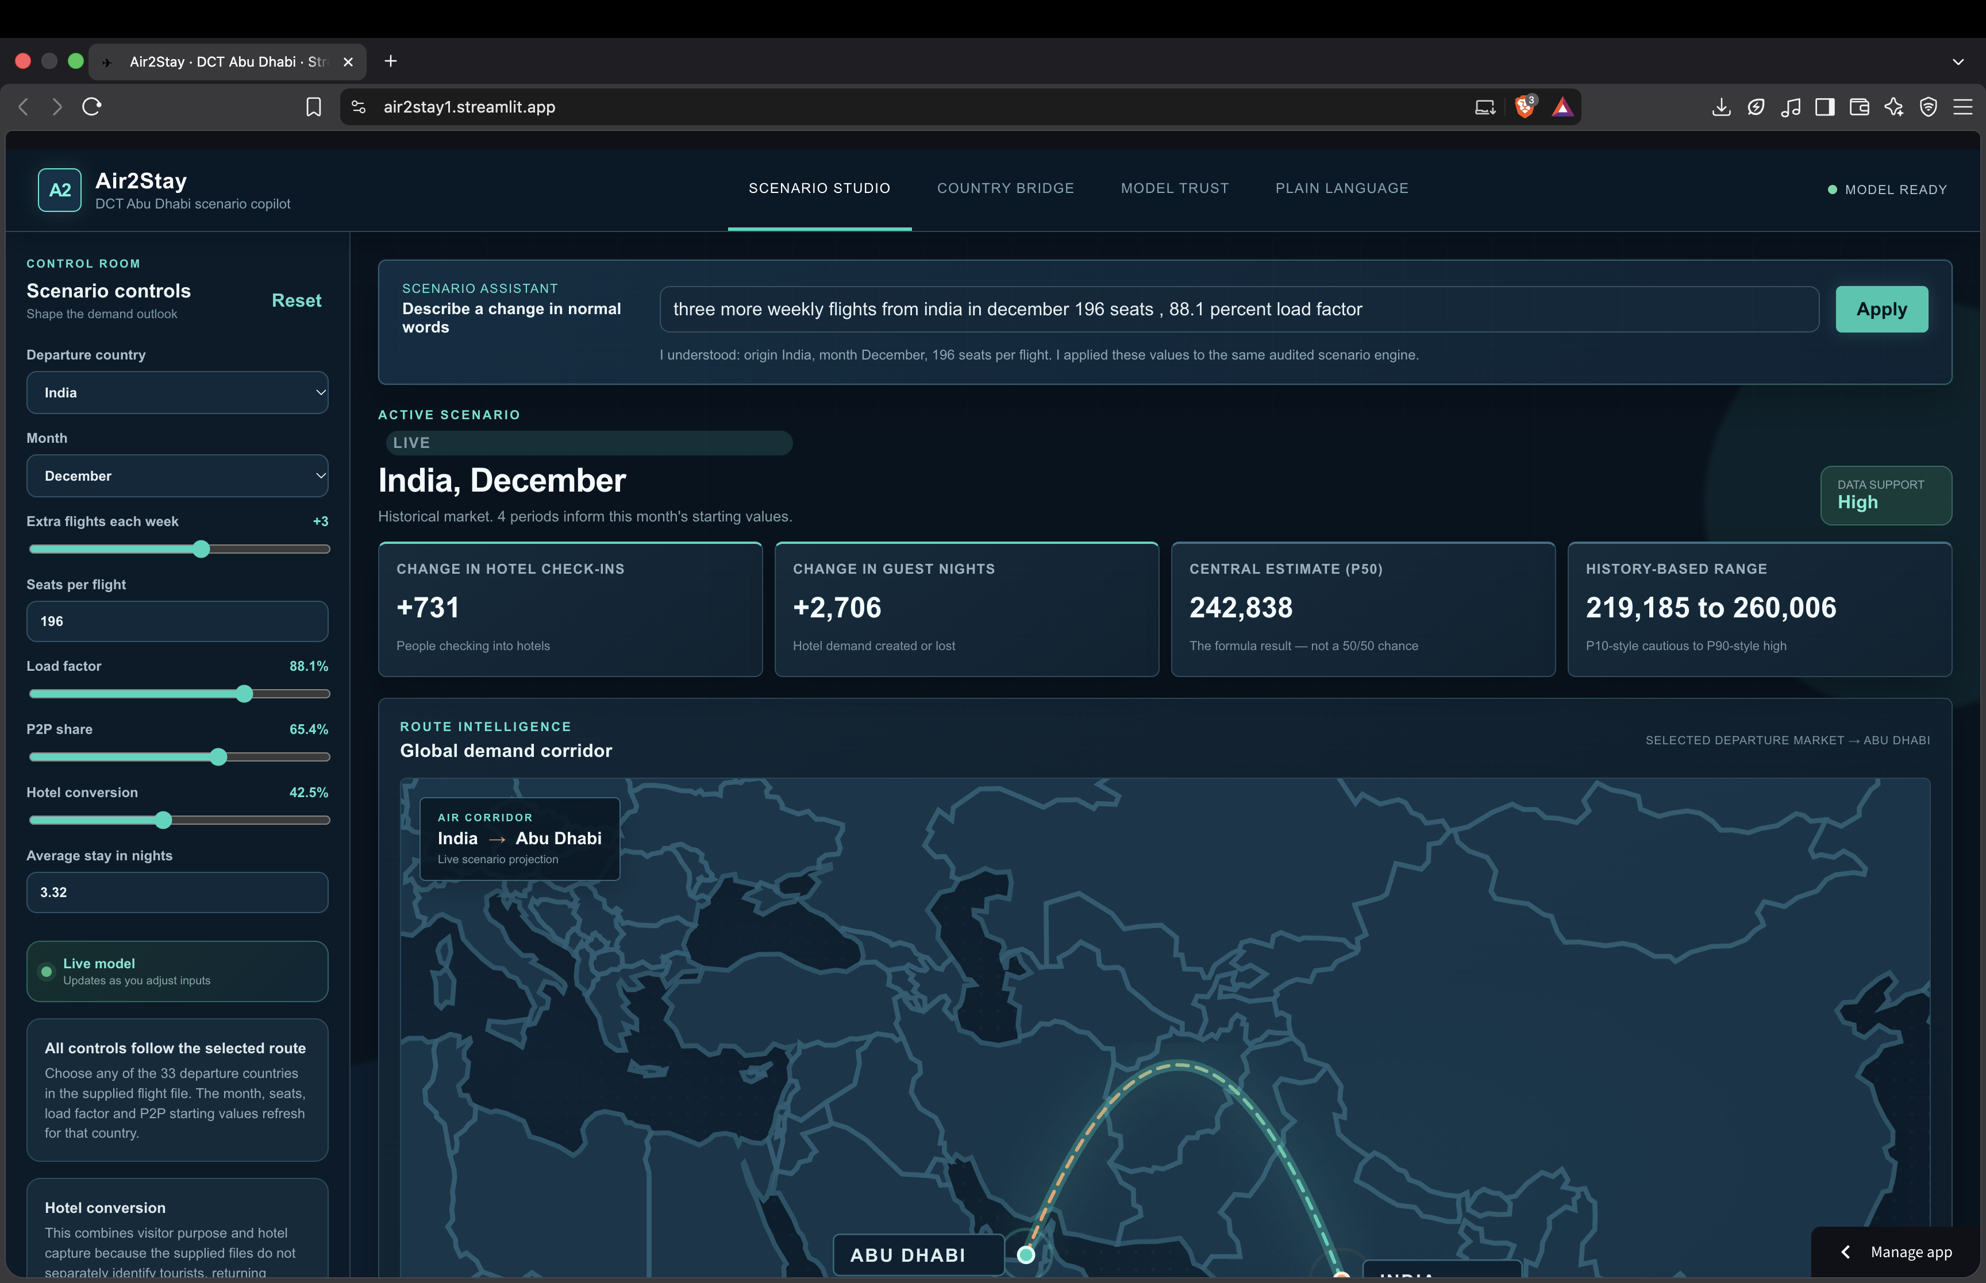
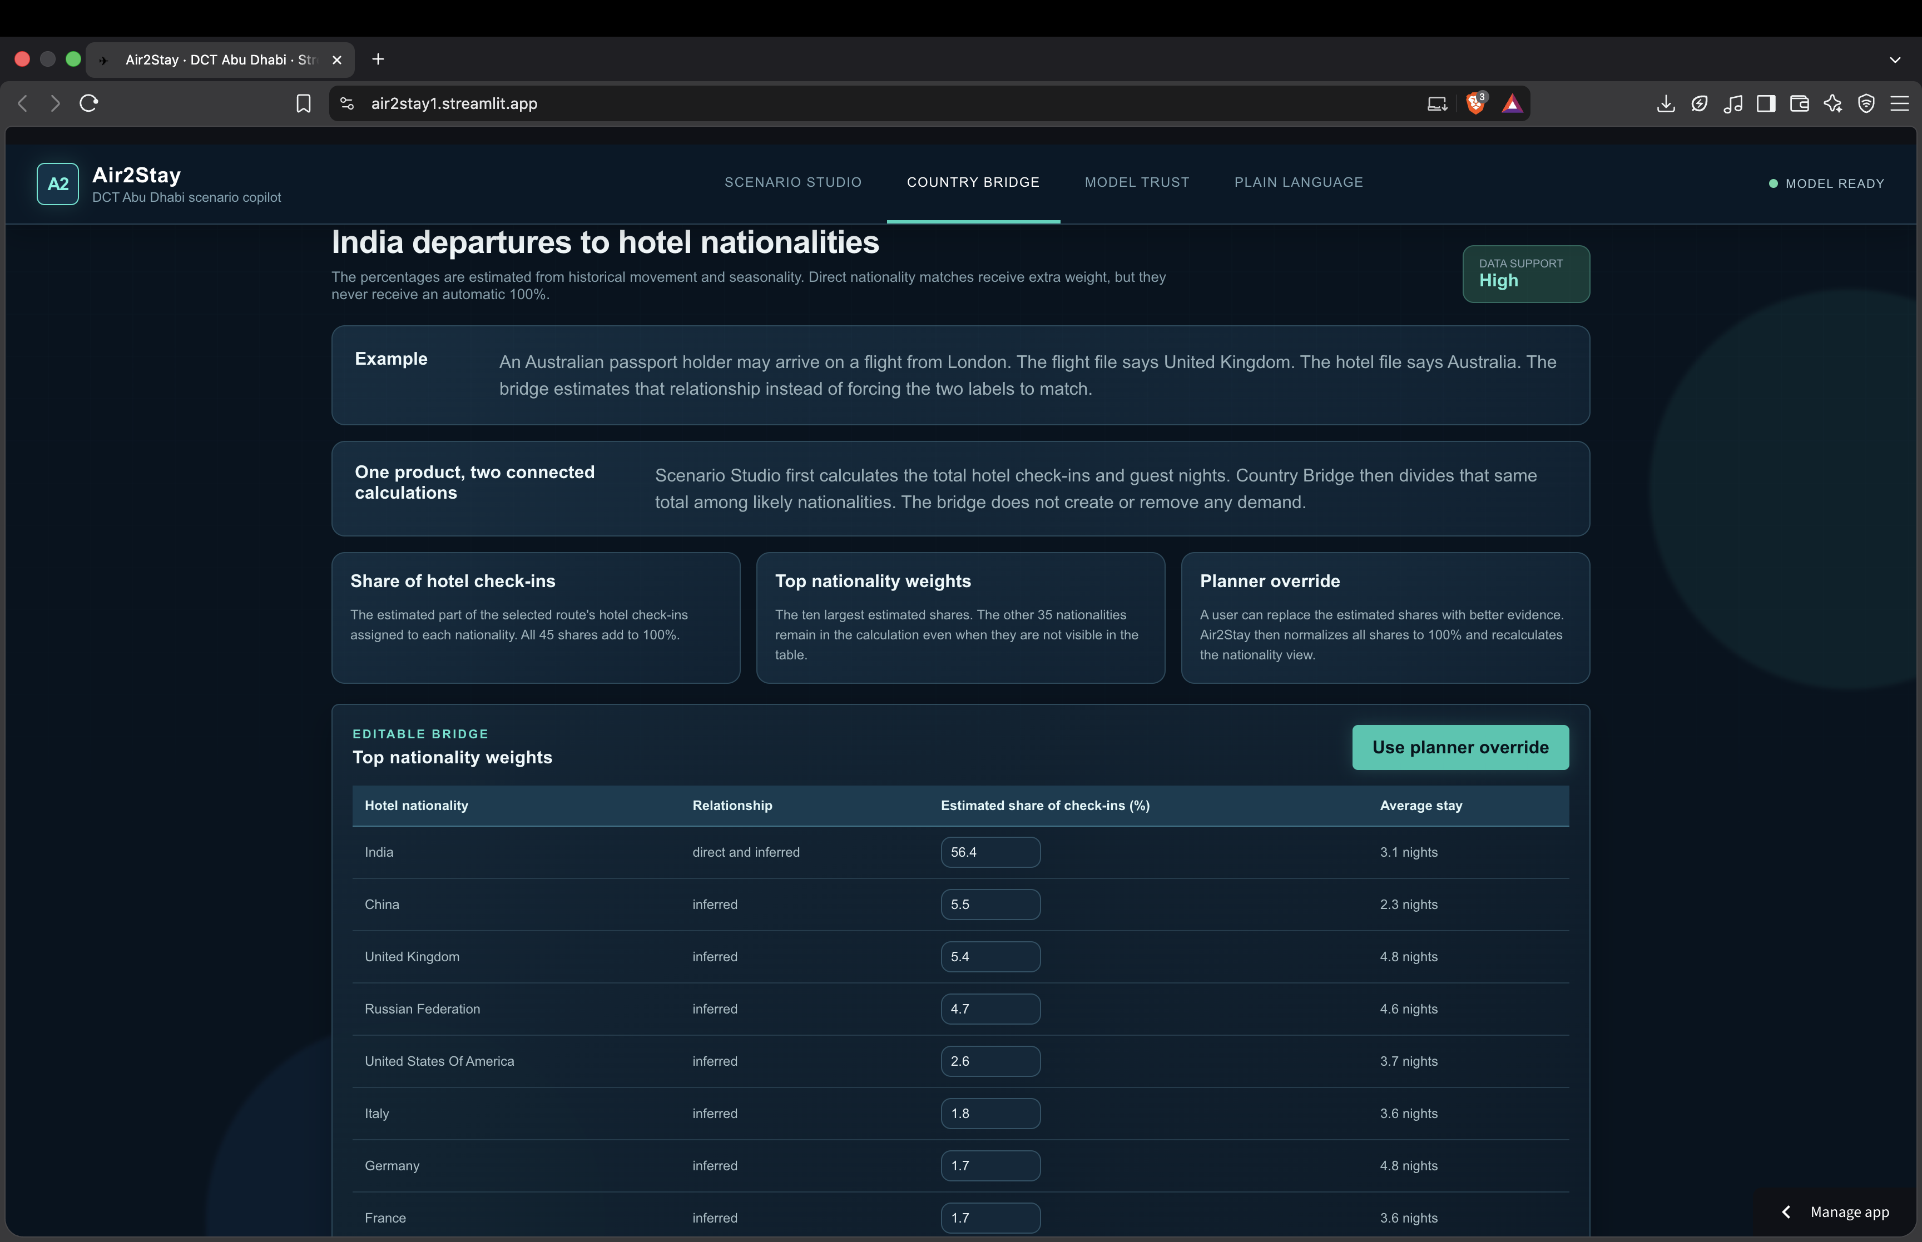
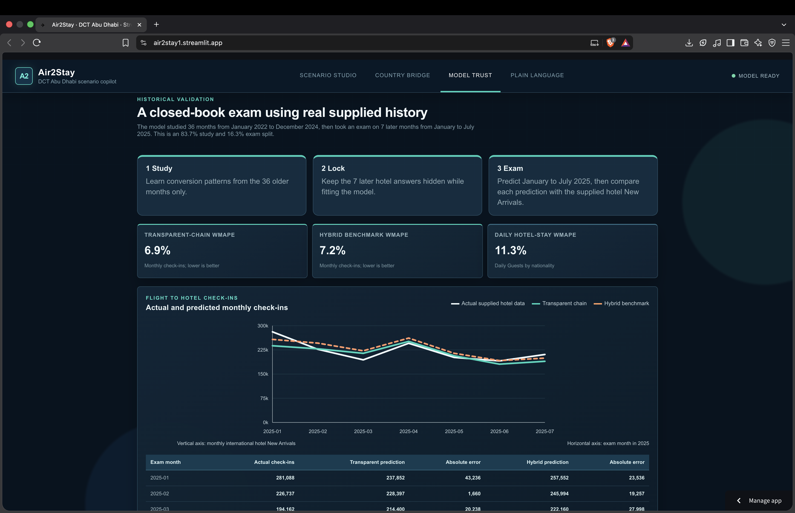
The working prototype, screen by screen
Live screenshots from the standalone web app — not mockups
Scenario Studio
Country Bridge
Model Trust
Change dials, see check-ins and nights update live
Splits the total across 45 likely nationalities
Actual vs. predicted, with both WMAPE scores
A fourth page, Plain Language, turns these same numbers into planner-ready sentences. One standalone HTML file, 33 departure countries, no server required.

Slide 10
Responsible use, known limits and the ask
PRIVACY & SAFETY
KNOWN LIMITATIONS
NEXT STEPS
Aggregate country-month data only: no names, passports, bookings or emails
Standalone HTML runs locally; no external API receives the data
Overrides change the browser session only; they should cite a named source (not stored in the prototype)
Outputs are discussion prompts; a human approves decisions
83.7/16.3 time split stops data leakage. It is model governance, not cybersecurity
Bridge is statistical: cannot identify any traveller
Conversion merges purpose, residency and lodging choice
No room inventory, events, fares or hotel prices
Mixed 2022 vs. later flight grain; short history
P10/P90 from only 7 months; assistant is rule-based
Pilot with DCT aviation and hotel planners on protected data
Add purpose-of-travel, route-to-nationality, events, inventory, schedules and fares
Production: access control, encryption, audit logs, versioned data, minimum-count suppression
Retrain monthly, monitor drift, use bootstrapped intervals
Optional governed LLM for the sentence box, returning only validated fields
If shortlisted: rehearse the live demo end-to-end, run it live against new, unrehearsed routes in front of judges, and record a timed walkthrough video
Ask: a short DCT pilot to test assumptions, then replace inferred bridge weights with DCT’s richer evidence.
Notes:
Sources: Technical Guide §14 (security, limitations Table 32, safeguards Table 31); competition deck slides 11–12. Note: the source files say raw competition files stay local and should not be published without DCT approval. If the Streamlit deployment exposes supplied data, check that against the challenge's confidentiality guidance.

