Slide 1





Script
Squad
SeniorCare
Senior citizen help alert to nearest nurse

Slide 2






Why Choose SeniorCare?
Dynamic Dashboard for Admin
Proximity-Based Nurse Notification
Admins can monitor all nurses' availability and track patients' calls in real-time.
Automatically alerts the nearest nurse when a patient triggers an emergency alert.
Nurse Availability Indicator
Navigation between Patient and Nurse
Easily track which nurses are currently available for a new assignment.
Guide nurses to the patient’s location efficiently
Multi-Language Support
Family Contact Notifications
Ensuring accessibility for both patients and nurses who may speak different languages.
Keeping family members informed during emergencies.

Slide 3
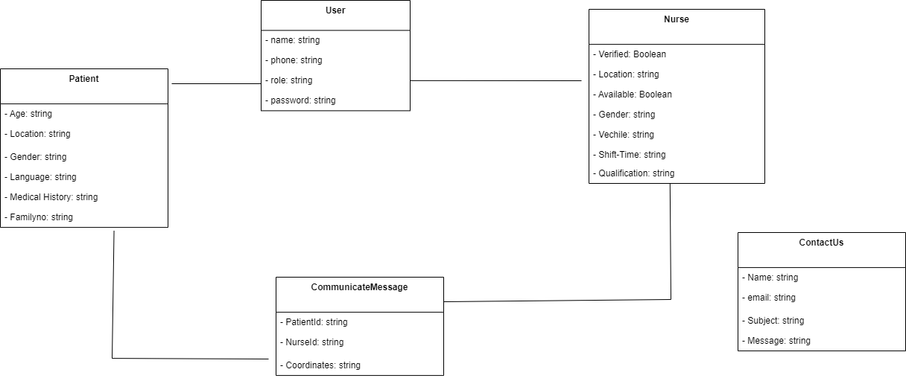
Schema Design

