Slide 1

GIT
Git is a free and open source distributed version control system designed to handle everything from small to very large projects with speed and efficiency.

Slide 2

Git Vs Github

Slide 3
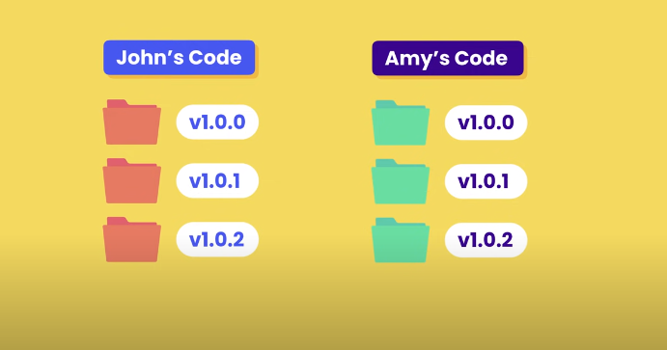
Without Version Control (GIT)

Slide 4
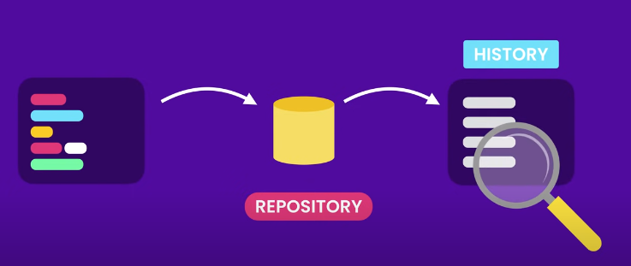
Version Control System

Slide 5
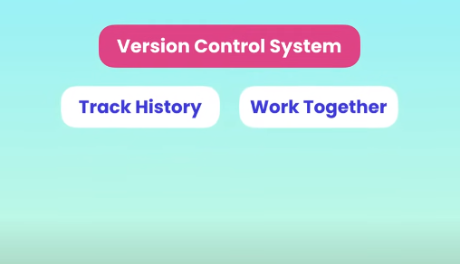

Slide 6
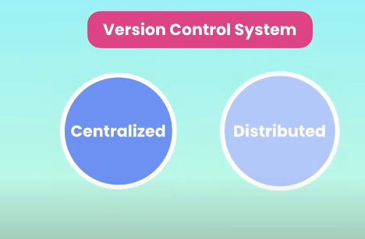

Slide 7
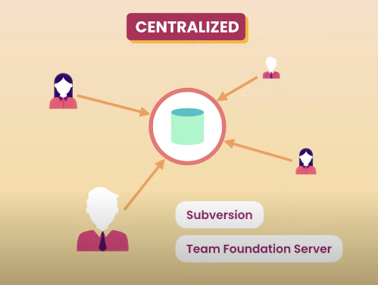

Slide 8
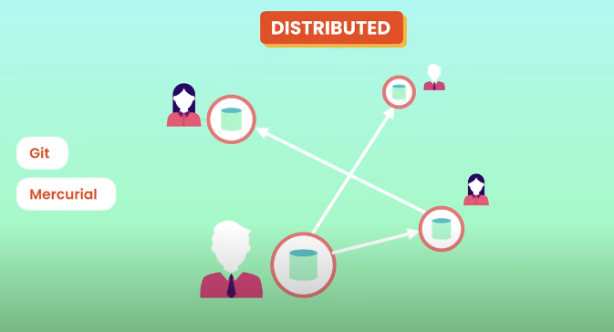

Slide 9
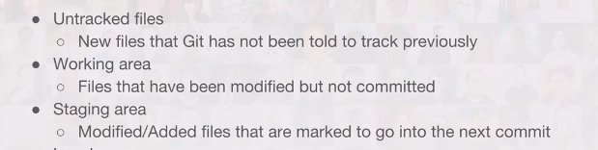
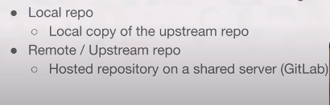
Terms for working with GIT

Slide 10
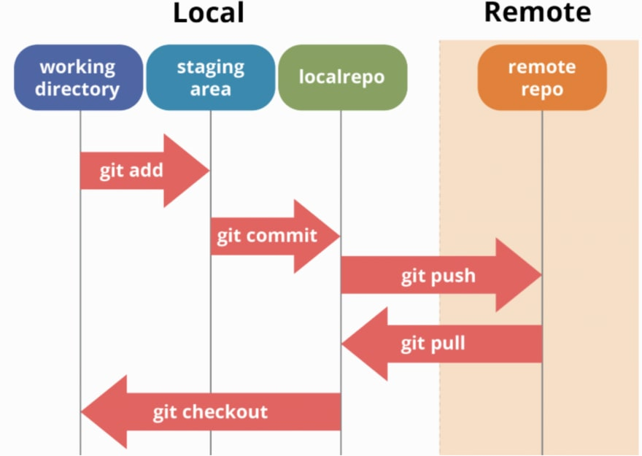
GIT WORKFLOW

Slide 11
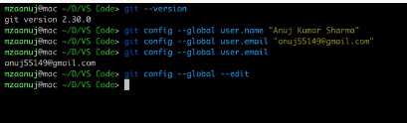
GIT INSTALATION
Download git from https://git-scm.com/downloads

Slide 12
Git init -> to initialize empty folder/repository
Git add –A – let git to track all file changes in folder (moves file from working directory to staging area)
Git add ab.txt -> tracks only ab.txt in folder to be committed and push later
Git status - > tracks file changes
Git commit –m “meaningful text” -> push changes from staging area to localrepo
Git log -> track commits
Git push -> push files from local repo to remote repo

Slide 13
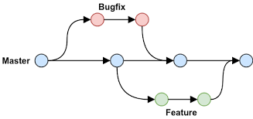
BRANCHES

Slide 14
Branches in Git
To create branch in git use command git checkout –b name
git branch -a to see list of branches
Git checkout anyname: switches branch
Dev > Git merge arbaz/login
Adding GIT IGNORE: to hide sensitive information
Create .gitignore file - >specify file names inside this file
PUSH CHANGES
Git add –A
Git commit –m “msg”
Git remote –v to track where we have pushed changes

