Slide 1
Adarsha Internship Session-1
C++ Basics for Competitive Programming

Slide 2
About Myself

Slide 3
My Journey and Experience

Slide 4
What is Competitive Programming ?
It teaches you how to think
Programming is fun, programming is an exercise for your brain, programming is a mental sport and when this sport is held over the internet involving sport programmer as a contestant then it is called Competitive Programming.

Slide 5
C++ Basics
Hello World->variables->datatypes
Input output
calculator
Function calls
Arrays and loops
2D array
Strings

Slide 6
PROGRAMS

Slide 7
Sum of Array elements
a[5] = {2,3,3,4,1};
sum = 13
Example:

Slide 8
Array element are same
Int a[5] = {1,1,1,1,2};
Int firstelement = a[0]; // 1
a[1,1,1,1]
1->ec
2-dia
a[1,1,1,2]

Slide 9
Smallest/largest and Product of array elements
a[5] = {2,3,3,4,1};
Min = a[0]; 2

Slide 10
Reverse an Array
Int a[6] = {1,2,3,4,5,6};
N = 6
{6,5,4,3,2,1}
{6,5,4,3,2,1}

Slide 11
Pass by Reference and Pass by Value

Slide 12
Guessing Number Game
Int secret = 3;
Int guessLimit =1
4
-> win

Slide 13
Sum of integers

Slide 14
Reverse integers

Slide 15
Array duplicates
Int a[]

Slide 16
Anagrams

Slide 17
STL(Standard Template Library)
The Standard Template Library (STL) is a set of C++ template classes to provide common programming data structures and functions such as lists, stacks, arrays, etc. It is a library of container classes, algorithms, and iterators. It is a generalized library and so, its components are parameterized

Slide 18
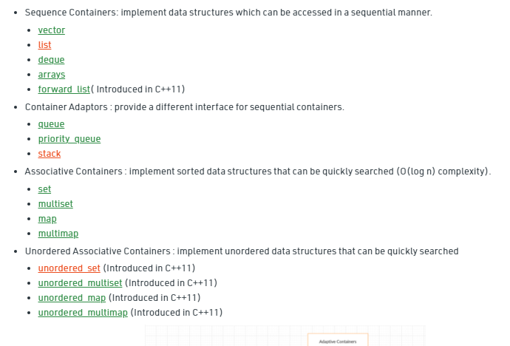
Different STL

Slide 19
Vectors
Vectors are same as dynamic arrays with the ability to resize itself automatically when an element is inserted or deleted, with their storage being handled automatically by the container. Vector elements are placed in contiguous storage so that they can be accessed and traversed using iterators. In vectors, data is inserted at the end. Removing the last element takes only constant time because no resizing happens. Inserting and erasing at the beginning or in the middle is linear in time.

Slide 20
Set
Sets are a type of associative containers in which each element has to be unique,

Slide 21
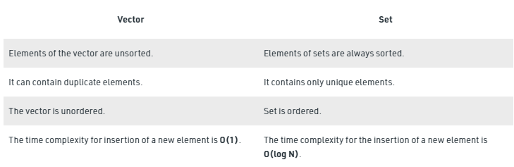
Vector vs Sets

Slide 22
Map
Maps are associative containers that store elements in a mapped fashion. Each element has a key value and a mapped value. No two mapped values can have same key values.

