Slide 1

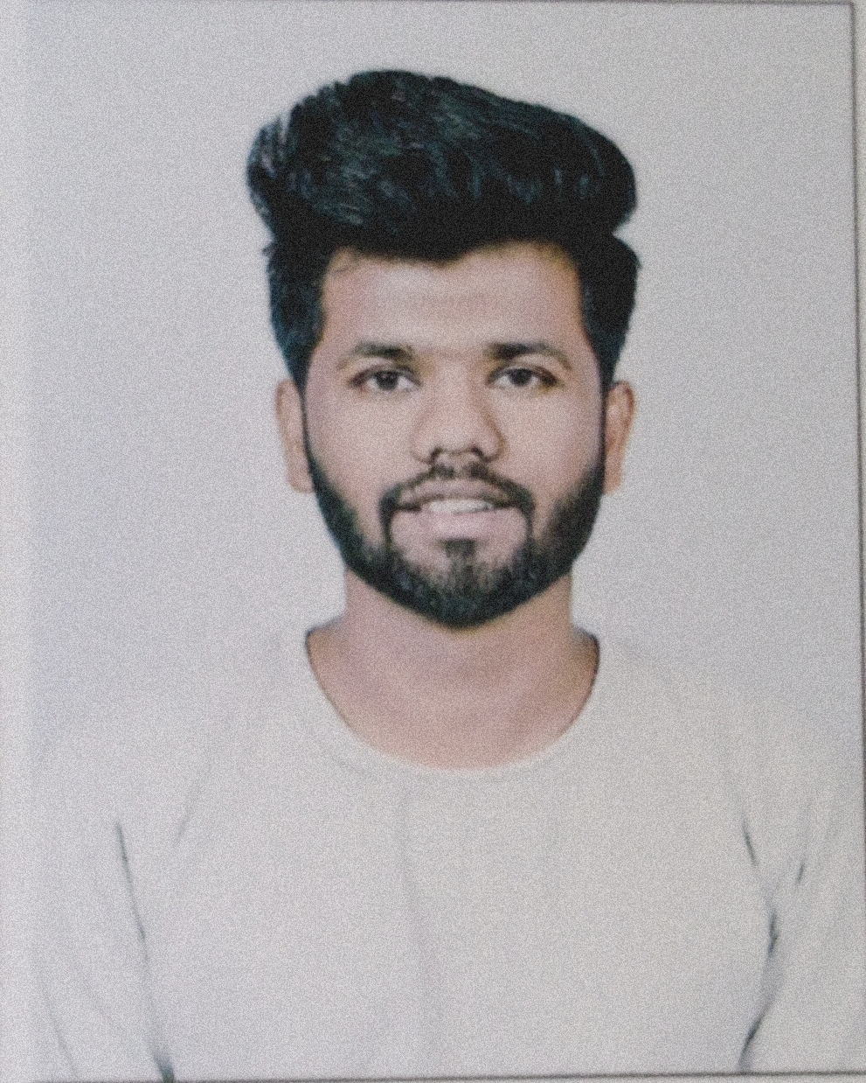



Arbaz Akhtar Mulla
Education and certificates Bachelor of Engineering & Technology,
Information Technology in Zeal college of engineering and research narhe, Pune.
Skills
Analyst/Software Engineer
Base Location: Mumbai
Email ID: ARBAZ.MULLA@CAPGEMINI.COM
Mobile No: +91 7249212019
Grade: A4
JAVA | Basics ,OOPS ,Data Structure, Collections, Array, Loops, Exception Handling
Spring Boot | Spring Boot, Spring Rest Services, Spring Rest-Ful Service
Spring | Components, Hooks, Virtual DOM, Routing, Forms & Validation
Database | PostgreSQL, MongoDB, Oracle
UI Tech | HTML 5 & CSS, JavaScript, React JS
Tools | Git & GitHub, Eclipse, Post-Man, Visual Studio Code, Pg Admin 4, SQL shell, git Bash.
Add On skills | Immersive Learning and Java
Strengths
Full Stack Developer
Hands-on experience on Core Java, PostgreSQL, Entity framework, SqlServer, MongoDB.
Proficient in creating Single page Web Applications in React with Authentication and routing
Hands-on experience in developing web pages using HTML 5, CSS, JavaScript, and ReactJS.
Ready to learn new technologies and implement them for Future Knowledge improvement.
Achievement
Agricultural loan
application is built to help customers to apply agriculture loans which is developed to automate all the activities of CRUD operations for Loan, Documents and Users through an application. We can create a system where we can manage all the information in a single place.
Note Making System
This application is built to help customer to keep their note updated. User can save and delete the note. It is easy to use.
Degreed: Successfully completed the degreed training in git, html, CSS, SQL, React., MongoDB
https://github.com/Arbazmulla321
Presentation Title | Author | Date © Capgemini 2017. All rights reserved | 1

