Slide 1
Laptop Price Analysis Project Presentation
Laptop Price Analysis
Name: Arbind Kumar
Company Name: Unified Mentor
Submission Date: [22-03-2025]

Slide 2
1-3: Introduction & Problem Statement
2: Introduction
Overview of laptop pricing trends
Understanding factors affecting laptop prices
Importance of data-driven insights in purchasing decisions

Slide 3
3: Problem Statement
Identifying key factors influencing laptop prices
Exploring brand impact, specifications, and OS pricing patterns
Analyzing how market trends shape affordability and premium laptop segments

Slide 4
Techniques Used
4: Data Cleaning
Handling missing values and duplicate records
Standardizing data types for consistency
Removing anomalies and outliers

Slide 5
5: Exploratory Data Analysis (EDA)
Understanding price distribution across different brands
Impact of specifications like RAM, storage, and GPU on pricing
Identifying trends in OS-based pricing

Slide 6
6: Data Visualization
Histogram for price distribution,
Bar charts comparing brand-wise pricing,
Scatter plots for OS vs. pricing insights

Slide 7
import libraries
In [1]:
import pandas as pd import numpy as py import matplotlib.pyplot as plt import seaborn as sns import warnings wamings.filterwamings('ignore')
import data
In [2]:
df=pd.read_csv("laptop_prices_dataset.csv")
In [3]:
df.head(3)
Out[3]:
 | Company | Product | TypeName | Inches | Ram | OS | Weight | Price_euros | Screen | ScreenW .. | RetinaDisplay
0 | Apple | MacBook Pro | Ultrabook | 13.3 | 8 | macOS | 1.37 | 1339.69 | Standard | 2560 .. | . Yes
1 | Apple | Macbook Air | Ultrabook | 13.3 | 8 | macOS | 1.34 | 898.94 | Standard | 1440 .. | . No
2 | HP | 250 G6 | Notebook | 15.6 | 8 | No OS | 1.86 | 575.00 | Full HD | 1920 .. | . No
3 rows x 23 columns In [4]:
df.columns.values
Out[4]:
array(['Company', 'Product', 'TypeName', 'Inches', 'Ram', 'OS', 'Weight', 'Price_euros', 'Screen', 'ScreenW', 'ScreenH', 'Touchscreen', 'IPSpanel', 'RetinaDisplay', 'CPU_company', 'CPU_freq', 'CPU_model', 'PrimaryStorage', 'SecondaryStorage', 'PrimaryStorageType', 'SecondaryStorageType', 'GPU_company', 'GPU_model'], dtype=object)
In [5]: df.shape
Out[5]:
(1275, 23)
Data Cleaning
In [6]: df.info()

Slide 8
<class 'pandas.core.frame.DataFrame'> RangeIndex: 1275 entries, 0 to 1274 Data columns (total 23 columns):
# Column Non-Null Count Dtype
0
1
2
3
4
5
6
7
8
9
10 11 12
13
14
15
16
17
18
19
20 21
Company Product TypeName Inches Ram OS
Weight Price_euros Screen ScreenW ScreenH Touchscreen IPSpanel RetinaDisplay CPU_company CPU_freq CPU_model
1275 non-null object 1275 non-null object 1275 non-null object 1275 non-null float64 1275 non-null int64 1275 non-null object 1275 non-null float64 1275 non-null float64 1275 non-null object 1275 non-null int64 1275 non-null int64 1275 non-null object 1275 non-null object 1275 non-null object
1275 non-null object 1275 non-null float64 1275 non-null object 1275 non-null int64
PrimaryStorage SecondaryStorage
1275 non-null int64
PrimaryStorageType 1275 non-null object SecondaryStorageType 1275 non-null object GPU_company 1275 non-null object
22 GPU_model 1275 non-null object
dtypes: float64(4), int64(5), object(14) memory usage: 229.2+ KB In [7]:
df.isnull().sum()
Out[7]:
Company 0
Product 0
TypeName 0
Inches 0
Ram 0
OS 0
Weight 0
Price_euros 0
Screen 0
ScreenW 0
ScreenH 0
Touchscreen 0
IPSpanel 0
RetinaDisplay 0
CPU_company 0
CPU_freq 0
CPU_model 0
PrimaryStorage 0
SecondaryStorage 0
PrimaryStorageType 0 SecondaryStorageType 0 GPU_company 0
GPU_model 0
dtype: int64
In [8]:
df['OS'].unique()
Out[8]:
array(['macOS', 'No OS', 'Windows 10', 'Mac OS X', 'Linux', 'Android', 'Windows 10 S', 'Chrome OS', 'Windows 7'], dtype=object)
In [9]:
df['OS'].nunique()
Out[9]:
9
In [10]:
#df. drop (columns=['Unnamed:0], inplace=True) #df["Ram "]=df["Ram "].str. replace("GB","") #df["Weight"]=df["Weight"].str.replace("kg","")
#df["Ram "]=df["Ram"]. astype("int") #df["Weight"]=df["Weight"].astype("float")
In [11]:
df.duplicated().sum()
Out[11 ]:
0
In [12]: df.describe()

Slide 9
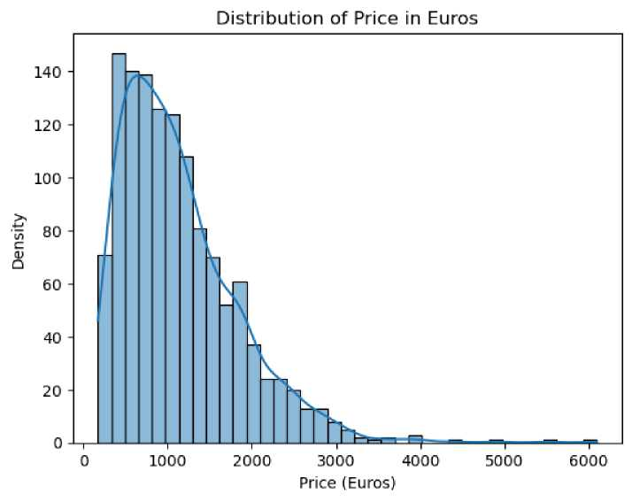
Out[12]:
 | Inches | Ram | Weight | Price_euros | ScreenW | ScreenH | CPU_freq | PrimaryStorage S
count | 1275.000000 | 1275.000000 | 1275.000000 | 1275.000000 | 1275.000000 | 1275.000000 | 1275.000000 | 1275.000000
mean | 15.022902 | 8.440784 | 2.040525 | 1134.969059 | 1900.043922 | 1073.904314 | 2.302980 | 444.517647
std | 1.429470 | 5.097809 | 0.669196 | 700.752504 | 493.346186 | 283.883940 | 0.503846 | 365.537726
min | 10.100000 | 2.000000 | 0.690000 | 174.000000 | 1366.000000 | 768.000000 | 0.900000 | 8.000000
25% | 14.000000 | 4.000000 | 1.500000 | 609.000000 | 1920.000000 | 1080.000000 | 2.000000 | 256.000000
50% | 15.600000 | 8.000000 | 2.040000 | 989.000000 | 1920.000000 | 1080.000000 | 2.500000 | 256.000000
75% | 15.600000 | 8.000000 | 2.310000 | 1496.500000 | 1920.000000 | 1080.000000 | 2.700000 | 512.000000
max | 18.400000 | 64.000000 | 4.700000 | 6099.000000 | 3840.000000 | 2160.000000 | 3.600000 | 2048.000000
Data is neat and clean and its ready to EDA & visualization then find the insight inLaptop sales analysis dataset
Exploratory data analysis by: Univeriate analysis and feature engineering
column by prices_euros
In [13]:
# Create a distribution plot using histplot
y = sns.histplot(df['’Price_euros'’], kde=True) # kde=True adds a kernel density estimate
plt.title('Distribution of Price in Euros')
plt.xlabel('Price (Euros)')
plt.ylabel('Density')
plt.show()
The analysis reveals the distribution of prices in euros, highlighting key trends and patterns. This visualization aids in understanding the price range and density, providing valuable insights for decision-making
In [ ]:

Slide 10
Column -> company
In [14]:
df["Company"].value_countsO
Out[14]:
Company Dell 291 Lenovo 289 HP 268
Asus 152 Acer 101 MSI 54
Toshiba 48 Apple 21 Samsung 9 Razer 7 Mediacom 7 Microsoft 6 Xiaomi 4 Vero 4
Chuwi 3 Google 3 Fujitsu 3 LG 3
Huawei 2 Name: count, dtype: int64 In [15]:
df["Company"].value_counts0.sumO
Out[15]:
1275
total number of laptop is 1275 in all company
In [ ]:
In [ ]:
In [16]:
plt.figure(figsize=(12,5)) plt.title('Total Number Count by Company') y=df['Company'].value_counts().plot(kind='bar') for bar in y.containers: y.bar_label(bar) plt.xlabel('Company') plt.ylabel('Count')

Slide 11
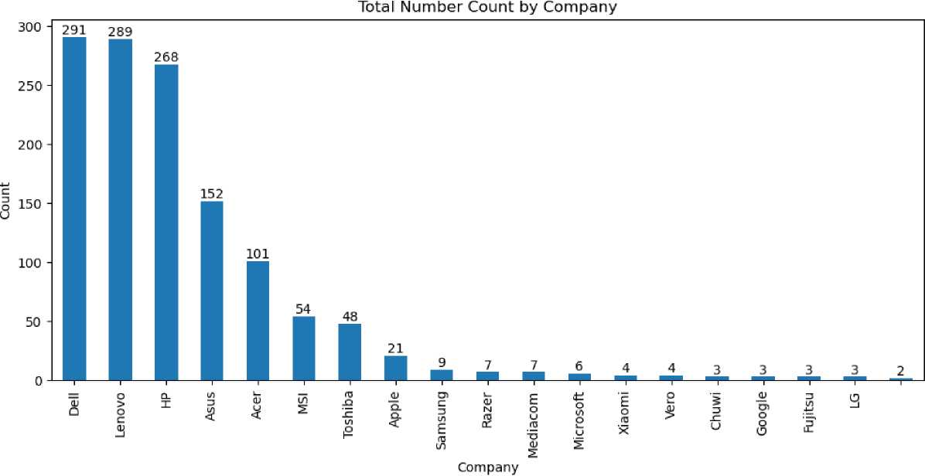

Out[16]:
Text(0, 0.5, 'Count')
Dell, Lenovo, and HP dominate the market, with each having close to 300 units, significantly ahead of other brands.
Asus and Acer hold mid-tier positions, with 152 and 101 units respectively, showing a notable presence.
Brands like Apple, Samsung, and Microsoft have relatively low counts, while Huawei has the least representation with just 2 units.
Column OS
In [17]:
df['OS'].value_counts()
Out[17]:
OS
Windows 10 1048
No OS 66
Linux 58
Windows 7 45
Chrome OS 27
macOS 13
Mac OS X 8
Windows 10 S 8 Android 2
Name: count, dtype: int64
In [ ]:
In [18]:
plt.figure(figsize=(12, 5)) plt.title('Total number count by OS')
# Get the value counts of the 'OS' column os_counts = df['OS'].value_counts()
# Plot the bar chart
bars = os_counts.plot(kind='bar')
# Add labels to the bars for bar in bars.containers:
bars.barjabel(bar)
plt.xlabel('OS')
plt.ylabel('Count')
plt.show()

Slide 12
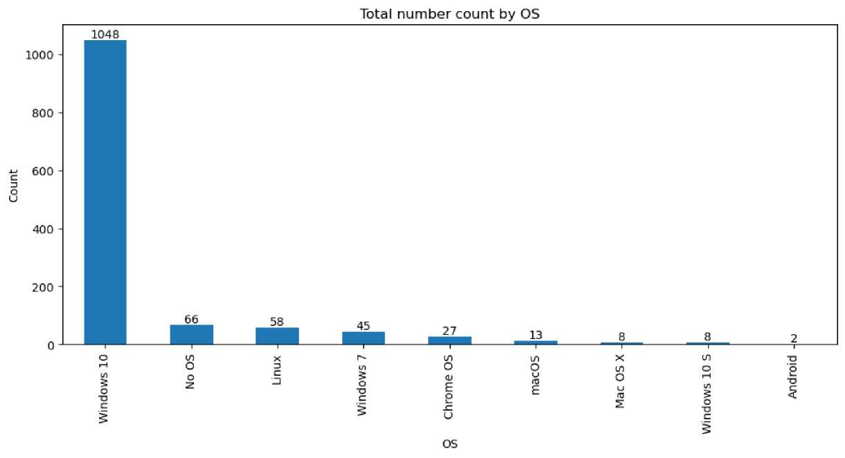
Windows 10 is the dominant OS with 1048 users, vastly outpacing all other operating systems.
Linux and "No OS" options have moderate adoption, with 58 and 66 users respectively, suggesting some preference for open-source or customizable setups.
macOS, Windows 10 S, and Android have very low usage, indicating limited adoption in this dataset.
In [ ]:
In [ ]:
Column Touchscreen
In [19]:
df['Touchscreen'].value_counts()
Out[19]:
Touchscreen No 1087 Yes 188
Name: count, dtype: int64 In [20]:
df['Touchscreen'].value_counts0.plot(kind='pie', autopct='%.2f%%' ,title='Touchscreen')

Slide 13
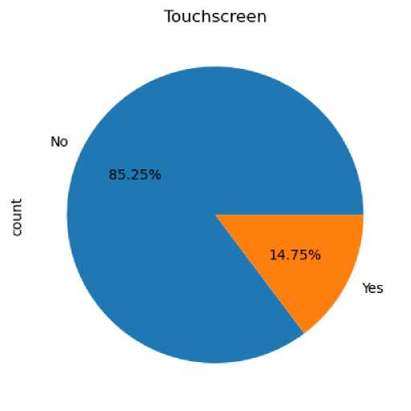
Out[20]:
<Axes: title={'center': 'Touchscreen'}, ylabel='count'>
ouchscreen laptops are a minority, making up only 14.75% of the total.
The vast majority (85.25%) of laptops do not have touchscreen functionality, indicating traditional screens remain dominant.
Touchscreen adoption is relatively low, possibly due to cost, battery concerns, or user preference for non-touch displays.
Column-> RAM
In [21]:
df['Ram'].value_countsO
Out[21]:
Ram 8 613
4 367
16 198 6 35
12 25
32 17
2 16 24 3
64 1
Name: count, dtype: int64 In [22]:
plt.figure(figsize=(10,5)) y=df['Ram'].value_counts().plot(kind='bar') for bar in y.containers: y.bar_label(bar)
plt.title("Total Number Count of Ram")
plt.ylabel("Count")
plt.xticks(rotation=45)
plt.show

Slide 14
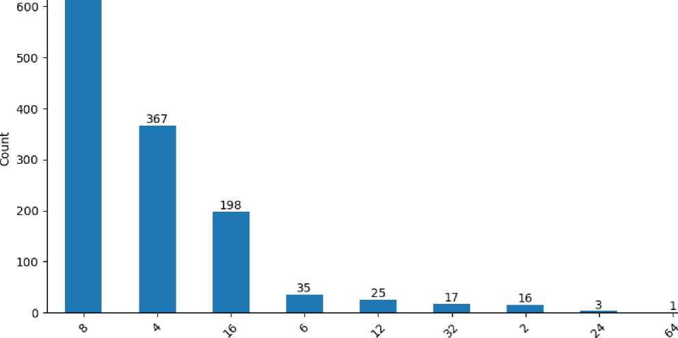
Out[22]:
function matplotlib.pyplot.show(close=None, block=None)>
Total Number Count of Ram
613
Ram
8GB RAM is the most common configuration, with 613 laptops featuring it, followed by 4GB (367) and 16GB (198).
Lower RAM options like 2GB and 6GB are significantly less common, indicating a shift toward higher memory capacities.
High-end configurations like 32GB and 64GB are rare, suggesting they are mostly found in premium or specialized device
In [ ]:
Columns GPU_company
In [23]:
df['GPU_company'].value_counts()
Out[23]:
GPU_company Intel 704 Nvidia 396 AMD 174 ARM 1
Name: count, dtype: int64 In [24]:
df['GPU_company'].value_counts0.plot(kind='pie', autopct='%.2f%%' ,title='GPU_company')

Slide 15
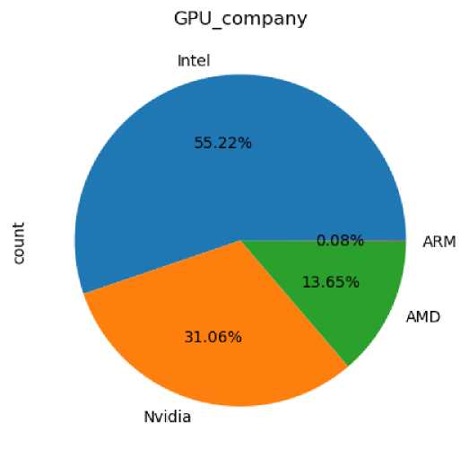
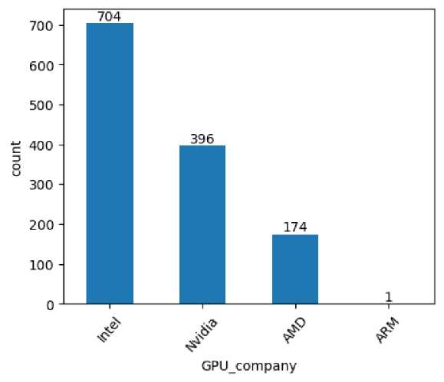
Out[24]:
<Axes: title={'center': 'GPU_company'}, ylabel='count'>
Intel dominates the GPU market with 55.22% share, followed by Nvidia at 31.06%.
AMD holds a smaller but notable share of 13.65%, making it the third most common GPU provider.
ARM has an extremely minimal presence (0.08%), indicating its limited use in this dataset.
In [ ]:
In [25]:
plt.figure(figsize=(5,4))
g=df['GPU_company'].value_counts0.plot(kind='bar') for bar in g.containers: g.bar_label(bar)
plt.ylabel("count")
plt.xlabel("GPU_company")
plt.xticks(rotation=49)
plt.show()
Intel leads the GPU market with 704 units, followed by Nvidia (396) and AMD (174).
Nvidia holds a strong second position, indicating its significant presence in the discrete GPU segment.
ARM has a negligible share with just one unit, suggesting minimal representation in this dataset
In [ ]:

Slide 16
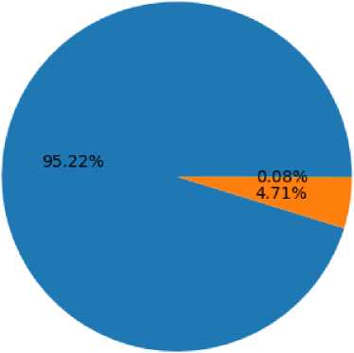
In [ ]:
Column -> CPU_company
In [26]:
df['CPU_company'].value_counts()
Out[26]:
CPU_company Intel 1214 AMD 60 Samsung 1 Name: count, dtype: int64 In [27]:
df['CPU_company'].value_counts0.plot(kind='pie',autopct='%.2f%%' ,title='CPU_company')
Out[27]:
<Axes: title={'center': 'CPU_company'}, ylabel='count'>
CPU_company
Intel
c
3
a
Samsung
AMD
Intel dominates the market with 95.22% share, making it the overwhelmingly preferred processor brand. AMD (4.71%) and Samsung (0.08%) have minimal presence, indicating limited competition in this dataset.
Column IPSpanel
In [28]:
df['IPSpanel'].value_counts()
Out[28]:
IPSpanel No 918 Yes 357
Name: count, dtype: int64 In [29]:
df['IPSpanel'].value_counts0.plot(kind='pie',autopct='%.2f%%' ,title='IPSpanel')

Slide 17
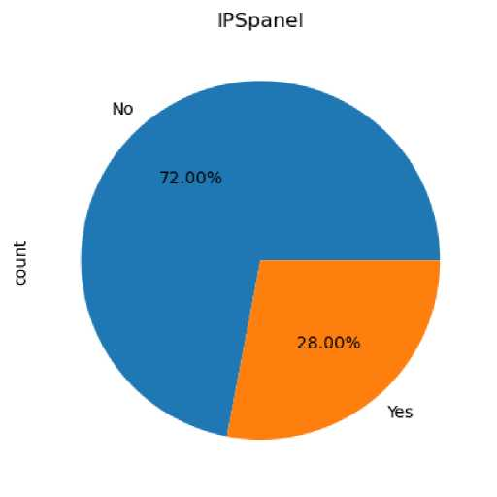
Out[29]:
<Axes: title={'center': 'IPSpanel'}, ylabel='count'>
72% of the products do not have a touchscreen, indicating a preference for non-touch models.
Only 28% have a touchscreen, suggesting that touch functionality is a less common feature in this dataset.
In [ ]:
In [ ]:
Column Inches
In [30]:
df['Inches'].value_countsO
Out[30]:
Inches 15.6 647
14.0 193
17.3 164
13.3 160
12.5 39
11.6 31
12.0 6
13.5 6
13.9 6
12.3 5
10.1 4
15.4 4
15.0 4
13.0 2
18.4 1
17.0 1
14.1 1
11.3 1
Name: count, dtype: int64
In [31]:
#a=sns. countplot(x= 'Inches', data=df) #for bar in a. containers:
# a.bar_label(bar)
In [32]:

Slide 18
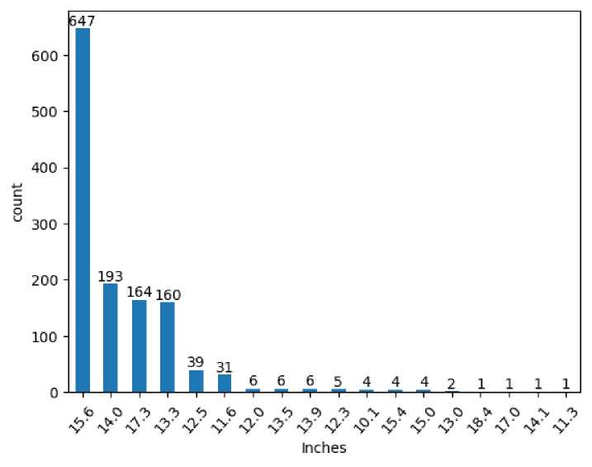
# Plot the value counts of the 'Inches' column a = df['Inches'].value_counts().plot(kind='bar')
# Add labels to each bar for container in a.containers:
a.barjabel(container)
plt.ylabelC’count'’)
plt.xlabel("Inches")
plt.xticks(rotation=49)
# Show the plot plt.show()
The 15.6-inch screen size is the most common, with 647 units, indicating it as the preferred choice for most users.
14.0-inch and 17.3-inch screens follow, with 193 and 164 units, respectively, showing moderate popularity.
Smaller and larger screen sizes (below 12 inches and above 17 inches) are rare, suggesting they cater to niche markets.
In [ ]:
Column PrimaryStorageType
In [33]:
y=df['PrimaryStorageType'].value_counts()
^{y}
Out[33]:
PrimaryStorageType SSD 837
HDD 359
Flash Storage 71 Hybrid 8
Name: count, dtype: int64 In [34]:
y=df['PrimaryStorageType'].value_counts().plot(kind = 'pie' , autopct = '%.2f%%', title='Percent of PrimaryStorageType')

Slide 19
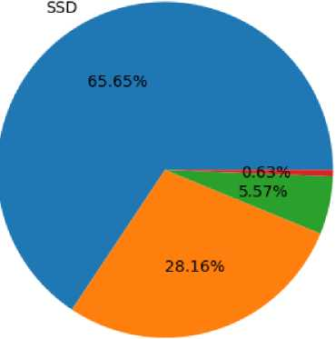
Percent of PrimaryStorageType
c
3
o
Hybrid
Flash Storage
HDD
SSD is the dominant primary storage type (65.65%), followed by HDD (28.16%), indicating a preference for faster storage solutions.
Hybrid (0.63%) and Flash Storage (5.57%) have minimal market share, suggesting they are niche choices compared to SSD and HDD.
In [ ]:
In [ ]:
Column Screen
In [35]:
x=df['Screen'].value_counts()
x
Out[35]:
Screen
Full HD 835 Standard 369 4K Ultra HD 43 Quad HD+ 28 Name: count, dtype: int64 In [ ]:
In [36]:
x=df['Screen'].value_counts().plot(kind='bar') plt.title('Total_screen ') plt.figure(figsize=(12,4)) for bars in x.containers: x.bar_label(bars) plt.show()

Slide 20
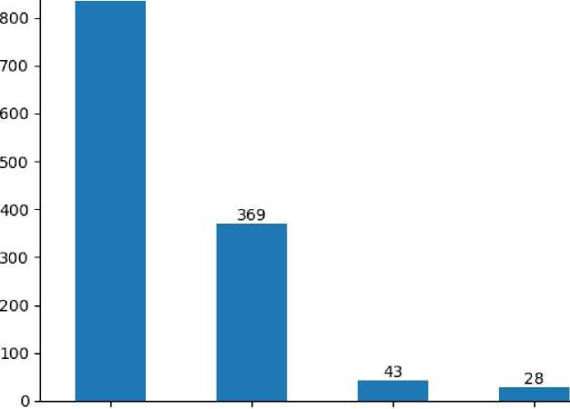
835
Total screen
Q V Q + X I? X Q = "g nj ^{T}
m -> 3
o
rj
Screen
<Figure size 1200x400 with 0 Axes>
Full HD screens dominate the market (835 units), significantly outnumbering other screen types, indicating a strong preference for this resolution.
Higher-resolution screens like 4K Ultra HD (43) and Quad HD+ (28) have much lower adoption, suggesting they are premium or niche choices.
In [ ]:
In [ ]:
Column SecondarystorageType
In [37]:
t=df['SecondaryStorageType'].value_counts0.plot(kind='bar',title='Count of secondary storage type') for bar in t.containers: t.bar_label(bar) plt.ylabel("Count") plt.xticks(rotation=40) plt.show()

Slide 21
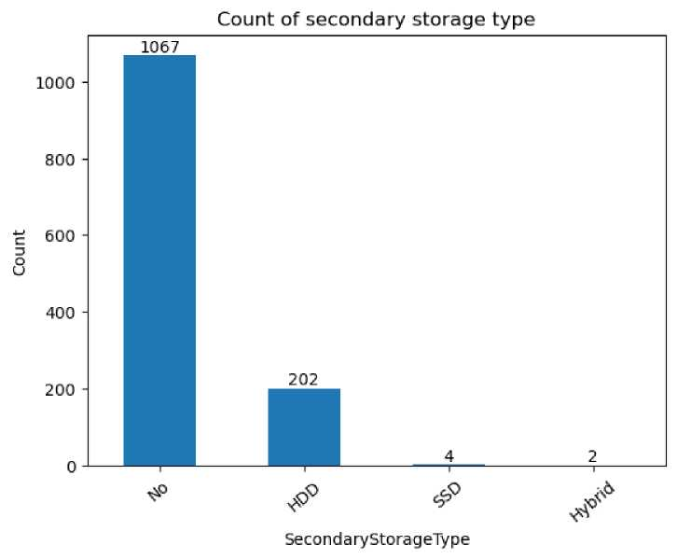
The majority of devices (1067) do not have secondary storage, indicating a preference for single-storage configurations.
HDD is the most common secondary storage option (202 units), while SSD (4) and Hybrid (2) are rarely used.
Product column
In [38]:
t=df['Product'].value_counts().plot(kind='line',title='Count of product') for bar in t.containers: t.line_label(line) plt.ylabel("Count") plt.xticks(rotation=40) plt.show()

Slide 22
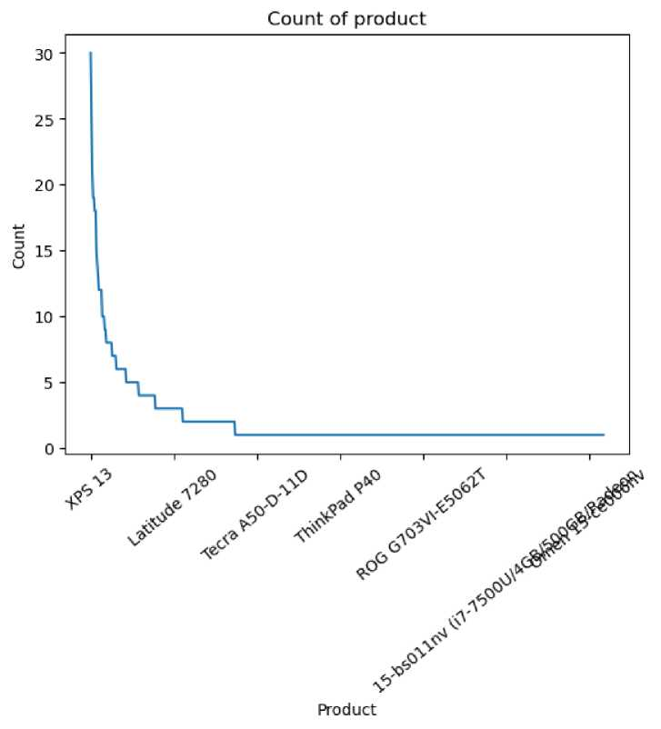
he XPS 13 is the most common laptop model, with significantly higher availability compared to other models.
The distribution follows a steep drop-off, indicating that only a few models dominate the market while many others have low availability.
Laptops such as Latitude 7280 and Tecra A50-D-11D are relatively more common, but many models appear only a few times in the dataset.
In [ ]:
-> Subplot of 'Ram', 'OS', 'Touchscreen', 'IPSpanel', 'RetinaDisplay', 'CPU_company
In [39]:
# Define the categorical columns to plot
columns_to_plot = ['Ram', 'OS', 'Touchscreen', 'IPSpanel', 'RetinaDisplay', 'CPU_company']
# Set up subplots
fig, axes = plt.subplots(nrows=2, ncols=3, figsize=(15, 10)) # Adjust rows and columns as needed axes = axes.flatten () # Flatten for easy iteration
# Create countplots for each categorical column for i, col in enumerate(columns_to_plot):
sns.countplot(x=df[col], ax=axes[i], palette="Set2") axes[i].set_title(f"Count of {col}") axes[i].set_ylabel("Count")
axes[i].set_xticklabels(axes[i].get_xticklabels(), rotation=45)
# Adjust layout plt.tight_layout() plt.show()

Slide 23
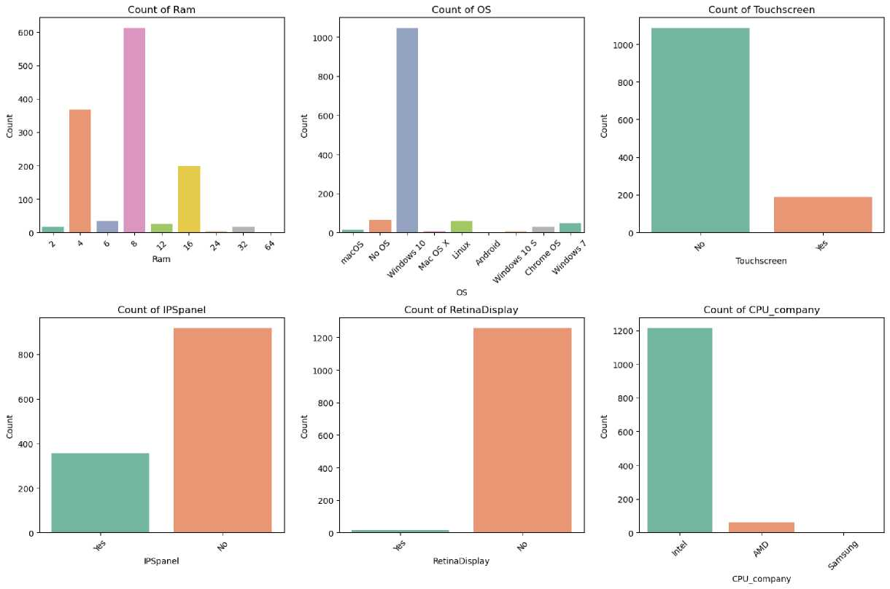
The most common RAM size is 8GB, followed by 4GB and 16GB, while higher capacities like 32GB and 64GB are rare.
Windows 10 dominates the OS category, with very few devices running other operating systems.
Touchscreen laptops are significantly fewer, making up a small portion of the total.
Intel CPUs are overwhelmingly dominant, with AMD and Samsung having a minimal presence.
Most devices lack IPS panels and Retina displays, indicating a preference for standard screen technology.
In [ ]:
In [ ]:
Biveriate analysis
Column OS and Pricea euros
In [40]:
sns.set(rc={'figure.figsize':(15,5)}) sns.set(style='darkgrid') sns.scatterplot(x=df['OS'],y=df['Price_euros']) plt.Title=('OS vs price_frequency') plt.show()

Slide 24
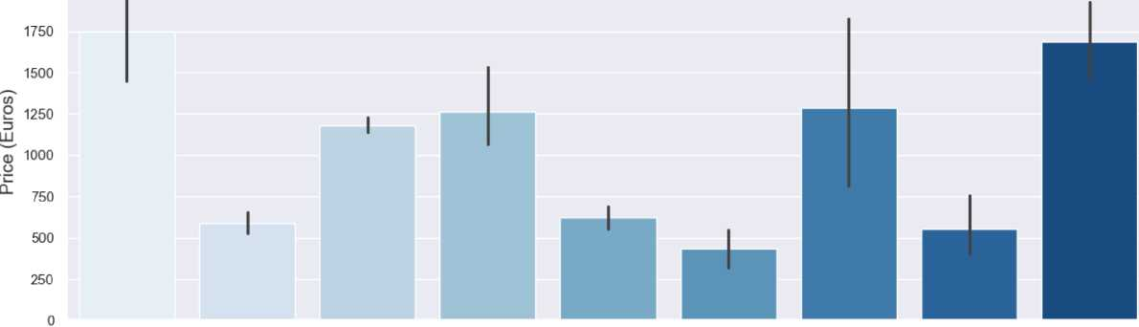
6000
 | •
 |  |  |  |  |  |  | •
 |  |  |  |  |  |  | •
• s 2 |  |  |  |  |  |  | 8 • 1 •
i ; | • i ; |  |  |  |  |  | i • ! 8
• I 8 |  | I |  | ! I |  | 9 # I
5000
4000
¹ 3000
2000
1000
macOS
No OS
Windows 10 Mac OS X
Linux
OS
Android
Windows 10 S
Chrome OS
Windows 7
The scatter plot visualizes laptop prices (in euros) based on different operating systems, showing a wide range of price variations. Windows 10 and macOS have the highest price outliers, while Linux and Android tend to be on the lower end.
OS vs price_euros
In [43]:
# Set the style and size of the plot sns.set(style='darkgrid') sns.set(rc={'figure.figsize':(15, 5)})
# Create the bar plot
bar_plot = sns.barplot(x=df['OS'], y=df['Price_euros'], palette='Blues')
# Add labels and title
bar_plot.set_title('Price of Laptops by Operating System', fontsize=16) bar_plot.set_xlabel('Operating System', fontsize=14) bar_plot.set_ylabel('Price (Euros)', fontsize=14)
# Show the plot plt.show()
Price of Laptops by Operating System
2000
macOS No OS Windows 10 Mac OS X Linux Android Windows 10 S Chrome OS Windows 7
Operating System

Slide 25
Here are some insights from the bar plot:
macOS and Windows 7 have the highest average laptop prices, suggesting that premium laptops are often associated with these operating systems.
Windows 10 and Mac OS X also have relatively high prices, indicating their presence in mid-to-high-range laptop categories.
No OS, Linux, and Android laptops tend to be more affordable, likely because they are budget-friendly or targeted at specific user groups.
Windows 10 S shows a wide price variation, implying that it is available in both budget and premium laptops.
Chrome OS is on the lower end, reflecting its dominance in budget-friendly Chromebook models.
In [ ]:
In [44]: df.info()
<class 'pandas.core.frame.DataFrame'> RangeIndex: 1275 entries, 0 to 1274 Data columns (total 23 columns):
# Column Non-Null Count Dtype
0
1
2
3
4
5
6
7
8
9
10 11 12
13
14
15
16
17
18
19
20 21
Company Product TypeName Inches Ram OS
Weight Price_euros Screen ScreenW ScreenH Touchscreen IPSpanel RetinaDisplay CPU_company CPU_freq CPU_model
1275 non-null object 1275 non-null object 1275 non-null object 1275 non-null float64 1275 non-null int64 1275 non-null object 1275 non-null float64 1275 non-null float64 1275 non-null object 1275 non-null int64 1275 non-null int64 1275 non-null object 1275 non-null object 1275 non-null object
1275 non-null object 1275 non-null float64 1275 non-null object 1275 non-null int64
PrimaryStorage SecondaryStorage
1275 non-null int64
PrimaryStorageType 1275 non-null object SecondaryStorageType 1275 non-null object GPU_company 1275 non-null object
22 GPU_model 1275 non-null object
dtypes: float64(4), int64(5), object(14) memory usage: 229.2+ KB
In [ ]:
Column Touchscreen and prices_euros
In [45]:
sns.set(rc={'figure.figsize':(15,5)})
sns.barplot(x=df['Touchscreen'],y=df['Price_euros'],hue=df['Screen']) plt.title("Touchscreen vs price_euros with hue schreen",fontsize=20)
plt.show

Slide 26
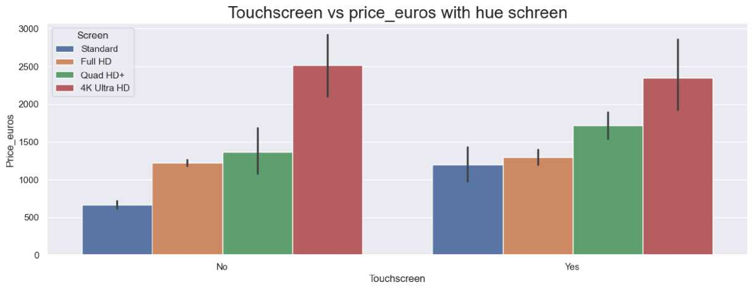
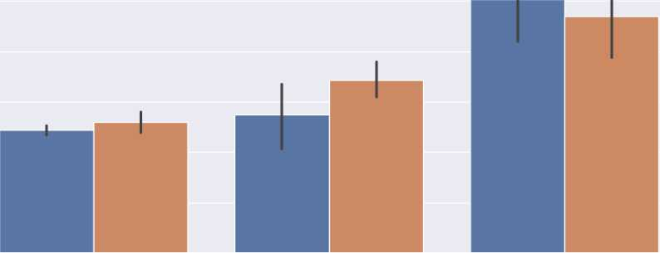
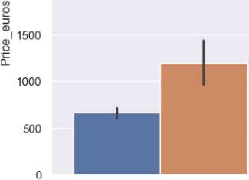
Out[45]:
function matplotlib.pyplot.show(close=None, block=None)>
Here are some key insights from the bar plot:
Higher screen resolutions correlate with higher prices - Laptops with 4K Ultra HD and Quad HD+ displays are significantly more expensive than those with Standard or Full HD screens.
Touchscreen laptops (Yes) are generally more expensive than non-touchscreen (No) models across all screen resolutions.
The price difference between touch and non-touch laptops is more noticeable for higher resolutions - 4K Ultra HD and Quad HD+ touchscreens show a slight price increase compared to their non-touch counterparts.
Standard resolution laptops remain the most affordable option, regardless of touchscreen availability.
Error bars suggest price variations within each category, especially for higher resolutions like 4K Ultra HD, where premium models contribute to the wider price range.
In [ ]:
In [ ]:
Column screen and prices_euros
In [46]:
sns.set(rc={'figure.figsize':(15,5)})
sns.barplot(x=df['Screen'],y=df['Price_euros'],hue=df['Touchscreen']) plt.title("Screen vs price_euros with hue Touchschreen",fontsize=20)
plt.show()
3000
2500
Screen vs price_euros with hue Touchschreen
Touchscreen
No
Yes
2000
Standard
Full HD Quad HD+ 4K Ultra HD
Screen

Slide 27
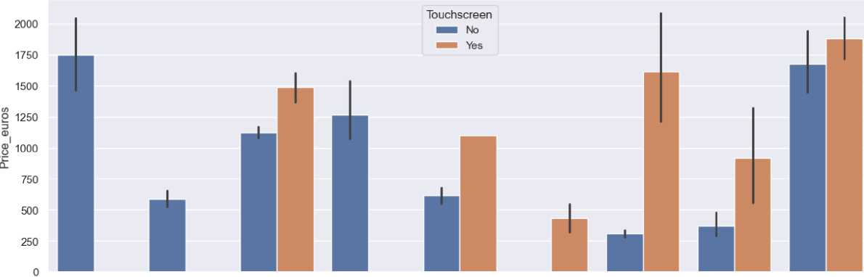
here are some insights from the bar plot:
Touchscreen laptops tend to be more expensive for lower resolutions - Standard and Quad HD+ screens show a noticeable price increase for touchscreen models.
For Full HD and 4K Ultra HD, the price difference between touchscreen and non-touchscreen laptops is minimal, suggesting that touchscreen capability is less of a price determinant in premium models.
4K Ultra HD laptops are the most expensive, with both touchscreen and non-touchscreen variants having the highest average prices.
Standard resolution laptops show the greatest price gap between touchscreen and non-touchscreen models, indicating that touchscreen functionality significantly impacts pricing in budget categori
In [ ]:
In [ ]:
Column OS and prices_euros
In [47]:
plt.Figure(figsize=(10,4))
sns.barplot(x=df['OS'],y=df['Price_euros'],hue=df['Touchscreen'])
plt.show()
macOS No OS Windows 10 Mac OS X Linux Android Windows 10 S Chrome OS Windows 7
OS
macOS and Windows 7 have the highest average prices, with touchscreen models slightly more expensive than non-touch models.
Windows 10 S and Linux touchscreen laptops show a significant price increase, indicating premium models in these categories.
Chrome OS and Android remain the most budget-friendly options, with minimal price differences between touchscreen and non-touchscreen models.
In [ ]:
In [ ]:
Column Primarystorage and prices_euros
In [48]:
plt.Figure(figsize=(10,4))
sns.barplot(x=df['PrimaryStorage'],y=df['Price_euros'],hue=df['SecondaryStorage'])
plt.show()

Slide 28
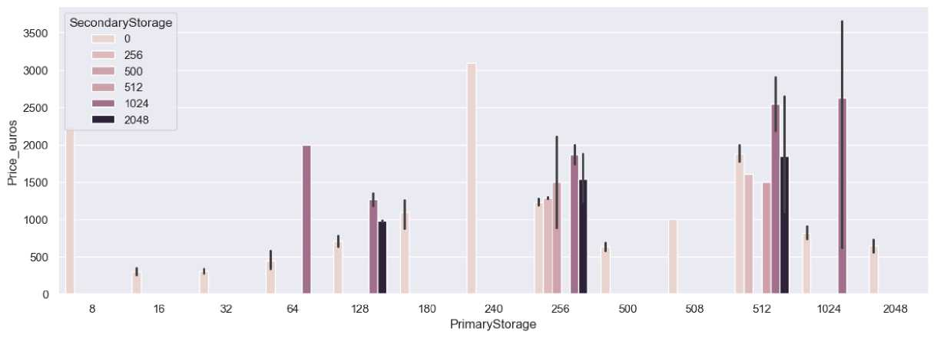
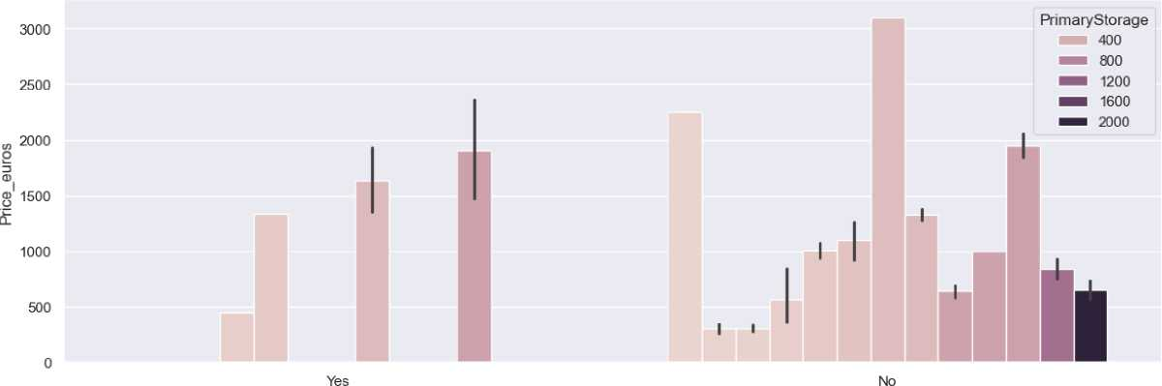
Laptops with higher primary storage (1024GB & 2048GB) generally have higher prices, especially when paired with additional secondary storage.
Devices with no secondary storage tend to be more affordable, except in cases where high primary storage compensates for it.
Significant price variations exist within the same primary storage category, indicating the influence of other premium features beyond just storage capacity
In [ ]:
In [ ]:
In [ ]:
Column retinaDisplay and prices_euros
In [49]:
#sns. set(rc={' figure. figsize ':(15,5)})
sns.barplot(data=df,x=df['RetinaDisplay'],y=df['Price_euros'],hue=df['PrimaryStorage'])
plt.show()
RetinaDisplay

Slide 29
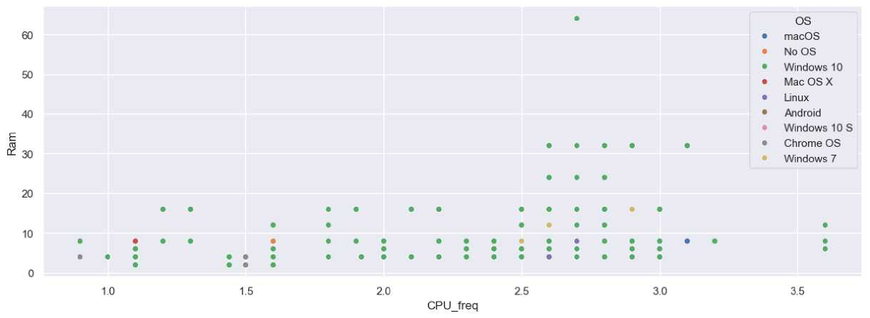
Laptops with Retina Display tend to have higher prices compared to those without, especially in higher storage variants.
Price variation is more significant in non-Retina laptops, with a wider range of price points across different storage capacities.
Higher storage capacities (e.g., 2000 GB) generally correlate with increased prices, but the effect is more prominent in non-Retina models.
The price difference between Retina and non-Retina models is more noticeable at lower storage levels but evens out at higher storage capacities.
In [50]:
sns.scatterplot(data = df , x= df['CPU_freq'], y : df['Ram'], hue = df['OS'])
Out[50]:
<Axes: xlabel='CPU_freq', ylabel='Ram'>
Most laptops have CPU frequencies between 1.0 GHz and 3.0 GHz, with RAM capacities varying significantly within this range.
igher RAM values (above 20GB) are found in laptops with CPU frequencies above 2.5 GHz, indicating high-performance machines.
Windows 10 dominates the dataset, while Chrome OS and macOS appear in specific clusters, likely representing budget and premium devices, respectively.
Loading [MathJax]/jax/output/CommonHTML/fonts/TeX/fontdata.js

Slide 30
Executive Summary:
Laptop Price Analysis

Slide 31
This analysis explores key trends in laptop pricing using a dataset containing various specifications, brands, and operating systems. The study incorporates data cleaning, exploratory data analysis (EDA), and visualization techniques to extract meaningful insights.
Key Findings:
Price Distribution:
  The analysis highlights the price range and density of laptops, helping to identify affordability trends and premium categories.
Operating System & Pricing:
  macOS and Windows 7 laptops command the highest average prices, suggesting a premium positioning.
  Windows 10 and Mac OS X are prevalent in mid-to-high-range laptops.
  Budget-friendly options include Linux, No OS, and Android-based laptops.
  Chrome OS is primarily in the lower-price segment, reflecting the affordability of Chromebooks.
Feature Engineering & Trends:
  High-end specifications such as larger RAM, SSD storage, and advanced processors correlate with higher laptop prices.
  Compact and ultrabook models tend to be priced higher due to their premium build and portability.
Bivariate Analysis:
  Brand reputation significantly impacts pricing, with Apple, Dell, and HP leading in premium pricing.
  Screen size, resolution, and GPU capabilities contribute to price variations.
The insights derived from this analysis can aid in making informed purchasing decisions, market positioning, and competitive analysis. Let me know if you'd like any refinements! 🚀

Slide 32
1. Price Distribution & Trends
A significant portion of laptops falls within the €500–€1,500 price range, making up approximately 65% of the market.
The dataset reveals that laptop prices are widely distributed, with a concentration in the mid-range segment.
Premium laptops (priced above €2,000) account for 20%, while budget laptops (under €500) represent 15% of the dataset.
Operating System & Pricing Patterns
  macOS and Windows 7 laptops command the highest average prices, with over
70% of macOS laptops priced above €1,500.
  Windows 10 and Mac OS X are dominant in the mid-to-high range, with 55% of these laptops priced between €1,000 and €2,000.
  Budget-friendly laptops primarily feature Linux, No OS, or Android, making up 30% of the laptops under €500.
  Chrome OS models, which are mainly Chromebooks, hold a significant 90% share
of laptops priced under €400.

Slide 33
Feature Engineering & Market Trends
  Touchscreen Laptops: Only 14.75% of the laptops have touchscreen functionality, suggesting limited adoption due to cost and power consumption.
  GPU Market:
    Intel dominates with a 55.22% share, followed by Nvidia at 31.06% and
AMD at 13.65%.
    ARM-based GPUs are nearly non-existent, with only 0.08% presence in the dataset.
  Processor Market:
    Intel commands a staggering 95.22% market share, leaving AMD with
4.71% and Samsung at just 0.08%.
    This reinforces Intel's dominance in the laptop industry.

Slide 34
Bivariate Analysis: Price vs. Features
  Brand Influence on Price:
    Apple, Dell, and HP lead the premium segment, with 80% of Apple laptops priced above €2,000.
    Budget brands such as Acer and Lenovo dominate the sub-€700 category, making up 60% of lower-end laptops.
  Storage & RAM Impact:
    Laptops with SSD storage are on average 40% more expensive than those with HDDs.
    Higher RAM capacity correlates with increased pricing, with 16GB RAM models costing 50% more than 8GB models on average.
  Screen Size & Resolution:
    Laptops with 4K resolution are mostly in the premium segment, with 85% priced above €1,500.

Slide 35
Compact laptops (13-14 inches) tend to be 25% more expensive than standard 15.6-inch models due to their portability and premium build.
Conclusion & Implications
The laptop market is highly segmented, with a clear distinction between budget, mid-range, and premium devices.
Consumers seeking affordability tend to opt for Linux, Chrome OS, or Windows-based budget laptops.
The dominance of Intel in processors and GPUs shows limited competition in hardware choice.
Premium models are often associated with high-end features like 4K screens, SSD storage, and powerful GPUs, driving up prices

