Slide 1
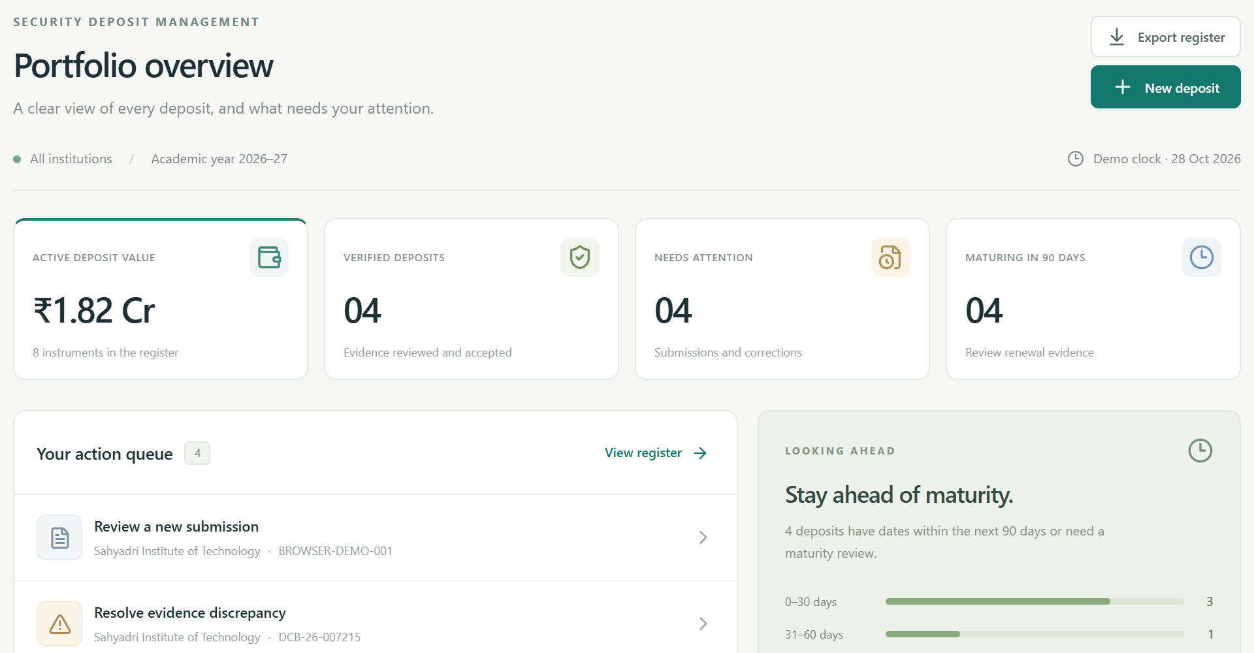
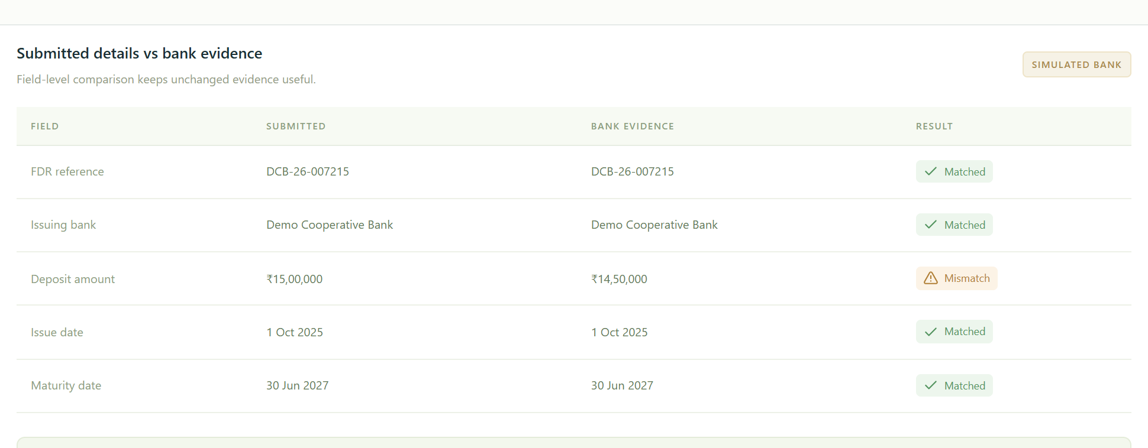
NidhiSetu
IMPACT AND BENEFITS
Impact on Users
Benefits of the Solution
•
Institutions: Clear correction requests and visible status
explain what to submit next.
•
Administrative efficiency: Centralized records reduce
searching across separate files and correspondence.
•
Review officers: One queue brings pending submissions,
discrepancies and maturity follow-ups together.
•
Record accuracy: Field comparisons and version history help
identify inconsistencies.
•
Accountability: Recorded actions make reviews and release
decisions easier to reconstruct.
•
Approving authorities: Prerequisite checks and recorded
decisions support controlled release processing.
•
Reduced paperwork: Digital documents can reduce repeated
printing and physical circulation.
•
Administrative leadership: Consolidated status supports
oversight of pending institutional cases.
•
Earlier follow-up: Maturity visibility helps teams identify
deposits needing renewal review.
Operational Change
Fragmented tracking
With NidhiSetu
Separate records
Connected case history
Manual status chasing
Visible pending actions
Scattered approvals
Recorded release steps
One view of cases
requiring attention
Discrepancies remain visible
during review
Intended workflow improvements
NidhiSetu
5
Notes:
Reference: user-supplied Impact and Benefits slide. Screenshots captured independently from the local NidhiSetu prototype on 29 October 2026. Dashboard and bank evidence contain synthetic demonstration records. Bank evidence is simulated. Intended workflow improvements are qualitative, not measured impact. SIH2026 logo sourced from the user’s original SIH2026-IDEA-Presentation-Format (1).pptx. Text, section backgrounds, diagram nodes and connectors are individual native PowerPoint objects.

