Slide 1
Speech Emotion Recognition with HuBERT and Hand-crafted Features
Does cross-attention fusion help?
A controlled, speaker-independent comparison on RAVDESS and CREMA-D
JATIN KUSHWAHA – 2024EEB1231
PRANAY SHEKHAR – 2024EEB1211
Notes:
Introduce the team and the question: does combining HuBERT with hand-crafted features, especially with cross-attention, actually help speech emotion recognition when tested on unseen speakers?

Slide 2
Motivation and problem statement
Emotion is expressed through pitch, loudness, timing and voice quality, not only words
Classical SER uses hand-crafted features (MFCC, prosody) with SVM / Random Forest
Self-supervised models such as HuBERT give much stronger speech representations
Recent work fuses both, often with cross-attention (e.g. the HuMP-CAT paper by Zhao et al., used as our reference)
Gains are rarely checked against a strong HuBERT-only baseline on unseen speakers
Our question
Given acted speech from speakers never seen in training, does fusing HuBERT with MFCC and prosody, and in particular cross-attention fusion, improve on HuBERT alone?
Six classes: neutral, happy, sad, angry, fearful, disgust
We use HuMP-CAT as inspiration only: no reproduction and no cross-lingual evaluation.
Speech Emotion Recognition · course project
2
Notes:
Emotion is carried by how something is said. Classical systems use MFCC and prosody; modern systems use self-supervised models such as HuBERT. Several papers, including the HuMP-CAT reference paper, fuse both with attention. We wanted to check whether that fusion helps under a strict speaker-independent protocol.

Slide 3
Objectives
Build a reproducible pipeline
speaker-independent folds, validation-only model selection
E1 – classical baseline
MFCC statistics with SVM and Random Forest
1
2
E2 – value of HuBERT
frozen HuBERT features pooled over time, small MLP
E3 – concatenation fusion
HuBERT + MFCC + prosody per frame, with stream ablations
3
4
E4 – cross-attention fusion
against concatenation, a size-matched self-attention model and HuBERT-only
Compare honestly
accuracy, per-class errors, computational cost and limitations
5
6
Speech Emotion Recognition · course project
3
Notes:
Each objective maps onto one experiment, so the comparison is built up one idea at a time.

Slide 4
Background: three kinds of speech features
MFCC
39 values per 20 ms frame
Prosody
4 values per 20 ms frame
HuBERT-base
13 layers × 768 per 20 ms frame
13 cepstral coefficients + Δ + ΔΔ
describes the short-time spectral envelope
classical, cheap, interpretable
F0 (semitones), voicing, periodicity, energy (dB)
intonation and loudness
F0 from Praat (60–800 Hz)
self-supervised, trained on unlabelled speech
used frozen (94.4 M parameters)
middle layers carry most emotion information
Cross-attention: Attention(Q, K, V) = softmax(QKᵀ / √dₖ) V, with queries from one stream (e.g. HuBERT) and keys / values from another (e.g. MFCC + prosody), so each frame can pick relevant frames of the other stream.
Speech Emotion Recognition · course project
4
Notes:
MFCC describes the spectral envelope, prosody describes intonation and loudness, and HuBERT is a self-supervised model whose hidden layers capture much richer speech information. Cross-attention lets one stream choose relevant frames of another stream.

Slide 5
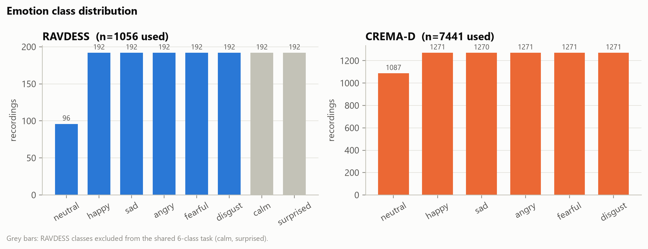
Datasets and preprocessing
 | RAVDESS | CREMA-D
Speakers | 24 actors | 91 actors
Recordings used | 1,056 | 7,441
Folds (speaker-independent) | 6 | 5
Test speakers per fold | 4 | 18
Mono, resampled to 16 kHz
Leading / trailing silence trimmed
DC removed, peak normalised
All streams on one shared 20 ms frame grid
Scalers and class weights fitted on training speakers only
Speech Emotion Recognition · course project
5
Notes:
Two acted English datasets. We keep the six shared emotions. Splits are by speaker, so the model is always tested on voices it never heard. Preprocessing is light: resample, trim silence, normalise.

Slide 6
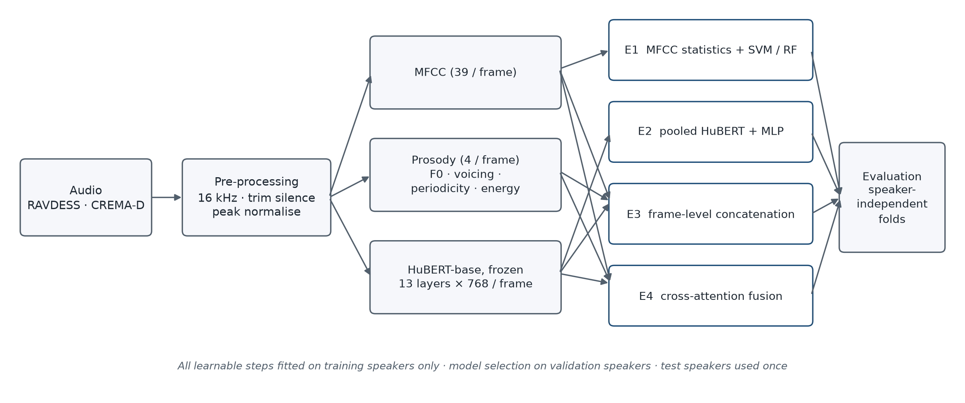
Overall methodology
Protocol: hyper-parameters chosen on validation speakers only · 3 seeds per configuration · checkpoint saved, reloaded, test predicted once · mean ± std over folds
Speech Emotion Recognition · course project
6
Notes:
Each experiment adds one idea. The protocol is identical for all of them: validation-only selection, three seeds, saved checkpoints, each test fold predicted once.

Slide 7
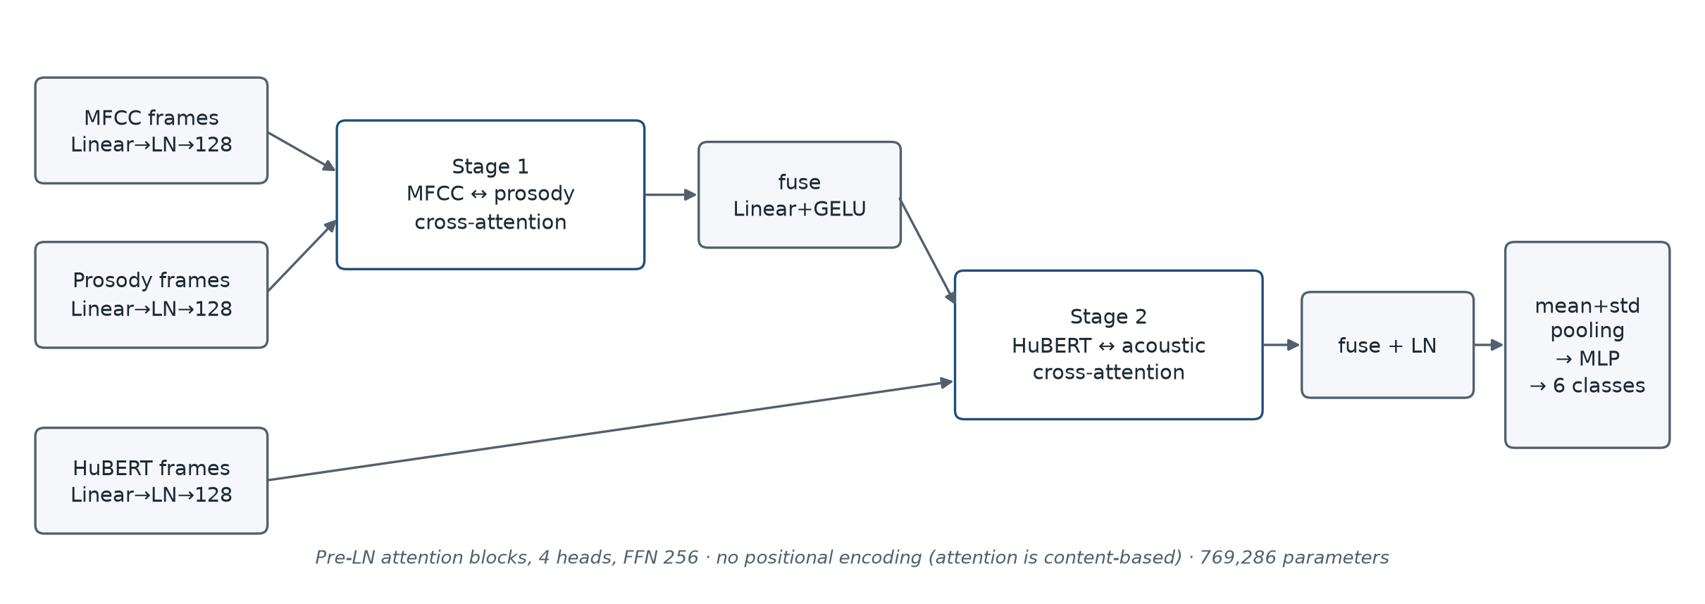
Models E1–E4
Model | Main idea | Trainable parameters
E1 | MFCC statistics → SVM / Random Forest | —
E2 | HuBERT pooled over time (mean, std) → MLP | 198 k – 1.58 M
E3 | per-frame HuBERT + MFCC + prosody → concatenation → pooling | 221,574
Control | E3 + 4 self-attention blocks (size-matched to E4) | 751,750
E4 | 2-stage bidirectional cross-attention → pooling | 769,286
Speech Emotion Recognition · course project
7
Notes:
E2 pools HuBERT over time before the classifier. E3 and E4 keep frames and pool after the model. E4 uses two stages of cross-attention. The self-attention control has almost the same number of parameters as E4, so it tells us whether attention capacity alone explains any difference.

Slide 8
Experimental setup
 | E2 | E3 | E4 and comparators
Optimiser | AdamW | AdamW | AdamW
Learning rates | 1e-3, 3e-4 | 1e-3, 3e-4 | 1e-3, 3e-4, 1e-4, 3e-5
Dropout | 0.2, 0.4 | 0.2, 0.4 | 0.2, 0.4
Candidates per fold | 39 | 4 | 8
Max epochs / patience | 50 / 10 | 50 / 10 | 150 / 10
Gradient clipping | none | 1.0 | 1.0
Macro-F1
primary metric (also UA, accuracy)
105 / 105
automated leakage-audit checks passed
Hardware: RTX 3050 laptop GPU (4 GB), 16 GB RAM
Python 3.12, PyTorch 2.14.1, scikit-learn
159 unit tests (leakage isolation, masking, determinism)
≈ 0.17
shuffled-label control = chance level
Speech Emotion Recognition · course project
8
Notes:
All neural models were trained with AdamW and early stopping on validation macro-F1. E4 and its comparators share a wider learning-rate grid, because the self-attention control in E3 always picked the smallest learning rate. Audits and shuffled-label controls check that no test information leaked.

Slide 9
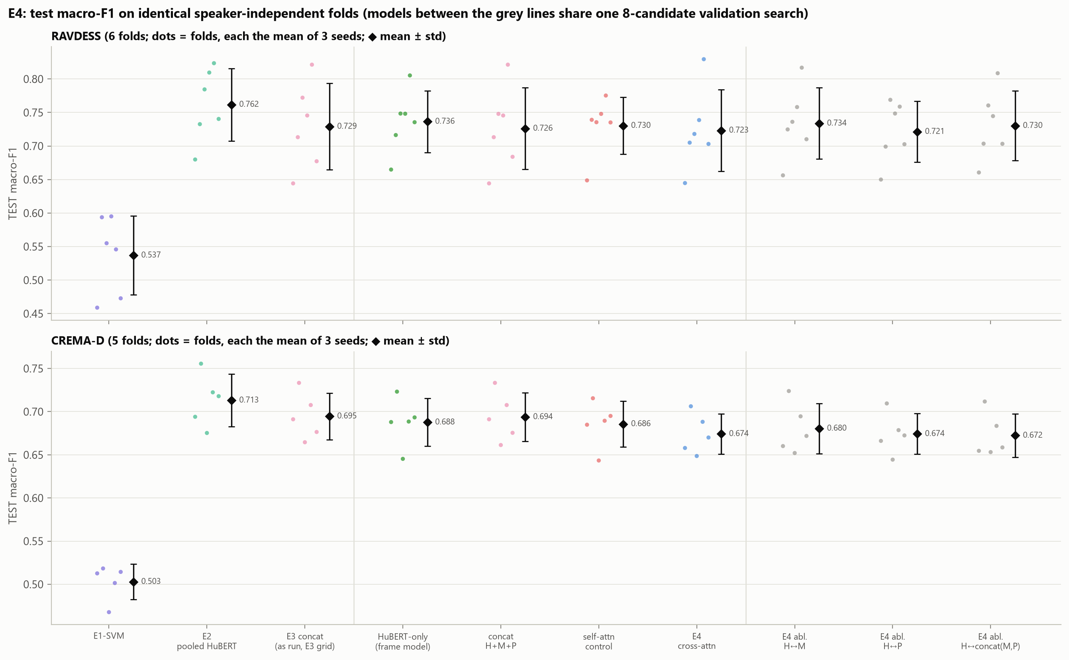
Results: pooled HuBERT is the strongest model
Test macro-F1, mean ± std over folds (each fold averaged over 3 seeds)
Model | RAVDESS | CREMA-D
E1 SVM | 0.537 ± 0.059 | 0.503 ± 0.021
E2 pooled HuBERT | 0.762 ± 0.054 | 0.713 ± 0.030
E3 concatenation | 0.729 ± 0.064 | 0.695 ± 0.027
HuBERT-only frame | 0.736 ± 0.046 | 0.688 ± 0.028
Self-attention control | 0.730 ± 0.043 | 0.686 ± 0.026
E4 cross-attention | 0.723 ± 0.061 | 0.674 ± 0.023
E2 best in 9 of 11 folds
E2 − E1: +0.225 / +0.210, in every fold
Speech Emotion Recognition · course project
9
Notes:
The pooled HuBERT model is clearly best on both datasets. All frame-level models are close to each other and below E2. E4, the most complex model, is not better than the simpler ones.

Slide 10
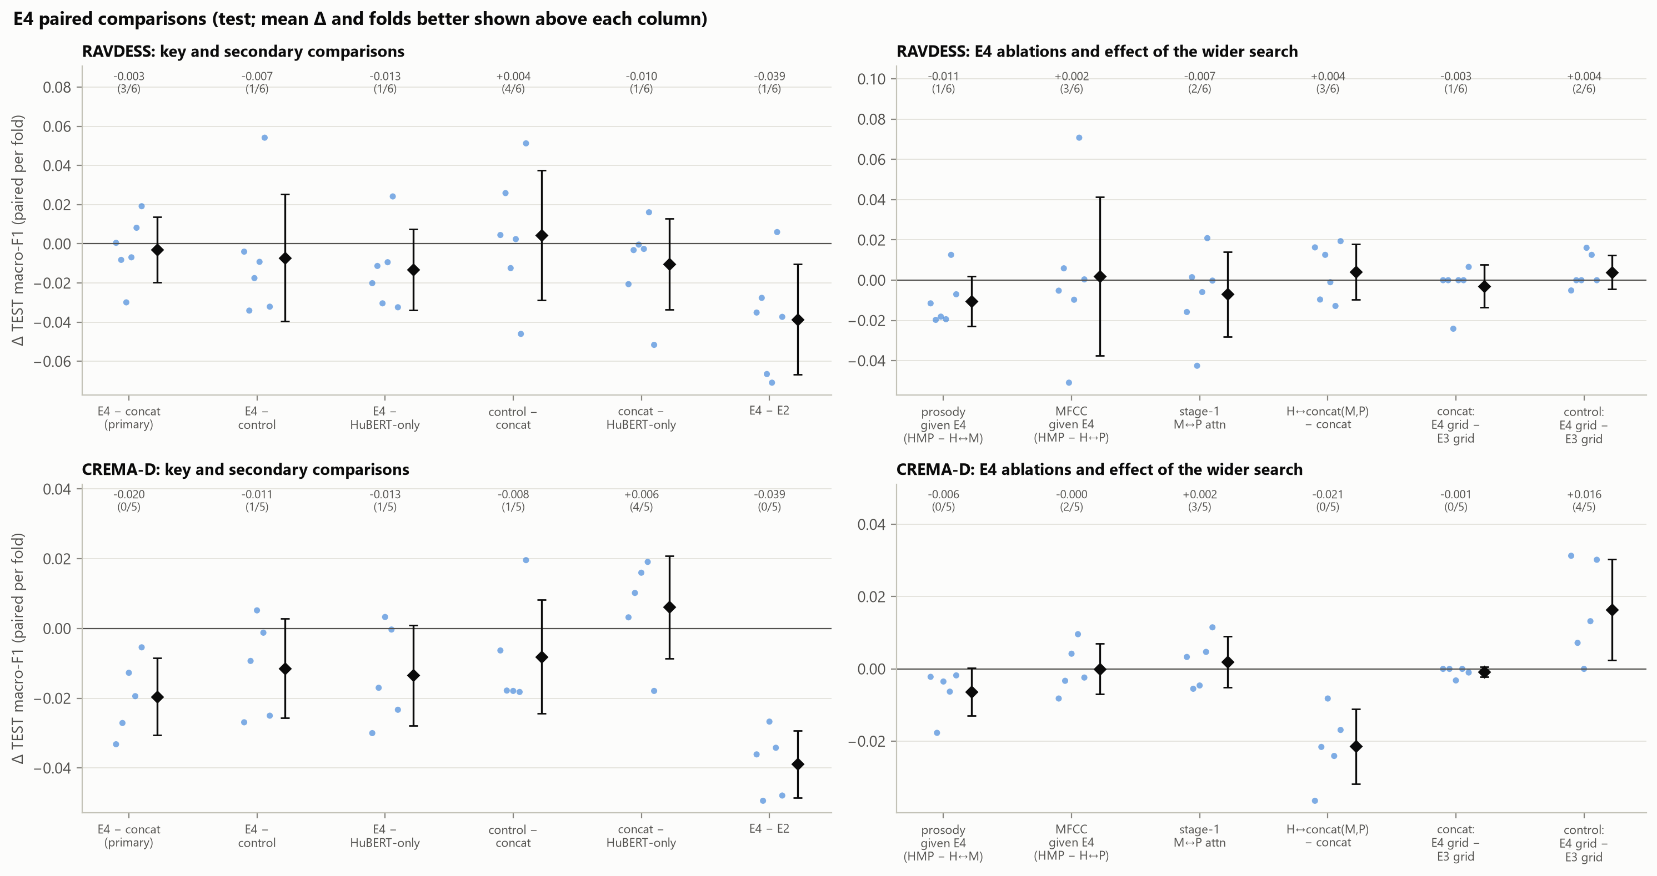
Does cross-attention help? No consistent improvement
Paired differences in test macro-F1 (folds in which E4 is better)
Comparison | RAVDESS | CREMA-D
E4 − concatenation | −0.003 (3/6) | −0.020 (0/5)
E4 − self-attention control | −0.007 (1/6) | −0.012 (1/5)
E4 − HuBERT-only | −0.013 (1/6) | −0.014 (1/5)
E4 − E2 | −0.039 (1/6) | −0.039 (0/5)
Every average difference is negative
Extra attention capacity alone does not help either
Same inputs, cross-attention instead of concatenation: −0.021 on CREMA-D, all 5 folds
With 6 / 5 folds we report consistency, not significance
Speech Emotion Recognition · course project
10
Notes:
We fixed a decision rule before testing E4: better on average on both datasets, in most folds, and by more than the seed-to-seed noise. None of the comparisons passed. On CREMA-D, E4 was below concatenation in every fold.

Slide 11
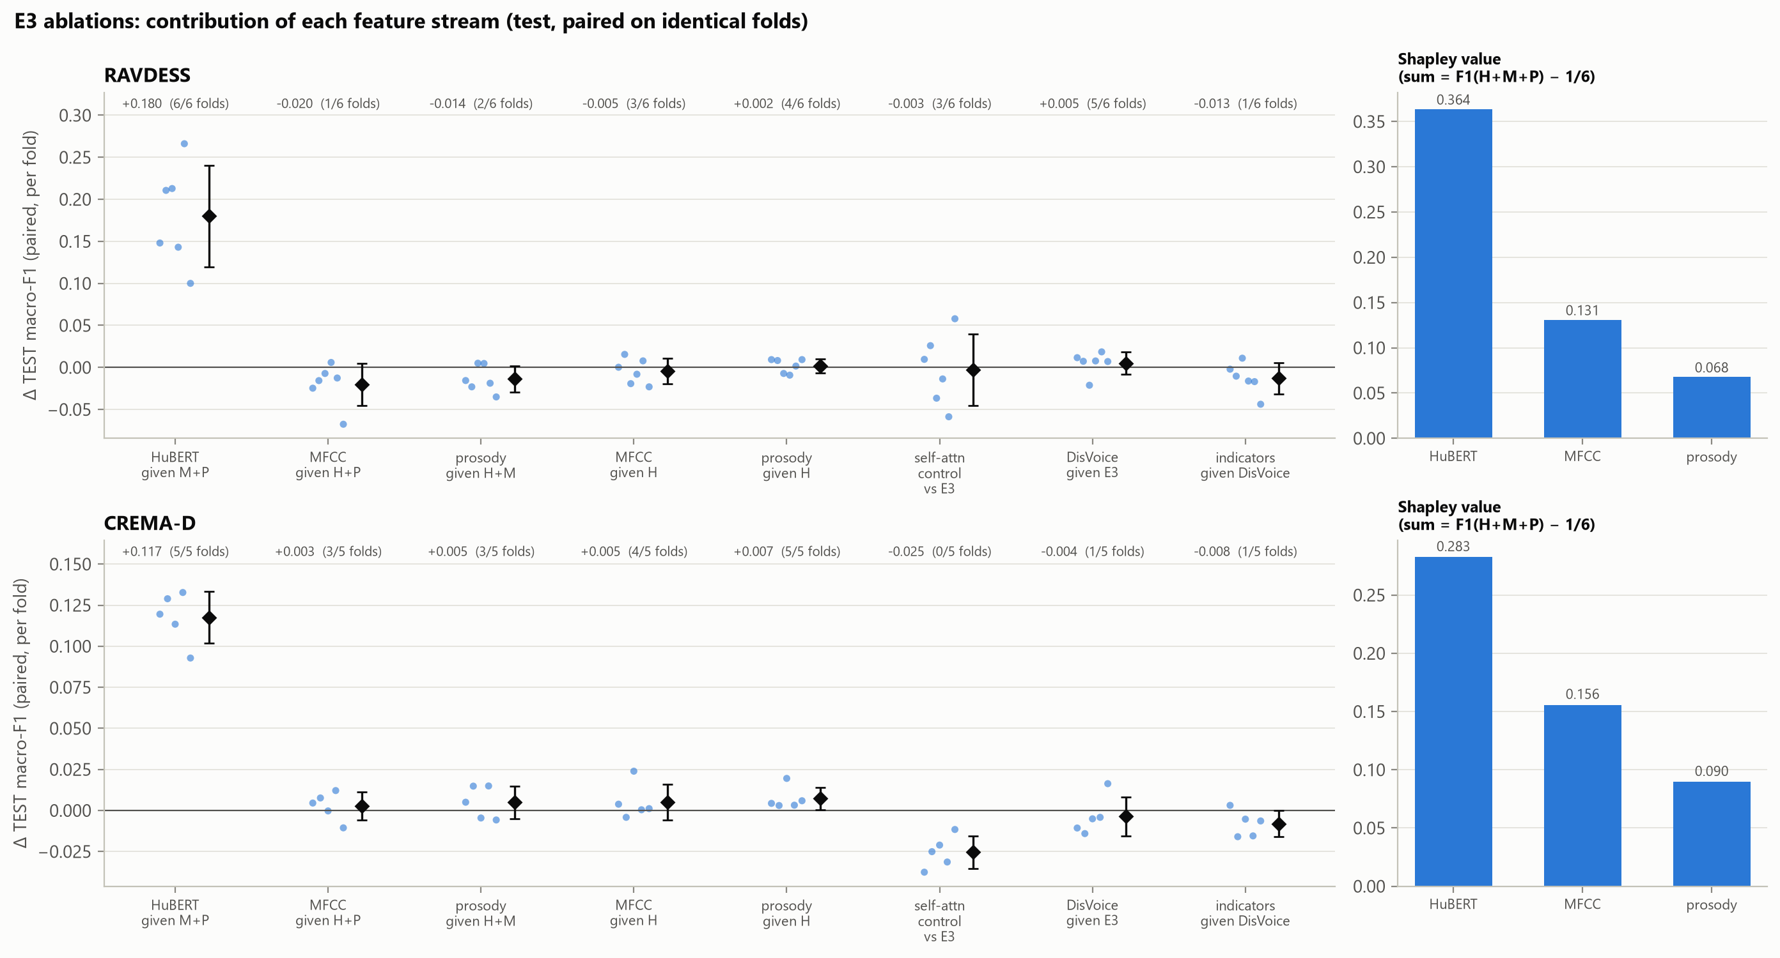
Ablations: HuBERT carries the information
E3 stream ablations, test macro-F1 (H = HuBERT, M = MFCC, P = prosody)
Streams | RAVDESS | CREMA-D
H + M + P | 0.729 | 0.695
H only | 0.747 | 0.685
M + P | 0.549 | 0.577
M only | 0.482 | 0.546
P only | 0.349 | 0.411
H + M + P + DisVoice | 0.734 | 0.691
Removing HuBERT: −0.180 / −0.117
Adding M + P to HuBERT: −0.018 / +0.010
Shapley (H / M / P): 0.36 / 0.13 / 0.07 and 0.28 / 0.16 / 0.09
Speech Emotion Recognition · course project
11
Notes:
Removing HuBERT costs a lot in every fold. MFCC and prosody are useful on their own but add almost nothing once HuBERT is there. Shapley values confirm HuBERT's dominance; the MFCC and prosody shares mostly come from subsets without HuBERT.

Slide 12
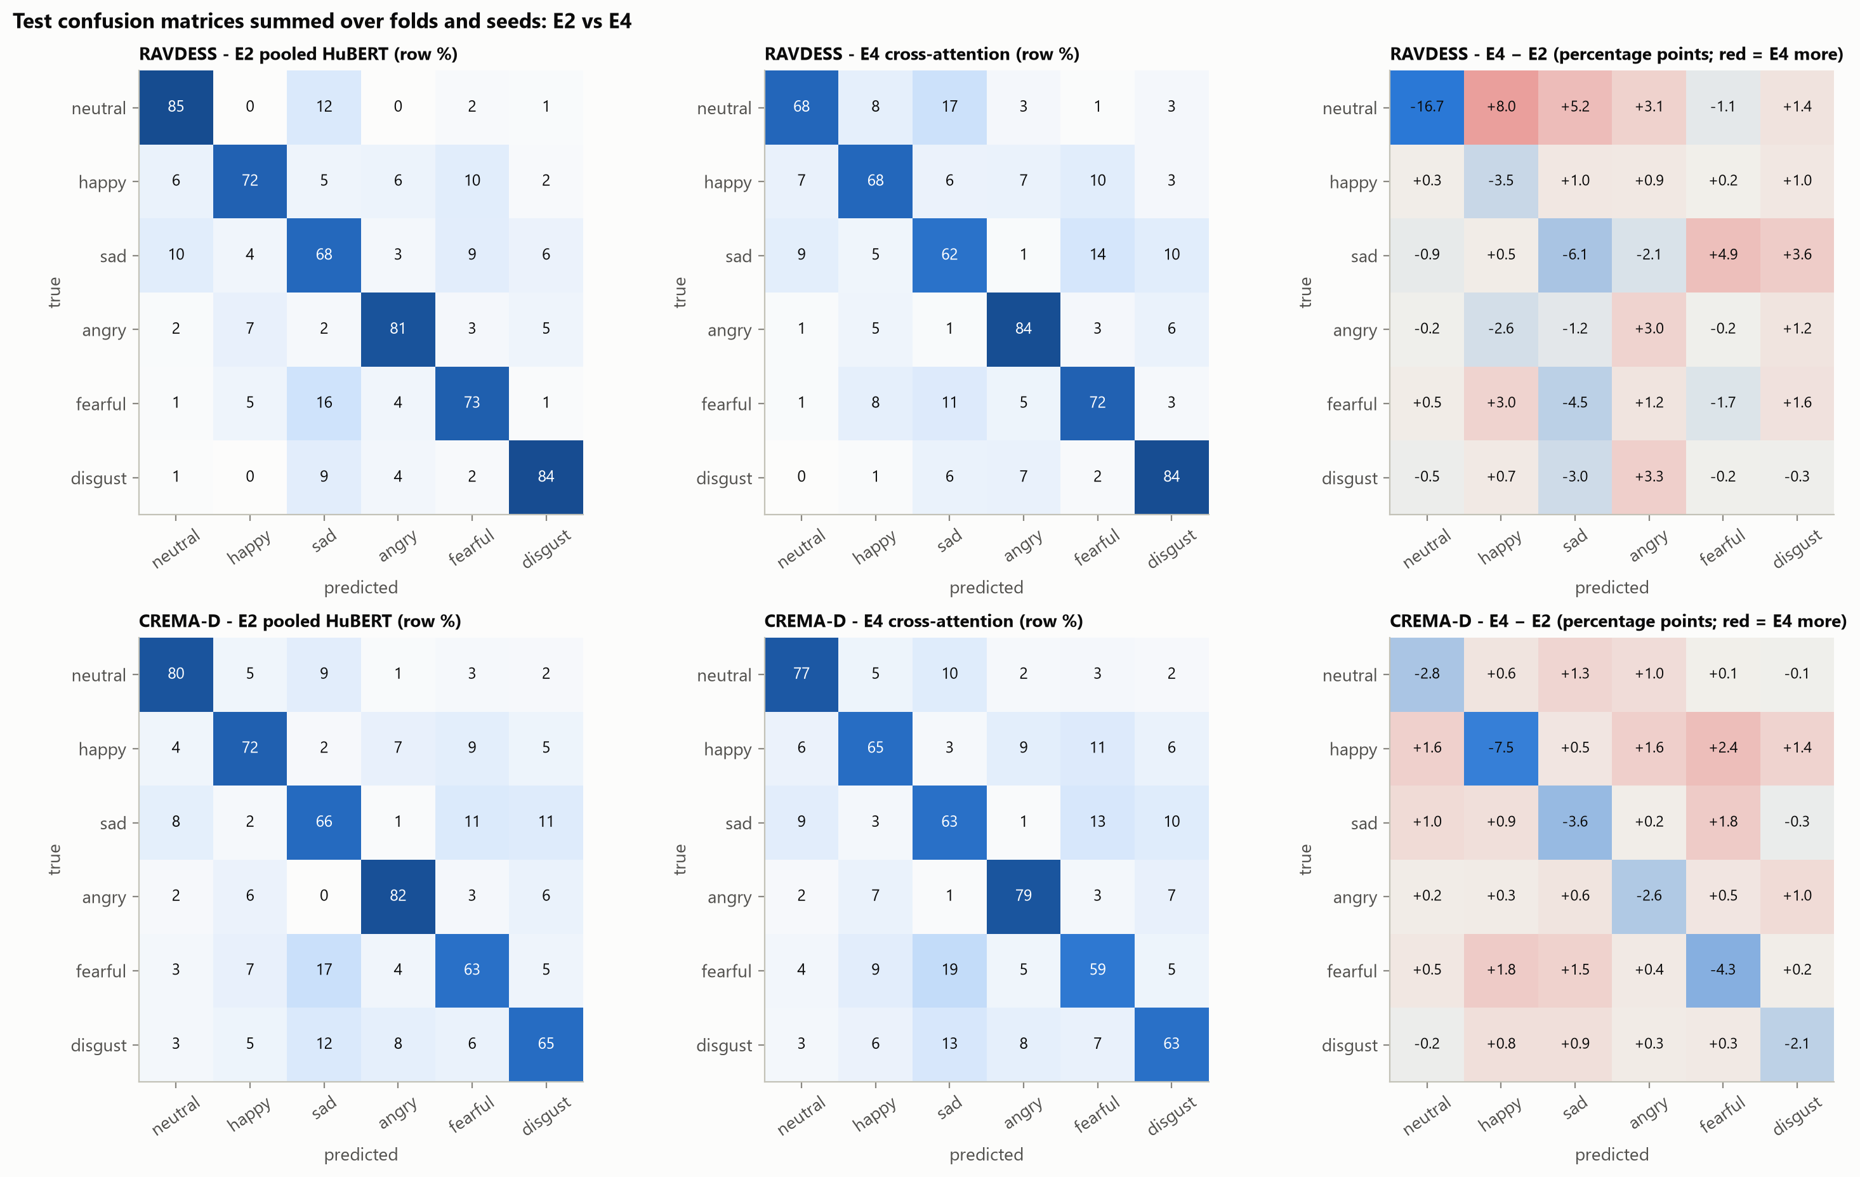
Per-class results and confusions
Shared confusions
fearful → sad, disgust → sad, neutral → sad in every model
RAVDESS
E4 − E2 on neutral: −0.100 (0/6 folds); HuBERT-only frame model shows the same loss (−0.096)
CREMA-D
E4 lower on every class; happy drops most (−0.066)
Speech Emotion Recognition · course project
12
Notes:
The same confusions appear in every model, including the MFCC baseline: fearful and sad, disgust and sad, neutral and sad. On RAVDESS the frame-level models lose mainly on neutral, and the HuBERT-only frame model shows the same loss, so it is not caused by fusion. On CREMA-D happy drops most.

Slide 13
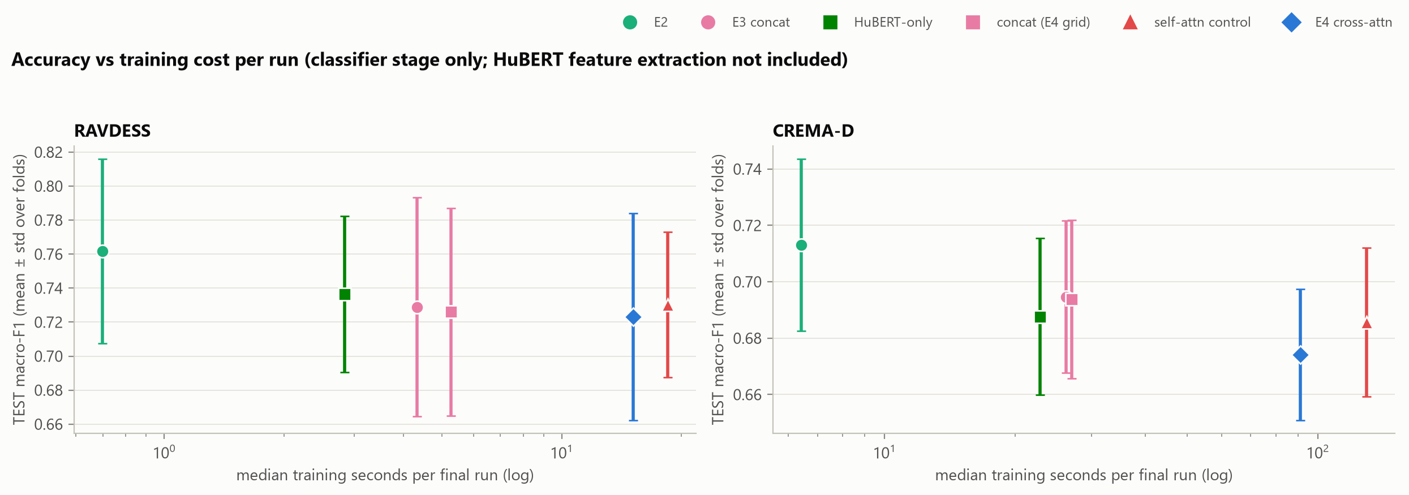
Accuracy versus computational cost
Classifier stage only (HuBERT feature extraction not timed)
Model | Params | Train s / run (R / C) | Inference ms / rec.
E2 | 198 k – 1.58 M | 0.70 / 6.4 | 0.04 / 0.07
Concatenation | 221,574 | 5.3 / 27.0 | 0.07 / 0.06
Self-attn control | 751,750 | 18.5 / 129.5 | 0.25 / 0.26
E4 | 769,286 | 15.1 / 91.0 | 0.26 / 0.27
14–22×
E4's training time per run compared with E2
Speech Emotion Recognition · course project
13
Notes:
Classifier stage only; HuBERT feature extraction is shared and was not timed. E2 is both the most accurate and the cheapest HuBERT model. The attention models cost several times more without any gain.

Slide 14
Limitations
Data
two acted English datasets; RAVDESS has only two sentences; no cross-corpus or cross-lingual test
Statistics
6 and 5 folds: low power, folds share training speakers; we report consistency, not significance
Representation
HuBERT used frozen; frame models use one layer per fold
Comparability
E2 and frame models differ in several ways (layers, search size, clipping, loss)
Attention design
no positional encoding: attention is content-based only
Cost
only the classifier stage was timed
Speech Emotion Recognition · course project
14
Notes:
Be explicit about what the results do and do not show.

Slide 15
Conclusion and future scope
0.762 / 0.713
E2 pooled HuBERT, best model
0.723 / 0.674
E4 cross-attention
+0.22
HuBERT over MFCC baseline (E2 − E1)
Conclusion
HuBERT carries almost all useful information
Concatenation and cross-attention did not improve on HuBERT alone
The simplest HuBERT model was the most accurate and the cheapest
Future scope
Explain the pooled vs frame-level gap one factor at a time (planned G-study; cancelled, not run)
Add MFCC / prosody statistics to the pooled E2 model
Position-aware cross-attention; cross-corpus evaluation
Speech Emotion Recognition · course project
15
Notes:
Main message: representation quality mattered far more than fusion complexity. The G-study was designed to find out why pooled HuBERT wins, but it was cancelled and never run; it is future work, not a result.

