Slide 1
IBM University Engagement Project Submission
“Exploring the Power of Agentic AI with IBM Granite and LangFlow”

Slide 2

Project Tile – Interview Trainer Agent
Domain of Project – Education (EdTech)
Student Name | Recent Passport Photo | Email ID | Mobile number [WhatsApp]
RISHABH SHARMA |  | sharmarishabh-ecs@atharvacoe.ac.in | 8639245281

Slide 3
Problem Statement -
Problem Statement : Interview Trainer Agent
The Challenge
Job seekers preparing for interviews often lack access to structured, personalized coaching. Interview questions, ideal answer structures, and company-specific expectations are scattered across many unreliable sources. Without real-time practice and specific feedback, candidates struggle to identify their weak areas — such as unclear STAR-structured answers, missing quantified impact, or an unpolished resume — before it costs them the actual interview.
The Objective
Build an AI-powered Interview Trainer Agent that delivers personalized, RAG-grounded interview coaching for job seekers. The solution should:
Tailored Question Generation – Generate technical and behavioral questions matched to the user's target role and experience level.
Live Mock Interview Mode – Conduct a real, turn-by-turn mock interview with contextual follow-up questions based on the candidate's own answers.
Answer Scoring – Score behavioral answers against the STAR framework and rewrite weak sentences as examples.
Resume Review – Review pasted resume text for structure, ATS-friendliness, and impact, with prioritized fixes.
Personalized Prep Roadmap – Generate a day-by-day preparation plan based on the user's timeline and confidence level.
Company-Type Awareness – Adapt question style and round structure to product companies, startups, IT services, or PSU hiring patterns.

Slide 4
Proposed Solution -
Proposed Solution: AI-Powered Interview Trainer Agent
The proposed solution is a multi-mode, RAG-based Interview Trainer Agent built on IBM watsonx Orchestrate and IBM Granite models to deliver personalized, real-time interview coaching. The system addresses the lack of structured, specific interview feedback through a single conversational agent with distinct, purpose-built modes.
At its core, the solution uses a Retrieval-Augmented Generation (RAG) pipeline. A curated knowledge base of 10 documents — covering role-specific technical questions, the STAR behavioral framework, HR guidelines, company hiring processes, interview formats, resume review rubrics, salary negotiation guidance, a glossary, a mock interview scoring rubric, and prep roadmap templates — is uploaded directly into watsonx Orchestrate's built-in knowledge base, which handles retrieval automatically before the Granite model generates a response.
The agent operates in four core modes:
Standard Q&A Mode answers general interview, resume, and career questions grounded in the knowledge base.
Mock Interview Mode conducts a live, turn-by-turn interview — asking one question at a time, scoring the answer, and generating a contextual follow-up question based on what the candidate specifically said.
Answer Scoring Mode evaluates a pasted behavioral answer against the STAR rubric and rewrites weak parts.
Prep Roadmap Mode builds a personalized, timeline-based preparation plan.
A dedicated Resume Review Flow evaluates pasted resume text for structure, ATS-friendliness, and impact, and produces a prioritized fix list.
watsonx Orchestrate manages the agent's behavior, knowledge retrieval, and conversation state, while watsonx.ai and IBM Granite power reasoning, follow-up question generation, and grounded response generation.
Overall, this solution delivers an end-to-end, agentic interview coach that goes beyond static Q&A — it behaves like a real interviewer, tracks context across a session, and gives specific, actionable feedback grounded in trusted preparation material.

Slide 5
Technology Used
IBM watsonx Orchestrate – For designing and orchestrating the agent's behavior, modes (Mock Interview, Resume Review, Prep Roadmap, General Q&A), and knowledge retrieval
GPT-OSS 120B (via Groq) – The underlying LLM powering natural language understanding, reasoning, and follow-up question generation
IBM Cloud – Hosts the watsonx Orchestrate instance, providing the infrastructure to build, deploy, and scale the Interview Trainer Agent
RAG (Retrieval-Augmented Generation) – Your agent has a connected knowledge base (knowledge_base field in the config), used to ground coaching responses in curated interview material rather than generic advice
React + Node.js/Express – Custom frontend chat interface and a secure backend proxy that connects to the Orchestrate agent's API without exposing credentials to the browser
IBM Bob – AI coding assistant used to scaffold and build the React frontend and Node.js/Express backend, including the secure API proxy layer
IBM Cloud IAM – Handles secure token-based authentication between your backend and the Orchestrate agent API

Slide 6
Component Used -
Profile – Defines the agent's name, description, welcome message, and quick-start prompts shown to the user.
Knowledge – 16 curated PDF documents uploaded as the RAG knowledge base (question banks, STAR framework, HR guidelines, roadmaps, etc.).
Behavior – The full system prompt defining mode detection, Mock Interview logic, Answer Scoring, Resume Review, and Prep Roadmap generation.
Name of IBM Granite model - granite-3-2-8b-instruct → used for grounded, real-time interview coaching responses.
Agent Style - Set to ReAct, enabling the agent to reason, act, and refine its approach across a multi-turn mock interview session.
Channels (Preview) - Used to test and demo the agent in the built-in chat preview.

Slide 7
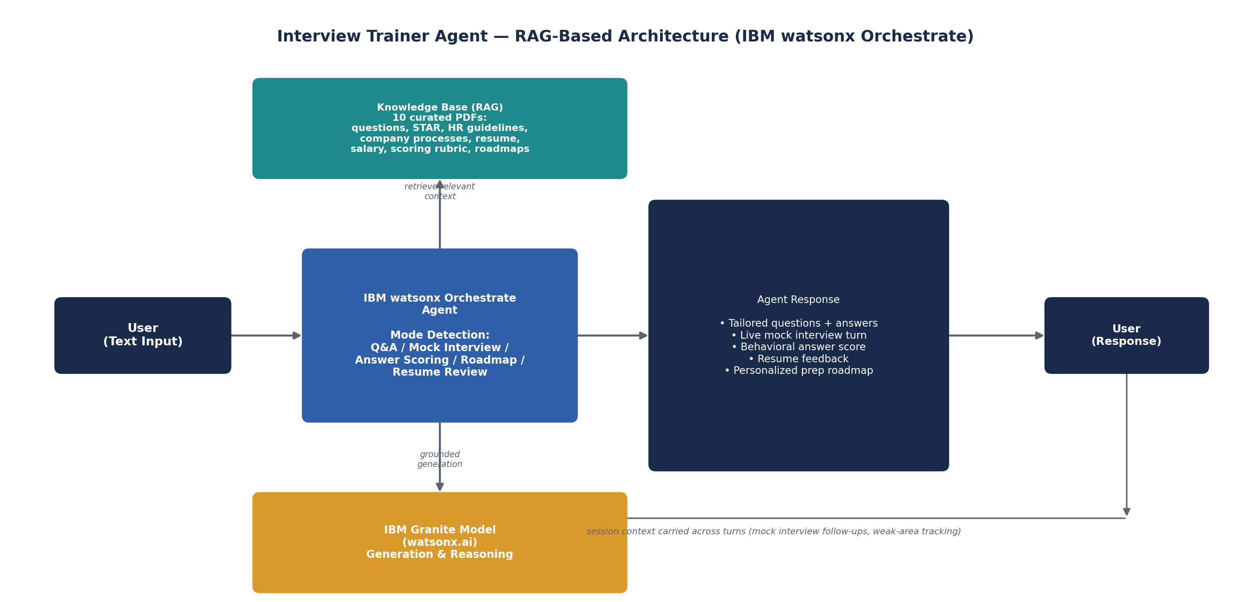
Architecture blueprint

Slide 8

Role of Agentic AI in the solution
Role of Agentic AI in the Interview Trainer Agent
Agentic AI enables the Interview Trainer Agent to function as an autonomous coach rather than a static Q&A bot. Using IBM watsonx Orchestrate and IBM Granite models, it detects the user's intent and switches between distinct operating modes automatically.
In Mock Interview Mode, the agent performs multi-step, stateful reasoning: it asks a question, evaluates the answer, decides a relevant follow-up based on the specific content of that answer, and tracks weak areas across the whole session — behavior that requires genuine agentic planning, not a single-turn response.
The agent also brings context awareness, carrying target role, experience level, and identified weak areas across the conversation without re-asking the user, and grounded retrieval, pulling from the curated knowledge base before generating coaching advice.
Additionally, the agent adapts its questioning style based on company type (product company, startup, IT services, PSU) and produces a closing session summary that synthesizes the entire conversation.
Overall, Agentic AI makes the system proactive, adaptive, and goal-driven, acting like a real human interview coach rather than a static FAQ tool.

Slide 9
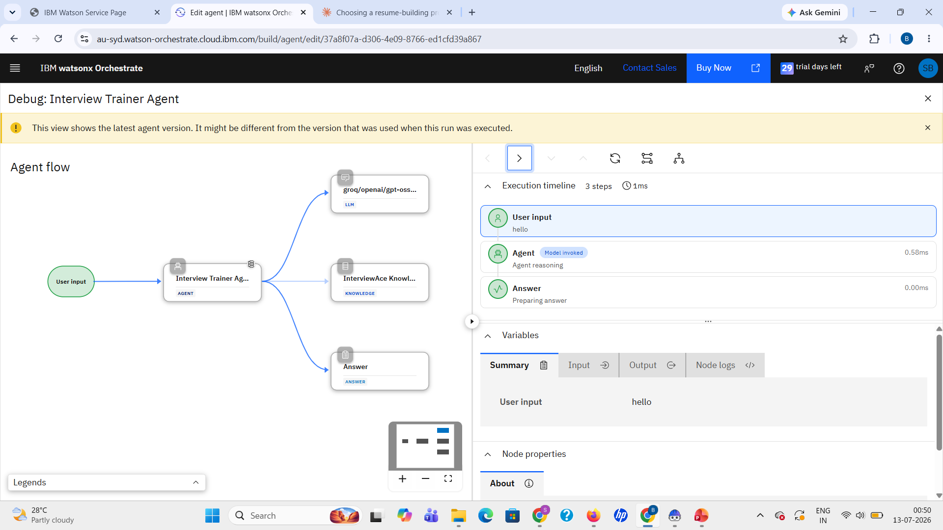
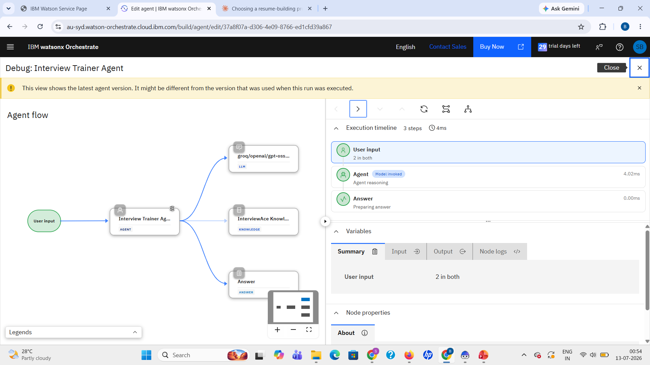
Token Usage
11,761 token are used
Before Prompt
After the Prompt

Slide 10
Novelty and Uniqueness
The proposed Interview Trainer Agent stands out by combining Agentic AI, RAG, and multi-mode coaching into a single conversational agent.
Live Mock Interview Mode – Instead of a static question list, the agent conducts a real turn-by-turn interview with contextual follow-up questions.
RAG-Grounded Accuracy – All coaching advice is retrieved from a 10-document curated knowledge base, reducing generic or fabricated advice.
STAR-Based Answer Scoring – Behavioral answers are scored on 5 dimensions with rewritten examples, not just generic praise.
Resume Review with Prioritized Fixes – Reviews pasted resume text and returns a ranked list of the highest-impact changes.
Personalized Prep Roadmaps – Generates realistic, timeline-based study plans (3-day to 1-month templates).
Company-Type Adaptive – Adjusts question style and round structure for product companies, startups, IT services, and PSU hiring.
Scalable & Enterprise-Ready – Built on IBM watsonx Orchestrate with IBM Granite models, ensuring reliability and governance.

Slide 11
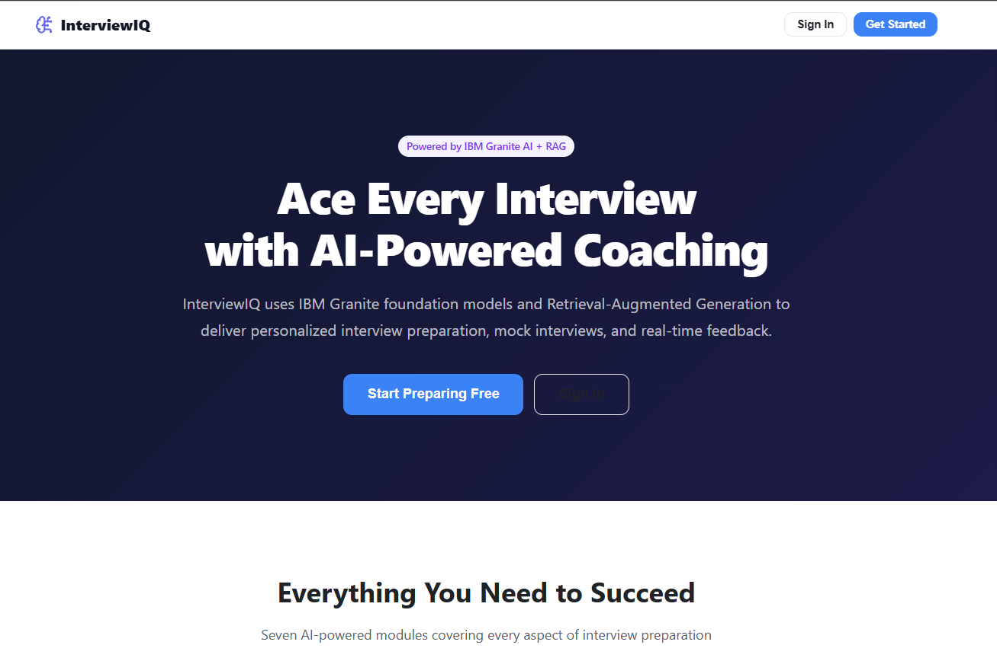
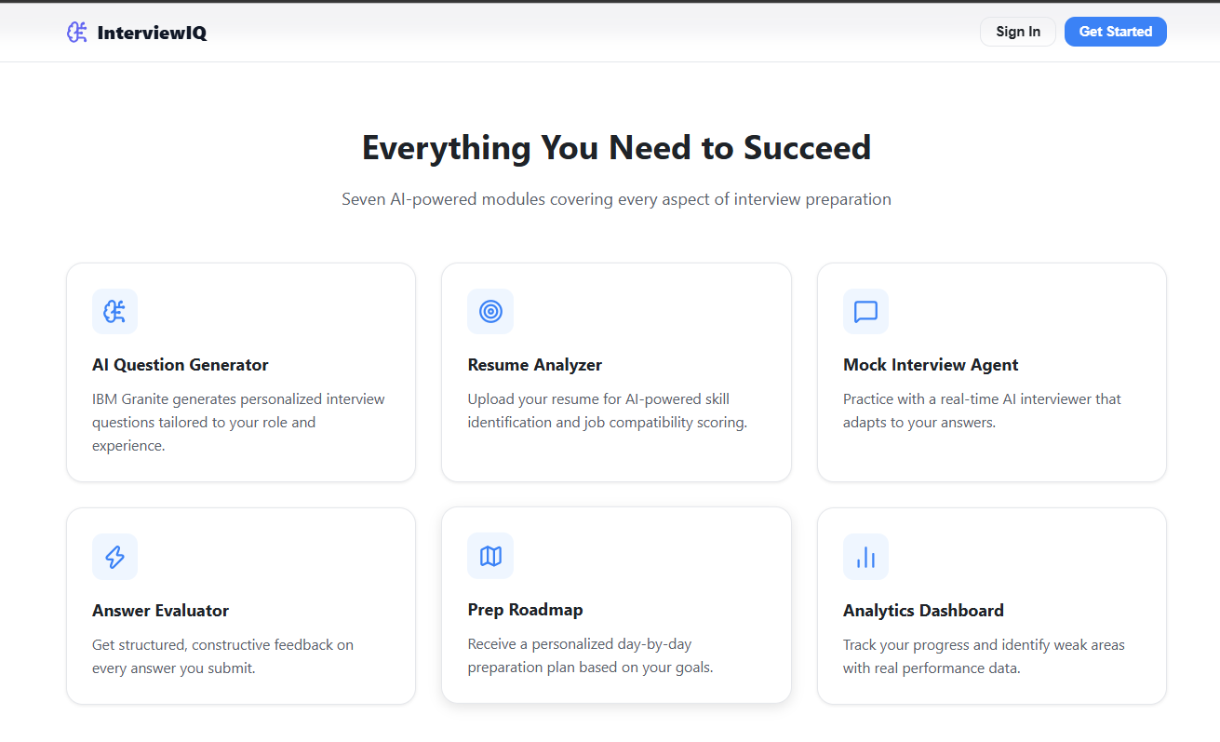
Git Hub Link
https://github.com/Arcadelord-Rishabh/Interview-Trainer-Agent

Slide 12
Future Scope
1. Resume File Upload & Voice-Based Mock Interviews –
The system can be extended to accept resume file uploads (PDF/DOCX parsing) instead of pasted text, and to support voice-based mock interviews, allowing candidates to practice spoken delivery and receive feedback on pacing and clarity, not just written content.
2. Practice Analytics Dashboard & Multilingual Support –
The system can be enhanced with a personal analytics dashboard that tracks a user's practice history across sessions — mock interview scores, recurring weak areas (e.g., STAR structure, missing quantification), and improvement trends over time. Paired with multilingual support, users could interact with the agent in their preferred regional language, making interview coaching more accessible to a wider range of candidates, especially those from non-English-medium backgrounds.
·
·

Slide 13
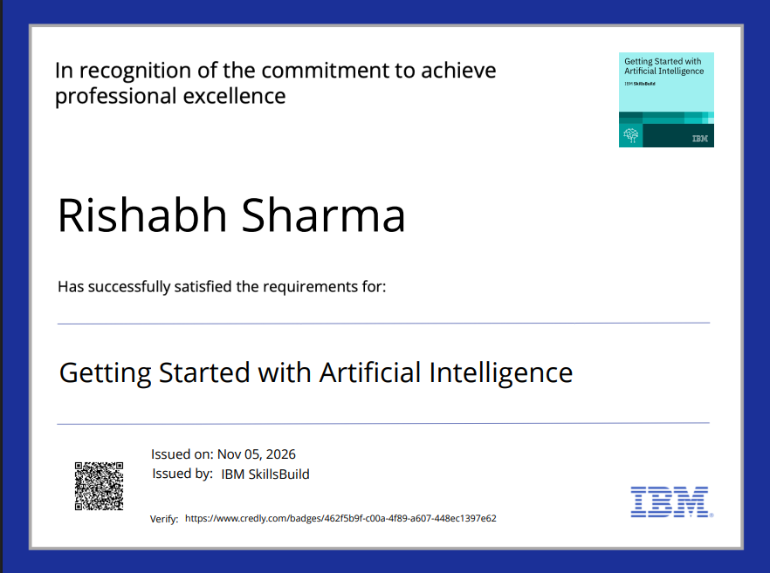
Certificates Earned:
Credly certificate - Getting Started with Artificial Intelligence

Slide 14
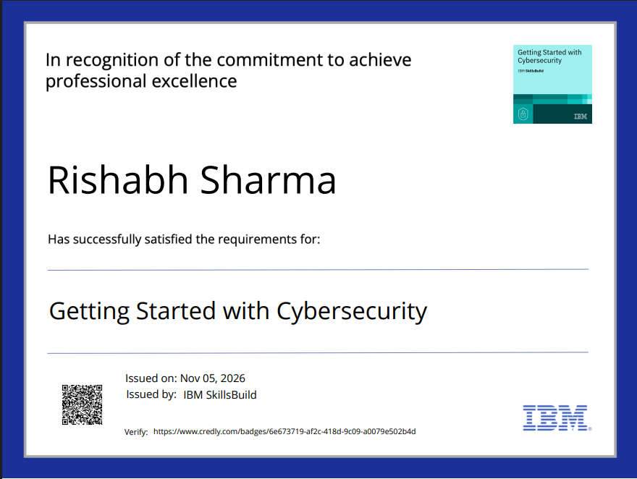
Certificates Earned:
Credly certificate – Getting Started with Cybersecurity

Slide 15
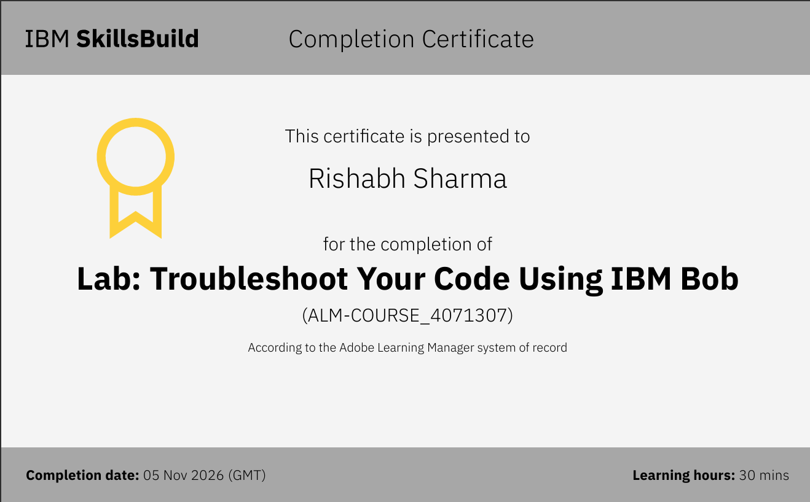
Certificates Earned:​
IBM BOB Certificate

Slide 16


