Slide 1
Capstone Project - The Battle of Neighborhoods
Warsaw vs. Berlin
Author: Arkadiusz Modzelewski

Slide 2
Introduction
Warsaw and Berlin are capital cities of countries which are especially dear to me. With a 4.2% GDP growth in 2019, Poland ranks as the second European's fastest-growing economy. Warsaw as one of the fastest-growing capital cities in the EU is also the place where I want to live after my Master studies.
These capital cities are located in two neighboring countries. Germany with its capital Berlin is one of the biggest economic powers in the world.
Similarities in these two capital cities will be checked to find patterns between venues which are located there. Comparison of these two capitals will help people who are looking for answers related to similarities in these places. It will be also valuable for people who are curious and want to know places which are located in Warsaw and Berlin.

Slide 3
Data
For this project data available on the Foursquare's API will be used. It will be used to check data in Berlin and Warsaw in terms of their neighborhoods. The data used includes information about different venues and their neighborhoods.
Moreover data about districts of these two cities, which was available on wikipedia.com, was used:
Warsaw: https://en.wikipedia.org/wiki/Districts_of_Warsaw
Berlin: https://en.wikipedia.org/wiki/Boroughs_and_neighborhoods_of_Berlin

Slide 4
Methodology
We will use the KMeans ML technique to segment districts with similar objects based on neighborhood data, and then we can judge the similarity or dissimilarity between districts and two cieties

Slide 5
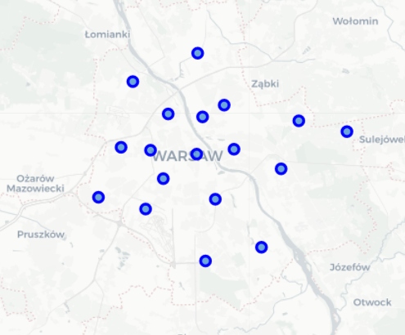
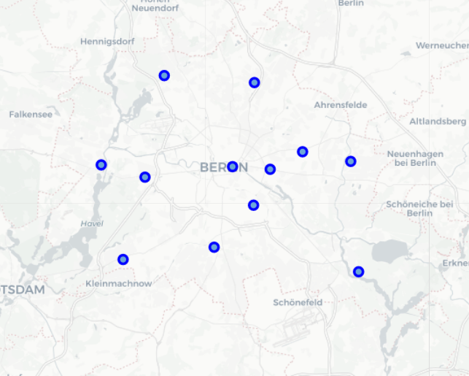
Results
The geograpical coordinates of Warsaw are 52.2319237, 21.0067265.
The geograpical coordinates of Berlin are 52.5170365, 13.3888599.
Points which are the coordinates of Warsaw and Berlin districts, respectively:

Slide 6
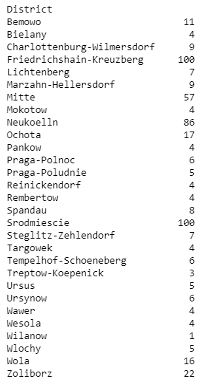
Number of venues in different districts:
Number of venues in Berlin is 300
Number of venues in Warsaw is 218.
There are 171 unique categories of venues.

Slide 7
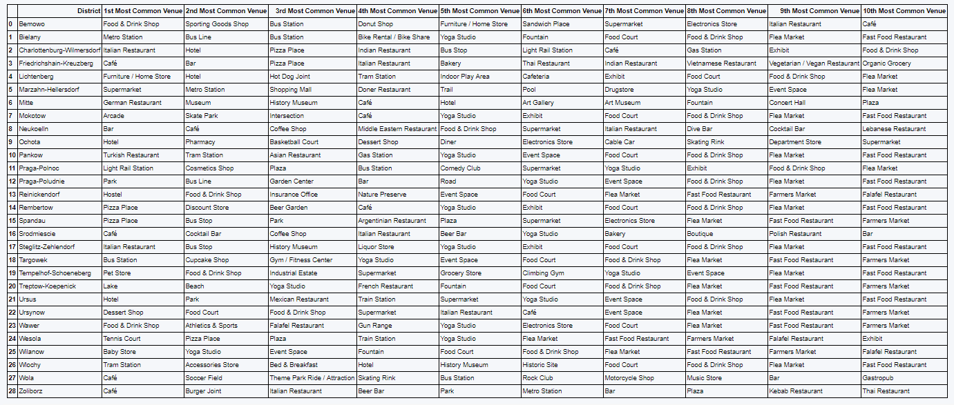
Ten most common venues in all districts:

Slide 8
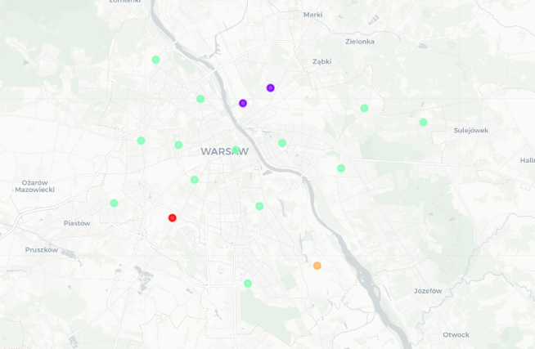
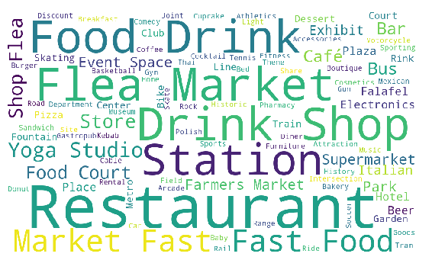
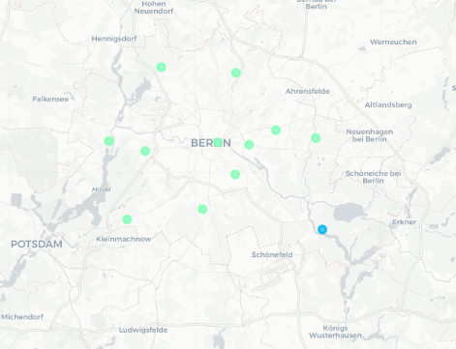
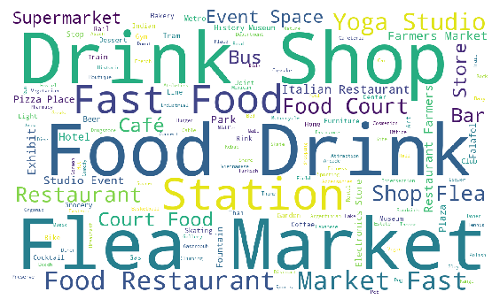
Word cloud in Warsaw:
Clusters in Warsaw:
Clusters in Berlin:
Word cloud in Berlin:

Slide 9
Discussion
Compering Warsaw and Berlin we see a lots of similatrities. There are a large number of Drinks Shoops, Fast Food, Food Drink and Flea Markets. In used data seems that Warsaw has a bigger number of restaurants and Berlin flea markets.

Slide 10
Conclusion
Based on data which is provided by Foresquare and research made, we can conclude that Warsaw and Berlin are similar cities. Results from this research could give a good insight for people who are interested in these two capital cities. Thanks to this research it is possible for example to conclude which venues are the most common in all districts in Berlin and Warsaw etc.

