Slide 1


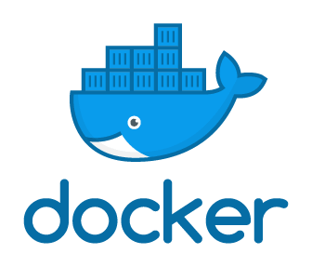
XNAT Container Service (CS)
Pipelines run in Docker images
Customisable interface
Inputs
Outputs
Parameters
Integrated with UI
Automated launch on ingest
Direct access to data
Runs in Kubernetes service mesh
Kubernetes
Containerised
pipelines

Slide 2
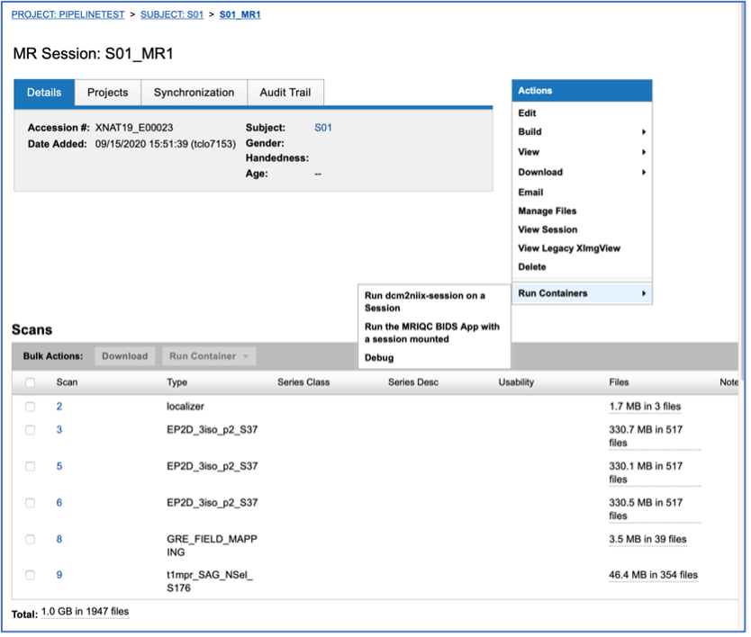
Launching Container Service Pipelines

Slide 3
Input
matcher
Task
Spec
Output spec
Repository
Source
App
Task
Repository
Sink

Slide 4
Input
matcher
Docker Image
Output spec
Repository
Source
BIDS Converter
BIDS app
BIDS Extractor
Repository
Sink

Slide 5
Docker-in/out-of-docker
Generate XNAT CS compatible Docker images
Provide Pydra task interface
Installs dependencies with Neurodocker
Insert XNAT CS interface for inputs/output configuration
Options for apps already published in Docker images
Extend base image
Run Docker-in-docker (or Docker-out-of-Docker)
App Image (extended)
Wrapper Image
Extend base
Docker-in-Docker

Slide 6
Arcana architecture
Core layer (abstract base)
Infrastructure layer (repository connectors, file-formats, structures)
Processing layer (preprocessing pipelines, derivation of standard markers)
Analysis layer (statistical analysis, study-specific customisations)

Slide 7
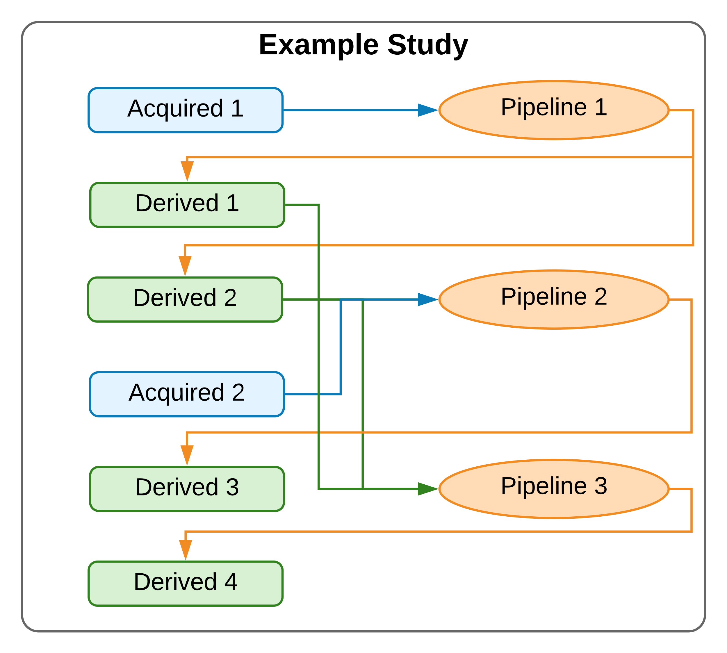
Example analysis class
Acquired File-groups or fields
Example Analysis
Pipelines
Derived
File-goups/ fields
Column specifications
Pipeline builder methods

Slide 8
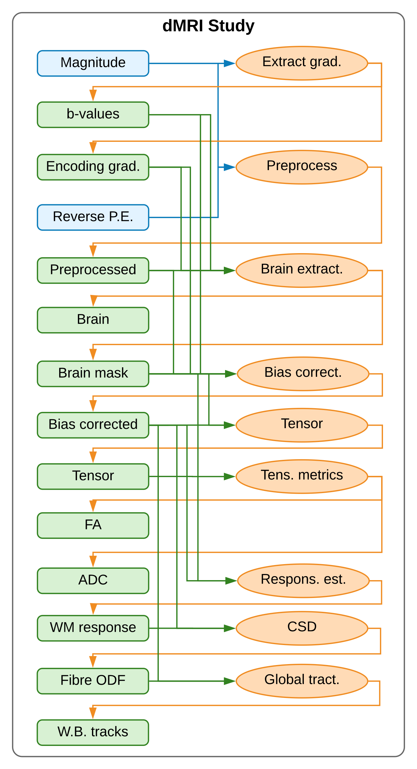
Example diffusion MRI class
Tensor metrics
FA, ADC
Tracks white matter tracts
long-range connections
Inherits common methods from base classes
MRI > EPI > dMRI > …
Registration, brain extraction
Reuses common derivatives
Preprocessing, Brain mask, etc..

