Slide 1

Where’s my field? Built on Arcas

Slide 2
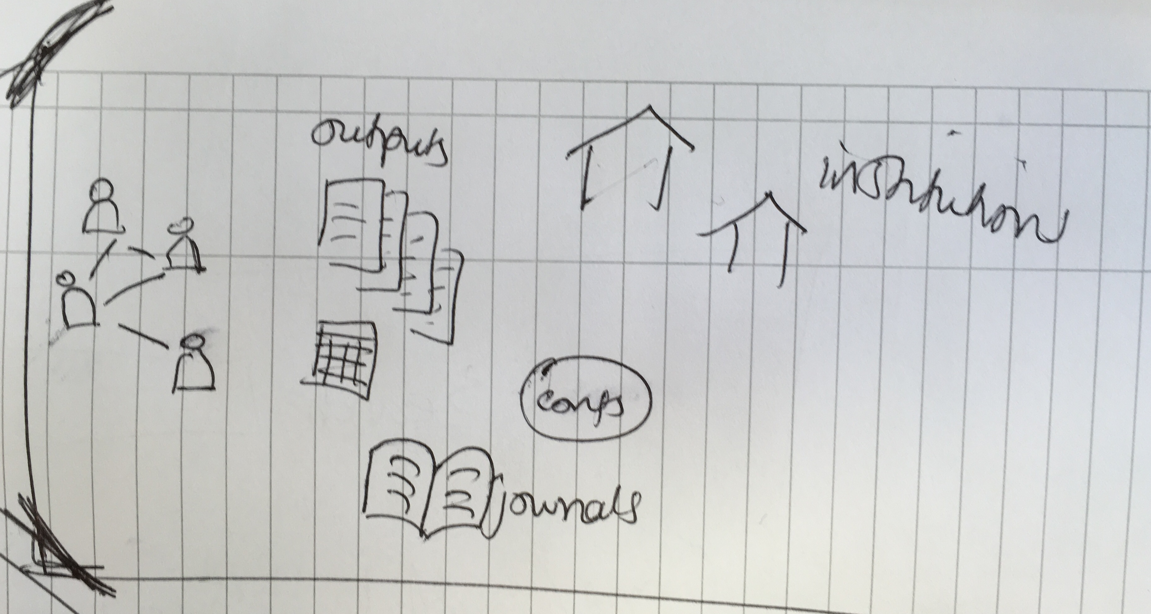
Where’s my field?
Notes:
Solution: web app to help users to visualise and explore the open scholarly literature metadata
repo and docs; best practise: version-control with short-loop iterations, open-source

Slide 3
Where’s my field?
Where now?
Notes:
Solution: web app to help users to visualise and explore the open scholarly literature metadata
repo and docs; best practise: version-control with short-loop iterations, open-source

Slide 4
Where’s my field?
Where now?
Where next? https://wheresmyfield.mybalsamiq.com/projects/wheresmyfield/grid
Notes:
Solution: web app to help users to visualise and explore the open scholarly literature metadata
repo and docs; best practise: version-control with short-loop iterations, open-source

Slide 5
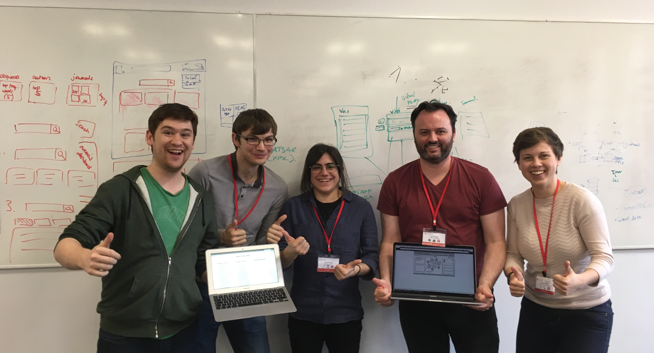
What’s our metadata?
Vision
Minimal product
Management
Collaboration
Take advantage of knowns:
build on skills
use existing resources
Notes:
Team
Mixed skill, no front-end but decided to build a webapp….

Slide 6
Where’s my field? Built on Arcas
https://github.com/ArcasProject/WheresMyField

