Slide 1


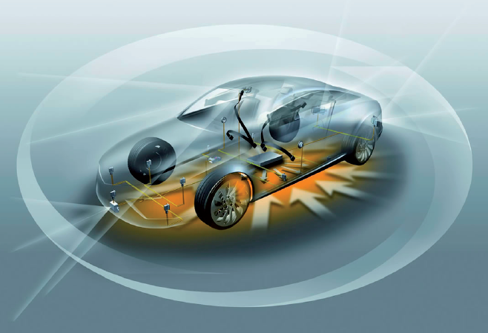




EAST-ADL dependability package illustrated by a brake example
Dr. Stefan Voget

Slide 2
Content
The Story
The Example
Architecture Overview
System Model
Safety Modeling

Slide 3
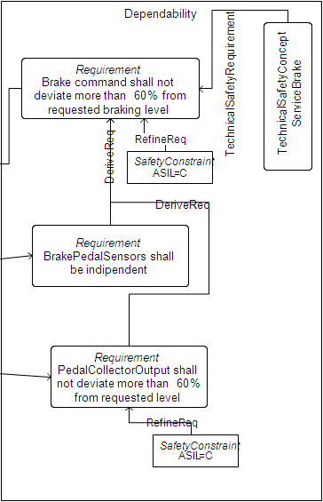
The Story From Requirement to Implementation
Model Based
Development Safety Analysis
SystemModel
Features
Model
VehicleLevel
Safety
Goal
Functional
Safety concept
Abstract functions
AnalysisLevel
Dependability
Derive
FunctionalSafetyConcept
ServiceBrake
FunctionaSafetyRequirement
Requirement
Brake Pedal shall not request
deviating braking level
DesignLevel
DeriveReq
TechnicalSafetyConcept
Technical
Safety concept
ServiceBrake
Concrete
functions
TechnicalSafetyRequirement
Requirement
BrakePedalSensors shall
be indipendent
DeriveReq
Requirement
Fault Tolerant Time
Interval shall be at least
100
ms
Implementation
Level
Software Architecture
Refine

Slide 4
The Story From Requirement to Implementation
System Model
Safety Modeling
Functional
Requirements
Vehicle
Model
Hazard & Risk Analysis
Behavior
Safety Goals
Analysis
Level
Functional Safety Requirements
Design
Level
Technical Safety Requirements
Implementation Level (HW/SW)
HW/SW Safety Requirements

Slide 5
The Story Distribution to meta-model standards
ReqIF
Requirement
EAST-ADL
SAFE
Functional Requirement
Requirement
Item
Hazard and Risk analysis
Safety Goal
Functional safety concept
Derived Requirement
Analysis
Function
Functional Safety Requirement
Technical safety concept
Derived Requirement
Design Function
Technical Safety Requirement
Satisfy analysis (Error model, FMEA, FTA, …)
Refine safety concept
AUTOSAR
Derived Requirement
SW
Configuration
SW / HW Safety Requirement
Code

Slide 6
Content
The Story
The Example
Architecture Overview
System Model
Safety Modeling

Slide 7
The Example References
This presentation will show extracts out of a brake system. This example has already been published several times to illustrate the use of EAST-ADL.
To get more information about the example see:
Atesst project
http://www.atesst.org/home/liblocal/docs/ows/I6_ATESST2_OWS_Validators.pdf
http://www.atesst.org/home/liblocal/docs/ATESST2_Deliverable_D6.1.2_V1.0.pdf
Maenad project
http://maenad.eu/public_pw/conceptpresentations/MAENAD_Validator_RegenerativeBraking_2011.pdf
The example is modeled with a graphical editor based on EATOP using the EAST-ADL language 2.1.11.
EATOP
http://eclipse.org/proposals/modeling.eatop/
http://code.google.com/a/eclipselabs.org/p/eclipse-auto-iwg/
EAST-ADL
http://www.east-adl.info/

Slide 8
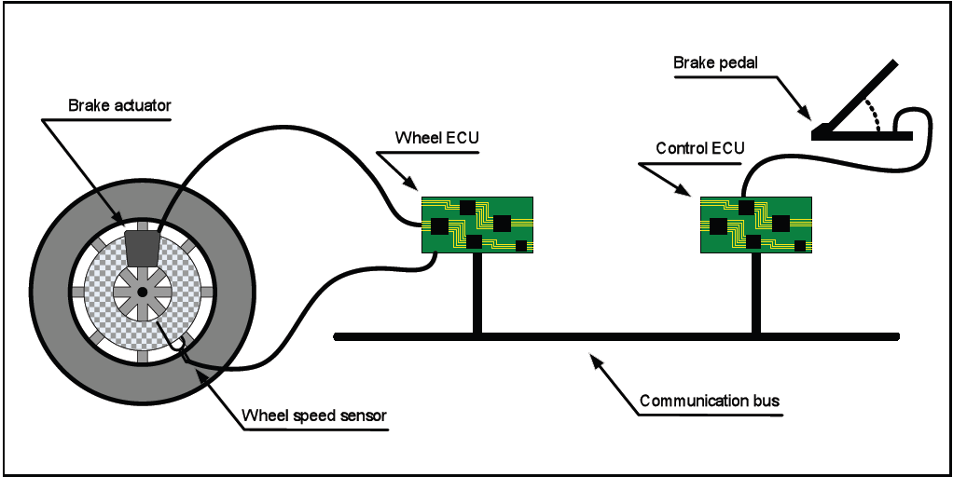
The Example Overview
The brake system has been modeled in several versions before. In this presentation we take a version including service brake and parking brake.
It is not the intention of this presentation to model the brake system complete and correct. Intention is to illustrate the EAST-ADL principles for safety modeling with a realistic system.
Therefore, some extensions in the safety modeling and analysis part are done compared to previous publications.
See (2)

Slide 9
Content
The Story
The Example
Architecture Overview
System Model
Safety Modeling

Slide 10
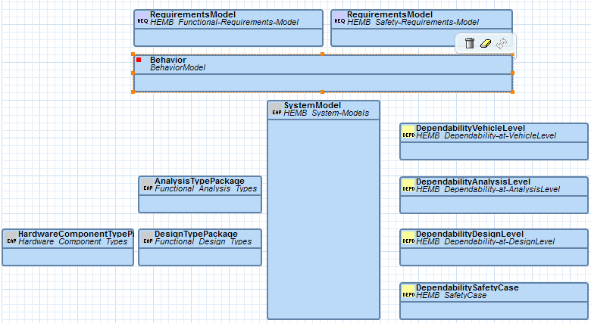
Architecture Overview
The architecture is composed in packages.
RequirementsModel: one package for functional and one for safety requirements
Behavior: encloses mainly the modes needed for the hazard and risk analysis
System Model: structures the abstraction levels, defines the root of the architectures,
encloses vehicle feature model and the allocation model
Analysis Type Package: collects all analysis function types and their parts
HardwareComponentTypePackage: collects all hardware component types and their parts
DesignTypePackage: collects all design function types and their parts
DependabilityVehicleLevel: hazard and risk analysis
DependabiliyAnalysisLevel: derived safety requirements allocated to functional safety concept
DependabilityDesignLevel: derived safety requirements allocated to technical safety concept
DependabilitySafetyCase: safety case modeling

Slide 11
Architecture Overview We are here
Functional
Requirements
Vehicle
Model
Hazard & Risk Analysis
Behavior
Safety Goal
Analysis
Level
Functional Safety Requirement
Design
Level
Technical Safety Requirement

Slide 12
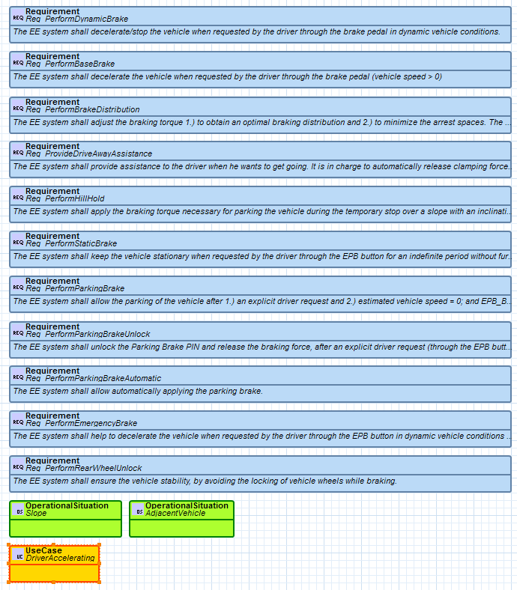
Architecture Overview Functional Requirements

Slide 13
Content
The Story
The Example
Architecture Overview
System Model
Safety Modeling

Slide 14
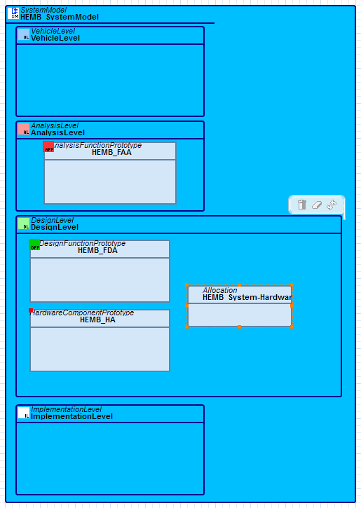
System Model Overview
The System Model
structures the abstraction levels,
defines the root of the architectures
encloses the vehicle feature model
encloses the allocation model
Vehicle level which contains the vehicle feature model
Analysis level contains the functional analysis architecture, i.e. the root of the architecture elements on this level
Design level contains
the functional design architecture
the hardware architecture
the allocation model
Implementation level refers to the AUTOSAR model

Slide 15
System Model We are here
Functional
Requirements
Vehicle
Model
Hazard & Risk Analysis
Behavior
Safety Goal
Analysis
Level
Functional Safety Requirement
Design
Level
Technical Safety Requirement

Slide 16
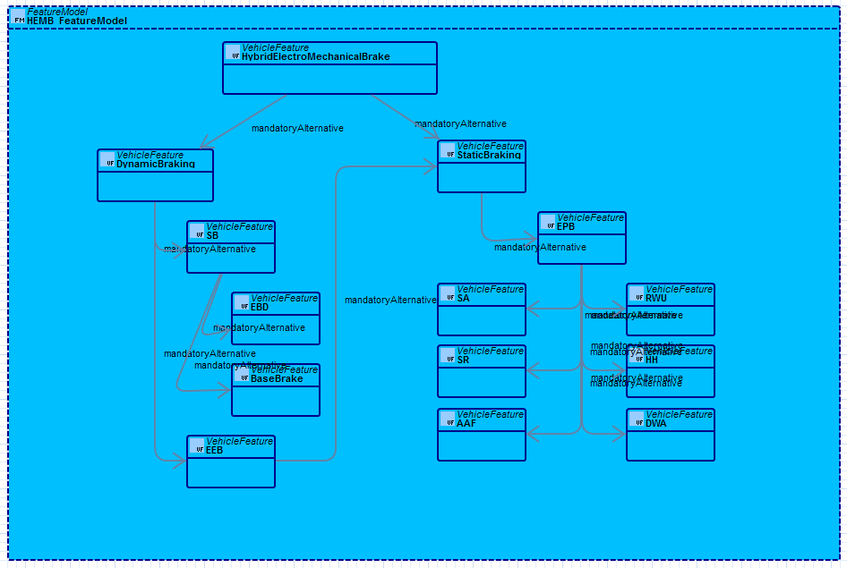
System Model Vehicle Feature model

Slide 17
System Model We are here
Functional
Requirements
Vehicle
Model
Hazard & Risk Analysis
Behavior
Safety Goal
Analysis
Level
Functional Safety Requirement
Design
Level
Technical Safety Requirement

Slide 18
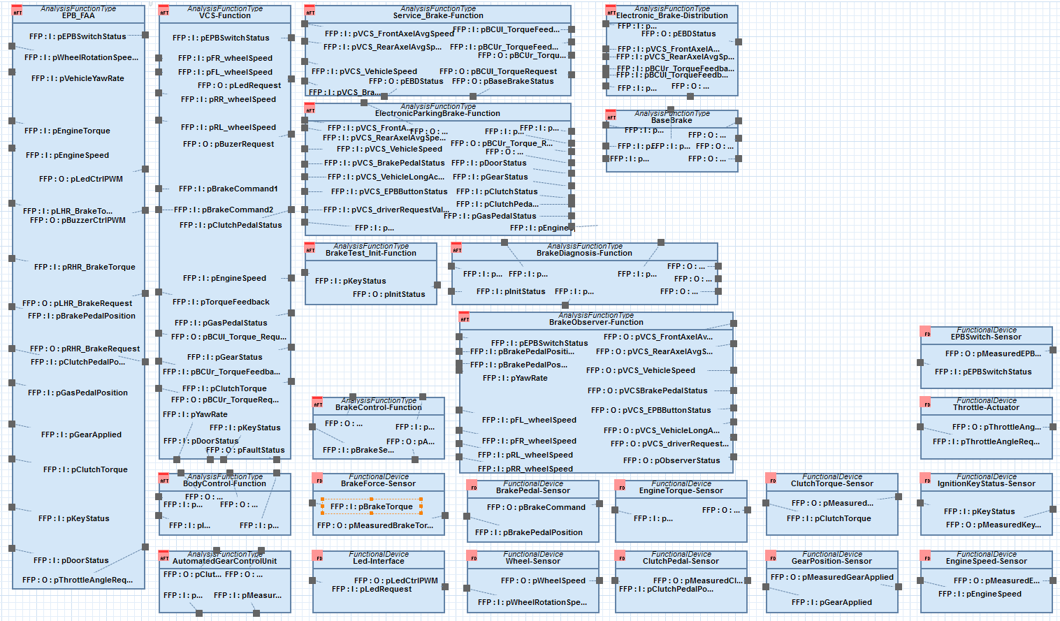
System Model Library of Analysis Function Types
EPB_FAA (electronic park brake) is the root analysis function type.
It is the type of the FAA element, which is a prototype.
i

Slide 19
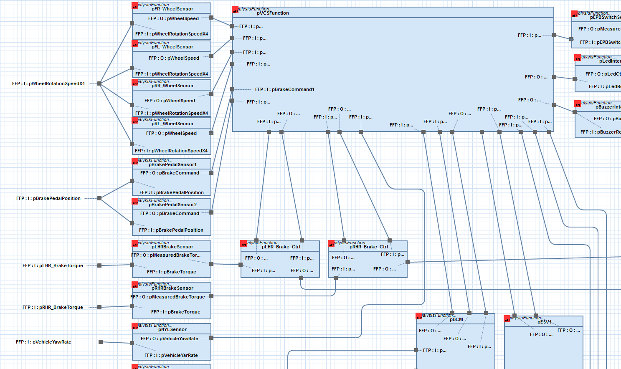
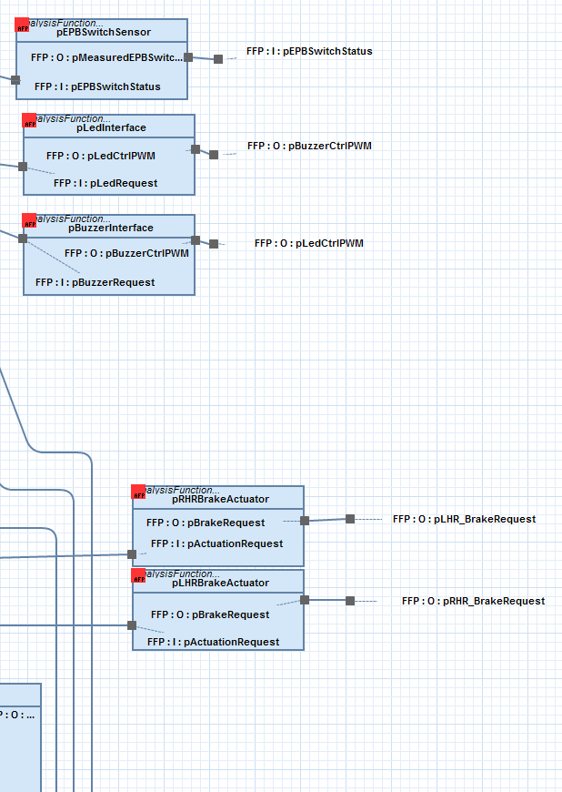
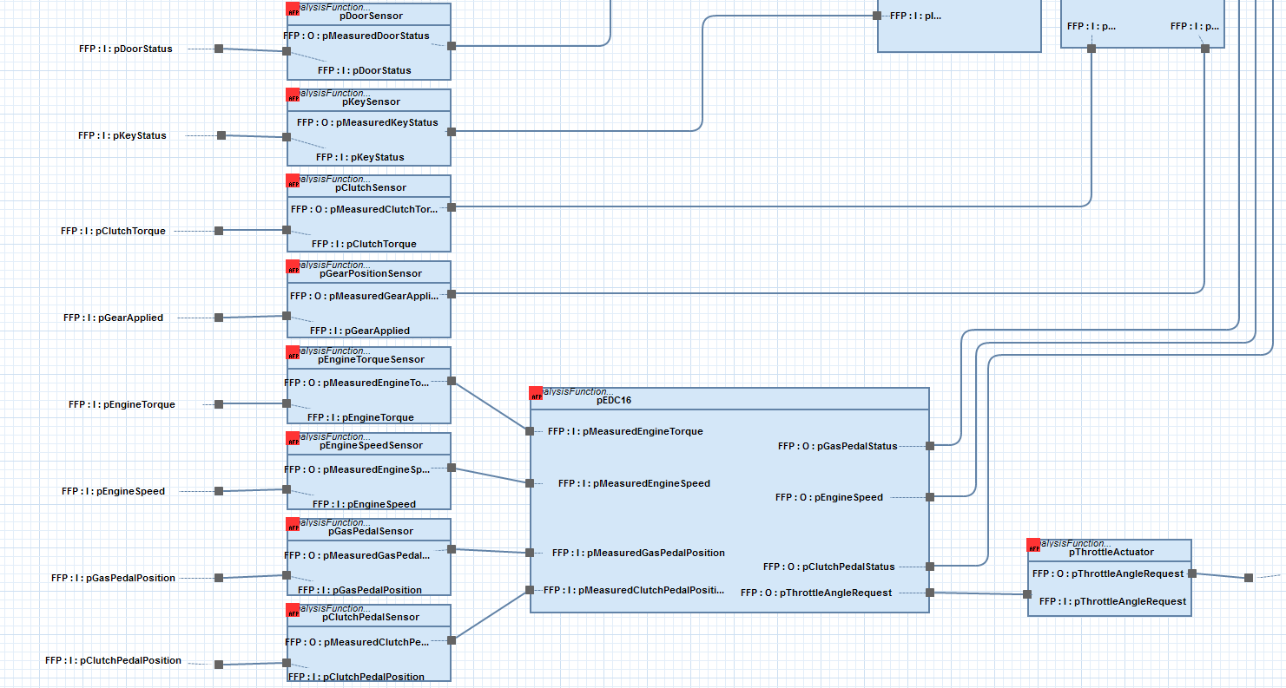
System Model Parts of the Functional Analysis Architecture
This picture shows the internals of the EPB_FAA.
These prototypes are parts of the EPB_FAA type.
i

Slide 20
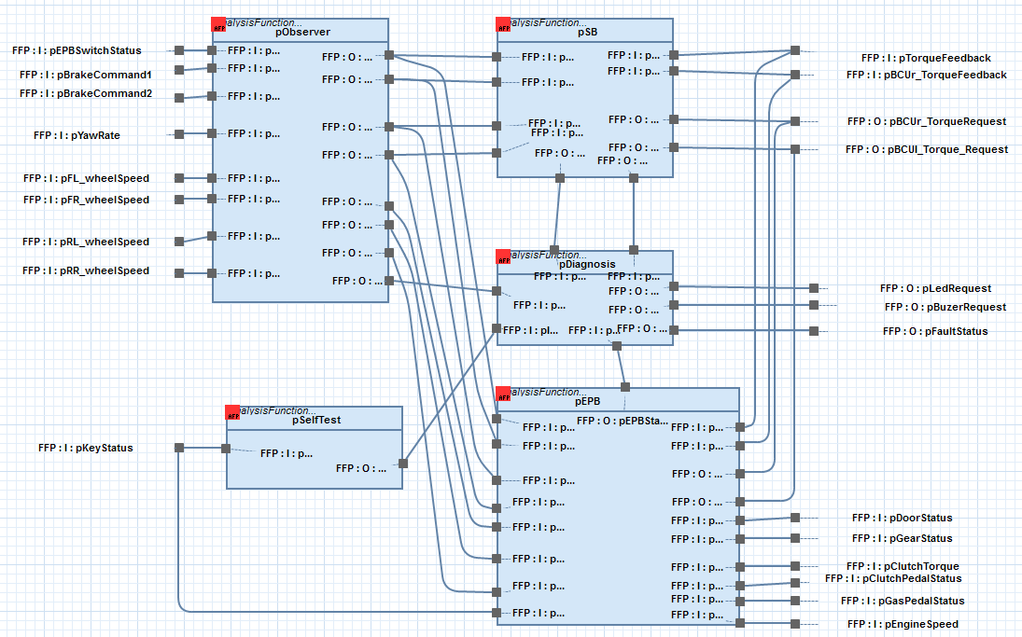
System Model Parts of the vehicle control system
This picture shows the internals of the VCS-Function.
These prototypes are parts of the VCS-Function type.
i

Slide 21
System Model Summary of so far shown hierarchy
System Model
EPB_FAA
VCS-Function
Types
contains
Is of type
part
Is of type
part
Prototypes
HEMB_FAA
(Functional Analysis Architecture)
pVCSFunction
pObserver
The chain of „is of type“ and „part“ relationships between types and prototypes defines a hierarchy of analysis function prototypes.
i

Slide 22
System Model We are here
Functional
Requirements
Vehicle
Model
Hazard & Risk Analysis
Behavior
Safety Goal
Analysis
Level
Functional Safety Requirement
Design
Level
Technical Safety Requirement

Slide 23
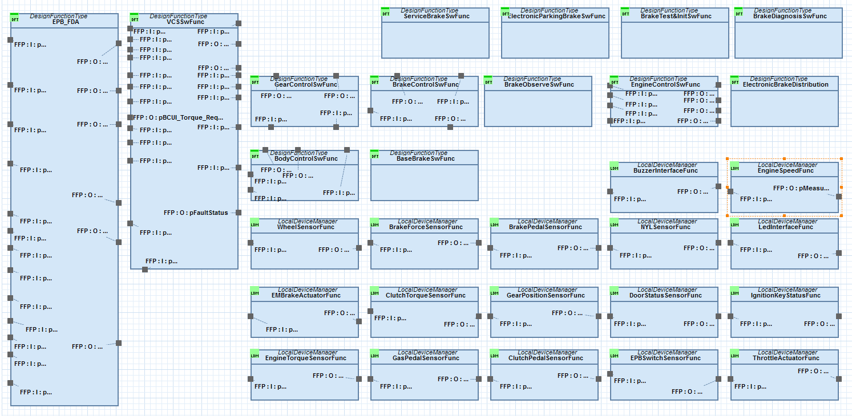
System Model Library of Design Function Types
EPB_FDA (electronic park brake) is the root design function type.
It is the type of the FDA element, which is a prototype.
i

Slide 24
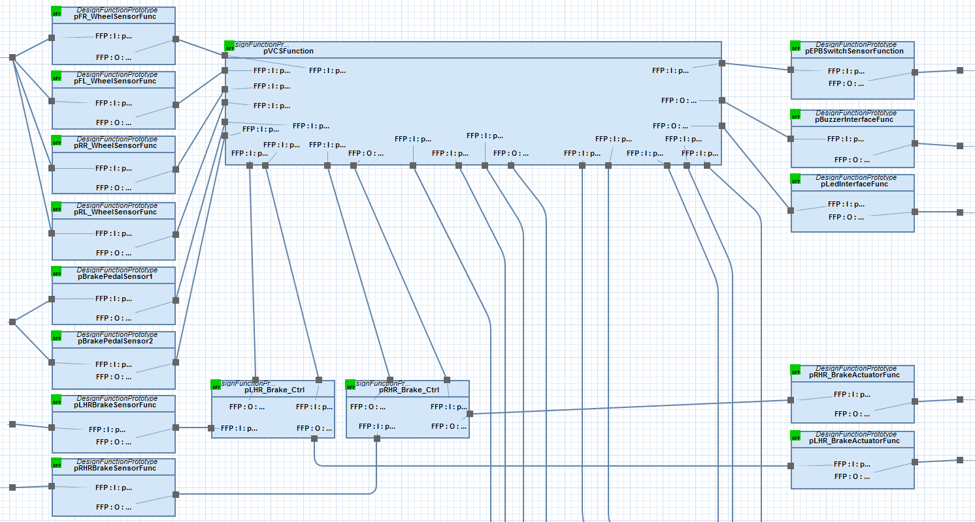
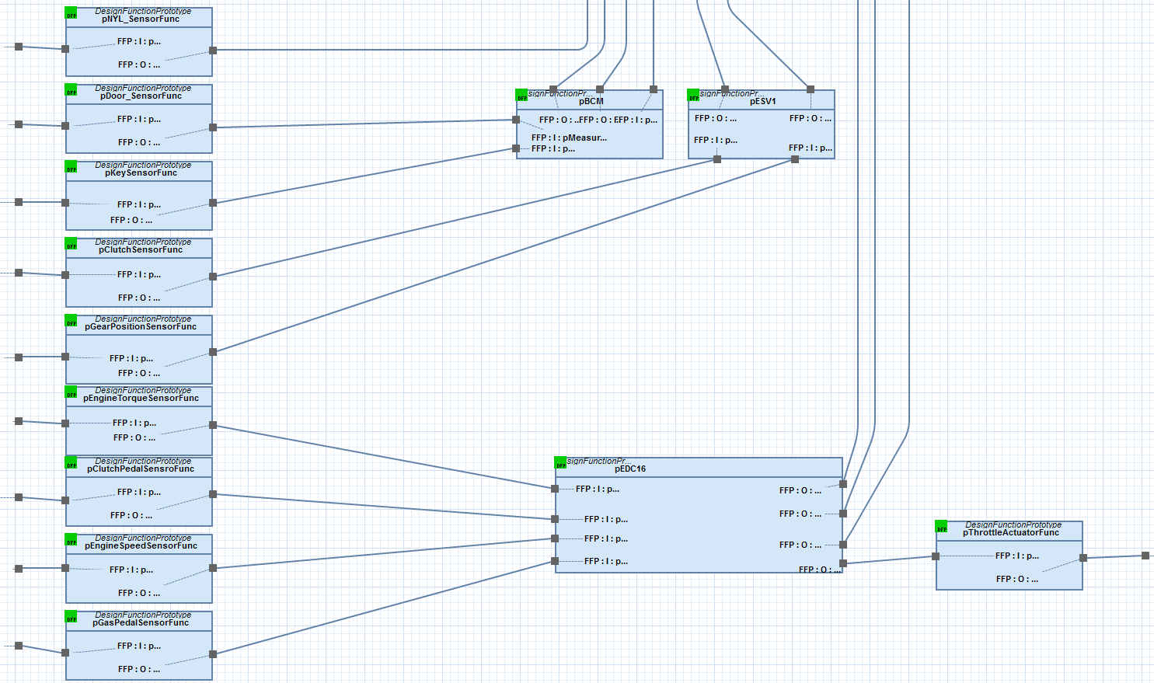
System Model Parts of the Functional Design Architecture
This picture shows the internals of the EPB_FDA.
These prototypes are parts of the EPB_FDA type.
i

Slide 25
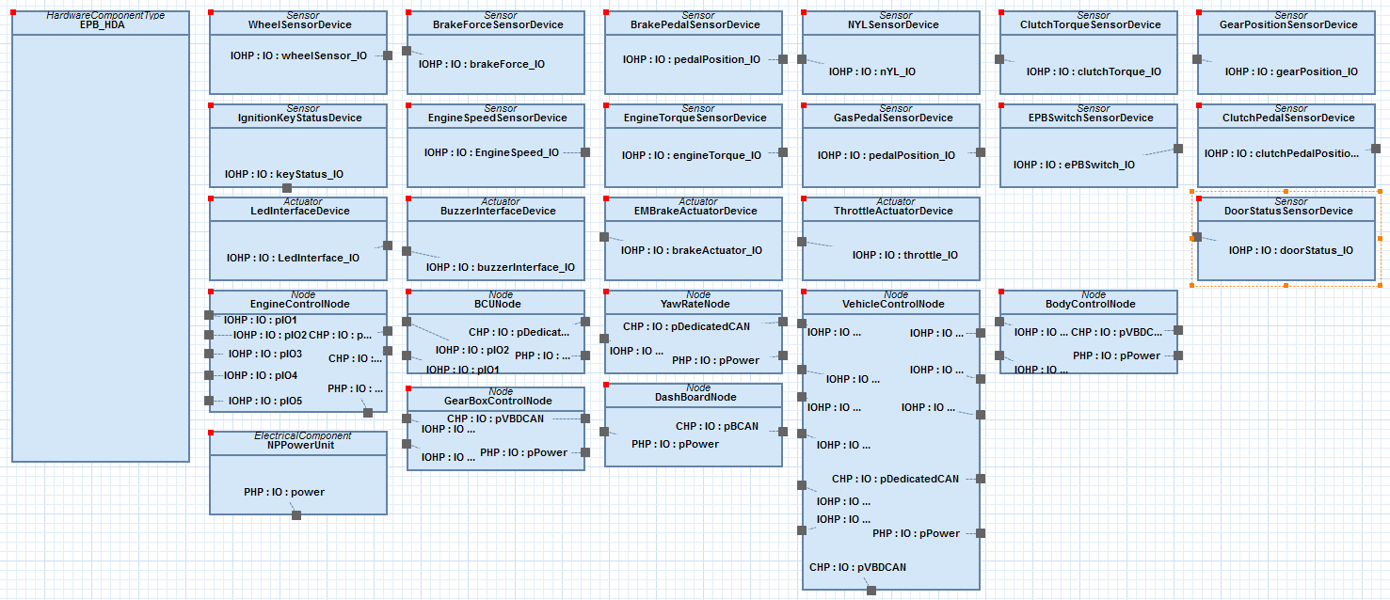
System Model Library of Hardware Component Types
EPB_HDA (electronic park brake) is the root hardware component type.
It is the type of the hardware architecture element, which is a prototype.
i

Slide 26
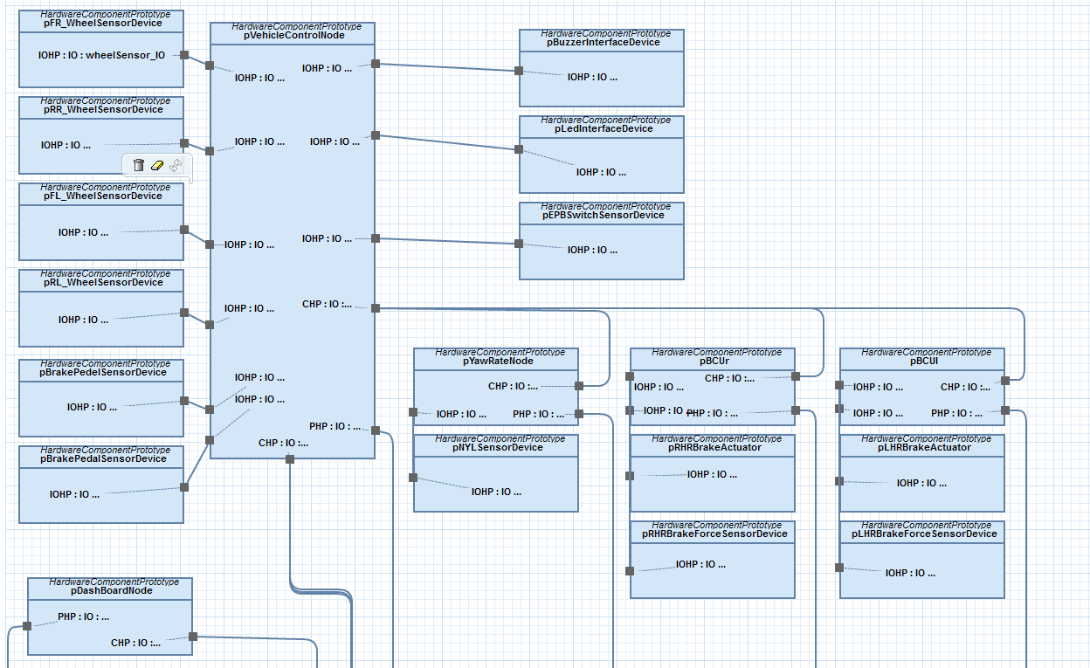
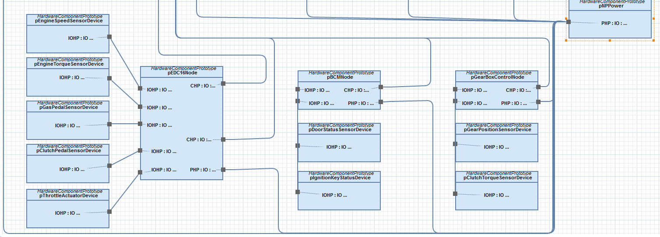
System Model Parts of the Hardware Architecture
This picture shows the internals of the EPB_HDA.
These prototypes are parts of the EPB_HDA type.
i

Slide 27
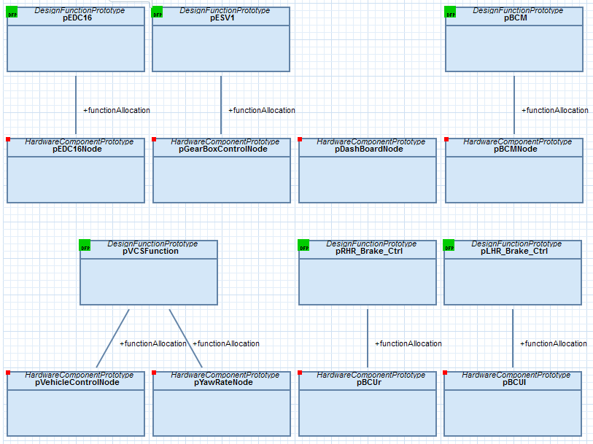
System Model Allocation
The allocation maps the design functions to hardware.
This is the system configuration on design level, which is done on implementation level in AUTOSAR.
i

Slide 28
Content
The Story
The Example
Architecture Overview
System Model
Safety Modeling

Slide 29

Safety Modeling Hazard analysis and risk analysis
ISO26262
3-7 Hazard analysis and risk assessment
SAFE – Safety Goal Modeling
Item Definition
3-8 Functional safety concept
Hazard
4-6 Specification of technical safety requirements
Hazardous Event
Operational Situation
5-6 Specification of hardware safety requirements
6-6 Specification of software safety requirements
ASIL
Safety Goal
A
B
C
D

Slide 30
Safety Modeling We are here
Functional
Requirements
Vehicle
Model
Hazard & Risk Analysis
Behavior
Safety Goal
Analysis
Level
Functional Safety Requirement
Design
Level
Technical Safety Requirement

Slide 31
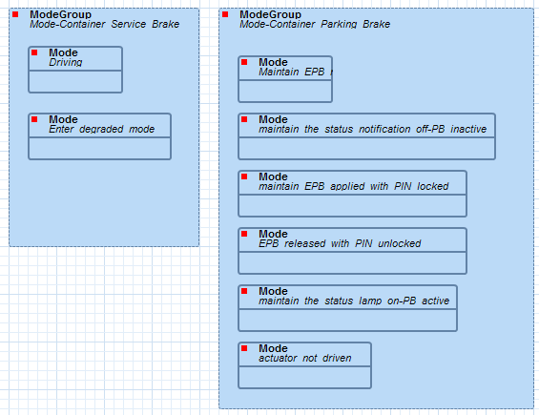
Safety Modeling Behavior Package
The behavior package defines the modes which will be used to define scenarios in the hazard and risk analysis.
i

Slide 32
Safety Modeling We are here
Functional
Requirements
Vehicle
Model
Hazard & Risk Analysis
Behavior
Safety Goal
Analysis
Level
Functional Safety Requirement
Design
Level
Technical Safety Requirement

Slide 33
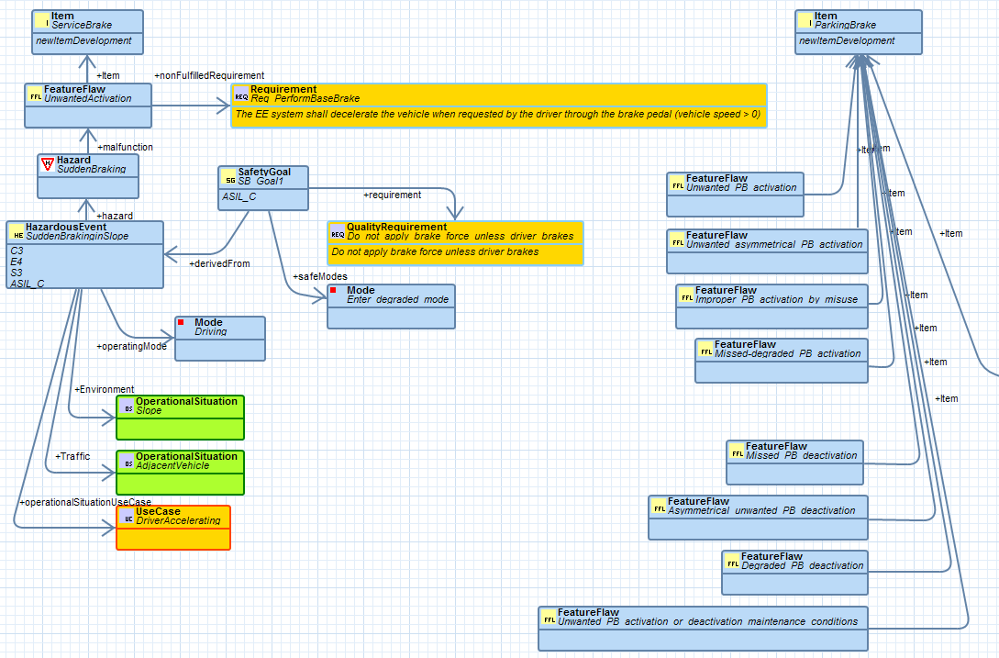
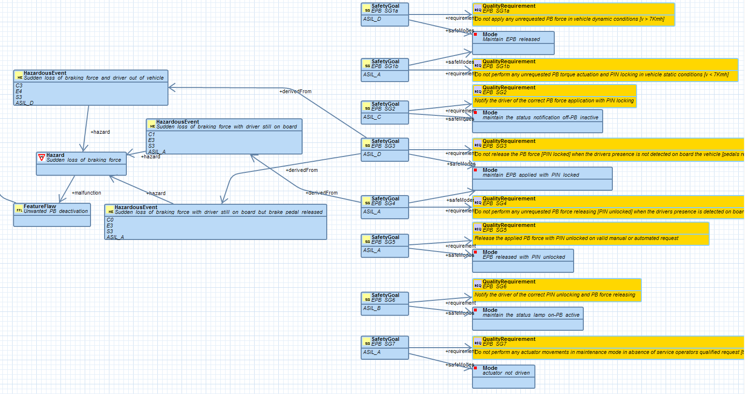
Safety Modeling Hazard and Risk Analysis
From the item „parking brake“ 8 safety goals are derived
From the item „service brake“ the safety goal „Do not apply brake force unless driver brakes is derived.
i
i

Slide 34
Safety Modeling Functional safety concept
Specification of the functional safety requirements … and their interaction necessary to achieve the safety goals.
ISO26262
3-7 Hazard analysis and risk assessment
SAFE - Functional safety concept
Safety Goal
3-8 Functional safety concept
Safe State
ASIL
4-6 Specification of technical safety requirements
A
B
C
D
5-6 Specification of hardware safety requirements
6-6 Specification of software safety requirements
Functional Safety Requirement
Functional Architecture Item

Slide 35
Safety Modeling We are here
Functional
Requirements
Vehicle
Model
Hazard & Risk Analysis
Behavior
Safety Goal
Analysis
Level
Functional Safety Requirement
Design
Level
Technical Safety Requirement

Slide 36
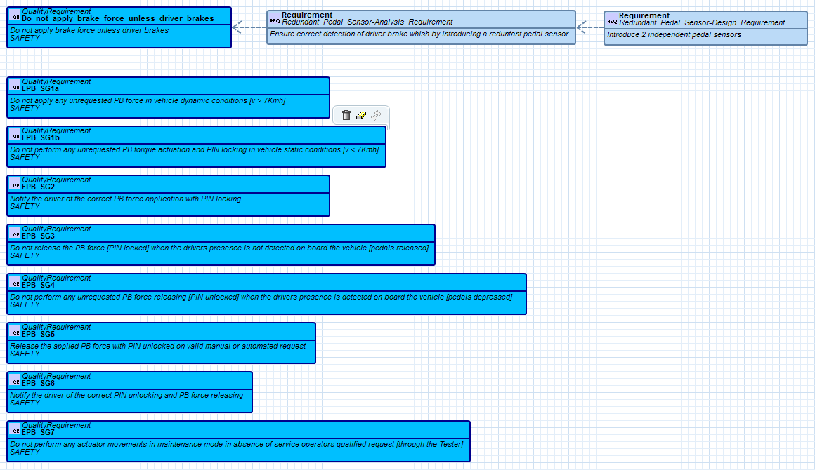
Safety Modeling Derived safety requirements
Safety goals are top level safety requirements.
They are derived by safety requirements on analysis level.
These analysis level safety requirements are derived by safety requirements on design level.
i

Slide 37
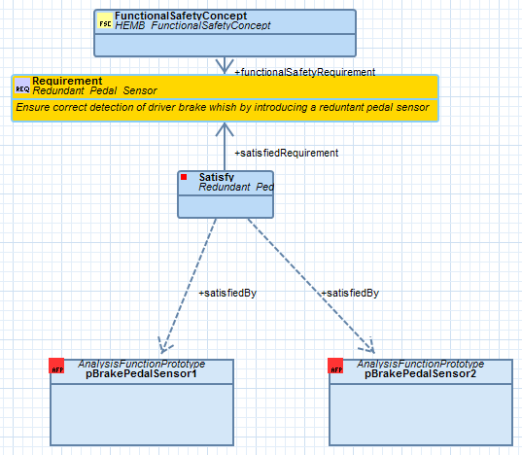
Safety Modeling Functional Safety Concept
On analysis level, the functional safety concept contains the safety requirements derived from the safety goal.
The satisfy relationship traces their fulfillment on horizontal level.
i

Slide 38
Safety Modeling We are here
Functional
Requirements
Vehicle
Model
Hazard & Risk Analysis
Behavior
Safety Goal
Analysis
Level
Functional Safety Requirement
Design
Level
Technical Safety Requirement

Slide 39
Safety Modeling Technical Safety Concept
Specification of the technical safety requirements and their allocation to system elements for implementation by the system design.
ISO26262
3-7 Hazard analysis and risk assessment
SAFE – Technical safety concept
3-8 Functional safety concept
Functional Safety Requirement
Functional Architecture Item
4-6 Specification of technical safety requirements
Technical Safety Requirement
Technical Architecture Item
5-6 Specification of hardware safety requirements
6-6 Specification of software safety requirements

Slide 40
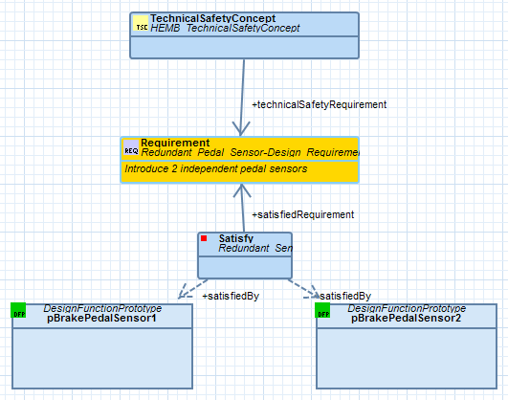
Safety Modeling Technical Safety Concept
On design level, the technical safety concept contains the safety requirements derived from the safety requirements on analysis level.
The satisfy relationship traces their fulfillment on horizontal level.
i

Slide 41
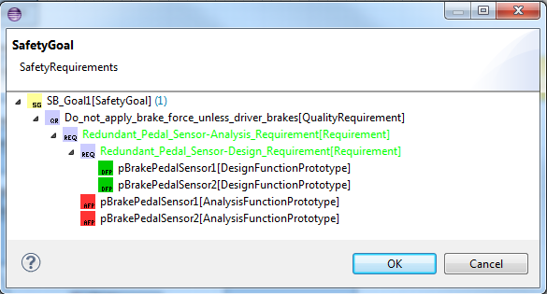
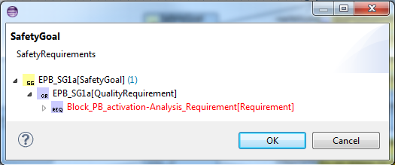
Safety Modeling Safety Goal Fulfillment
These views show the safety requirements tracing tree. The satisfying architecture elements are shown as leaves of the tree.
In case a safety requirement is satisfied, it is shown in green text color, otherwise in red text color.
Yellow icon: safety goal
Blue icon: derived safety requirement
Red icon: analysis function
Green icon: design function
i

Slide 42
Thank you for your attention This document is based on the SAFE project in the framework of the ITEA2, EUREKA cluster program Σ! 3674. The work has been funded by the German Ministry for Education and Research (BMBF) under the funding ID 01IS11019, and by the French Ministry of the Economy and Finance (DGCIS). The responsibility for the content rests with the authors.

