Slide 1
Temtris
Course Project for CSCI 352
Curt Lynch and Hunter Johnson

Slide 2
Background
Tetris clone made using C# and WPF
We thought Temtris would be easy enough given the medium and time constraints.
WPF is not a particularly good choice for real-time games.

Slide 3
Approach
Backend
Matrix
Movement
User Input
Frontend
Main menu buttons
Process data from matrix and show it on the screen
Strategy / factory method pattern
difficulty
generation of tetraminos
Template patter
separate game engine logic from ‘Temtris’ logic
reusable game engine code for future projects

Slide 4
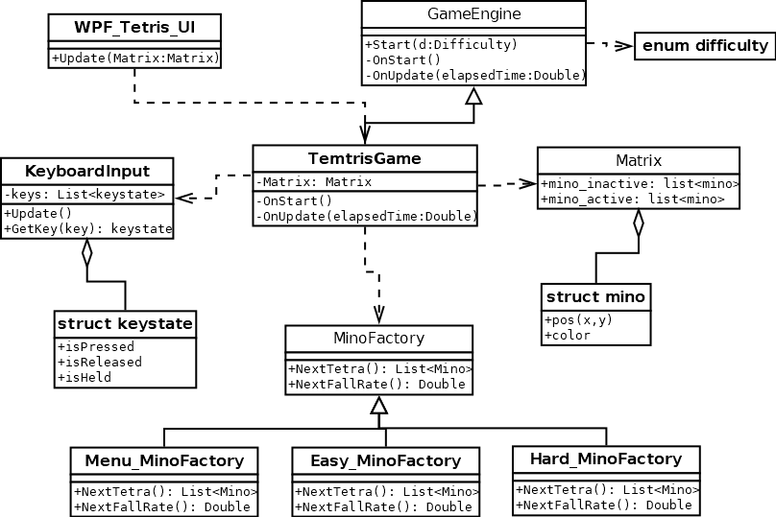
Class Diagrams

Slide 5
Demo
Controls
W: Rotation
A: Move left
D: Move right
S: Fall faster

Slide 6
Future Work
Swap active piece with next
Music / sound effects
More varied / interesting difficulty options
UI rework: make Temtris a bit easier on the eyes (possibly outside of WPF)
Multiplayer modes co-op / versus
Scoreboard

Slide 7
Questions
Curt Lynch : curjlync@ut.utm.edu
Hunter Johnson: hunmjohn@ut.utm.edu
Temtris Repository: https://github.com/Arcdeciel82/Temtris

