Slide 1

VeriSource
A VERIFICATION AGENT FOR BUYERS
Check what suppliers claim against official sources, and see exactly how each answer was reached.
Product demo | India
Notes:
Open with the one-line idea: a buyer already knows some suppliers and needs to check what those suppliers claim. VeriSource does the checking and shows its work.

Slide 2



Supplier claims are hard to verify by hand
Evidence is scattered
Official lists, issuer records and supplier websites, each checked one supplier at a time.
SEEN IN OUR OWN TESTING
“4 out of 12 checks”
Claims are self-reported
A supplier's website says what the supplier wants to say.
A small language model once said this. The number was invented.
A chatbot can sound sure while guessing
So in VeriSource the app writes every result, not the model.
The buyer cannot tell which answers come from evidence.
Notes:
The problem is not only the effort of checking. It is trust. We saw a small model invent a count that did not exist, and that shaped the design: the model never states facts.

Slide 3




VeriSource in four steps
The buyer describes a need and the suppliers they know. The agent gathers evidence from public pages and official records. Every claim ends as proven, unproven or contradicted, with its source and date.
1 Describe
2 Confirm
3 Collect
4 Review
Type or speak the need and the suppliers, in plain language.
Check what the agent understood, then confirm the requirements and the checks.
Evidence arrives from public pages and official lists while you watch.
Read the verdicts, open the evidence, record your decision, export a PDF.
India only. The system never contacts a supplier.
Notes:
Keep this brief: four steps. The rest of the demo walks through them with a real case.

Slide 4
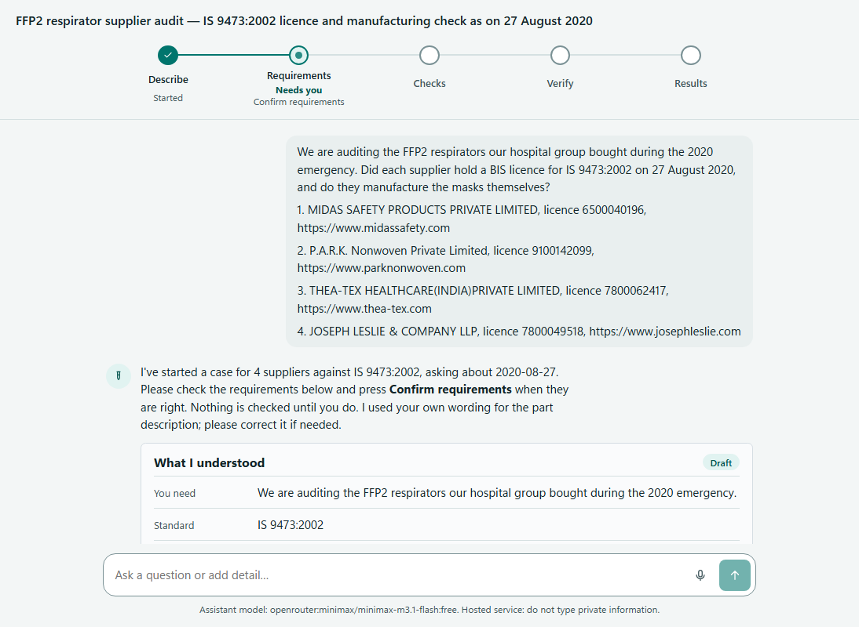
Start by chatting, in your own words
THE CASE WE WILL RUN
A hospital group audits the FFP2 respirators it bought during the 2020 emergency.
For each of four suppliers: did they hold a BIS licence for IS 9473:2002 on 27 August 2020, and do they make the masks themselves?
The agent fills in what it can read from the message and shows it back for correction. It asks only when in doubt.
Notes:
LIVE DEMO starts here. Paste the message with the four suppliers. Point out that nothing is checked yet; the agent has only drafted what it understood.

Slide 5
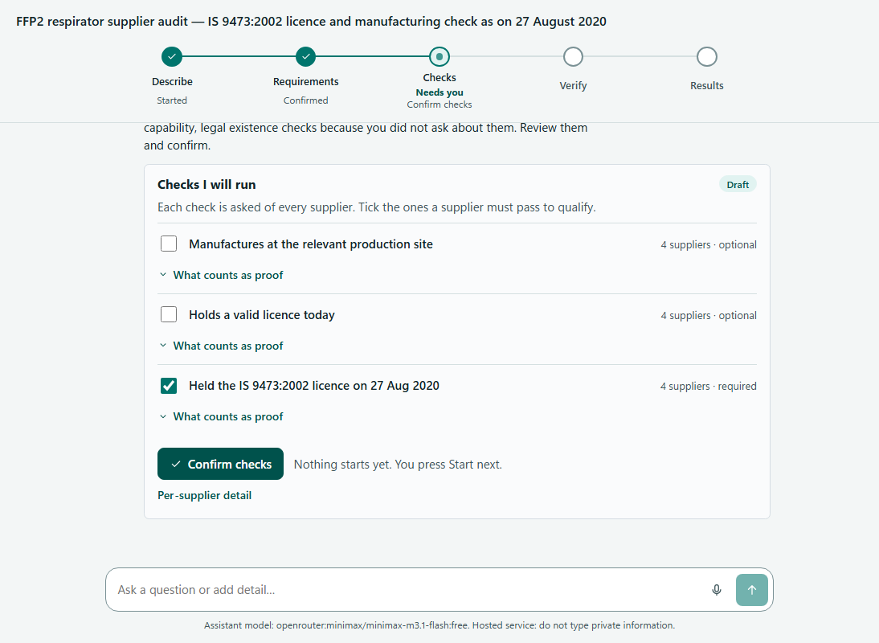
The buyer holds every gate
1
Confirm requirements
Correct anything the agent read wrongly.
2
Confirm checks
Tick what a supplier must pass to qualify.
3
Start verification
Nothing runs until the buyer says go.
4
Record a decision
The buyer decides. The agent never does.
No model output can trigger any of these.
Notes:
This is the trust story for a buyer. The agent proposes, the buyer decides. Show the checks card and tick the licence check. Mention the 'what counts as proof' expanders.

Slide 6
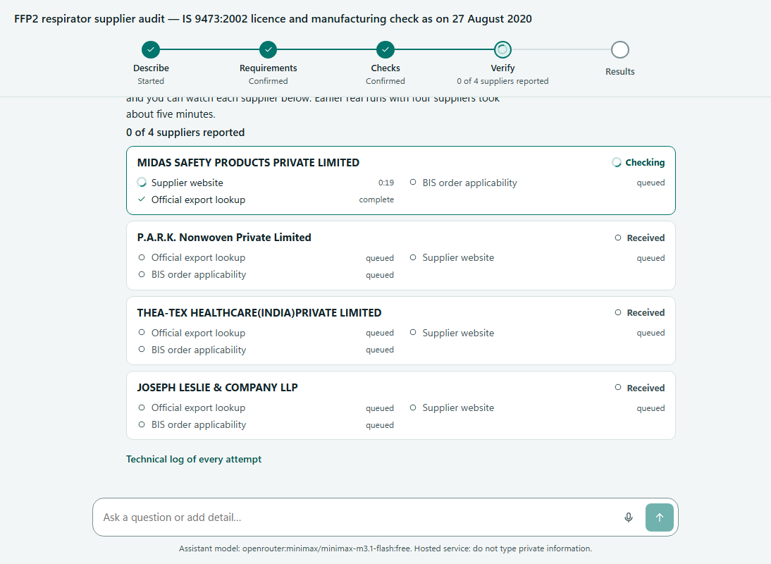



Watch the evidence arrive
257 s
live collection for four suppliers in a measured run (236 s for two)
Every supplier gets its own checks: the official licence export, the supplier website and BIS order applicability.
A background worker keeps the queue, so the work survives a closed tab or a restart.
Progress is announced per supplier, and a log of every attempt is one click away.
Notes:
Start verification in the demo. While it runs (about four minutes for four suppliers), talk through slides 7 and 8, or take questions. The 257 s figure is from a measured live run; 236 s was for two suppliers.

Slide 7
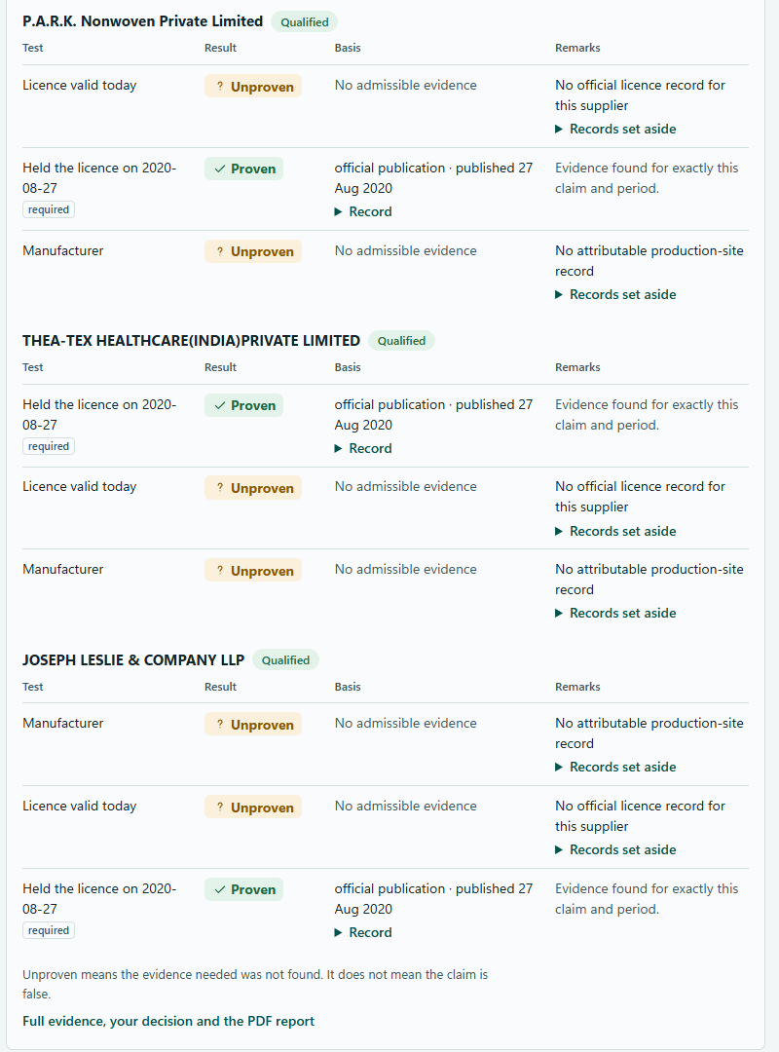
Results the buyer can inspect
4
8
0
proven
unproven
contradicted
Held the BIS licence on 27 Aug 2020
All four suppliers proven, from the official BIS FFP2 licence list. Each result links to the record it came from.
Manufacturer and licence valid today
Unproven. The evidence needed was not found. That does not mean the claim is false, and the report says so.
Notes:
Open the report. Show a proven row and expand its Record to show the source and publication date. Then show an unproven row and its 'records set aside'. Stress: unproven is not false.

Slide 8



Three verdicts, nothing guessed
Proven
Unproven
Contradicted
Evidence found for exactly this claim and period, from an official source. History is labelled as history: “held the licence on 27 Aug 2020”.
Evidence is missing, stale or ambiguous. Shown as a gap, never as a failure.
A source refutes the claim. Built into the rules, but no real source can show it yet.
Every verdict shows its source, its date and the checks that were tried.
Notes:
The vocabulary is fixed on purpose. Processing state (queued, checking, done) is shown separately from the verdict. Be upfront that contradicted exists in the design but cannot be demonstrated on the real data we have.

Slide 9



What happens behind the chat
Chat assistant
Buyer gates
Collector
Evidence engine
Report
Understands the message and asks short questions. Writes no facts.
The buyer confirms requirements and checks, and starts verification.
A background worker reads public pages and official lists.
Rules every claim from stored evidence, not from a model.
Verdicts with sources and dates, a PDF export, the buyer's decision.
Runs on one laptop. Cases are private to the signed-in buyer. Evidence and verdicts stay on the machine; only the chat text goes to a hosted free model, and the screen says which model is in use.
Notes:
Minimal technical view. Key message: the model sits in the first box only. Verdicts come from the evidence engine through ordinary application code. The privacy note matters: the typed chat text is the one thing that leaves the laptop, and the UI discloses it.

Slide 10



Honest by construction
The assistant confirms nothing
Facts are written by the app
It can open a case, ask a question and explain results. Nothing else.
Once a case exists, results come from the stored assessment. The model's free text never reaches the buyer.
Gaps stay gaps
No shortcuts
Missing or ambiguous evidence is unproven. No guessing, no rounding up.
It never contacts a supplier, never solves a CAPTCHA and never uses seeded demo data.
Notes:
This is what separates VeriSource from a neighbouring chatbot: it could not truthfully claim its answers come only from stored evidence; this one can. The guardrails stay in place whichever model is used.

Slide 11
What it can prove today, and what it cannot
Provable now
Not provable yet
Held the BIS licence for IS 9473:2002 on 27 Aug 2020
Source: the imported BIS FFP2 licence list (cutoff 27 Aug 2020, 29 rows).
Real runs on 20 Oct 2026: 4 of 4 suppliers proven.
Manufacturer: a supplier's own website is self-report, so the engine refuses it.
Licence valid today: the export is historical and the live BIS search is CAPTCHA-protected.
Legal existence and current GST: no free, attributable source wired in.
Contradicted: no source can refute a claim yet.
If the buyer requires “valid today”, no supplier qualifies. That is by design.
Notes:
Be candid here. If a buyer ticks 'valid today' as required, no supplier qualifies, by design. We prefer an honest gap to a guess.

Slide 12
What we have measured so far
~5 s
257 s
4 of 4
2 to 7 s
to create a case from a pasted message
live collection, four suppliers
suppliers proven for the BIS licence claim
for hosted chat answers
Not measured yet, and not claimed
Accuracy against human auditors. Timing for a 30-supplier case. Voice accuracy with a real microphone. An accessibility audit of the new layout.
Notes:
Only numbers we actually measured. The 257 s run was live, four suppliers; the ~5 s case creation was from a pasted message. We have no accuracy figure and will not quote one.

Slide 13
Where it goes next
First: make more claims provable
A certificate route (ISO certificate to issuer record) and a real source that can contradict a claim.
ROADMAP: DRAFTED AS SPECS, NOT BUILT
Supplier discovery
Drawings and PDFs
Outreach
The agent finds suppliers for the buyer.
Start a case from an uploaded document.
Follow-ups drafted, each one approved by the buyer.
Monitoring
Voice acceptance
Second country
Re-check suppliers over time.
Prove spoken input works for real buyers.
Extend beyond India.
Notes:
Supplier discovery is the closest to the original agentic goal. Outreach is only ever with the buyer's approval of each message. None of the roadmap items is built; they are drafted as specifications.

Slide 14
The agent proposes. The buyer decides.
Every answer is tied to a source, a date and the checks that were tried. A gap is shown as a gap.
Thank you. Questions?
Notes:
Close on the principle, then take questions. If time allows, show the cases drawer to reopen an earlier assessed case.

