Slide 1
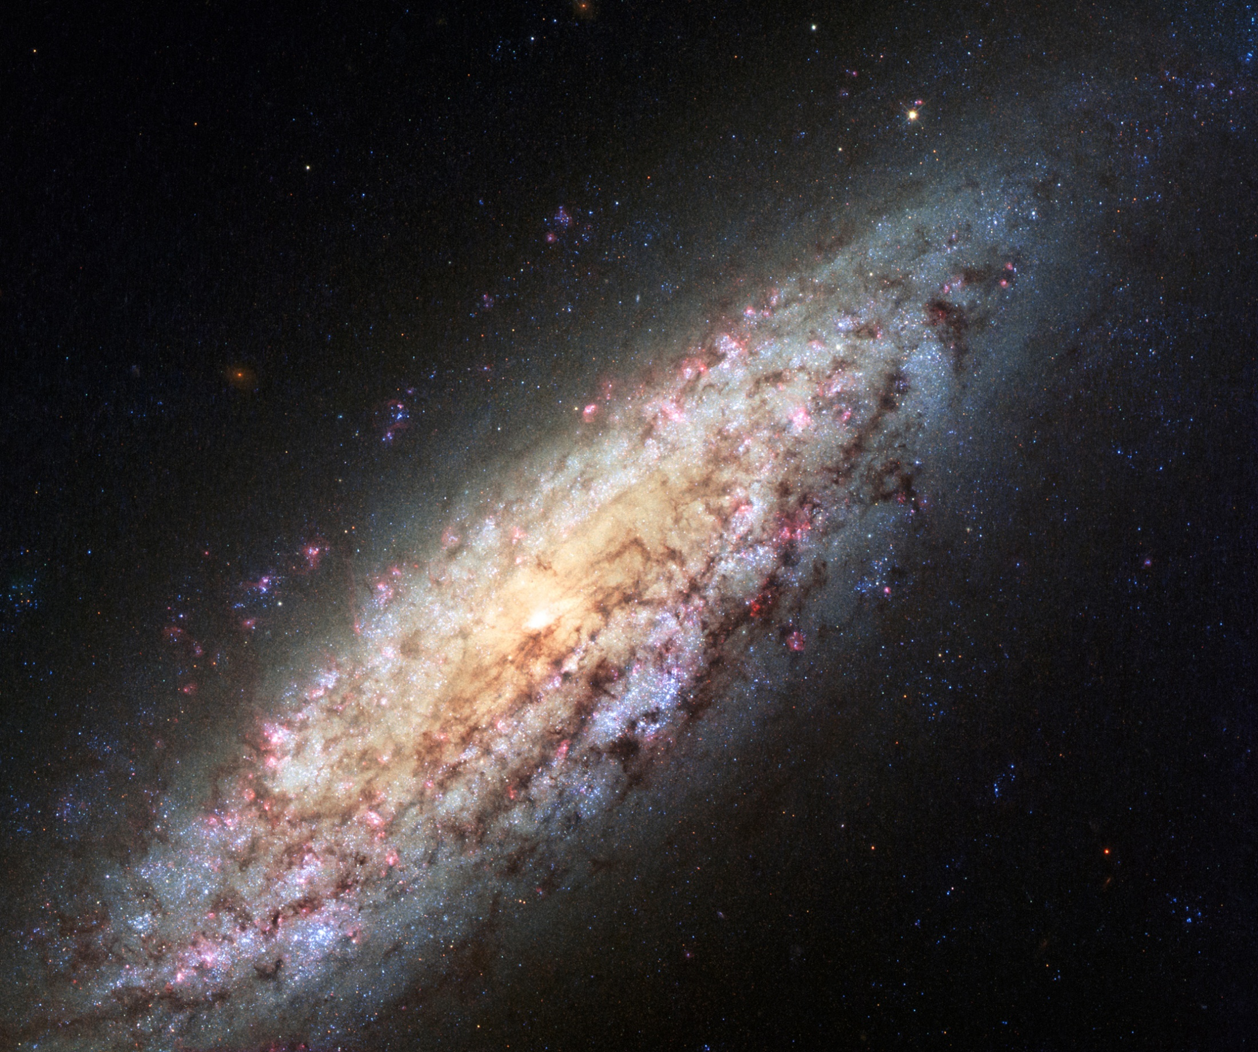
INTERACTIVE
INSTALLATION
Group 20_ Miklos Mayer, Conall Mackay, Michelle Rosinski, Megan Hutchison, Aditya Vashist
Notes:
Slide 1- > Give clear overview of the team members, and their roles throughout the project. (Miklos, Aditya- main coders; Conall, Michelle- research, gather facts and information; Megan- create presentation and visuals of final installation)

Slide 2
OUR
INTERACTIVE
INSTALLATION
Raising awareness, and encouraging people to
visit the Mill’s Observatory
The first observatory open to the public in
the U.K
Re-opened October 2019
£100,000 spent on repairs: visitors important
more than ever
Notes:
Slide 2: Explaining our theme for the installation. Information regarding Mill’s Observatory in Dundee.

Slide 3
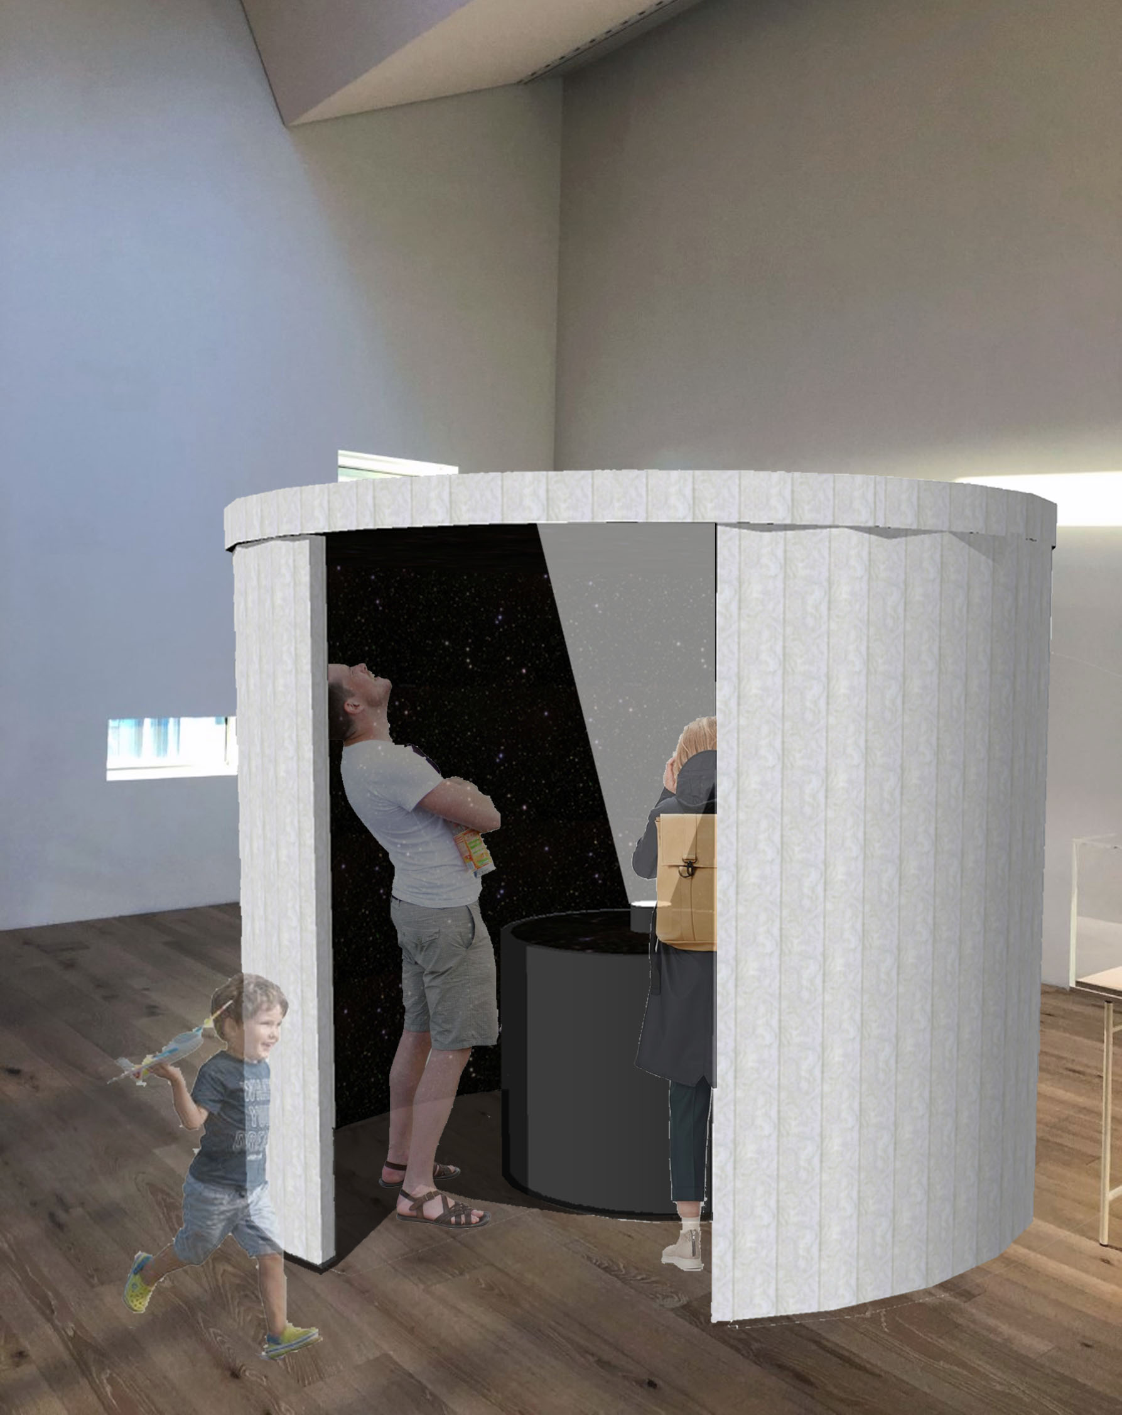
THE
INSTALLATION
V&A exhibition space, 2nd floor
Enclosed dome structure
Circular interactive screen
Projector located central
Constellation projected
onto structure roof
Replicating the Observatory
Notes:
Slide 3- How our installation looks- location, structure, user interaction, why

Slide 4
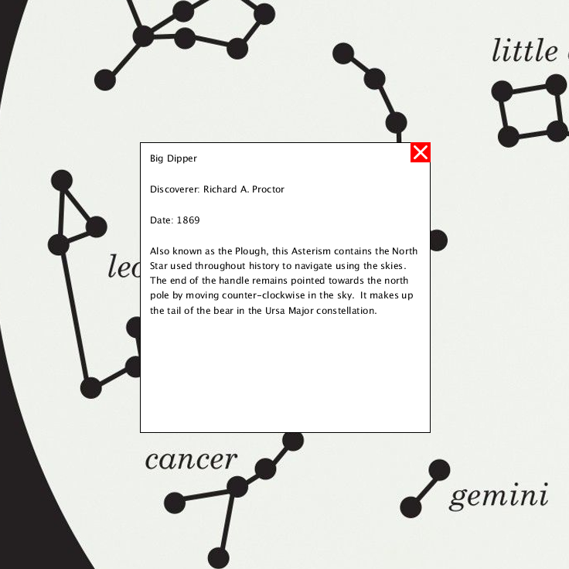
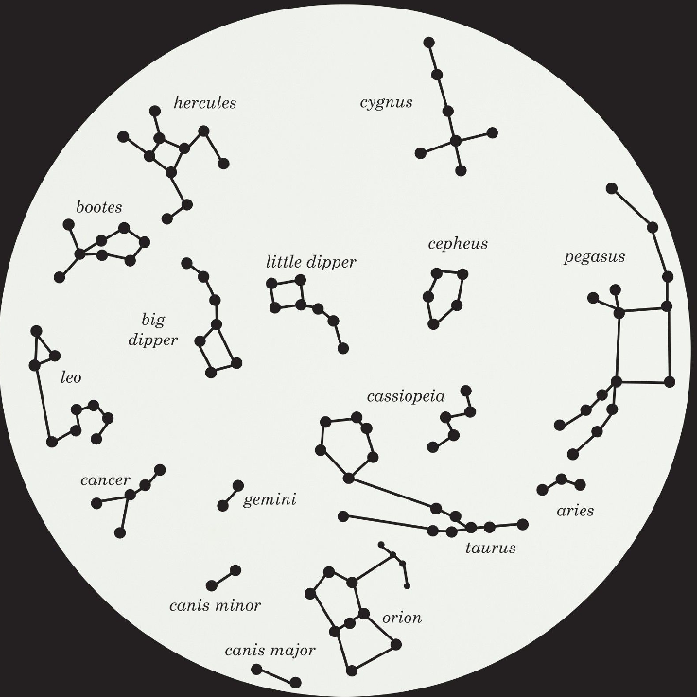
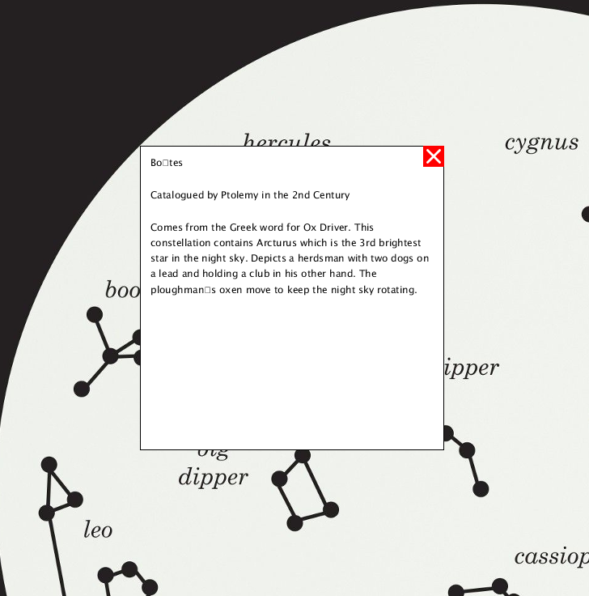
HOW
THE USER
INTERACTS
User zooms onto different
constellations using scroll
Clicking on constellations
reveals information
Notes:
Slide 4: User interaction explained

Slide 5
THANK YOU FOR LISTENING…
Please watch a demonstration of our code in action.
Are there any questions?

