Slide 1
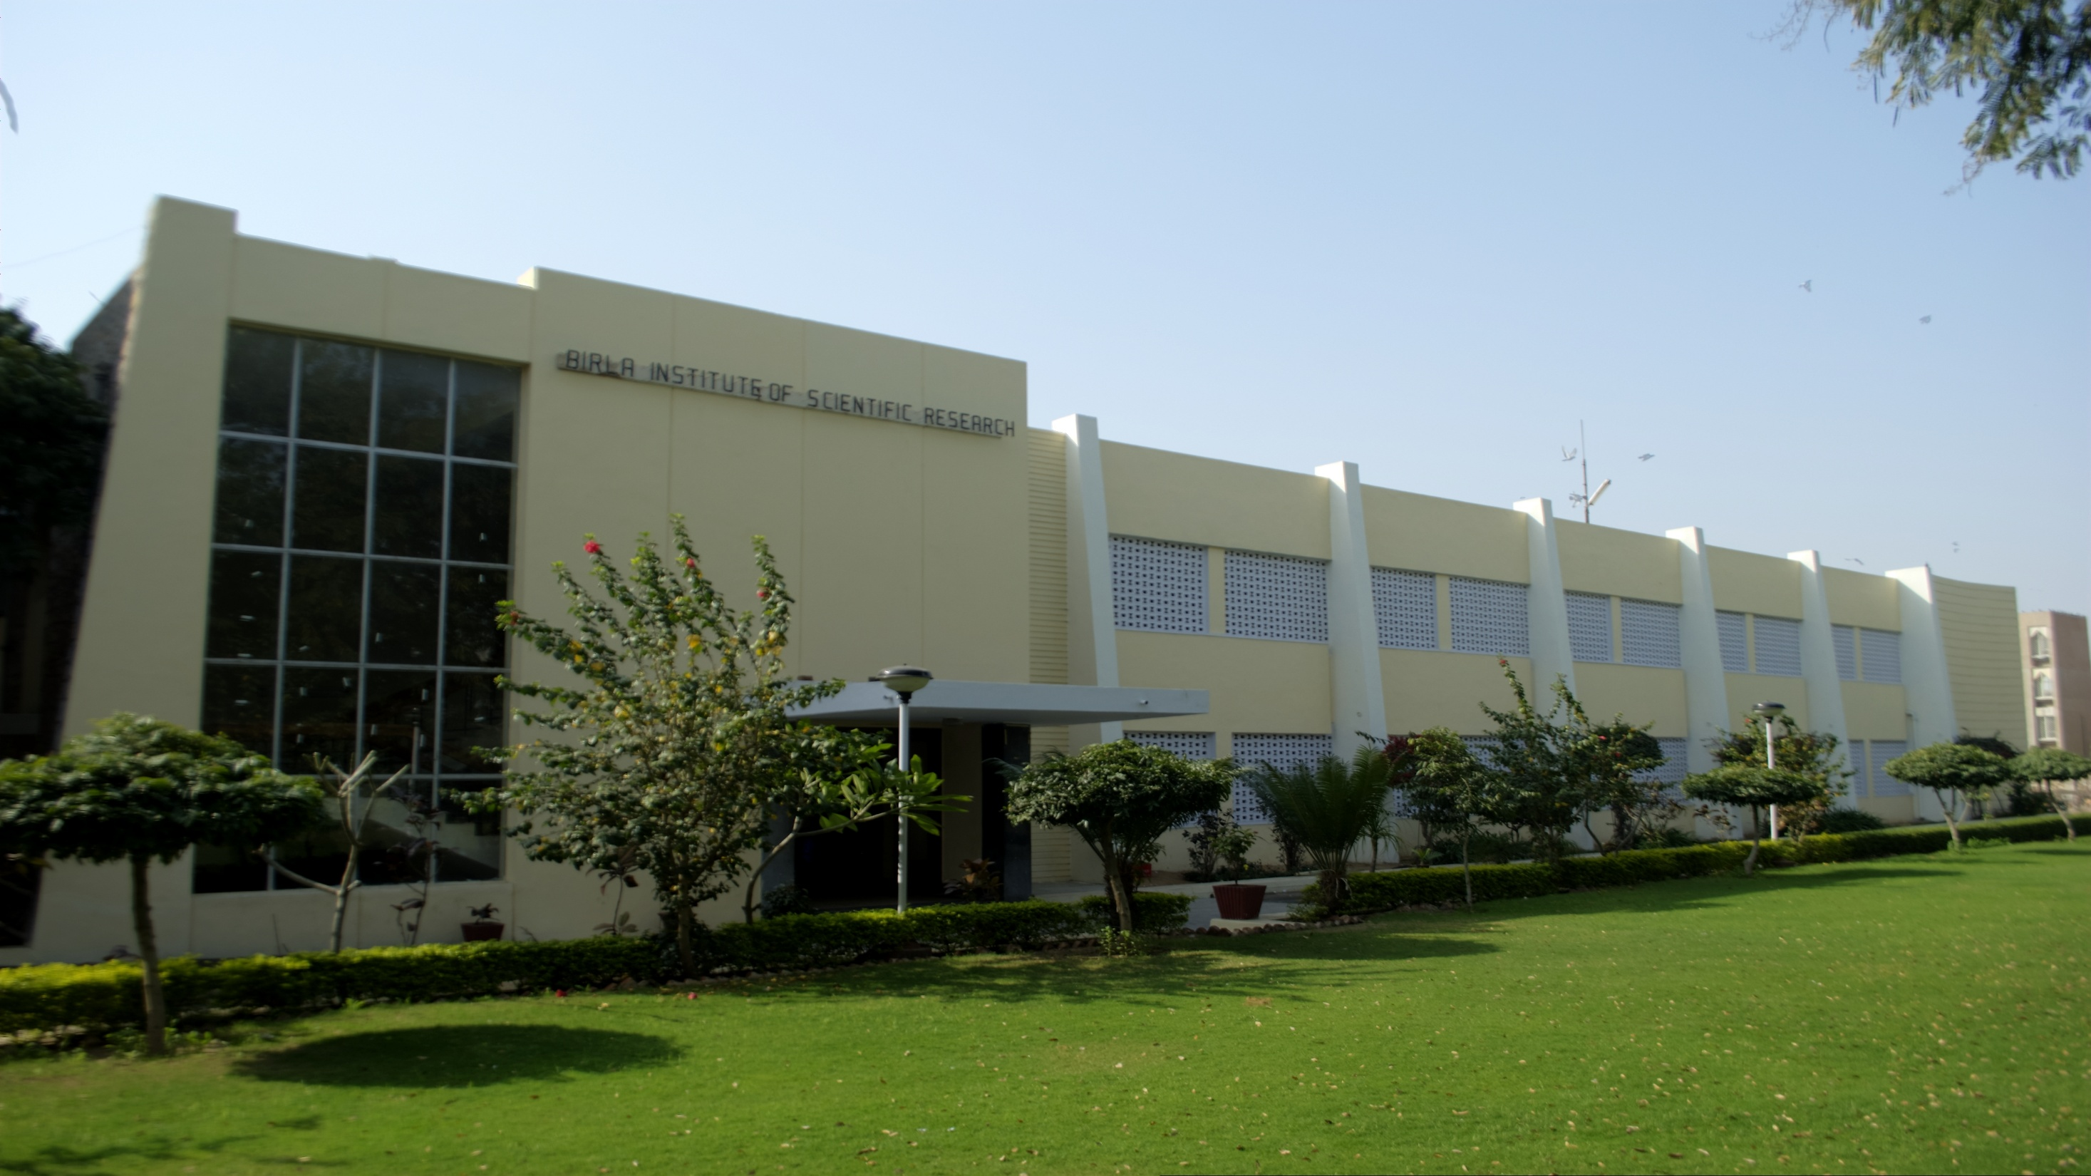
COLLEGE ERP SYSTEM
Submitted By:
Aveg Chaudhary(BE/25108/11)
Aayushi Sharma(BE/25099/11)
Ruchika Singh(BE/25102/11)
Kharanshu Saini(BE/25098/11)
Guided by
Mrs. Seema Gaur

Slide 2

Previously, all the resource management activities were performed manually which utilize a lot of man hours and paper work. The system which we have proposed reduces the man hours and also follows the eco-friendly concept.
College ERP provides a platform for sharing information between all the stakeholders, viz. Students, Teachers, Administrators and Management
The software is aimed at bringing in process refinement, efficiency, accountability and control in our College
This software is built using Asp.net and uses SQL Server 2008 as the Database and runs on the Microsoft Visual Studio server.
Will reduce the work overload on the management; the successful implementation of these modules will automate the functioning of the college system.

Slide 3
Software Modules
College Enterprise Resource Planning
Attendance Management System
Marks Storage & Retrieval System
Feedback System

Slide 4
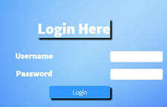
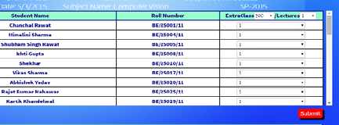
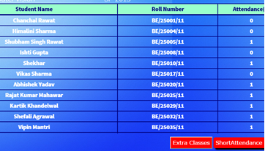
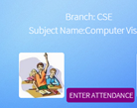
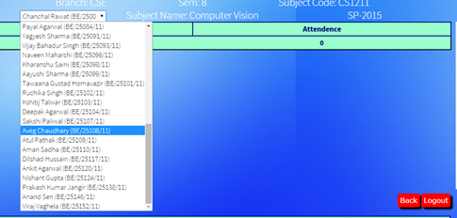


Attendance Management System
Faculty View
Initial Login for Faculty
Used for generating report of a particular student
Faculty Uses this page to Enter the daily attendance subject-wise
Faculty uses this page to generate report
Interface for viewing the report
Interface for entering attendance
Report Generated Class-wise

Slide 5
Student’s View
Can check attendance using three options
Login using user-id & password
1. Total attendance of a subject
Student
3. Percentage-wise attendance of a subject
2. Date-wise attendance of a subject

Slide 6
Feedback Management System
Student’s View
Student can :
1. Enter feedback
2. Class-wise view
3. Faculty-wise view
4. Other suggestions
Student can rate a faculty on a scale of 10
Student can view class-wise report for a particular semester
View Faculty-wise report & add suggestions

Slide 7
Faculty View
Login using user-id & password
Can view feedback using three options
1. View complete report of a particular class
Faculty
3. View student suggestions.
2. View report of a particular faculty

Slide 8


Marks Storage & Retrieval System
Faculty View
ENTER MARKS
Mid-Semester
End-Semester
3. Internal
VIEW & UPDATE
Verify marks of students using class-wise result and make necessary updates

Slide 9
Student’s View
Login using user-id & password
Can check marks for a particular semester
Student
End-Semester Marks
Mid-Semester Marks
Internal Marks

Slide 10



Future Scope
Phase III: Time Table Generation, Online Notice Board, Payroll System
Phase II: Creation & Maintenance of Student & Faculty Profiles, Online Placement Cell
Phase I: Online Assignment Allocation, Online Lecture Notes

Slide 11
Conclusion
Transparency in administration at all levels.
Accountability in the system.
Improvement in the quality of education management.
Reducing paper work and promoting green force.
Utilization of college resources effectively and efficiently.

Slide 12
Thank You

