Slide 1
Alone in a new city ?
If you want to know more about the city, who do you turn to ?

Slide 2
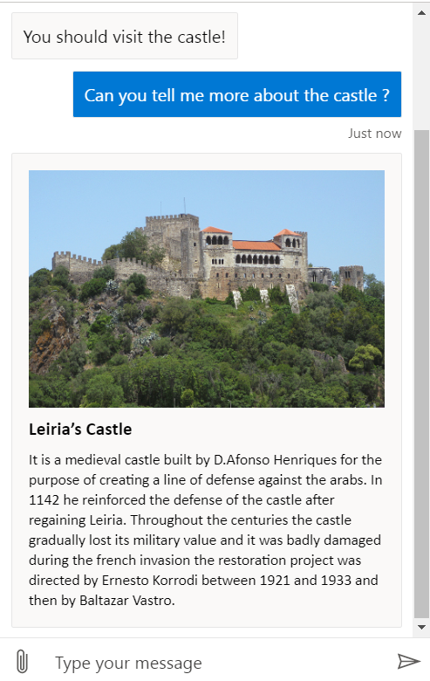
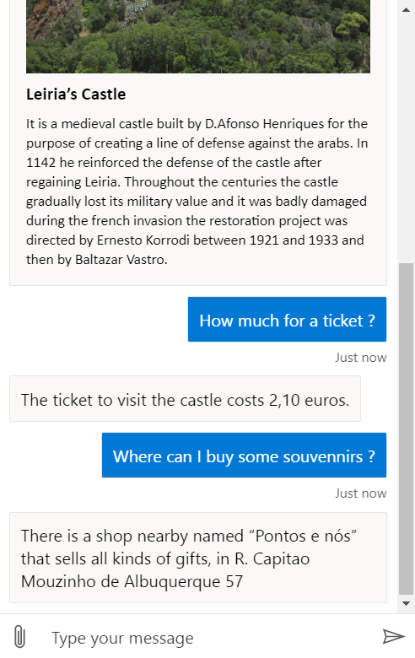
Leiria Bot powered by Code Stout
A buddy for your travels around Leiria city
(and other cities ?)

Slide 3
The solution
A virtual assistant chatbot that has your back!
Ask questions about places of interest around the city and get answers immediately about them.
Check the nearest restaurants and souvenir shops around you.

Slide 4


Features
Voice support (Text to Speech)
Integration with messaging apps
Integration with Google Maps

Slide 5
Business
Public investment
Aimed at tourism center and city halls.
Private investment
Sponsors/Advertisements.

Slide 6

Thank you! From the CodeStout Team!

