Slide 1
CENTRAL NURSE PMS
Five-bed centralized Patient Monitoring System
Live demonstration presentation
Demo goal
Show the running nurse-station UI, deterministic alarms, clinical views, audit trail and verification evidence.
Educational prototype ? not for clinical use
Central Nurse PMS | Demo walkthrough | 1

Slide 2
Demo flow
Recommended order: establish the live system, trigger one alarm, then prove the supporting views.
? 1. Live nurse station: five beds, waveforms and alarm rail
? 2. Trigger SpO? ? 82%: show priority, visual state and alarm entry
? 3. Trends and Ward: clinical context and physical layout
? 4. Audit: event accountability and acknowledgement
? 5. Standards and Scope: design decisions and evidence coverage
? 6. Finish with npm run verify and npm test
Estimated time: 8?12 minutes
Central Nurse PMS | Demo walkthrough | 2

Slide 3
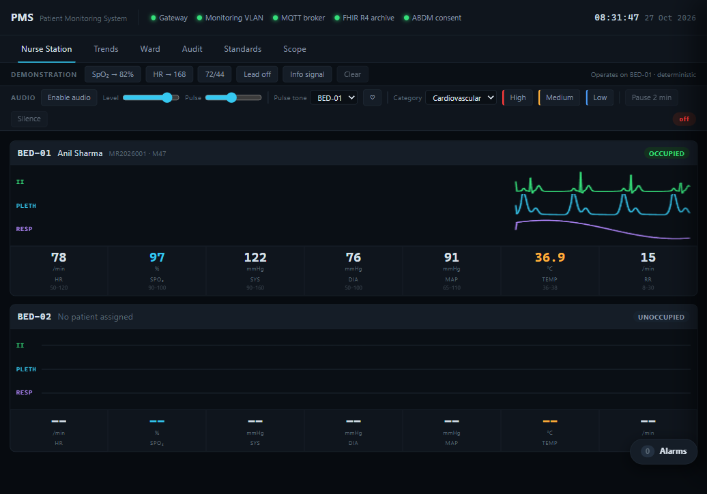
Live nurse station
Start here. Point out the five-bed display, ECG / pleth / respiration sweeps, patient states, alarm limits and the persistent alarm count.
Presenter cue
Key message: one nurse station sees the whole ward without hiding alarms.
Use the live app to reproduce this state during the demonstration.
Central Nurse PMS | Demo walkthrough | 3

Slide 4
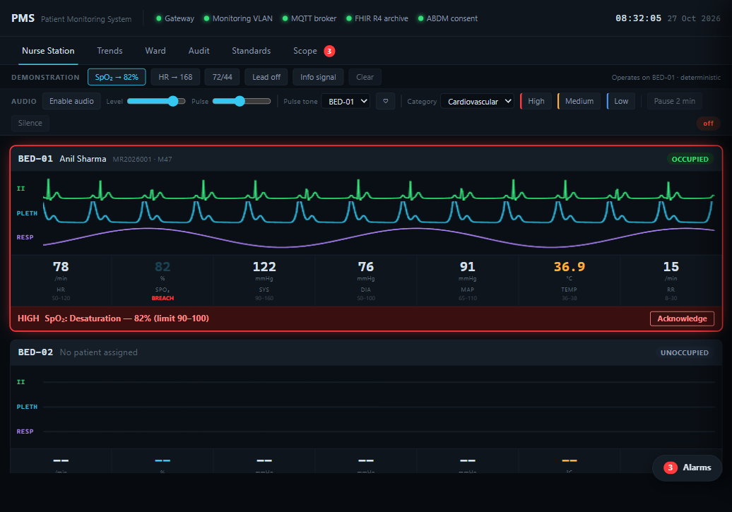
Deterministic alarm scenario
Click ?SpO? ? 82%?. Explain that the scenario operates on BED-01 and makes the demonstration repeatable. Show the red tile state, HIGH priority and alarm rail.
Presenter cue
Key message: alarms are actionable, visible and reproducible.
Use the live app to reproduce this state during the demonstration.
Central Nurse PMS | Demo walkthrough | 4

Slide 5
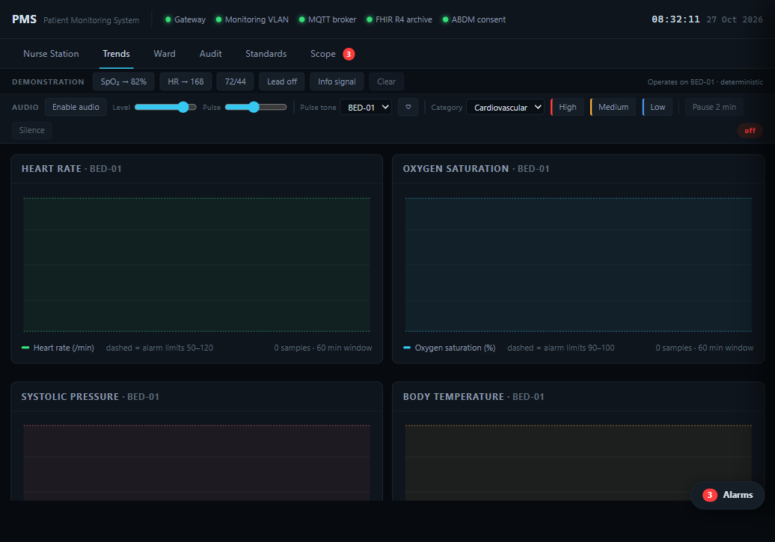
Trends view
Use the Trends tab to explain reference limits, longitudinal values and derived MAP. The alarm limits remain part of the clinical context.
Presenter cue
Key message: a number is interpreted against limits and time, not shown in isolation.
Use the live app to reproduce this state during the demonstration.
Central Nurse PMS | Demo walkthrough | 5

Slide 6
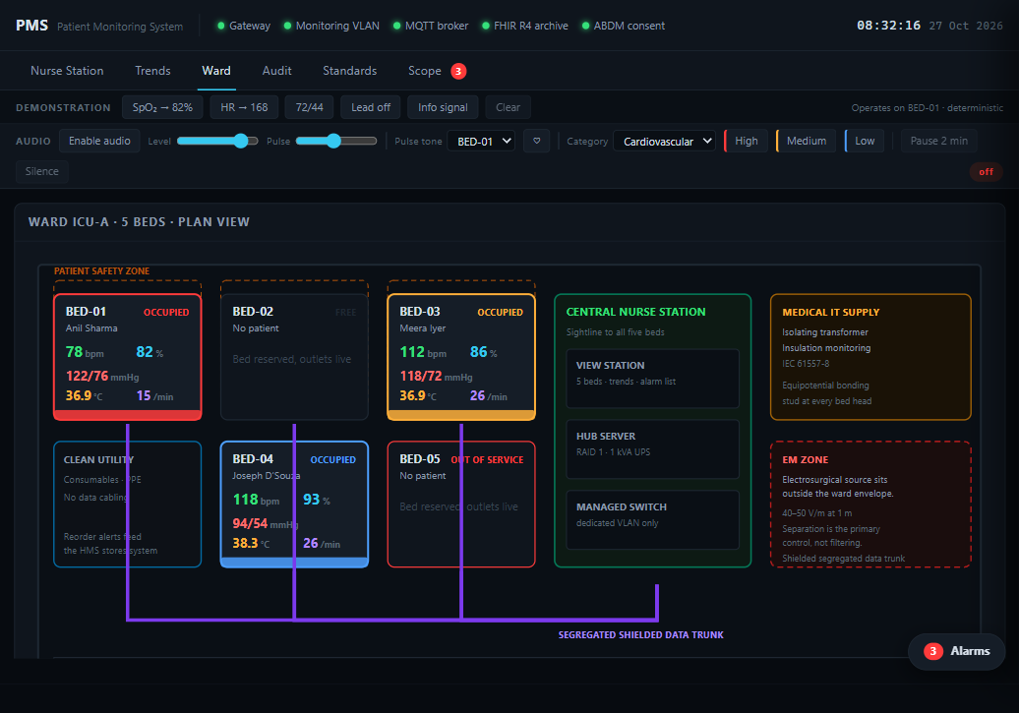
Ward view
Use the Ward tab to show the bedhead zone, nurse-station sightline and separated electrosurgical source. Separation is the primary EMC control.
Presenter cue
Key message: the physical design supports monitoring reliability.
Use the live app to reproduce this state during the demonstration.
Central Nurse PMS | Demo walkthrough | 6

Slide 7
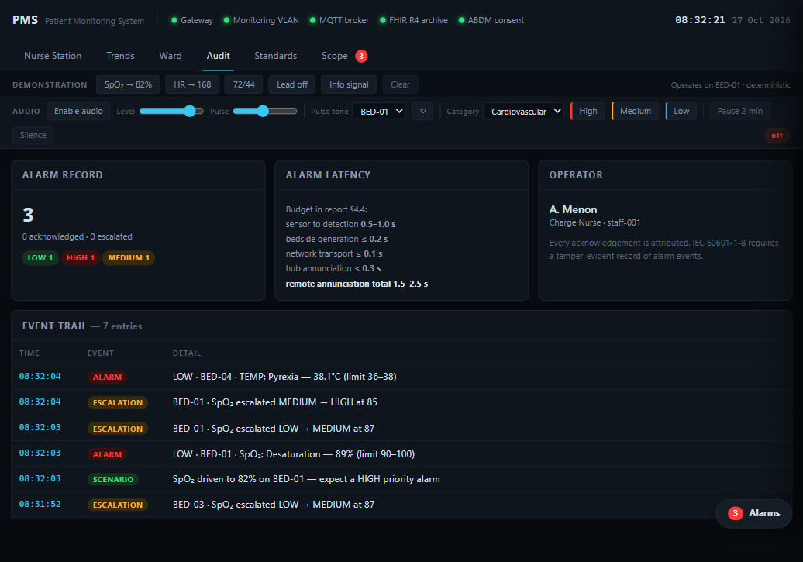
Audit view
Use the Audit tab to show the event trail, alarm history, acknowledgement state and latency budget. Be clear that the browser demo is in-memory; production persistence is specified in the report.
Presenter cue
Key message: alarm safety includes accountability, not only annunciation.
Use the live app to reproduce this state during the demonstration.
Central Nurse PMS | Demo walkthrough | 7

Slide 8
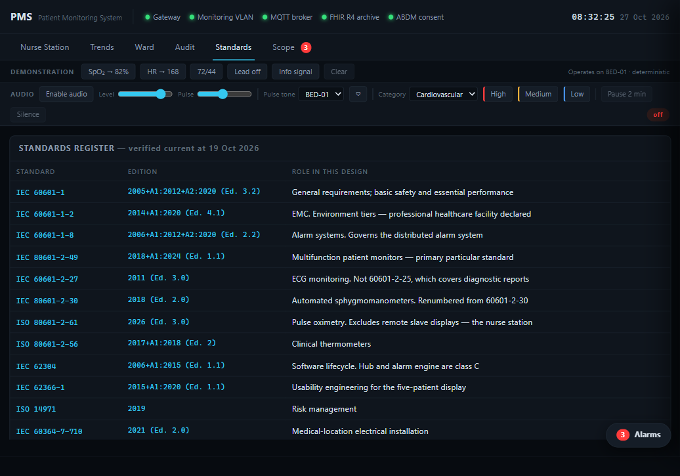
Standards and scope coverage
Standards records deliberate corrections and limitations. Scope Coverage is generated from the repository evidence and helps prevent unsupported claims.
Presenter cue
Key message: standards are checked and limitations are stated honestly.
Use the live app to reproduce this state during the demonstration.
Central Nurse PMS | Demo walkthrough | 8

Slide 9
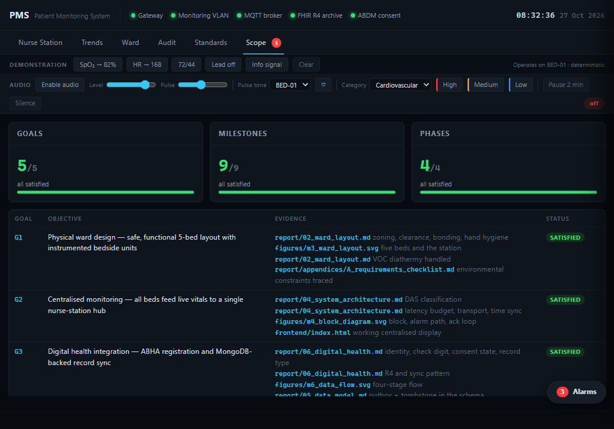
Scope Coverage view
Finish the UI tour with the generated goal and milestone coverage view. Then run npm run scope and npm run verify in the terminal.
Presenter cue
Key message: the project is executable and auditable, not just a static report.
Use the live app to reproduce this state during the demonstration.
Central Nurse PMS | Demo walkthrough | 9

Slide 10
Close with executable proof
The presentation shows the behavior; the repository commands verify it.
npm run ci
Full quality gate: lint, scope, report, tests, build and smoke.
npm run verify
Executes schema, FHIR, standards, cross-reference and behavioral checks.
npm test
Injects deliberate faults and confirms the gate catches them.
npm start
Builds and serves the demo at http://127.0.0.1:8420.
Keep the safety statement explicit: this is an educational prototype, not a certified medical device.
Central Nurse PMS | Demo walkthrough | 11

