Slide 1
Concurrency: asyncio and parallel proccesing
Reference:
Ch 7-8, Advanced Python Programming
Ch 13, Expert Python Programming
Multithreading VS Multiprocessing VS Asyncio (With Code examples)
Heyang Long

Slide 2

Asynchronous programming
Asynchronous programming is a way of dealing with slow and unpredictable resources.
One clock cycle (depends on CPU speed, ~nanosecond)
Same OOM with registers, but slower
A few hundred clock cycle
~millisecond

Slide 3
Qualitative description of waiting for input/ output
To put the relative speed of each memory type into perspective, if you were to have the CPU with a clock speed of about 1 second, a register access would be equivalent to picking up a pen from a table. A cache access would be equivalent to picking up a book from a shelf. Moving higher up the hierarchy, a RAM access would be equivalent to loading up the laundry (about 20 times slower than the cache). When we move to persistent storage, things are quite different. Retrieving an element from an SSD will be equivalent to going on a 4-day road trip while retrieving an element from an HDD can take up to 6 months! The duration can stretch even further if we move on to access resources over the network.

Slide 4
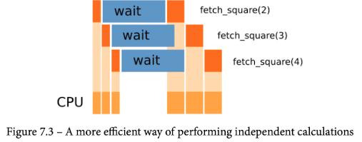
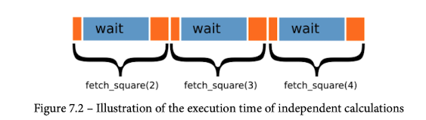
Concurrency
The idea is that we can move on and start handling other resources while we wait for a resource to become available.

Slide 5
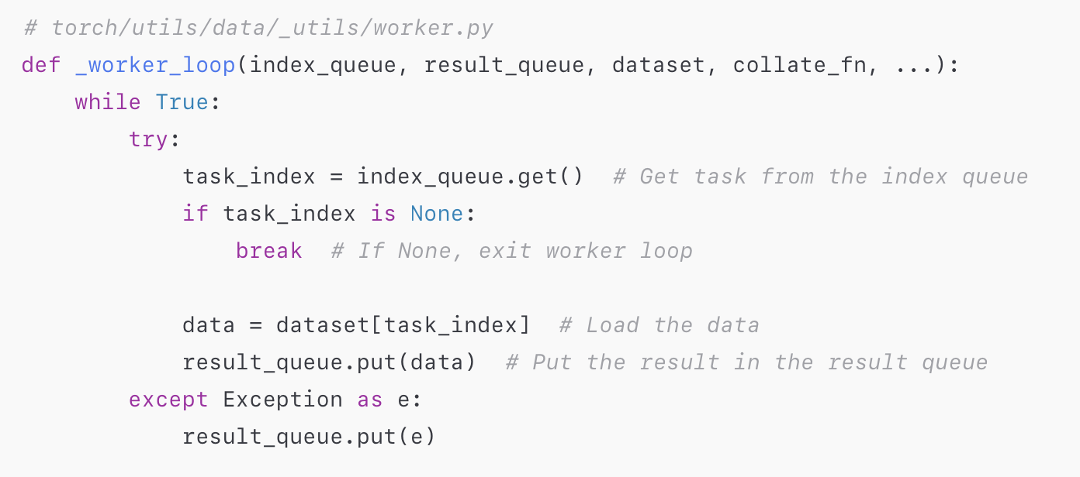
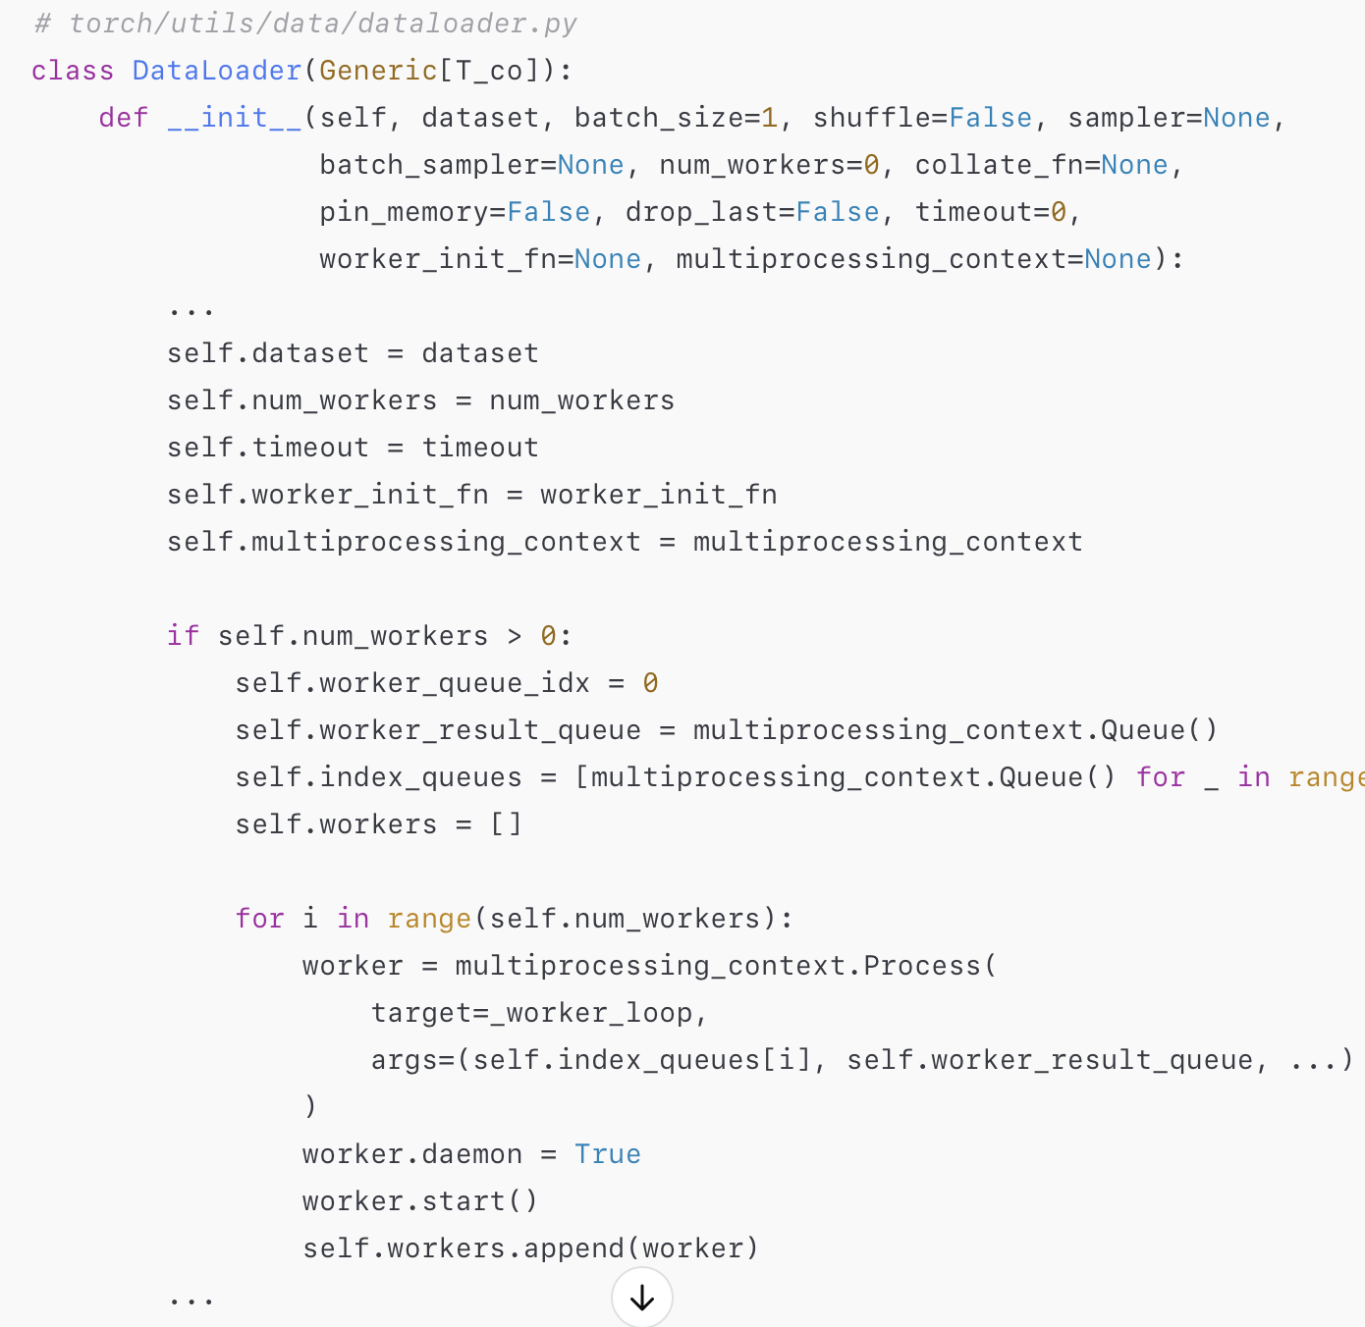
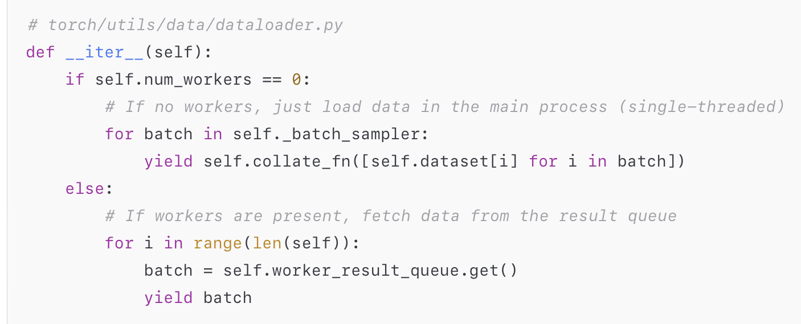
Concurrency usage in advanced packges
Pytorch

Slide 6
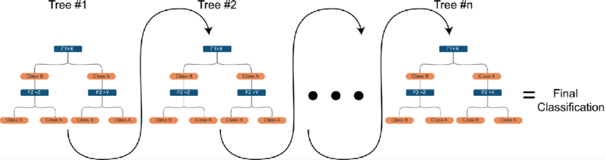
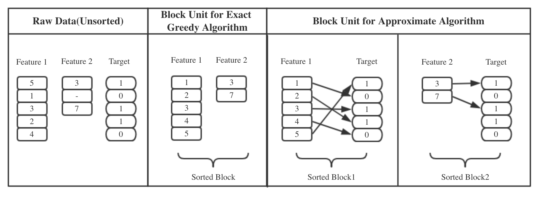
XGBoost Parallelization

Slide 7
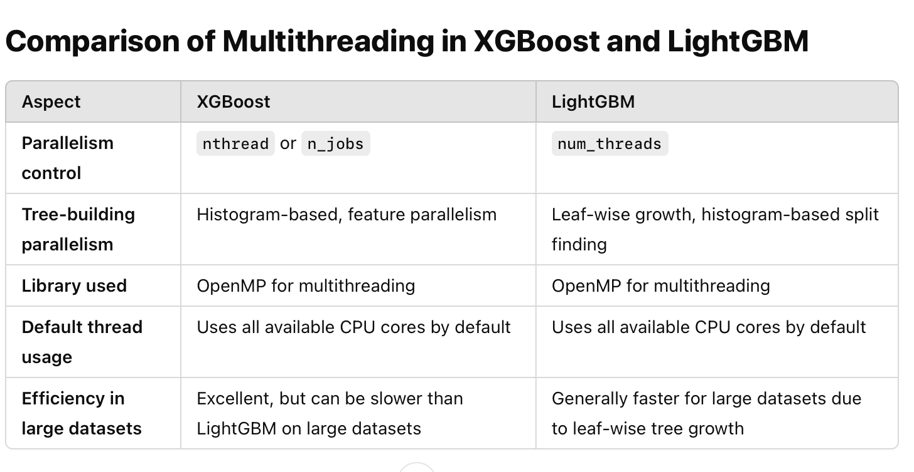
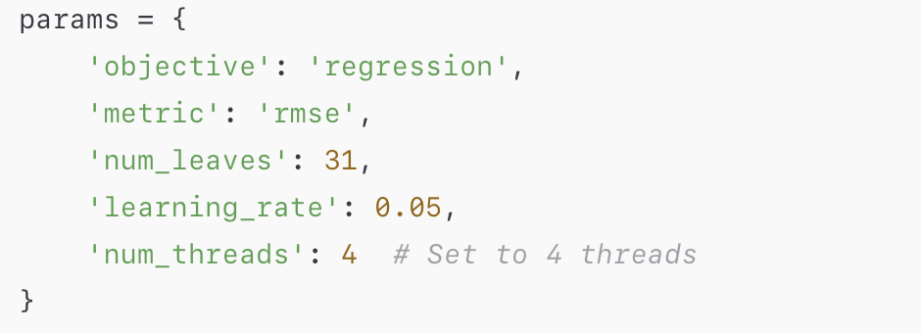
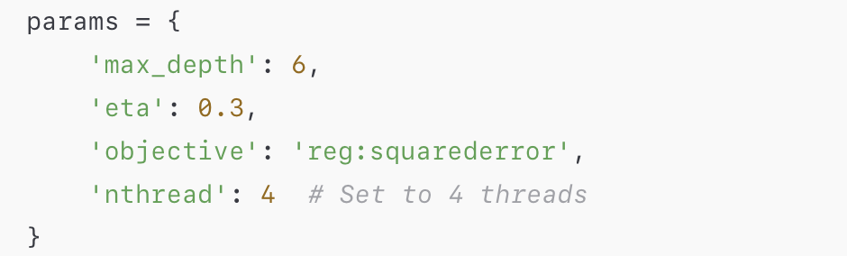
Concurrency usage in advanced packages

Slide 8
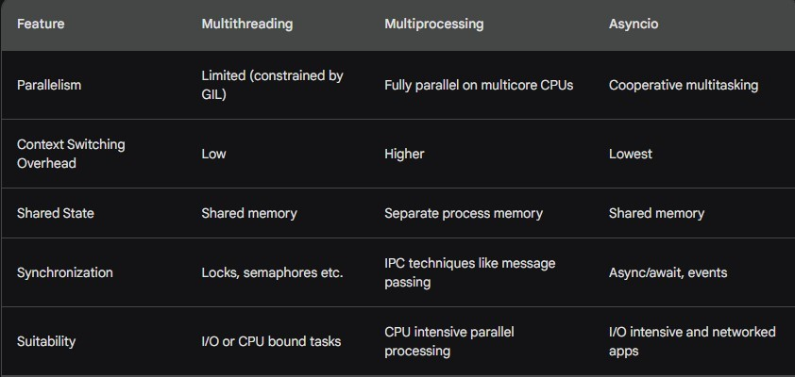
Comparison - Asyncio, Multithreading and Multiprocessing

Slide 9
Comparison - Asyncio, Multithreading and Multiprocessing
Use multithreading when you need to run I/O bound or CPU bound jobs concurrently in a single process. Examples - serving concurrent requests in a web server, parallel processing in data science apps etc.
Leverage multiprocessing for CPU bound jobs that require truly parallel execution across multiple cores. Examples - multimedia processing, scientific computations etc.
Asyncio suits network applications like web servers, databases etc. where blocking I/O operations limit performance. Asyncio minimizes blocking for high throughput.

Slide 10
Concurrency out-of-state usage
Pytorch
XGBoost, LGBM

Slide 11
Multithreading
Issues
Race hazard
Deadlock
Implementation
Timeslicing
The CPU switches from one thread to another so fast that there is an illusion of threads running simultaneously
Parallelism without multiple processing units is obviously virtual and there
is no performance gain from running multiple threads on such hardware.
Cython, GIL

Slide 12
When should threading be used?
Building responsive interfaces
Delegating work
Multiple HTTP requests
Building multiuser applications
less expensive than using multiprocessing

Slide 13
Examples
Threading: example1-3
Future: example4
Pytorch utilization
Dataloader
torch.set_num_threads(n)

Slide 14
Asyncio Implementation
Event loops
Asyncio: example 5-7
Coroutines: example 8-11

Slide 15
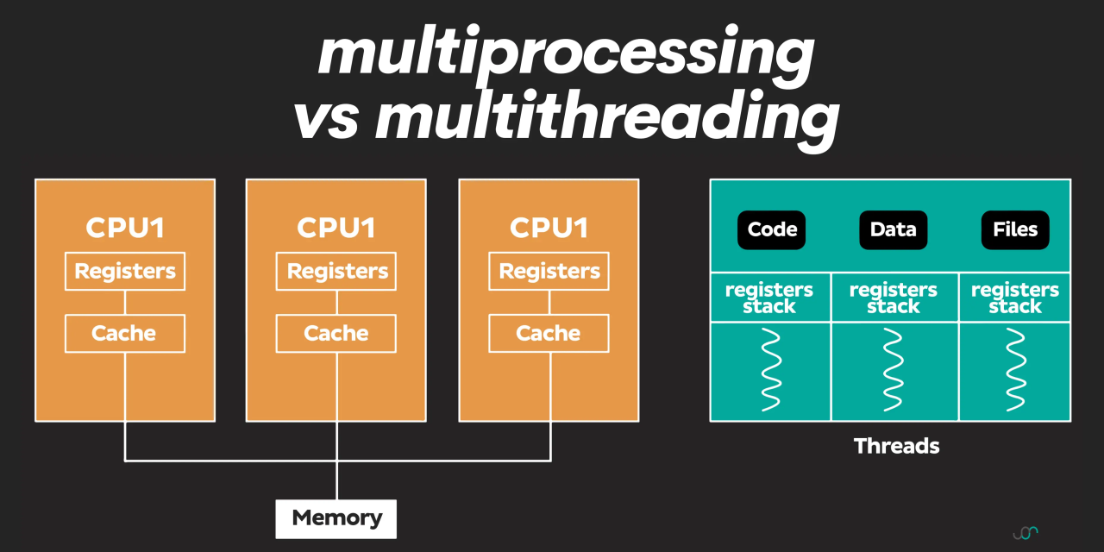
Multiprocessing
Separate Python processes that do not constrain each other with GIL allow for better resource utilization
The other advantage of using multiple processes is the fact that they do not share memory context. So it is harder to corrupt data and introduce deadlocks into your application

Slide 16
Multiprocessing
multiprocessing.Pool
apply/ apply_async
map/ map_sync
multiprocessing.Process
Examle: processes.py

Slide 17
Case study: Monte Carlo simulation of pi

Slide 18
Concurrency usage in advanced packges
Pytorch

