Slide 1
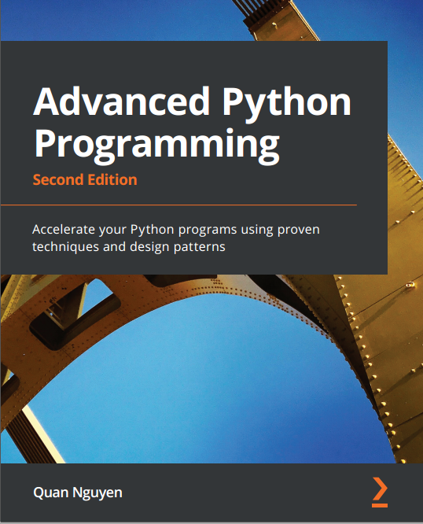
琪石俱乐部
第三期Advanced Python读书小组
吴林达
2024.9.21

Slide 2
课程安排
每周日 11am 美东时间
日期 | 题目 | 主讲人
Sept 21 | 1）1. Profiling and pure python optimization (v1. ch 1-3; v2. ch 1-3) | Linda Wu
Sept 29 | 2）Cython, numba, and other compilers (v1. ch 4-5; v2. ch 4-5) | Wen Luo
Oct 6 | 3）Automatic differentiation (v2. ch 6 sections 1-3) | Kimmy
Oct 13 | 4）Accelerated linear algebra (v2. ch 6 sections 4-5) | Peixuan Liu
Oct 20 | 5）Concurrency: asyncio and parallel processing (v1. ch 6-9; v2. ch 7-8) | Heyang Long
Oct 27 | 6）Threading and cocurrennt web requests (v1. ch 10-12; v2. ch 9) | Henry Yang
Nov 3 | 7）Processes (v1. ch 13-18; v2. ch 10-11) | Vivian Zheng
Nov 10 | 8）Deadlocks, starvation, race conditions, and GIL (v1. ch 19-22; v2. ch 13-16) | Zekang Cheng

Slide 3
Agenda
Ch 1. Benchmarking and Profiling
Ch 2. Pure Python Optimizations
Ch 3. Fast Array Operations with NumPy and Pandas
Demo

Slide 4
Ch 1. Benchmarking and Profiling
Benchmarking: Measure of performance
Profiling: Identifying performance bottlenecks
Goal: Find and focus on optimizing the slowest parts of your code.
80-20 rule (80% of time spent on 20% of code)
Timing tools: UNIX time, timeit, pytest-benchmark. Demo
Memory tools: memory_profiler. Demo
Profiling tools: profile, cProfile. Demo

Slide 5
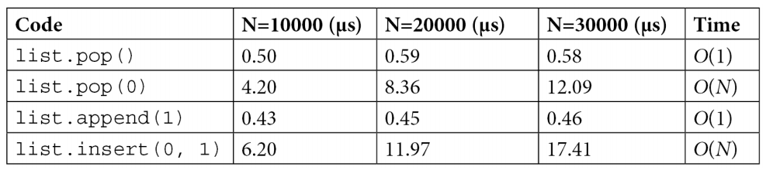
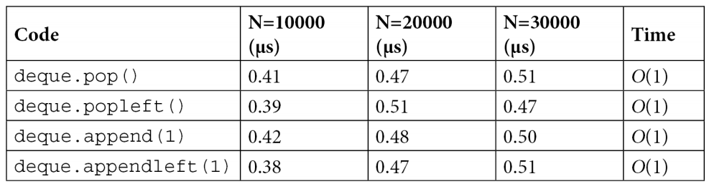
Ch 2. Pure Python Optimizations
Algorithmic efficiency
Choosing optimal data structures
list, deque, dict, set, heapq
Efficient Python coding techniques
cache, generator
Demo

Slide 6
Ch 3. Fast Array Operations with NumPy and Pandas
Vectorization for efficient loops and multi-dimensional arrays
numpy
Structured data analysis and manipulation
pandas
Demo

Slide 7
Resource
原书code：https://github.com/PacktPublishing/Advanced-Python-Programming-Second-Edition
读书小组code: 琪石读书小组github
读书小组ppt: 琪石OneDrive共享文件夹

