Slide 1
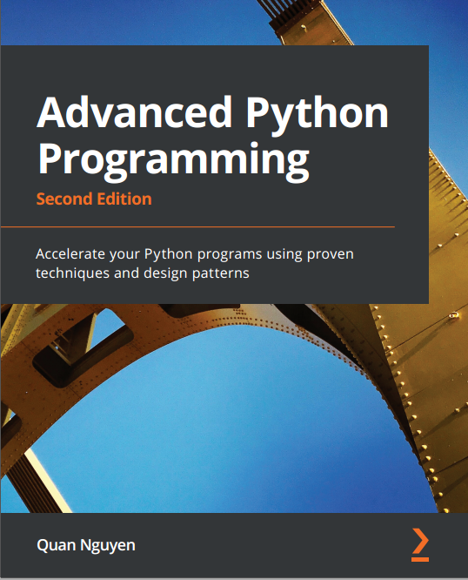
琪石俱乐部
第三期Advanced Python读书小组
罗闻
2024.9.28

Slide 2
Agenda
Ch 4. C Performance with Cython
Ch 5. Exploring Compliers
Demo

Slide 3
Ch 4. C Performance with Cython
Compiling Cython entensions
distutils (setuptools after Python 3.12)
Pyximport
Cythonmagic extension
Static types
Declaring variables
Declaring functions
Declaring classes
Sharing declarations
Working with arrays
C arrays and Pointers
Working with NumPy arrays
Working with typed memoryviews
Using a particle simulators in Cython
Profiling Cython
Using Cython with Jupyter

Slide 4
Ch 5. Exploring Compilers
Numba
Using Numba decorators
Type specializations
Object mode versus native mode
Numba and NumPy
JIT classes
Limitations in Numba
The PyPy project
Setting up PyPy
Running a particle simulator in PyPy
Other interesting projects
Nuitka
Pyston

Slide 5
Resource
原书code：https://github.com/PacktPublishing/Advanced-Python-Programming-Second-Edition
读书小组code: 琪石读书小组github
读书小组ppt: 琪石OneDrive共享文件夹

