Slide 2
Something ‘bout Dubbing
22限定
原生生物

Slide 3
Shall I compare thee to a summer’s day?
Thou art more lovely and more temperate.
Once you fly, you will walk with your eyes skyward, for there you have been, and there you will go again.
The trumpet of prophecy! O, wind
If Winter comes, can Spring be far behind?
Quoth the raven, "Nevermore. "
Notes:
Shakespeare, Da Vinci, Shirley, Poe

Slide 4
连读、重读
发音、声调
节奏、语气

Slide 5
发音
显然这是英语老师要解决的问题……
chaos
café
island
Rihanna
report
Notes:
元、辅、重

Slide 6
发音
关于“口音”
The rain in Spain falls mainly on the plain.
In Hertford, Hereford and Hampshire, hurricanes hardly ever happen.

Slide 7
声调
To be or not to be.
www.bilibili.com/video/BV11s411q7u2

Slide 8
声调
语气
句意
感情色彩[难]

Slide 9
连读
on the edge
go on
clock in
dead end
last time
pop song
Notes:
元，辅元，辅，略

Slide 10
连读
‘bout, ‘cuz, ‘n‘
My dear son Jacob, I’m sorry to inform you that your mother passed away.
Please return to paradise. We need you here.
The past is never dead, it is not even past…

Slide 11
重读
----Why did you go to the police? Why didn’t you come to me first?
----What do you want for me? Tell me, anything, but do what I beg you to do.

Slide 12
节奏、语气
On the North-East tip of North America, on an island called Newfoundland, there’s an airport. It used one of the biggest airports in the world.
纪录片
本地人

Slide 13
节奏、语气
This is the park.
It’s not look like a park, you have to… imagine.
You see, this, this is the grass.
And there is where the children play.
And this, this is the sea.
Do you hear the sea?

Slide 14
整活时间到！

Slide 15
PART I 旁白&诗
共三段

Slide 16
双城记

Slide 17
It was the best of times, it was the worst of times, it was the age of wisdom, it was the age of foolishness, it was the epoch of belief, it was the epoch of incredulity.
It was the season of Light, it was the season of Darkness, it was the spring of hope, it was the winter of despair, we had everything before us, we had nothing before us.
We were all going direct to Heaven, we were all going direct the other way--in short, the period was so far like the present period, that some of its noisiest authorities insisted on its being received, for good or for evil, in the superlative degree of comparison only.

Slide 18
这是最好的时代，这是最坏的时代；这是智慧的年代，这是愚蠢的年代；这是信仰的时期，这是怀疑的时期；这是光明的季节，这是黑暗的季节；这是希望之春，这是绝望之冬；我们的前途拥有一切，我们的前途一无所有；我们正走向天堂，我们也正直下地狱。
总之，那时和现代是这样相像，以至那时声名最远的某些作家对于他所接收的这个时代，评说是好是坏，都固执地只用最高级的对比之词。

Slide 19
Richard Cory [By E. A. Robinson]

Slide 20
Whenever Richard Cory went down town,
无论何时理查德·科里走到城里来，
We people on the pavement looked at him:
我们这些流浪在街头的家伙都会盯着他看：
He was a gentleman from sole to crown,
他有一股彻头彻尾的绅士气派，
Clean favored, and imperially slim.
干净利落，瘦硬的腰杆一点儿也不会弯。
And he was always quietly arrayed,
他总是打扮得整齐有品位，
And he was always human when he talked;
讲起话来也总是充满了谦逊味，
But still he fluttered pulses when he said,
但他的每声“早安”都让人如痴如醉，
"Good-morning," and he glittered when he walked.
他的每一次举步都仿佛有阳光点缀。

Slide 21
And he was rich—yes, richer than a king—
当然他很富，可以说，富可敌国，
And admirably schooled in every grace:
更让人钦佩的是他处处修养卓绝：
In fine, we thought that he was everything
总之，我们觉得他本人就是一种无声的劝说，
To make us wish that we were in his place.
让我们渴望成为他的样子并充满喜悦。
So on we worked, and waited for the light,
我们一如既往地做工，等待着那心底的黎明，
And went without the meat, and cursed the bread;
我们依旧没有肉吃，一再诅咒劣质的面包；
And Richard Cory, one calm summer night,
我们的理查德·科里，披着夏夜的月影，
Went home and put a bullet through his head.
回到家中，用一颗子弹射穿了自己的脑勺。

Slide 22
Mr. Tambourine man [By Bob Dylan][节选]

Slide 23
Hey! Mr. Tambourine Man, play a song for me,
嘿！铃鼓先生，为我奏一曲
I'm not sleepy and there is no place I'm going to.
我尚未入眠，且无处可归
Hey! Mr. Tambourine Man, play a song for me,
嘿！铃鼓先生，为我奏一曲
In the jingle jangle morning I'll come followin' you.
在这铿锵作响的早晨让我与你同去

Slide 24
Though I know that evenin's empire has returned into sand,
尽管我知道，黄昏的帝国早已归於尘土
Vanished from my hand,
自我的掌心消逝
Left me blindly here to stand but still not sleeping.
留下我盲然在此伫立，却了无困意
My weariness amazes me, I'm branded on my feet,
我惊奇於自己的倦乏，我的双足俱已烙印
I have no one to meet
此地无人可遇
And the ancient empty street's too dead for dreaming.
古远旷废的街道又过份死寂，不宜梦想

Slide 25
Hey! Mr. Tambourine Man, play a song for me,
嘿！铃鼓先生，为我奏一曲
I'm not sleepy and there is no place I'm going to.
我尚未入眠，且无处可归
Hey! Mr. Tambourine Man, play a song for me,
嘿！铃鼓先生，为我奏一曲
In the jingle jangle morning I'll come followin' you.
在这铿锵作响的早晨让我与你同去

Slide 26
Take me on a trip upon your magic swirlin' ship,
带我登上你魔样涡漩的帆船开始旅程吧
My senses have been stripped, my hands can't feel to grip,
我的知觉已被剥去，我的双手无法握紧
My toes too numb to step, wait only for my boot heels
足趾麻木难以起步，仅仅等待我的靴跟
To be wanderin'.
游荡徘徊
I'm ready to go anywhere, I'm ready for to fade
无论如何我已准备离去，我已经打算消失
Into my own parade, cast your dancing spell my way,
匿身自己的行伍，对我施下你的舞咒蛊惑我的道路吧
I promise to go under it.
我一定屈从它的魔力

Slide 27
Hey! Mr. Tambourine Man, play a song for me,
嘿！铃鼓先生，为我奏一曲
I'm not sleepy and there is no place I'm going to.
我尚未入眠，且无处可归
Hey! Mr. Tambourine Man, play a song for me,
嘿！铃鼓先生，为我奏一曲
In the jingle jangle morning I'll come followin' you.
在这铿锵作响的早晨让我与你同去

Slide 28
PART II 独白&旁白
共四段

Slide 29
教父

Slide 30
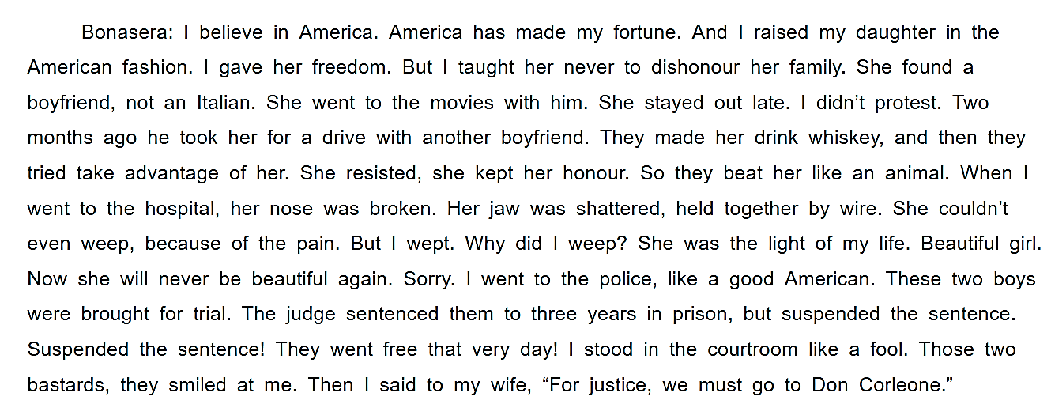

Slide 31
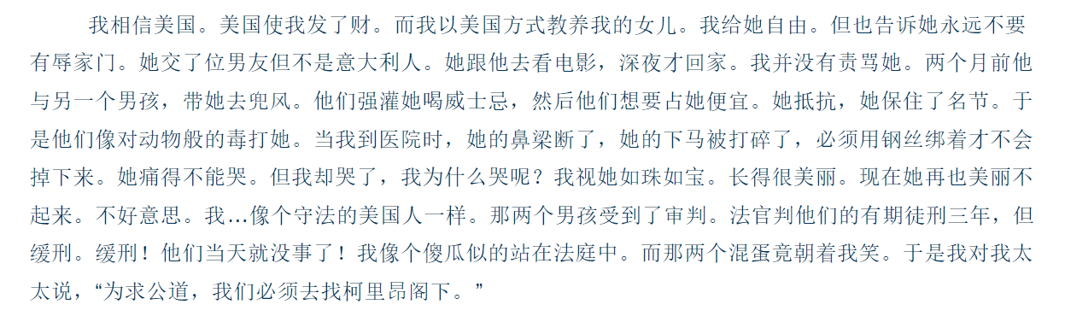

Slide 32
致埃文汉森

Slide 33
Dear Evan Hansen:
Turns out that this wasn't an amazing day after all.
This isn't going to be an amazing week, or an amazing year.
Cuz, cuz why would it be?
Oh I know, I know.
Because there's Zoe and all my hope is... pinned on Zoe who I don't even know and who doesn't know me.
But... you know. Maybe... Maybe if I could just talk to her then maybe...
Maybe nothing would be different at all.
I wish everything was different.
I wish I was a part of... something.
I wish that... anything I said... mattered to anyone.
I mean. Face it.
Would anyone even notice me if I just... disappeared tomorrow?
Sincerely your best and most dearest friend, me.

Slide 34
汉密尔顿

Slide 35
I imagine death so much it feels more like a memory.
Is this where it gets me, on my feet, several feet ahead of me?
I see it coming, do I run or do I let it be?
There is no beat, no melody.
Burr, my first friend, my enemy.
Maybe the last face I ever see.
If I throw away my shot, is this how you’ll remember me?
What if this bullet is my legacy?
Legacy. What is legacy?
It’s planting seeds you never get to see.

Slide 36
America, you great unfinished symphony, you sent for me!
You let me make a difference.
A place where even orphan immigrants can leave their fingerprints and rise up.
I’m running out of time. I’m running, and my time’s up.
Wise up. Eyes up.
I catch a glimpse of the other side.
Laurens leads a soldiers’ chorus on the other side.
My son is on the other side.
He’s with my mother on the other side.
Washington is watching from the other side.
Teach me how to say goodbye.

Slide 37
Rise up. Rise up. Rise up.
Eliza…
My love, take your time.
See you on the other side.
Raise a glass to freedom…

Slide 38
历历在目

Slide 39
Benjamin Bryant was born into an ordinary home, to an ordinary mother and father, in a small town by the sea.
His mother was an composer, or at least, she dreamed she’d be.
So, when her own dream didn’t pan out, she began to dream for him.
Then, when he was just eleven year’s old, he got sick, and was forced to stay inside for an entire year.
And in that year, he began to worry that he hadn’t lived enough.
So he made up a story, of the great life he thought he wanted to live, which only made him forget the great life he already had.

Slide 40
How he had filled a new home with light and joy and promise.
How he met a girl, his neighbor, who felt all alone in the world, and he made her feel okay again.
And how, even when he was sick, he still gave his parents hope.
How he reminded them exactly who they were, after they had almost forgot them.
So, when he knew he was going to go, he was okay.
Because he had already lived a great life, a full life.
And he was everything he needed to be.
Just as he was.

Slide 41
PART III 对白
共两段

Slide 42
教父

Slide 43
C: Why did you go to the police?
C: Why didn't you come to me first?
B: What do you want of me?
B: Tell me anything, but do what I beg you to do.
C: What is that?
B: I want them dead.
C: That I cannot do.
B: I'll give you anything you ask.
C: We've known each other many years, but this is the first time you ever came to me for counsel or for help. I can't remember the last time that you invited me... to your house for a cup of coffee... Even though my wife is godmother to your only child. But lets be frank. You never wanted my friendship... And you were afraid to be in my debt.

Slide 44
B: I didn’t want to get into trouble.
C: I understand. You found paradise in America, Had a good trade, made a good living, had police protection and there were counts of law. You didn’t need a friend like me. But now you come to me and say, “Don Corleone, give me justice.” But you don’t asl with respect. You don’t offer friendship. You even don’t think to call me Godfather. You come on to my daughter’s wedding day and ask me to murder for money.
B: I ask you for justice.
C: That is not justice. Your daughter is alive.
B: Let them suffer, then, as she suffers. How much should I pay you?

Slide 45
C: Bonasera, Bonasera. What I have done to make you treat me so disrespectively? If you’d come in friendship, the scum ruined your daughter would be suffering this very day. And if an honest man like you should make enemies, they’d be my enemies. And they would fear you.
B: Be my friend… Godfather.
C: Good. Some day, and that day may never come, I’ll ask a service for you. But until that day… Accept this justice as a gift on my daughter’s wedding day.

Slide 46
人人都在谈论杰米

Slide 47
M: Oh, here he is. What time do you call this? I’ve been ringing and ringing.
D: Ah, look at that, I must have switched it off, sorry.
M: I wish I could switch you off!
D: Calm down, I’m here aren’t I? Giz a fag.
M: Get your own.
D: I’ve given up.
M: You’ve given up?
D: I can’t, not at home, Cheryl says.
M: (Laugh.) Cheryl says. (gives him the cigarette)
D: Thanks.

Slide 48
M: So what would Cheryl say if she knew you were here with me?
D: She’d kill me. Then you. Then herself. Probably in that order.
M: Look. You’re Jamie’s dad, and he needs you, and I’m sick of covering.
D: Right, his birthday.
M: I lied for you. Again. I picked out a card and said it came from you. I even picked out a crap card, just like the sort of crap card you would have gave him, plus twenty quid inside that I could not afford – Christ, the lengths I go on for you!
D: So stop that.
M: And tell him the truth. That his dad can’t be bothered to see him? “Happy birthday, Jamie – surprise!”

Slide 49
D: Oh listen to your self.
M: I wish you would listen!... Jamie looked forward to his Saturdays with you. How long’s it been since he’s spent proper time with you?
D: No, don’t you do that, Jamie hated Saturdays with me.
M: Cuz you always dragged him off to the football! Couldn’t you have done something he would have liked for once?
D: My Saturday are my time, so if I want to go and support Wednesday on me day off –
M: It were never about football. It were about spending time with you.
D: It were embarrassing! Me, turning up at the match with that… Well you know what he’s like.

Slide 50
M: You never commit to owe it. Like his bike that birthday. “I’ll teach him how to ride,” you said, “he’s six now.” Five minutes later he comes running back inside, in tears, you never bothered again. I had to teach him, just like I had to teach him everything!
D: That’s exactly what you wanted, don’t you blame me for being my part!
M: You’re a shit dad. Face it!
D: Yeah, cuz that’s the part you gave me.

Slide 51
Thank you for listening!

