Slide 1




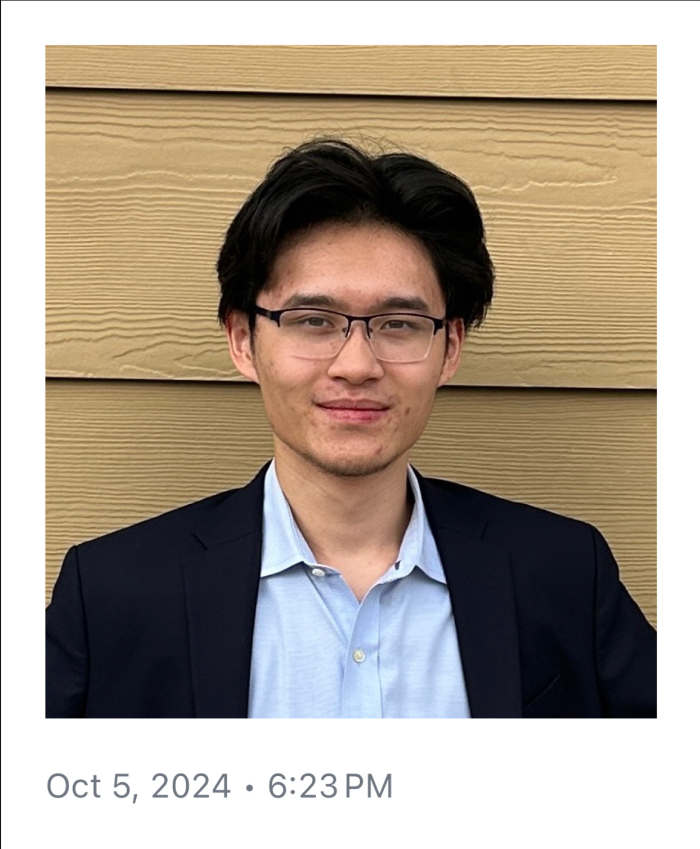
Cotton Field Detector by Lamassu
Ryan Dempsey
Mechanical
Sophomore
Dempsey.ryanq@tamu.edu
UIN: 733006834
Michael Bengil
Computer Science
Sophomore
Mace.bengil@tamu.edu
UIN: 733006828
Maxwell Vo
Electrical
Sophomore
Mvo12@tamu.edu
UIN: 533003790

Slide 2
Methodology
Our group used RoboFlow to label the cotton fields within satellite aerial photos. Obtaining said satellite images and how we determined which fields were cotton fields was through the USDA CroplandCROS site.
Data was then fed into a YOLOv7 PyTorch machine learning model for training, where the model was optimized to recognize cotton fields within the satellite images. After training, the model was evaluated and fine-tuned to improve accuracy in identifying cotton fields based on the labeled data.
Finally, we developed a straightforward Flask website as the front-end interface.

Slide 3
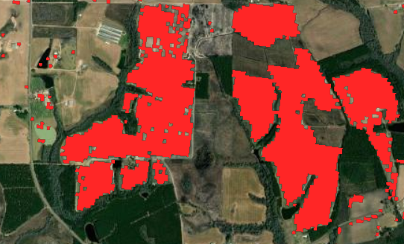
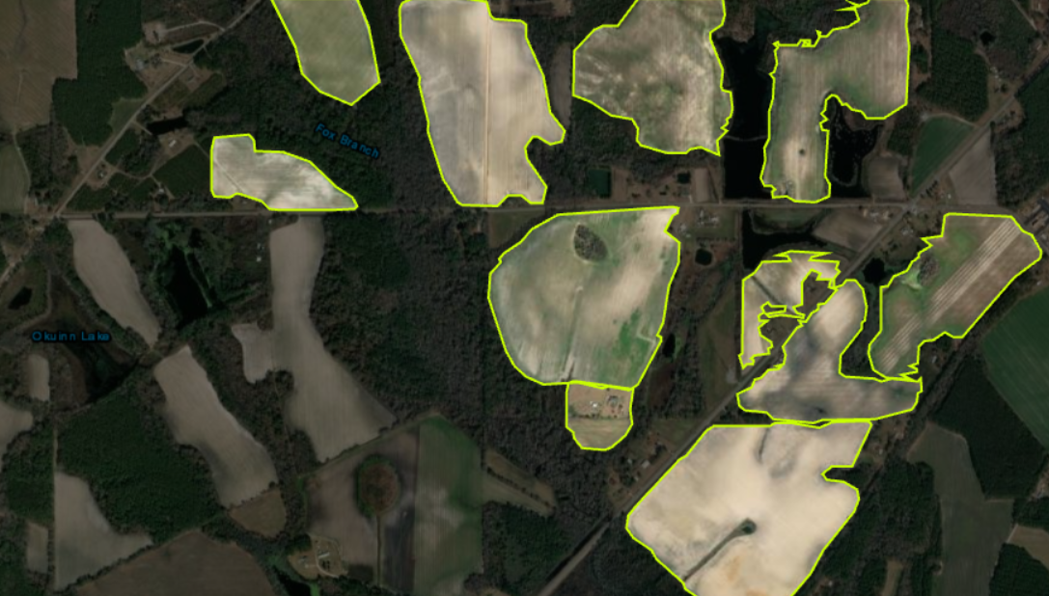
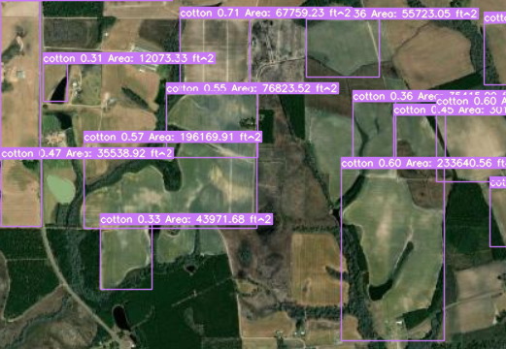
Results
Our model can accurately identify cotton fields, but with relatively low confidence intervals due to the small dataset.
True cotton field locations, marked in red, from the CroplandCROS web app
An example labeled image from our dataset
The calculated area of the cotton fields are an overestimation of the true area.
The development of this program can prove beneficial to the agriculture industry.
Detection output with a 30% confidence threshold

