Slide 1
IBM University Engagement Project Submission
“Exploring the Power of Agentic AI with IBM Granite and LangFlow”

Slide 2

Project Title – AI-Powered Athlete Performance Analysis Assistant
Domain of Project – Sports Analytics / Healthcare / Artificial Intelligence
Student Name | Recent Passport Photo | Email ID | Mobile number [WhatsApp]
Archana A D |  | adarchana72@gmail.com | 7034072601

Slide 3
Problem Statement -
Problem Statement : Athlete Performance Analysis Assistant
The Challenge
Athletes generate large amounts of performance data during training sessions and competitions, including fitness metrics, match statistics, endurance levels, speed, workload indicators, and recovery information. Coaches often find it difficult to transform this raw data into meaningful insights that help improve athlete performance. Existing systems mainly store performance data but provide limited intelligent analysis and personalized recommendations. Without AI-driven assistance, identifying strengths, weaknesses, injury risks, and performance trends becomes time-consuming and less effective.
The Objective
Build an AI-powered Athlete Performance Analysis Assistant that evaluates athlete performance using training records, fitness metrics, and match statistics. The solution should:
Performance Data Retrieval (RAG): Collect athlete statistics, training records, fitness metrics, and sports knowledge from trusted sources.
Performance Trend Analysis: Analyze historical and current performance to identify strengths, weaknesses, and improvement opportunities.
Training Recommendation Agent: Generate personalized training schedules, recovery plans, and fitness recommendations based on athlete performance.
Multi-Agent System :
Athlete Data Agent
Performance Analysis Agent
Training Recommendation Agent
Coaching Insight Agent
Visualization Dashboard – Display athlete performance trends, fitness metrics, progress charts, comparisons, and personalized recommendations.

Slide 4
Proposed Solution -
Proposed Solution: AI-Powered Athlete Performance Analysis Assistant
The proposed solution is a multi-agent AI-powered Athlete Performance Analysis Assistant built using IBM watsonx Orchestrate, LangFlow, IBM Granite Models, and Retrieval-Augmented Generation (RAG) to help athletes and coaches analyze performance, identify improvement areas, and make informed training decisions.
The system addresses the challenges of analyzing athlete performance by combining training records, fitness metrics, match statistics, and sports science knowledge into one intelligent platform.
At its core, the solution uses a Retrieval-Augmented Generation (RAG) pipeline to retrieve relevant information from trusted sports science resources, coaching manuals, and athlete performance datasets. These documents are stored in a vector database, allowing the Granite model to provide accurate, context-aware recommendations instead of relying only on general AI knowledge.
The system consists of four specialized agents:
• Athlete Data Agent – Collects and organizes athlete profiles, training records, fitness metrics, wearable device data, and match statistics.
• Performance Analysis Agent – Evaluates athlete performance, identifies trends, measures progress, and highlights strengths and weaknesses.
• Training Recommendation Agent – Generates personalized workout schedules, recovery strategies, endurance improvement plans, and injury prevention recommendations based on the athlete's performance.
• Coaching Insight Agent – Produces detailed coaching reports, summarizes athlete progress, compares historical performance, and provides AI-powered coaching insights.
The solution includes a user-friendly dashboard built using React or Streamlit, where coaches and athletes can visualize performance trends, fitness scores, workload analysis, progress charts, and personalized recommendations.
IBM watsonx Orchestrate manages the workflow between multiple agents, while IBM Granite Models perform reasoning, summarization, and intelligent decision-making. LangFlow simplifies the creation and orchestration of the multi-agent workflow, making the system modular, scalable, and easy to maintain.
Overall, the proposed solution acts as an intelligent sports performance assistant that empowers athletes and coaches with data-driven insights, personalized training recommendations, and continuous performance monitoring to achieve better athletic performance.

Slide 5
Technology Used
IBM watsonx Orchestrate – Used to build and manage the AI-powered multi-agent workflow. It coordinates the Athlete Data Agent, Performance Analysis Agent, Training Recommendation Agent, and Coaching Insight Agent.
IBM Granite Model (Granite-4.0-8B-Instruct) – Used for natural language understanding, reasoning, performance analysis, report generation, and personalized training recommendations.
IBM Cloud – Provides a secure, reliable, and scalable cloud platform to deploy and manage the Athlete Performance Analysis Assistant.
RAG– Retrieves athlete training guides, sports science research papers, fitness manuals, and coaching documents from trusted sources to generate accurate and context-aware responses.
IBM Watsonx.ai - Used for AI model deployment, embeddings, prompt engineering, and AI governance.
Vector Database (FAISS/Chroma) – Stores embeddings of sports science documents, athlete performance data, coaching manuals, and fitness resources for efficient semantic retrieval.
LangFlow – Provides a visual interface for designing, connecting, and orchestrating the multi-agent workflow with IBM Granite Models.

Slide 6
Langflow component Used -
1) Chat Input – Provides the interface where athletes or coaches enter queries, training records, fitness metrics, or match statistics through text input.
2) IBM watsonx AI Agent - Processes athlete data using IBM Granite Models to analyze performance, identify strengths and weaknesses, and generate intelligent coaching insights.
3) IBM Granite model - Granite-4.0-8B-Instruct → Performs natural language understanding, performance analysis, reasoning, report generation, and personalized training recommendations.
4) Chat output -Displays AI-generated responses such as performance reports, trend analysis, coaching insights, recovery plans, and personalized training recommendations.
5) File Component - Stores and retrieves athlete profiles, training records, fitness metrics, match statistics, and sports science documents used for Retrieval-Augmented Generation (RAG).
6) Vector Store (FAISS / ChromaDB) - Stores document embeddings of sports science research papers, coaching manuals, fitness guidelines, and athlete performance data for semantic search and accurate knowledge retrieval.
7 ) RAG Retriever - Retrieves the most relevant information from the vector database before sending it to the Granite model, ensuring accurate and context-aware responses.
8) Prompt Component - Provides structured prompts that guide the AI model to generate athlete-specific performance analysis, coaching reports, and personalized training strategies.

Slide 7

Role of Agentic AI in the solution
Role of Agentic AI in Athlete Performance Analysis Assistant
Agentic AI enables the Athlete Performance Analysis Assistant to function as an intelligent and autonomous sports analytics system rather than a traditional chatbot. Using IBM watsonx.ai, IBM watsonx Orchestrate, LangFlow, and IBM Granite Models, the solution coordinates multiple specialized AI agents to analyze athlete performance and deliver personalized coaching insights.
Each agent performs a dedicated task while collaborating with other agents to achieve the overall objective.
Athlete Data Agent collects athlete profiles, training records, fitness metrics, wearable device data, and match statistics from multiple sources.
Performance Analysis Agent evaluates historical and current performance, identifies strengths, weaknesses, performance trends, and improvement opportunities.
Training Recommendation Agent generates personalized workout schedules, recovery strategies, endurance improvement plans, and injury prevention recommendations based on the athlete's performance patterns.
Coaching Insight Agent creates comprehensive coaching reports, summarizes athlete progress, compares previous performances, and provides AI-powered recommendations for coaches.
Agentic AI enables context-aware decision-making by understanding the athlete's sport, position, fitness level, training history, performance goals, and injury history. It continuously adapts recommendations whenever new performance data becomes available.
Through Retrieval-Augmented Generation (RAG), the agents retrieve relevant knowledge from trusted sports science documents, coaching manuals, and fitness guidelines, ensuring accurate and evidence-based recommendations.
Overall, Agentic AI transforms the system into an intelligent digital performance coach that supports athletes and coaches with real-time analysis, personalized training plans, continuous monitoring, and data-driven decision-making to enhance athletic performance.

Slide 8
Novelty and Uniqueness
The proposed Athlete Performance Analysis Assistant stands out by combining Agentic AI, Retrieval-Augmented Generation (RAG), sports analytics, and personalized coaching into a single intelligent platform.
Multi-Agent Intelligence – Instead of a single chatbot, multiple specialized agents collaborate to collect athlete data, analyze performance, generate personalized training recommendations, and create coaching reports.
RAG-Based Performance Analysis – Integrates sports science research, coaching manuals, and fitness guidelines with AI reasoning to provide accurate, evidence-based recommendations.
Personalized Training Plans – Creates customized workout schedules, recovery strategies, endurance improvement plans, and injury prevention recommendations based on each athlete's performance and goals.
Performance Trend Analysis – Continuously monitors training records and match statistics to identify strengths, weaknesses, progress, and areas requiring improvement.
Comprehensive Coaching Reports – Generates AI-powered summaries that help coaches make informed decisions through clear insights and performance comparisons.
Data Visualization Dashboard – Presents athlete progress, fitness metrics, performance trends, and personalized recommendations using interactive charts and graphs.
Scalable & Enterprise-Ready – Built using IBM watsonx Orchestrate, IBM Granite Models, LangFlow, and IBM Cloud, ensuring a secure, scalable, and reliable AI solution.
This makes the solution an intelligent digital performance coach that empowers athletes and coaches with real-time insights, personalized recommendations, and data-driven decision-making to enhance athletic performance.

Slide 9
Git Hub Link
https://github.com/Archana-A-D/Athlete-Performance-Analysis-Assistant.git
·
·
·

Slide 10
Future Scope
1. Wearable Device Integration Integrate smartwatches and fitness trackers to collect real-time fitness data and provide more accurate performance analysis.
2. Injury Prediction Use AI to predict injury risks based on training workload and performance history, helping athletes prevent injuries.
3. Real-Time Match Analysis Analyze live match statistics and provide instant coaching insights and tactical recommendations.
4. Personalized Nutrition & Recovery Recommend customized nutrition plans and recovery strategies based on athlete performance and fitness goals.
5. Team Performance Analytics Expand the system to compare player performance, analyze team statistics, and support coaching decisions.
·
·
·

Slide 11
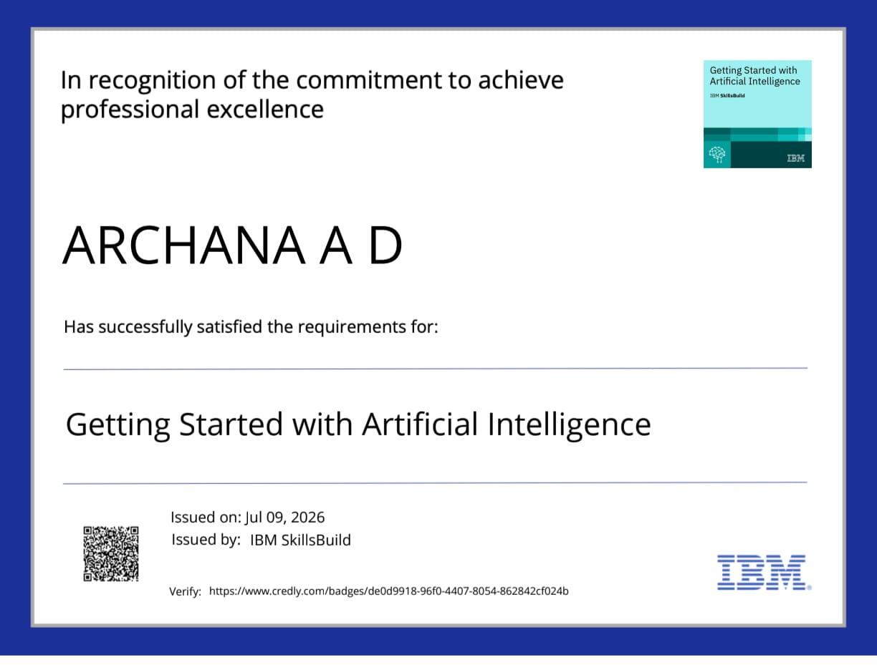
Certificates Earned:
IBM Credly Certificate

Slide 12
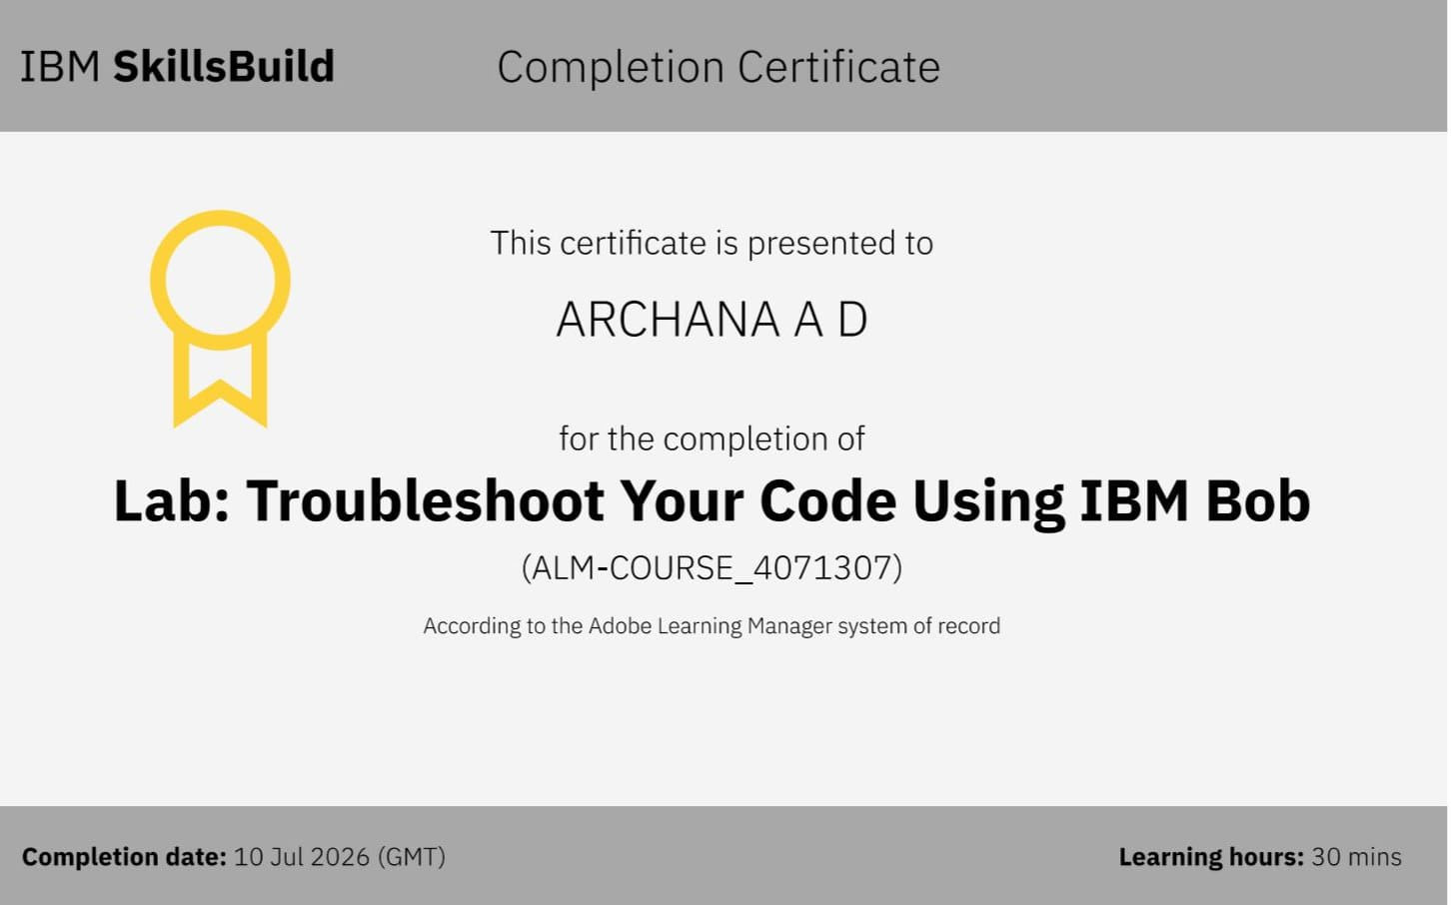
Certificates Earned:​
IBM BOB Certificate

Slide 13


