Slide 1


SRI SRINIVASA EDUCATIONAL AND CHARITABLE TRUST®
SAPTHAGIRI COLLEGE OF ENGINEERING
(Affiliated to Visvesvaraya Technological University, Belagavi and Approved by AICTE, New Delhi)
DEPARTMENT OF INFORMATION SCIENCE AND ENGINEERING
Internship Presentation on
“ Python Full Stack”
Under the Guidance of:
Dr. H R Ranganatha
Head of Department of I.S.E, S.C.E
Presented By:
Archana N J (1SG21IS011)

Slide 2
Table Of Contents
Introduction about the company
Overview of the organization
Tasks Performed
Learning Experience
Knowledge Acquired
Skills Learned
Challenging Task Performed
Problem Identified
Reflection
Conclusion

Slide 3

Introduction
Karunadu Technologies is a leading technology company specializing in software development, data analysis, and machine learning solutions.
A leading Skills and Talent Development company that is building a manpower pool for global industry requirements.
Empower individual with knowledge, skills and competencies that assist to escalate as integrated individuals with a sense of commitment and dedication towards the society.

Slide 4
Overview of the organization
Industry : Embedded Software Products
Headquarters : Bengaluru, karnataka
Type : Privately Held
Founded : 2017
Specialties : Software Development, Web Designing, Digital Marketing, Skill Development, Machine Learning, Artificial Intelligence, Data Analytics, DataScience, Generative AI, Internet Of Things, and Full stack Web Application Developement

Slide 5
Learning Experience
Gained hands-on experience with the machine learning development process.
Learned about data collection, preprocessing, and feature engineering.
Explored various machine learning algorithms for classification tasks.
Developed and evaluated a model for predictions.
Enhanced my skill and ability to work in a team.
Gained experience and also helped in developing my interpersonal skills.

Slide 6
Knowledge Acquired
Python and features of python.
Gained practical experience in the machine learning lifecycle: data collection, pre-processing, feature selection, model training, and evaluation.
Deepened understanding of supervised learning algorithms, particularly SVM used in this project.
Learned data visualization techniques for effective communication of project findings.
Performance evaluation metrics (accuracy, precision, recall)

Slide 7
Skills Learned
Technical: Proficient in Python, building GUIs using PyQt5
Machine learning libraries: Scikit-learn
Machine learning algorithms:Linear Regression, Multiple Linear Regression, K Nearest Neighbor, Logistic Regression ,SVM
Data Analytics and Visualization: Pandas, NumPy, Matplotlib
Improved ability to analyze complex datasets and extract meaningful insights.
Project management: Setting goals, meeting deadlines, and effective communication
Soft Skills: Enhanced communication, teamwork, and problem-solving abilities.

Slide 8
Challenging Task Performed
Data pre-processing: Handling missing values and inconsistencies in the dataset.
Model Interpretation: Analyzed feature importance and model coefficients to understand the influence of different features.
Statistical Analysis: Performed descriptive statistics to understand data distribution and central tendencies.
Accuracy: To measure the performance of the trained model.

Slide 9
Problem Statement
Problem Statement: Prediction of whether the customer has subscribed to a term deposit or not using Support Vector Machine
Dataset Variables: Age, Job, Marital, Education, Default, Balance, Housing, Loan, Contact, Day, Month, Duration. Etc…
Output: Has the customer subscribed to a term deposit? (Yes or No)
Algorithm used: Support Vector Machine
Project Goal: To accurately predict, using the Support Vector Machine algorithm, whether a customer will subscribe to a term deposit, based on the provided customer data.
2024-25

Slide 10
STEPS INVOLVED IN IMPLEMENTATION OF SVM
1. Learn from Data:
We use customer info (age, job, etc.) and their past choices.
2. Clean & Prepare:
We organize the data and fix any issues, so the computer can understand it.
3. Train the Model:
SVM is a tool that finds the best way to separate customers who will subscribe from those who won't.
SVM helps us draw a clear line between potential subscribers and non-subscribers
4. Check How Well It Works:
We test the model to see how accurate its predictions are.
5. Predict:
Now, we can predict if new customers will subscribe.

Slide 11
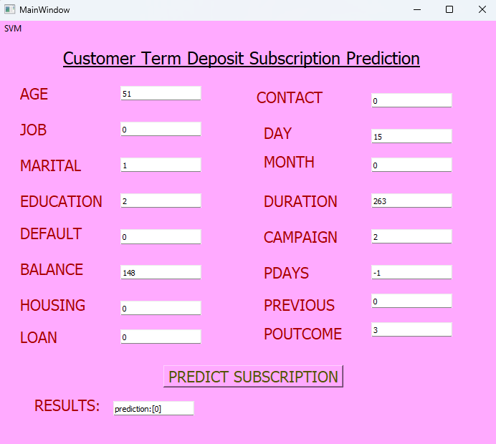
Outcome

Slide 12
Reflection
The internship at Karunadu Technologies was a highly enriching experience that provided valuable insights and skills.
Beyond technical expertise, the project challenged me to develop strong project management skills.
I learned effective time management skills by prioritizing tasks and utilizing project management tools to ensure timely completion of the project.
This internship has significantly boosted my professional growth, and I'm eager to continue learning and applying my skills to make a positive impact in this field.

Slide 13
Conclusion
The internship program done in python provided a valuable learning experience, offering hands-on practice with real-world data and machine learning applications.
The internship provided a solid foundation in machine learning,python and its applications in various sectors.
Since the project we’ve done is completely based on SVM, it helped me to deeply understand the concepts of supervised learning and the libraries used for implementation.
Enhanced communication and collaboration skills through teamwork and interdisciplinary projects.

Slide 14
THANK YOU

