Slide 1
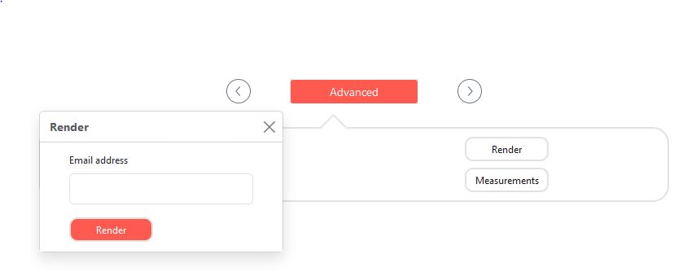
Process Of Renderer
User Enter Their Email ID And Press Render Button.
When User Clicks Render Button “UserMail+Today’sDate.GLB” Flie
Will Download On Our Backend Server
Also It’s Trigger “Render.py” Script For Rendering That GLB File
When “Render.py” Script Triggered It Will Open Blender3D On Background And also Import “UserMail+Today’sDate.GLB” Flie.
After Importing GLB File On Blender It Will Set Render Quality Settings Automatically And Render an Image.
When Rendering Is Completed Render Image Will Mailed to User’s Email ID Using Python SMTP Module.

Slide 2
How To Setup Renderer
Step 1 -> Install blender
Open Terminal.
Type “sudo snap install blender --classic” Hit Enter.
Step 2 -> Install python3
Open Terminal.
Type “sudo apt-get install python3” Hit Enter.
Step 3 -> Install pip
Open Terminal.
Type “sudo apt-get install python-pip3” Hit Enter.
Step 4 -> Install virtualenv
Open Terminal.
Type “sudo pip3 install virtualenv” Hit Enter.
Then Create Virtual Environment By Typing “virtualenv venv” Hit Enter.
You Can use any name insted of venv.
For Activating Your Virtual Environment Type “source venv/bin/activate” Hit Enter.

Slide 3
Step 5 -> Install Flask
Open Terminal.
First You Need to Activate Your Virtual Environment.
Then You Can Type “” Hit Enter.
Type “pip3 install flask” Hit Enter.
Step 6 -> Setup Blender Plugins
Open This Link https://github.com/CGArtPython/bpy_building_blocks_addon/releases.
Then Download Latest Version Of bpy_building_blocks_addon
After Downloading Completed Open Blender.
Go To Edit -> Preferences -> Add-ons -> Then Install bpy_building_blocks_addon.zip
Now Just Enable bpy_building_blocks_addon

Slide 4
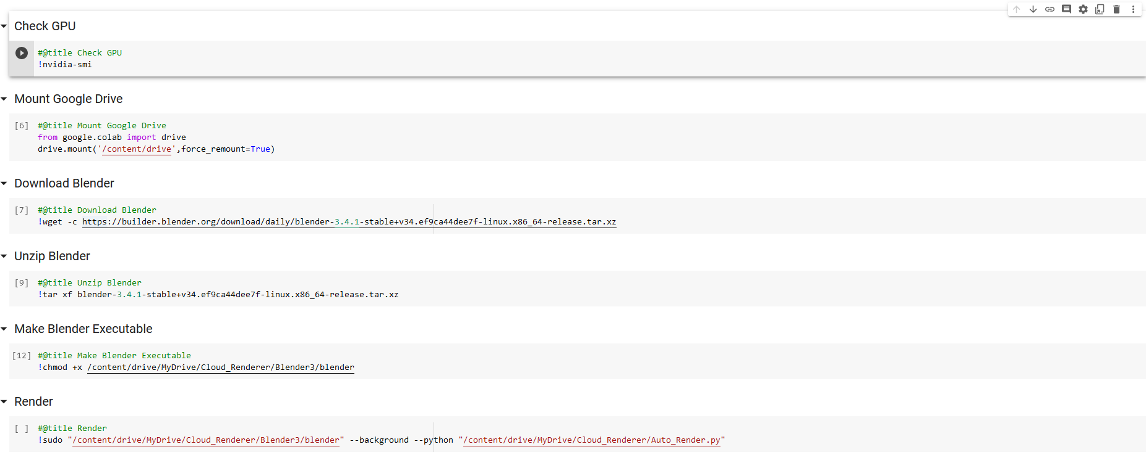
Render With Google Collab

