Slide 1
Showroom3D_Web(React)
Archana
13 July,2024

Slide 2
Requirements
State management
Modularization

Slide 3
State management
Light controls in the scene to reflect on the UI and vice versa
Update animations,material variants values based on the object added / selected
Modes (arrangement,measurements,camera,collaboration)
Update light control values based on Day/Night toggle
Add objects to Physics world when new object added into the scene

Slide 4
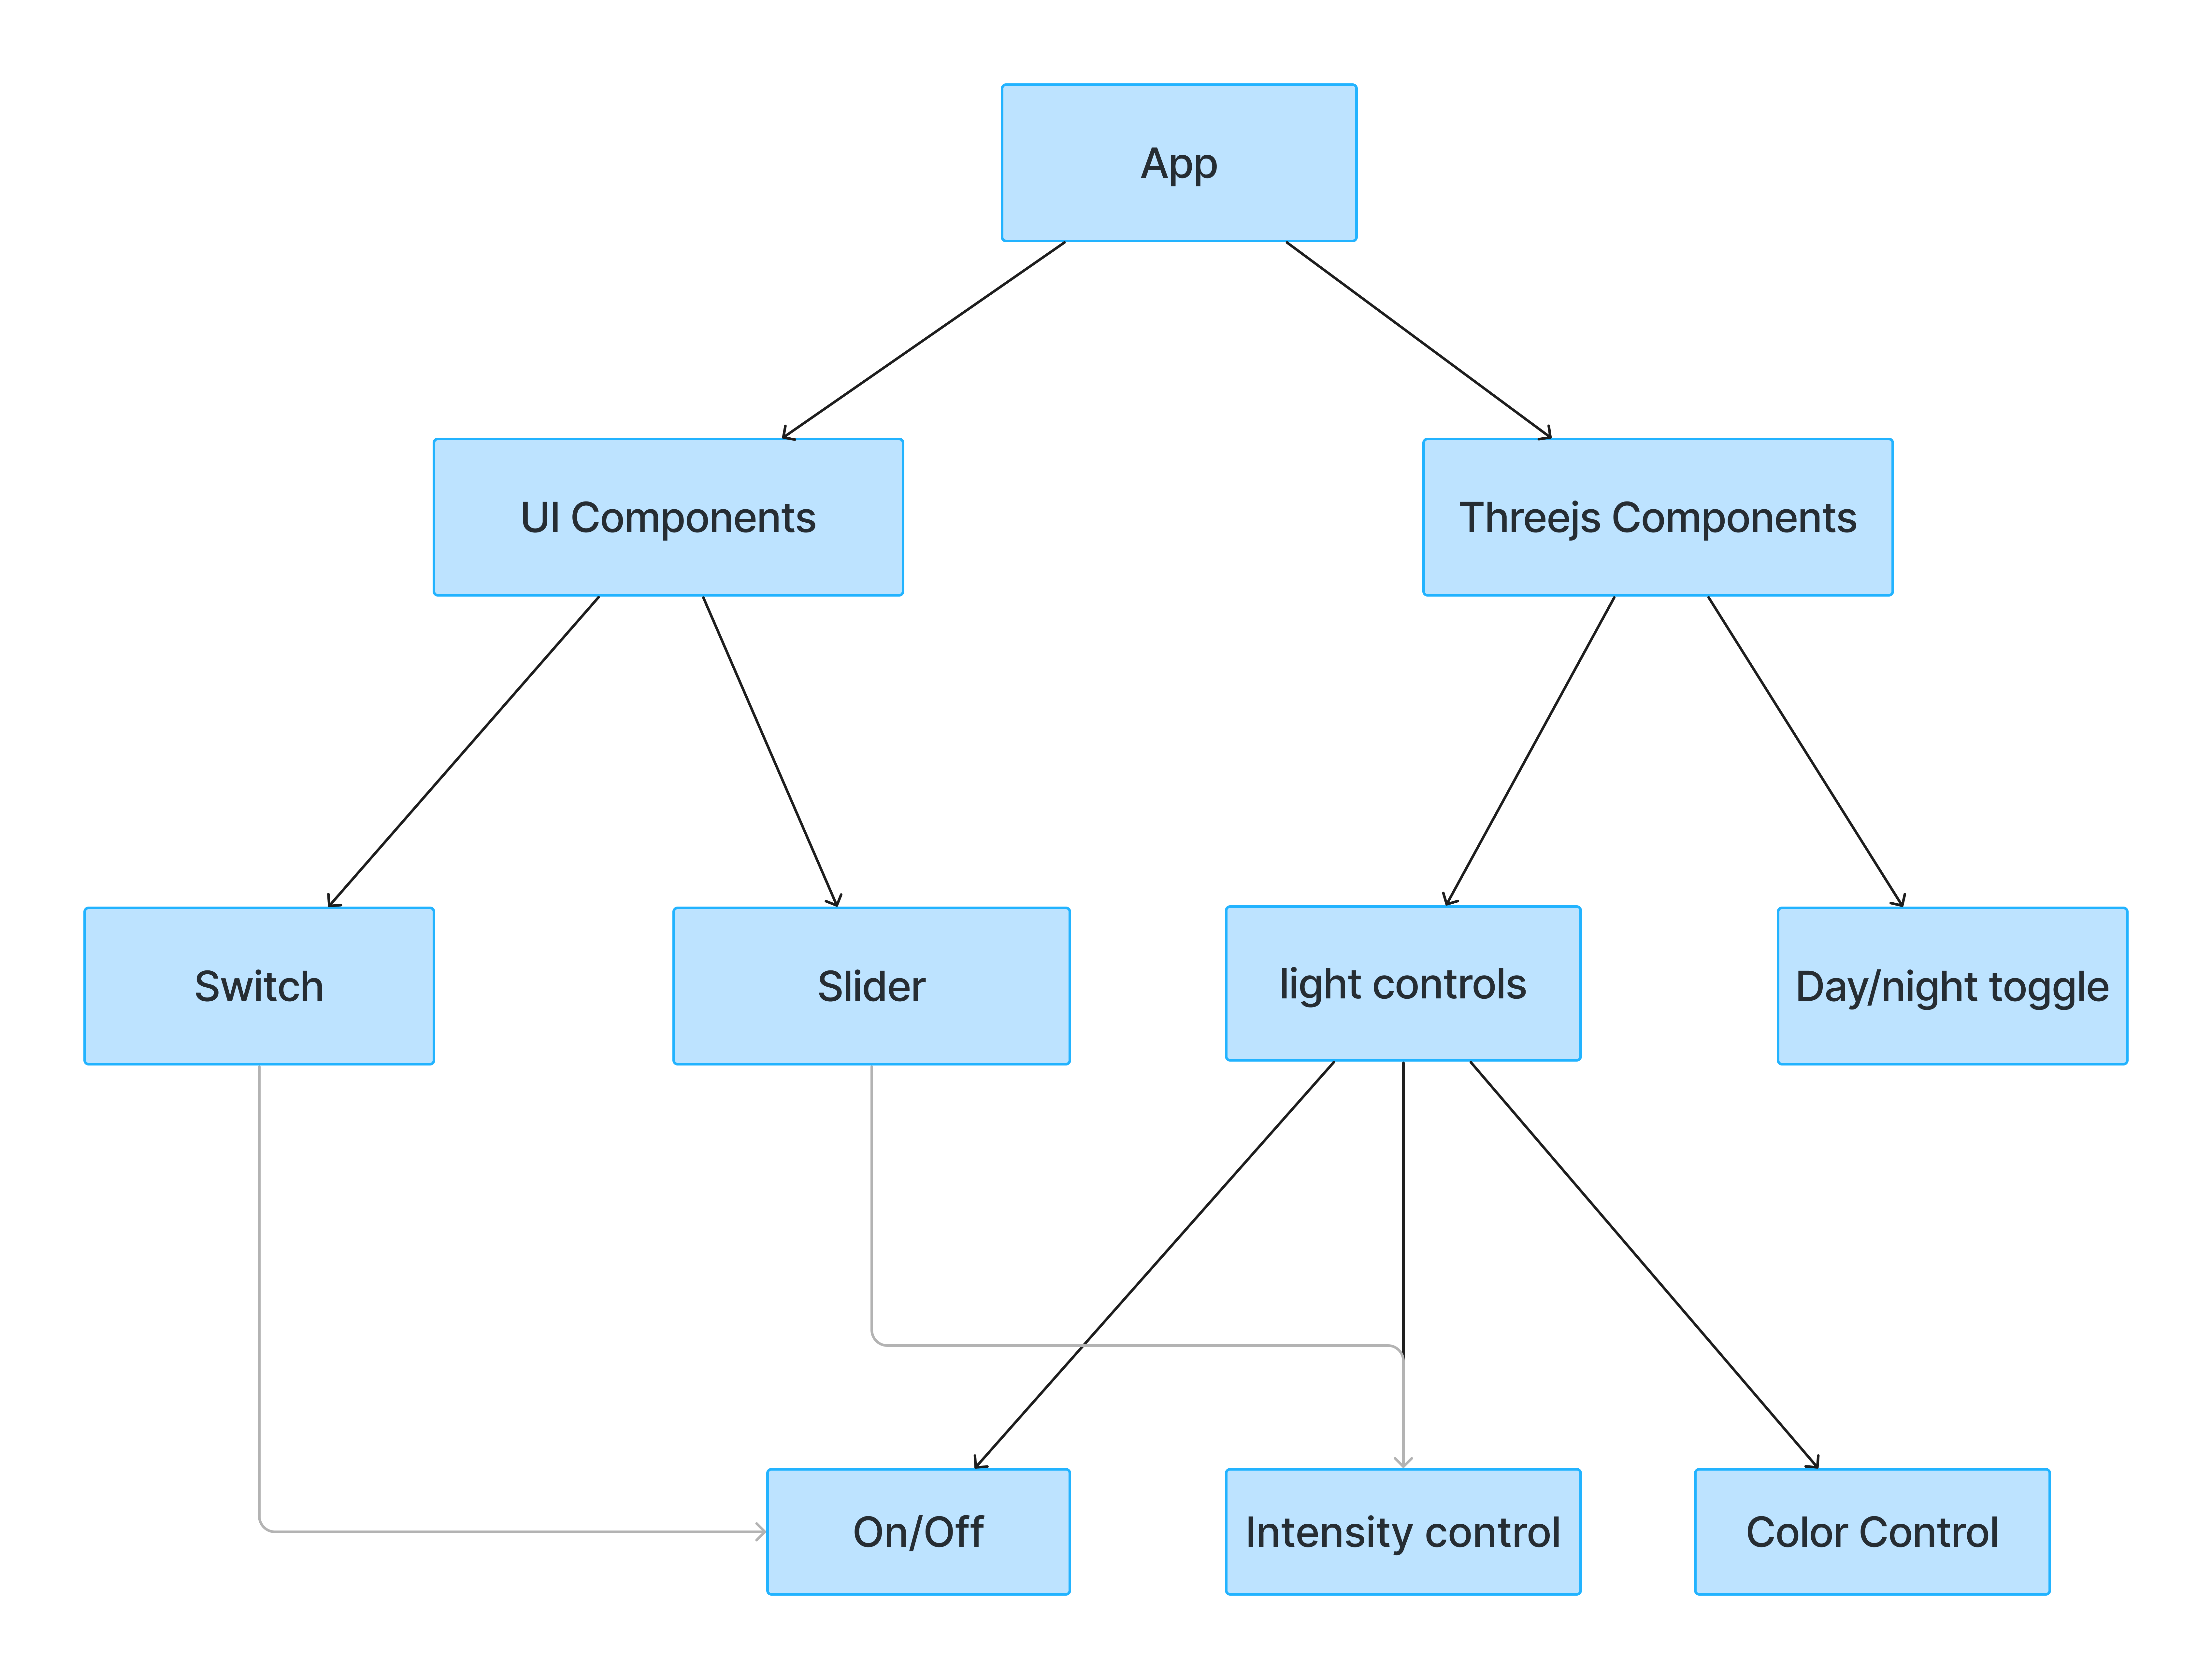
Modularization

Slide 5
Steps to move demo to react
Create basic UI components
Load basic threejs scene and setup postprocessing effects
enable camera controls,viewpoints and themes
Load different furniture types and its related dynamics,variants and etc by maintaining state to reflect accurately on the UI
Load different light types and show related light controls by maintaining state to reflect accurately on the UI
Implement arrangement features
Implement measurements features
Implement HD Render feature

Slide 6
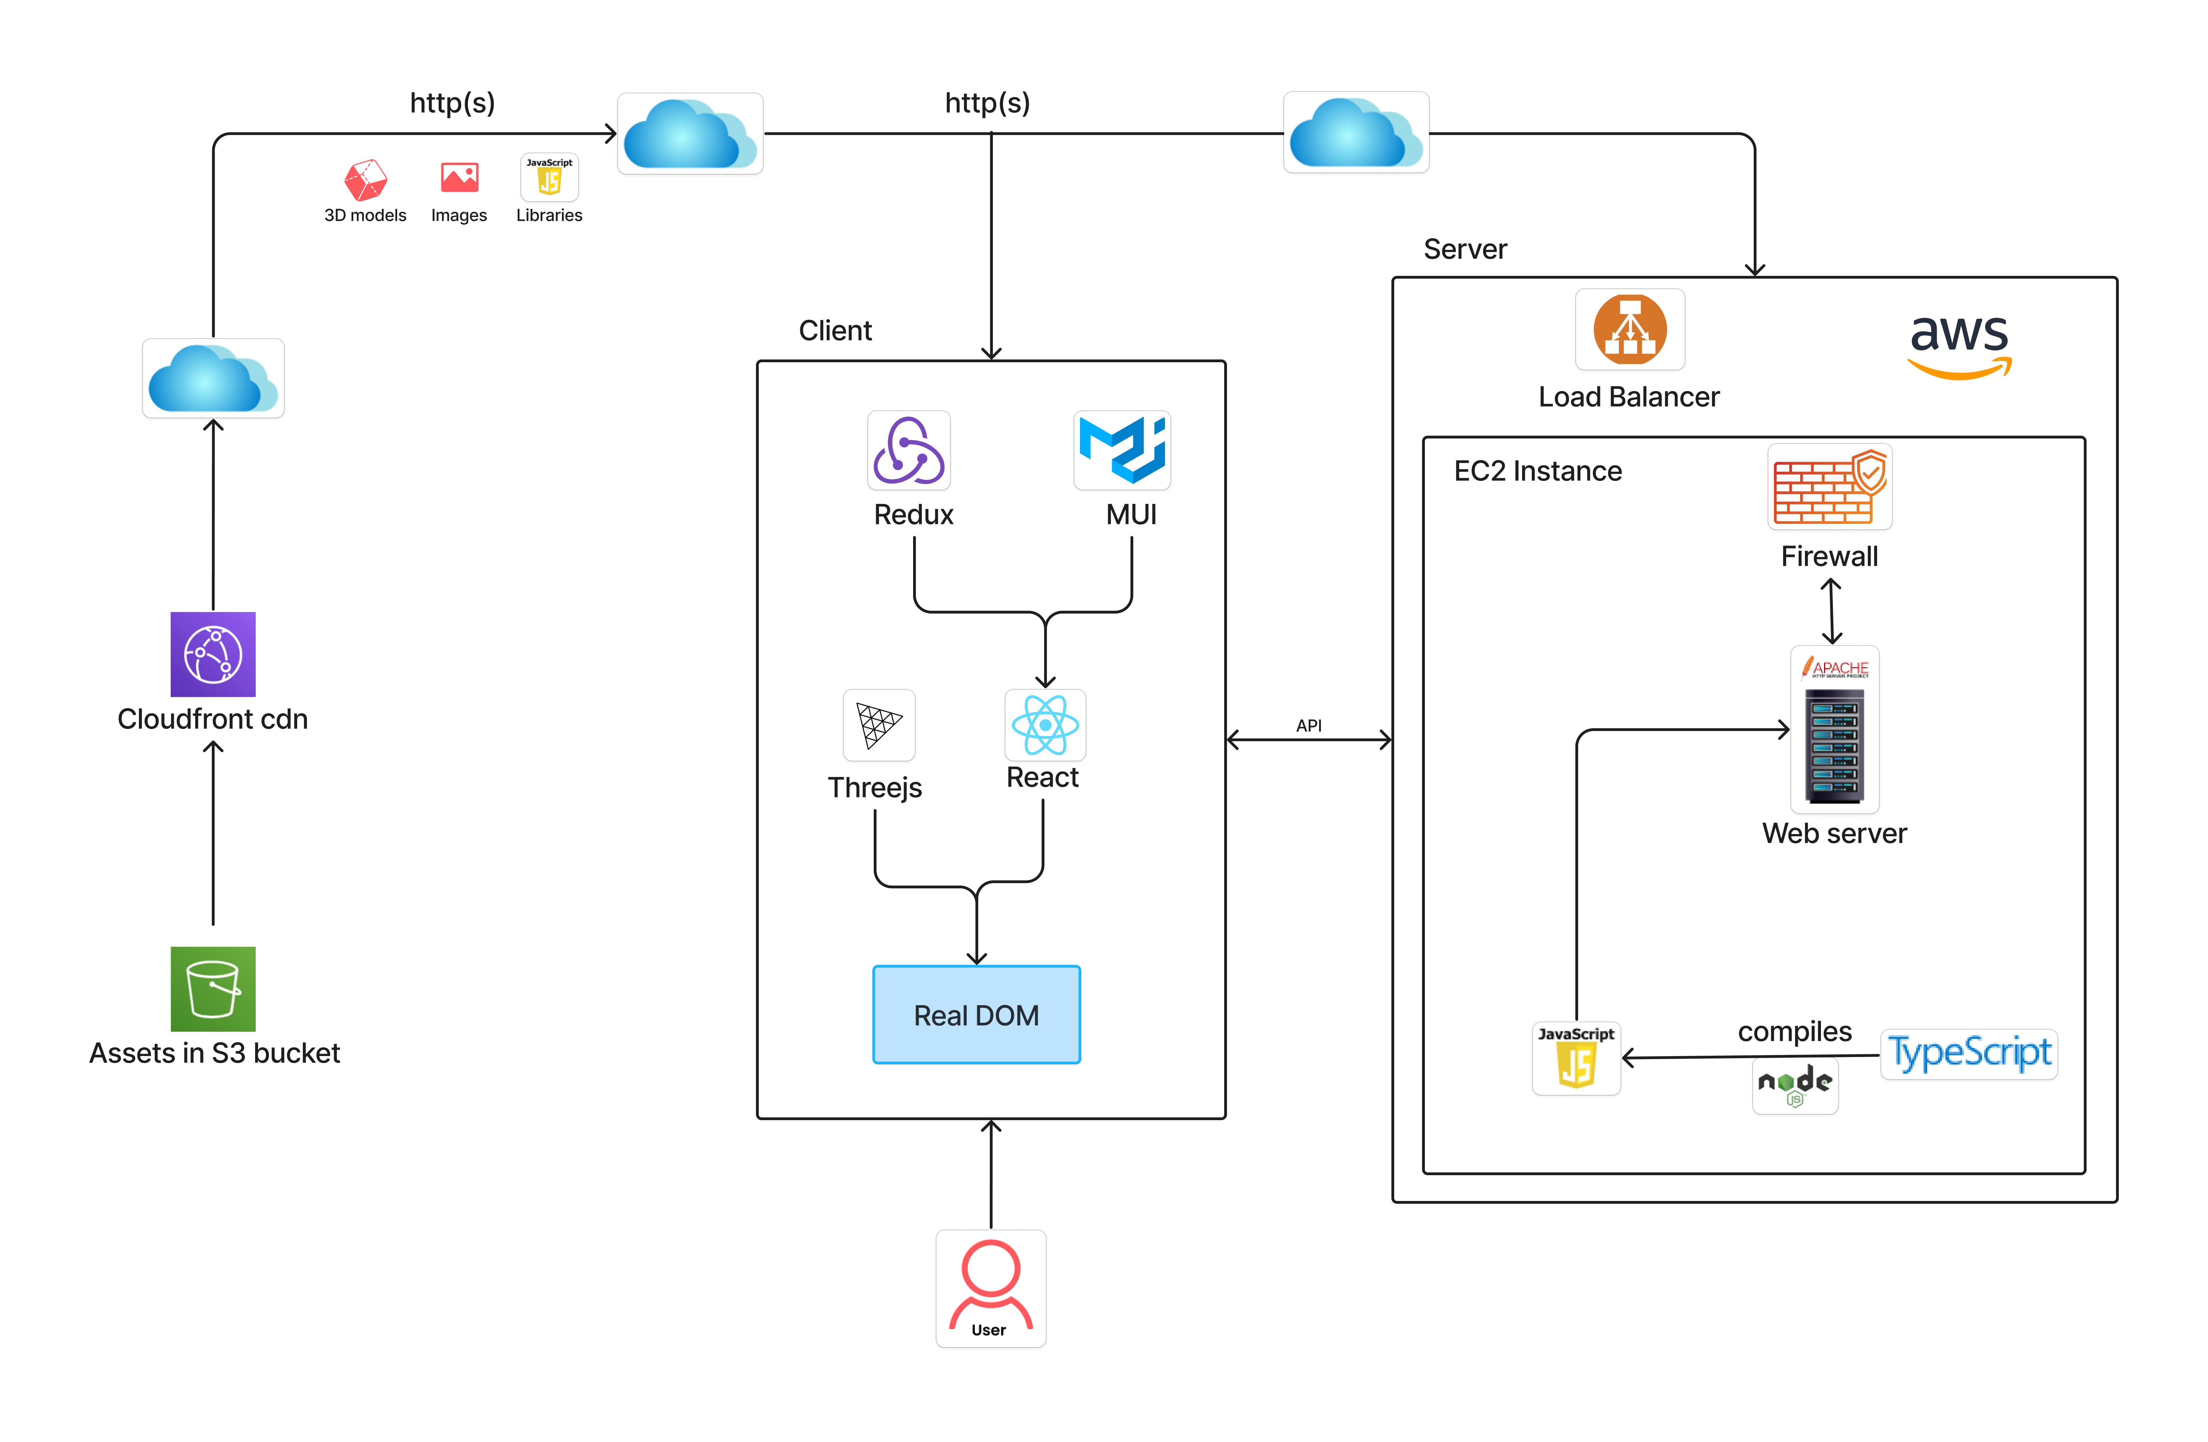
Showroom3D system diagram

Slide 7
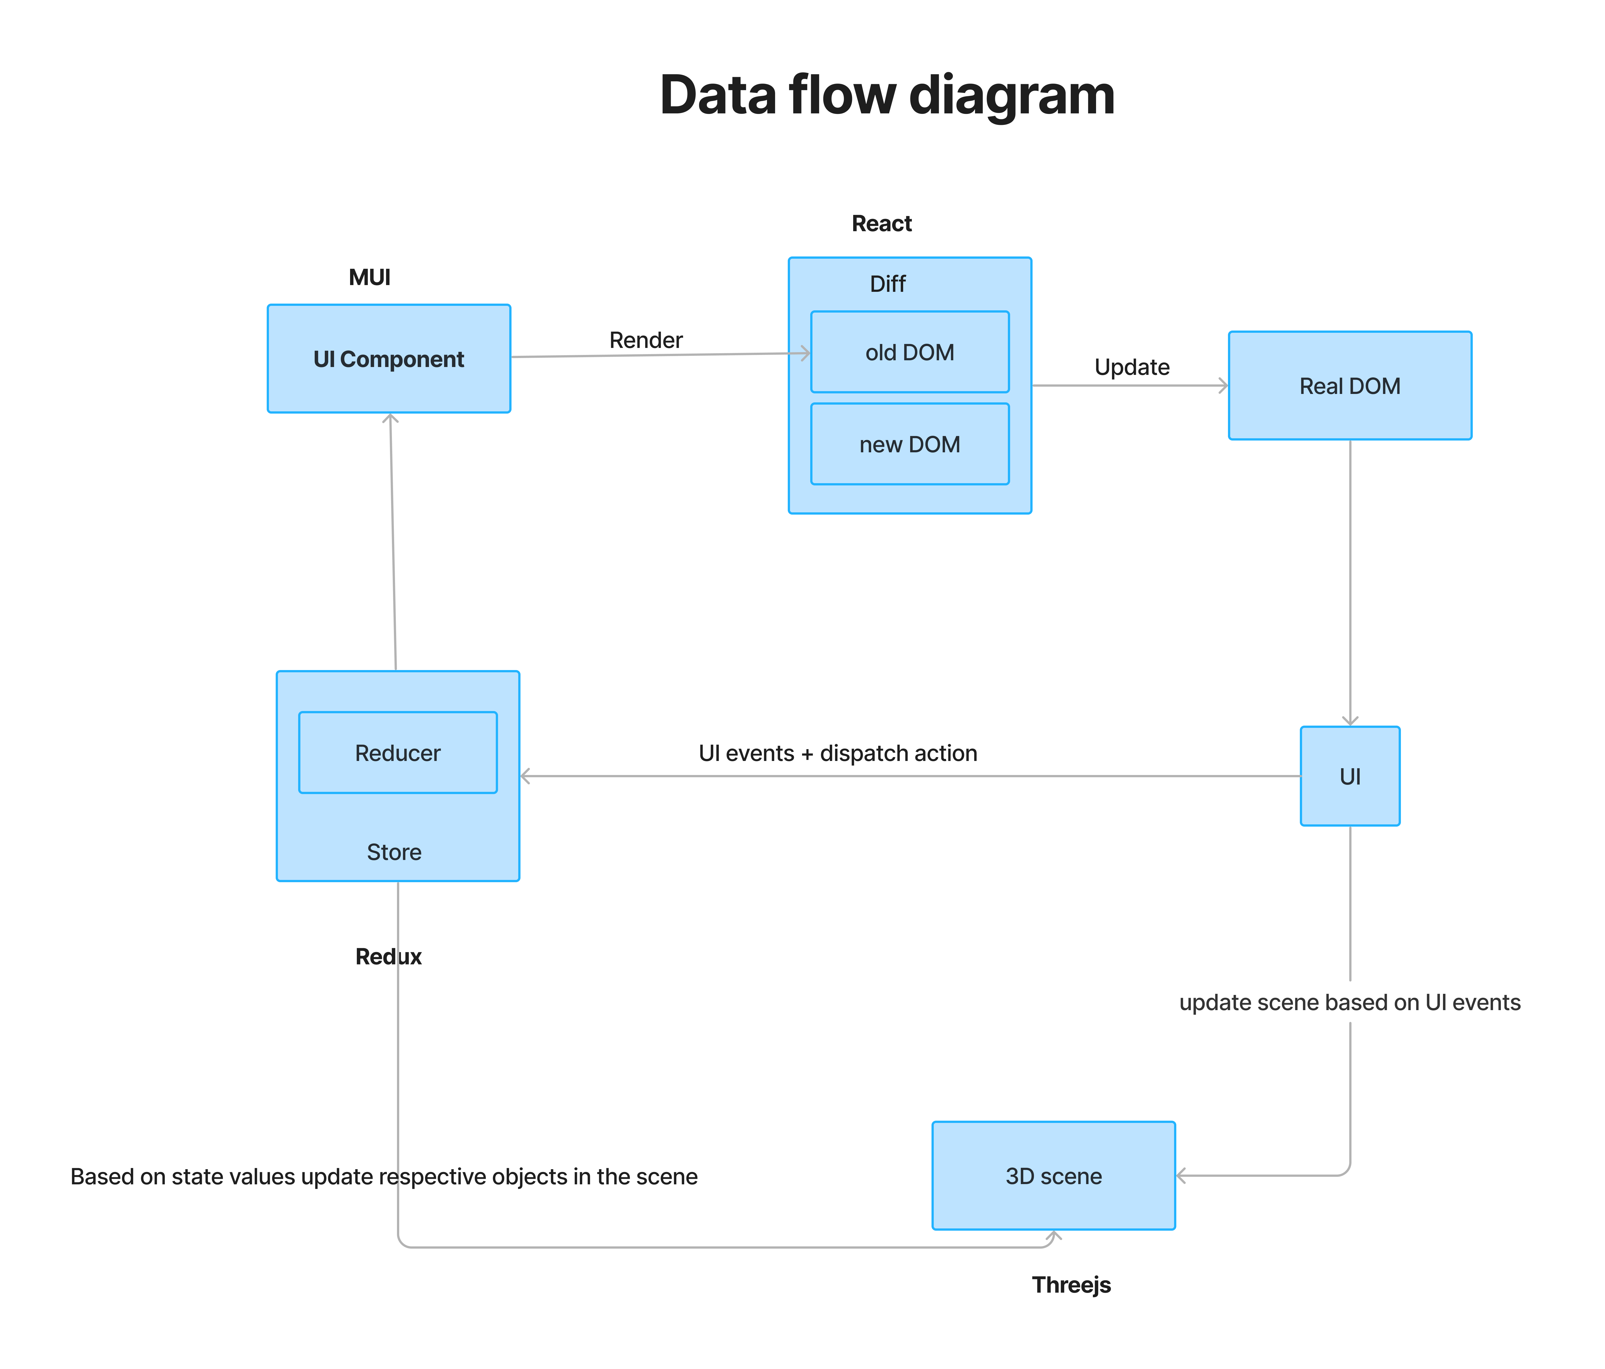

Slide 8
Major Technologies
Threejs
Typescript
React
React Context
Redux
MUI

Slide 9
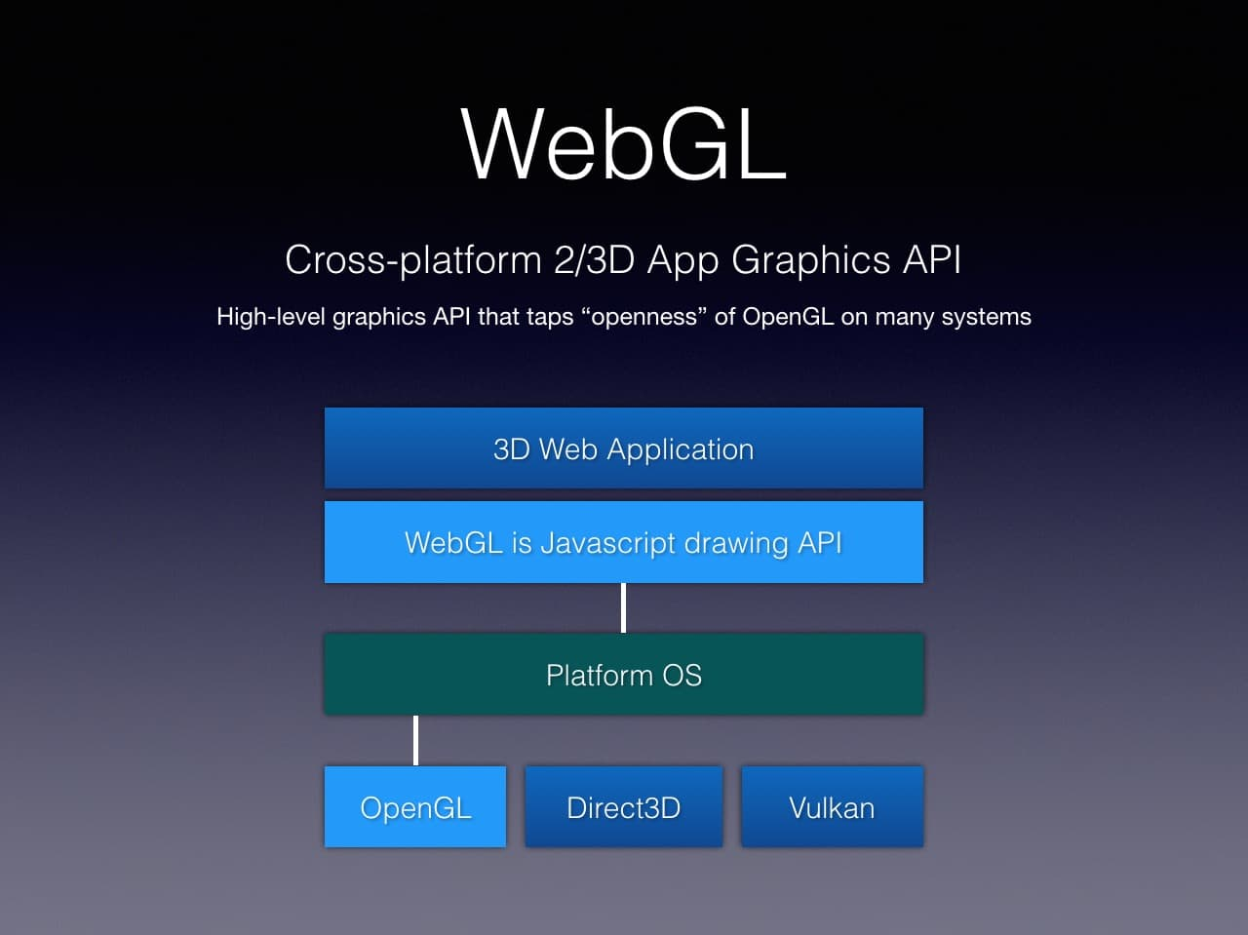
Threejs

Slide 10
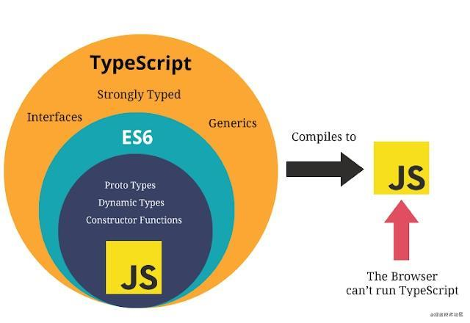
TypeScript
Static Typing
JavaScript Compatibility
Improved Code Readability

Slide 11
React
Modular and Reusable
By breaking down the UI into smaller, manageable components, React promotes modularity and we can reuse these components across the app
Virtual DOM
When the state of an object changes, React updates the virtual DOM first, which then compares it with the real DOM and makes only the necessary updates. This results in faster and more efficient rendering.
JSX – JavaScript Syntax Extension
With jsx, we can write html code inside js file, so that we can write reusable UI components as well
Dynamic Content
We can dynamically update content of dynamics,material variants etc when we add object
Predictable State Management
By using redux or react context, values will be explicitly updated in the state
Scalability
The ability to break down the UI into reusable components and manage state efficiently helps in scaling applications as they grow

Slide 12
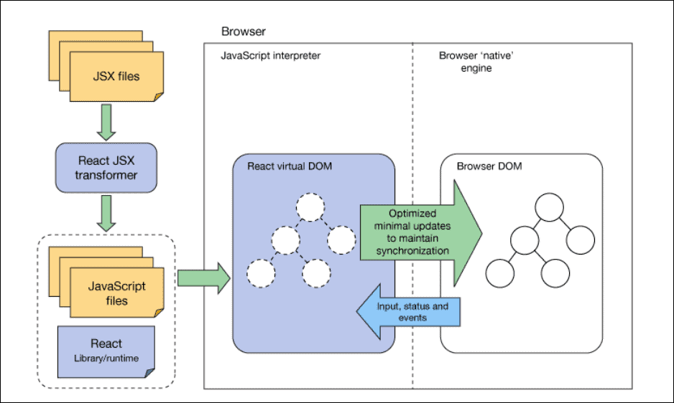
React Architecture

Slide 13
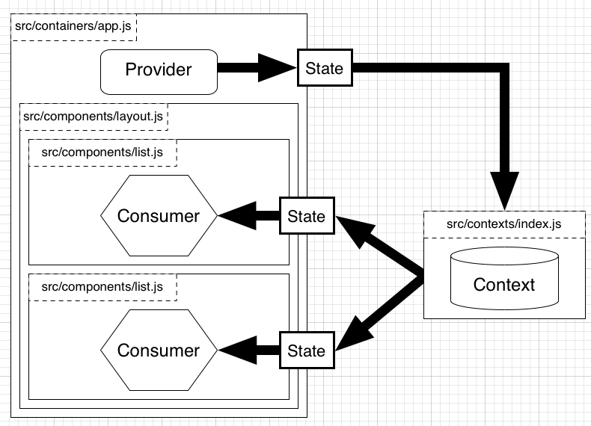
React Context
Ease of Use
Improved Performance
Global State Management

Slide 14
Redux
Centralized State Management
Predictable State Changes
Improved Maintainability
Easier Debugging and Testing

Slide 15
Context API Vs Redux
Context API | Redux
Requires minimal Setup | Requires extensive setup to integrate it with a React Application
Specifically designed for static data, that is not often refreshed or updated | Works like a charm with both static and dynamic data
Adding new contexts requires creation from scratch | Easily extendible due to the ease of adding new data/actions after the initial setup
Debugging can be hard in highly nested React Component Structure even with Dev Tool | Incredibly powerful Redux Dev Tools to ease debugging
UI logic and State Management Logic are in the same component | Better code organization with separate UI logic and State Management Logic

Slide 16
MUI
Material Design
Pre-built Components
Performance
Accessibility
Responsive Design
Customization and Theming
Drawbacks:
Some components, such as carousel and color picker, are not available in MUI
Bundle Size

Slide 17
Bootstrap Vs MUI
Bootstrap | MUI
Unnecessary JS, jQuery scripts, and large class definitions might make that application heavy | It works on React JS components,doesn’t require any library to work
comparatively less customizable than Material UI. | Material UI is highly customizable
High speed of development because of reusable code | Speed of development is lesser than compared to bootstrap but can be increased by extensive use of reusable components and templates.

