Slide 1
React
By Archana

Slide 2
Test automation
Test automation refers to the use of software tools to execute pre-defined test cases and verify the results automatically.
It involves writing scripts or using automated testing frameworks to simulate user actions, check the application's functionality, and ensure that it behaves as expected.
This process reduces the need for manual testing, improves accuracy, and allows for more frequent and efficient testing.
Types of testing
Unit Testing: Tests individual components or functions in isolation.
Integration Testing: Ensures different components work together as expected.
End-to-End Testing (E2E): Simulates real-world user scenarios by testing the complete workflow from start to finish.
Regression Testing: Ensures that new code changes haven't broken existing features.

Slide 3
Test automation in React
React Router can be a powerful tool in test automation for React applications
When testing React applications that use React Router, we can simulate and verify different routes, navigation behaviors, and ensure that the correct components are rendered for specific routes
Automated tests can be written using tools like Jest, React Testing Library, or Cypress to simulate user interactions, such as navigating between pages or testing deep links.
Memory router: This router keeps the history of the routes in memory, which makes it perfect for testing.
MemoryRouter | React Router
Cypress: It supports End-to-End (E2E) testing.
For testing navigation, routing, and user interactions in a browser-like environment, Cypress is an excellent tool.
React Component Testing | Cypress Documentation

Slide 4
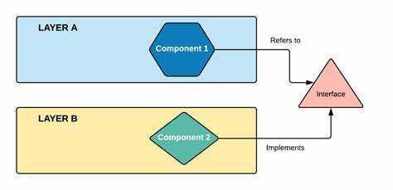
Dependency Injection
Dependency Injection (DI) is a design pattern used to manage dependencies (objects or services) in software applications
It allows one object, known as a client, to be provided with its dependencies by an external source rather than creating them within the object itself.
The key idea is that the inversion of control occurs, meaning the object doesn't control its dependencies but receives them from elsewhere, often from a dependency injector or container.
Real-World Example: Imagine an online shopping platform where a Checkout class needs a PaymentService to process payments. Without DI, the Checkout class would create its own instance of the PaymentService.

Slide 5
Dependency Injection in React
In React, DI isn't a built-in concept, but you can achieve similar functionality using certain patterns and techniques
There are a few ways to achieve Dependency Injection in React: Context API,Higher-Order Components (HOCs),Prop Injection, Dependency Injection Libraries etc
Context API: React’s Context API can be used for DI by providing services or dependencies to child components via a provider. This is especially useful for globally shared services like authentication, themes, or API clients.
HOCs: HOCs can also be used to inject dependencies into components. They wrap the target component and pass the dependencies via props.
Dependency Injection Libraries: For more advanced DI scenarios, we can use DI libraries like InversifyJS or TSyringe with React
microsoft/tsyringe: Lightweight dependency injection container for JavaScript/TypeScript (github.com)
inversify/InversifyJS: A powerful and lightweight inversion of control container for JavaScript & Node.js apps powered by TypeScript. (github.com)

Slide 6
Benefits of DI
Looser Coupling: Dependencies can be swapped out or changed without modifying the components.
Scalability: DI makes it easier to manage complex and growing projects by separating concerns.
Improved Testability: You can easily mock dependencies during testing.

