Slide 1
AURORA’S PG COLLEGE(MCA) RAMANTHAPUR
INTERNSHIP SEMINAR
ON
ONLINE DOCTOR APPOINTMENT SYSTEM
SUBMITTED BY:
ARCHANA.B
Hall Ticket no: 132521862023

Slide 2
ONLINE DOCTOR APPOINTMENT SYSTEM

Slide 3
PROFILE OF CLIENT ORGANISATION:
Founded in 2014, FRATELLO INNOTECH PVT. LTD. located at Kphb, Hyderabad, has a rich background in developing Mobile Applications and IOT projects, especially in solving latest problems, Software Development and continues its entire attention on achieving transcending excellence in the Development and Maintenance of Software Projects and Products in Many Areas.
In today's modern technological competitive environment, students in computer science stream want to ensure that they are getting guidance in an organization that can meet their professional needs. With our well-equipped team of solid information systems professionals, who study, design, develop, enhance, customize, implement, maintain, and support various aspects of information technology, students can be sure
We understand the customer needs and develop their quality of professional life by simply making the technology readily usable for them. We practice exclusively in software development, network simulation, search engine optimization, customization, and system integration. Our project methodology includes techniques for initiating a project, developing the requirements, making clear assignments to the project team, developing a dynamic schedule, reporting status to executives and problem solving.

Slide 4
ABOUT THE PEOPLE:
As a team we have the clear vision and realize it too. As a statistical evaluation, the team has more than 40,000 hours of expertise in providing real-time solutions in the fields of Mobile Apps Development in Android, IOS, and Flutter, Web Designing, Web Development, Cloud Computing, Image Processing and Implementation, client Server Technologies in Java, (J2EE), ANDROID, Python, PHP, Oracle
Our Vision:
“Impossible as Possible” this is our vision; we work according to our vision.

Slide 5
INTRODUCTION:
Sometimes you come across small problems where you to need consult doctors about your health problems or for the nearest ones and follow their prescriptions. Doctors online will provide you the power of direct interaction between doctors of your choice as and when required for your small problems. Using this web applications, patients will able to fill online form in just few seconds before entering to the virtual office room. It will also enable you to upload your lab results such as x-ray copies, health history etc which can be viewed by your referred doctors.
Vision of the project:
“The Interface has to be simple to use, as the target end-users for the system are non-technical persons. Our system also aims to provide a complete IT solution for Online Doctor Appointment.”
Mission of the project:
Any user can see the details of the doctor.
Only the Registered user can make the appoinement.
The users can see their appointments and doctor available timings etc.

Slide 6
EXISTING SYSTEM
Under manual system, you need to wait in a line to take appointment for the doctors and wait for your time
You have to provide your information and other reports at other places like at medical store, Reception etc.,
You have to be present physically at the doctor’s cabin.
Patients have to wait for hours or some days to take their health reports.
Under manual system, most of the times the mode of payment is cash. Through which patient might feel some difficulties.
DRAWBACKS:
It is not secure to maintain important information manually always.
It needs much time to generate health reports.
It is tedious to manage historical data which needs much space to keep all the past years applications, books etc.
Co-ordination between various branches is very difficult

Slide 7
PROPOSED SYSTEM:
To make a truly online system to have meet with online doctors, all manual process has been automated through this system.
Patient have to fill online form by which id and password created which is received to their email
Through this panel, patients can select the required doctors and have appointment with them on their time from their own place.
Patients will get all their reports and medicine prescriptions in their inbox after appointment session.
Patient can pay the required fees using their account or debit or credit card.
ADVANTAGES:
The proposed system is faster than manually maintained system and can handle data easily.
Computerization of the details of the patients and doctors.
Maintenance time and cost are greatly reduced.
Report can be generated easily and quickly.
Accurate information can be generated easily and quickly at different levels

Slide 8
FEASIBILITY STUDY:
1.TECHNICAL FEASIBILITY: A number of issues have to be considered while doing a technical analysis.
Understand the different technologies involved in the proposed system before commencing the project
we have to be very clear about the technologies that are to be required for development of the new system.
Find out whether the organization currently possesses the required technologies. Is the required technology available with the organization?
2. OPERATIONAL FEASIBILITY: this test of feasibility asks if the system will work when it is developed and installed. Are there major barriers to Implementation?
Is there sufficient support for the project from management from users?
Are the current business methods acceptable to the user?
Have the user been involved in the planning and development of the project?
Since the proposed system was to help reduce the hardships encountered in the existing manual system, the new system was considered to be operational feasible.

Slide 9
3.ECONOMIC FEASIBILITY:
Economic feasibility attempts 2 weigh the cost of developing and implementing a new system. against the benefits that would accrue from having the new system in place
A simple economic analysis which gives the actual comparison of costs and benefits are much more meaningful in this case.
There could be various types of intangible benefits on account of automation.
These could include increased customer satisfaction, improvement in product quality better decision making timeliness of information, expediting activities, improved accuracy of operations, better documentation and record keeping, faster retrieval of information, better employee morale.

Slide 10
MODULE DESCRIPTION:
Patient Details:-
For the first time visitors, they have to just enter their basic details and can enter their dashboard. System will take care of creating their new profile. For existing patients, they will have to enter their id and password. This module will like virtual office from where all activity can be performed.
Doctors Module:-
Through this module, doctors can register themselves into system and login with their details and they can do the operations like mention the available timings and reply for queries and give remedy details etc.
Admin Module:
Through this module, admin can add the user details and modify them. If required they may deleted them. And they maintain the medicine details , remedy details , doctor details, medicine details and also they may also generate reports also.
Medicine Module:-
This module will provide details of medicines which should be taken by the patients. It will also include the limit up to which these medicines should be taken and date to have meet again with doctors.

Slide 11
Disease and Remedy Details:
This module will provide details about all the disease and their remedy details for both patients and doctors in time and it maintain the all the details of the disease and it remedy information in the database.
Fee Transactions Module:-
Patients will have to make their payment online to take services using this system. Each doctors will have some fees which need to pay before their appointment session begins.
Online Report Module:-
Patients can get their lab results and health reports through tis section which is available under each patient homepage. When documents are available under this module, a special notification symbol appears above it which helps to notify their patients. Thus it provide relieve to patients for carrying these from here and there.

Slide 12
SRS DOCUMENTATION:
Software & Hardware Requirements:
Hardware Configuration:
Processor Intel I3 Processor
RAM 4 GB
Monitor 15 inch color monitor or LED
Hard disk 160 GB
Key board Standard 102 keys
Mouse Optical
Software Configuration:
Operating system Windows
IDE PyCharm
Language Python
Framework Django
Back End MYSQL
Front End HTML, CSS, JS.Bootstrap
Server Apache Tomcat

Slide 13
Functional and Non-Functional Requirements
Functional Requirements:
Patients can take appointment online portal.
Patient can view the old appointment details and their records.
User must be able to view his/her status
User must be able to edit his profile
User must be able to view all details of Doctors
Non-Functional Requirements:
System should be timeless.
System should be consistent throughout whole application process
System should handle any user errors including login and invalid situations
System must be reliable, secure.
System must be platform independent

Slide 14
ANALYSIS USING USE-CASE DIAGRAMS:
This Use Case Diagram is a graphic depiction of the interactions among the elements of Doctor Appointment System
It represents the methodology used in system analysis to identify, clarify and organize system requirements of Online Doctor Appointment System.
The main actors of Online Doctor Appointment System in this Use Case Diagram are Admin, Manager, Official, Doctor and Client
Actors perform the different type of use cases such as Schedule Doctors, Manage Appointment. Manage details, Generates reports, Manage schedule, Manage Clinics, Manage Clients .

Slide 15
The relationships between the actors and the use cases:
Admin Entity:
Use case of Admin Entity is to add users to the portal
Manager Entity:
Use case of Manger Entity is Report Generation, Managing details and viewing diseases
Official Entity:
User case of Official Entity is modifying details, Scheduling Doctors, sending messages to inbox, deleting users.
Doctor Entity:
User case of this entity is to mention available dates, view queries of clients and responds to the queries.
Client Entity:
User case of Client entity is to take an appointment, raise a query and view response

Slide 16
DESIGN PHASE:
USE – CASE DIAGRAM:
A use case diagram is the primary form of software requirements for a new software program underdeveloped.
Use cases specify the expected behavior (what), and not the exact method of making it happen (how). Use cases once specified can be denoted both textual and visual representation (i.e. use case diagram).
A use case diagram is usually simple. It does not show the detail of the use cases:
It only summarizes some of the relationships between use cases, actors, and systems.
It does not show the order in which steps are performed to achieve the goals of each use case.

Slide 17
Manager:
Admin

Slide 18
Official:
Doctor:

Slide 19
Client:

Slide 20
ACTIVITY DIAGRAM:
An activity diagram visually presents a series of actions or flow
of control in a system similar to a flowchart or a data flow diagram.
Activity diagrams are often used in business process modeling.
They can also describe the steps in a use case diagram.
Activities modeled can be sequential and concurrent. In both cases an activity diagram will have a beginning (an initial state) and an end (a final state).

Slide 21
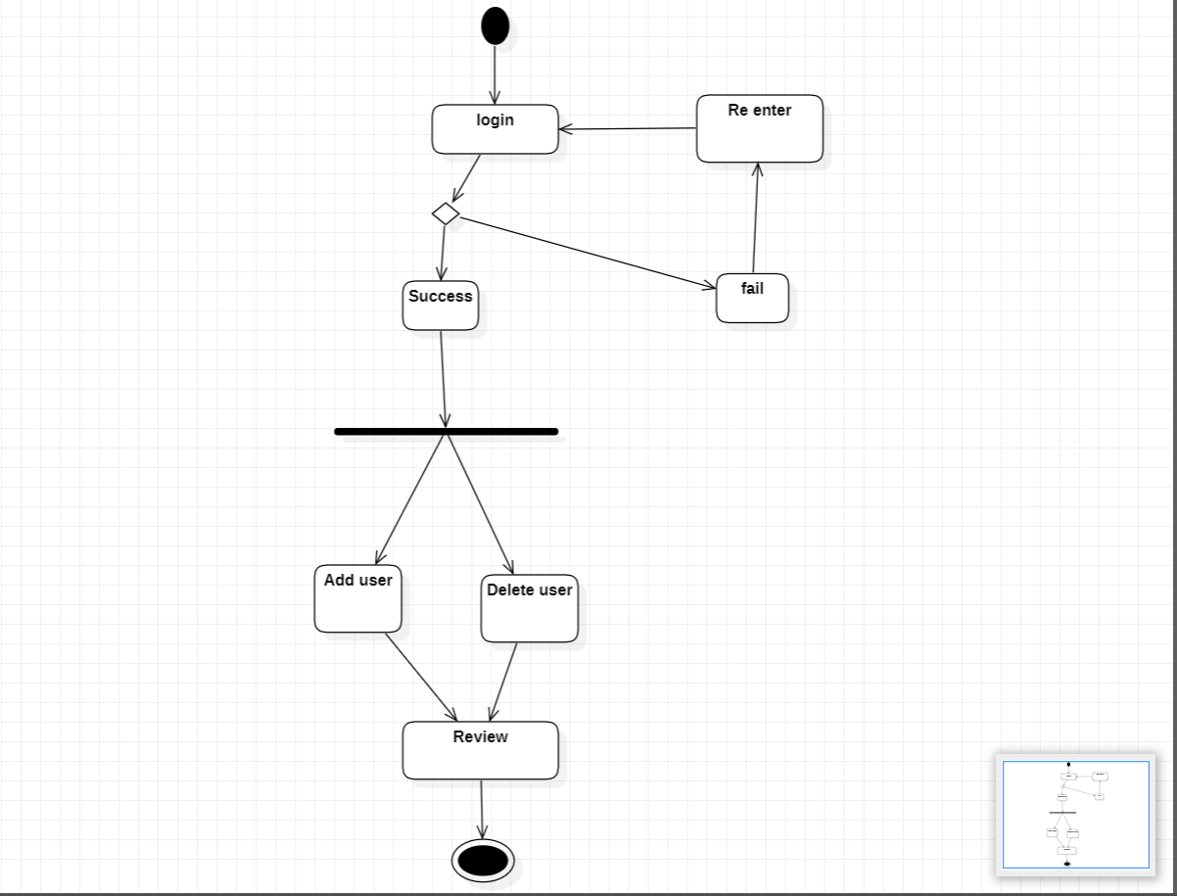
Admin:

Slide 22
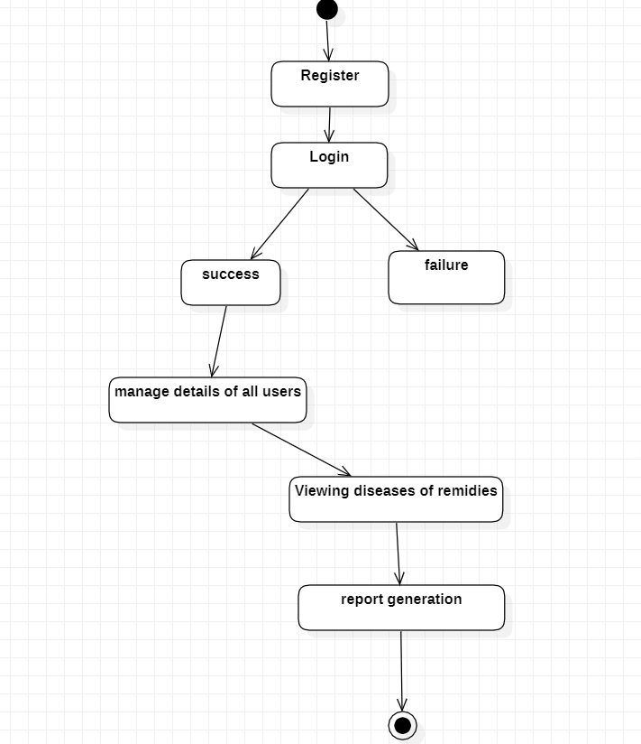
Manager:

Slide 23
SEQUENCE DIAGRAM:
Sequence Diagrams are interaction diagrams that detail how operations are carried out.
It portrays the communication between any two lifelines as a time-ordered sequence of events, such that these lifelines took part at the run time.
In UML, the lifeline is represented by a vertical bar, whereas the message flow is represented by a vertical dotted line that extends across the bottom of the page.
It incorporates the iterations as well as branching.

Slide 25
Manager:

Slide 26
Client:

Slide 27
Doctor:

Slide 28
CLASS DIAGRAM:
A class diagram in the is a type of static structure diagram that describes the structure of a system by showing the system's classes, their attributes, operations (or methods), and the relationships among objects.
A UML class diagram is made up of:
A set of classes and
A set of relationships between classes
The class diagram of Online Doctor appointment system is:

Slide 29
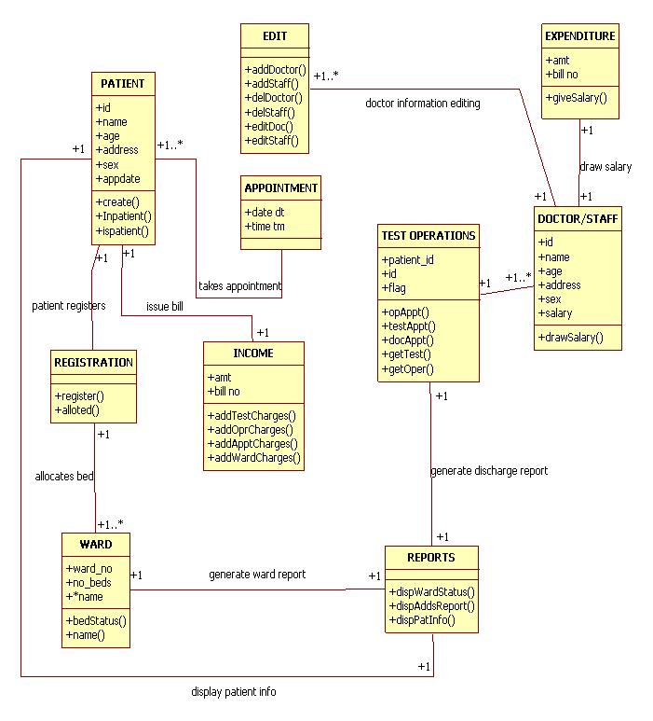

Slide 30
THANK YOU

