Slide 1
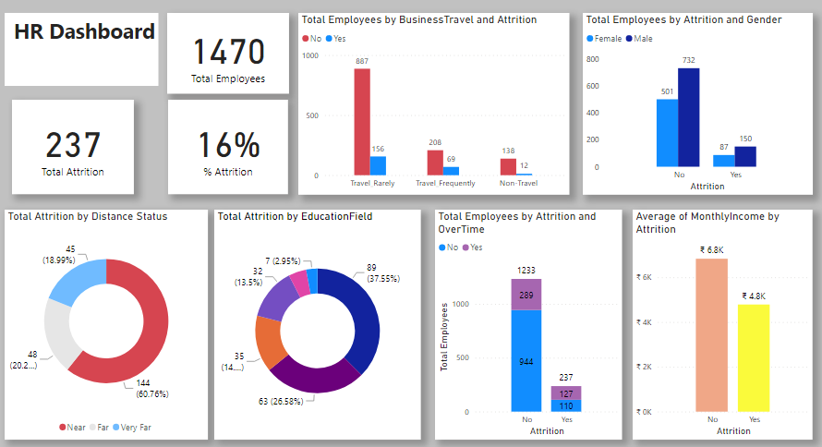
Power BI Dashboard

Slide 2
